Slide 1
Chapter 6 Orthogonality
6.1 Inner product, length, and orthogonality 内积，模长，正交
6.2 Orthogonal sets 正交组，正交集
6.4 The Gram-Schmidt process
格莱姆-施密特过程

Slide 2
6.1 Inner product, length, and orthogonality
内积， 模长， 正交
The Inner Product
If u and v are vectors in R^{n}, then the number
u^{T}v
is called the inner product of u and v, and often it is written as
u • v.
This inner product is also referred to as a dot product.

Slide 3
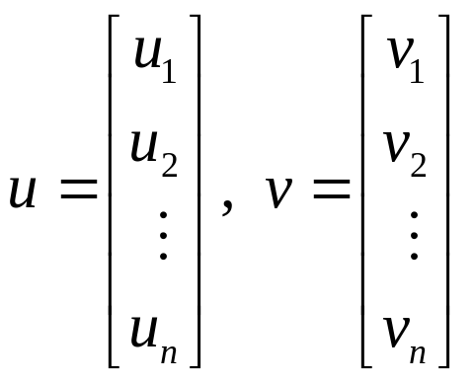
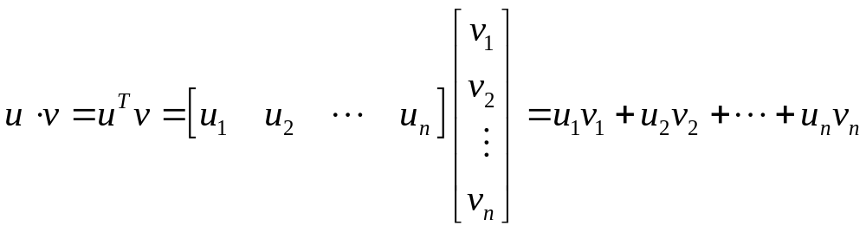

Slide 4
THEOREM 1
Let u,v, and w be vectors in R^{n}, and let c be a scalar. Then
a. u • v = v • u
b. ( u + v ) • w = u • w + v • w
c. ( c u ) • v = c ( u • v ) = u • ( cv )
d. u • u ≥ 0； and u • u = 0 if and only if u = 0.

Slide 5
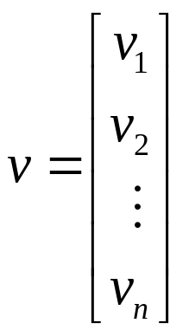
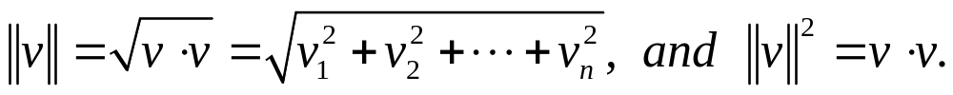
The Length of Vector
DEFINITION
The length ( or norm 范数) of is the nonnegative scalar ||v|| defined by
||cv|| = |c| ∙ ||v||， ∀v∈R^{n} , c∈R

Slide 6
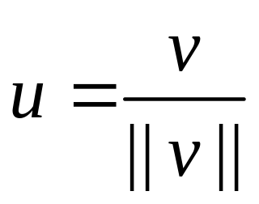
A vector whose length is 1 is called a
unit vector. 单位向量
Normalizing v : （v ≠ 0） 单位化
u is in the same direction as v.

Slide 7
Distance in R^{n}
DEFINITION
For u and v in R^{n}, the distance between u and v, written as dist(u, v), is the length of the vector u – v. That is,
dist(u, v) = ||u-v||.

Slide 8
Orthogonal Vectors 正交向量
DEFINITION
Two vectors u and v in R^{n} are
orthogonal ( to each other )
if
u • v = 0.

Slide 9
THEOREM 2 The Pythagorean Theorem
(Pythagoras 毕达哥拉斯)
Two vectors u and v are orthogonal
if and only if
|| u + v ||² = || u ||² + ||v||².
Homework: 6.1 Exercises 8, 10, 14, 24

Slide 10
6.2 Orthogonal sets
A set of vectors
{u₁, u₂, …, u_{p}}
in R^{n} is said to be an orthogonal set if each pair of distinct vectors from the set is orthogonal, that is, if
u_{i} • u_{j} = 0 whenever i ≠ j.

Slide 11
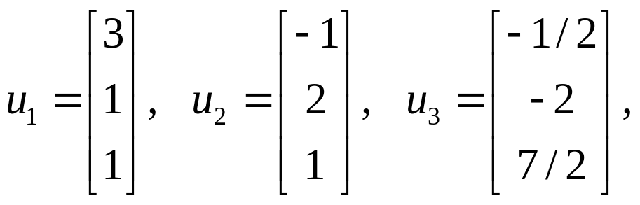
orthogonal set

Slide 12
THEOREM 4
If S = {u₁, u₂, …, u_{p}} is an orthogonal set of nonzero vectors in R^{n}, then S is linearly independent and hence is a basis for the subspace spanned by S.

Slide 13
DEFINITION 正交基
An orthogonal basis for a subspace W of R^{n} is a basis for W that is also an orthogonal set.
{u₁,u₂,u₃} is an orthogonal basis of Span{u₁,u₂,u₃}.

Slide 14
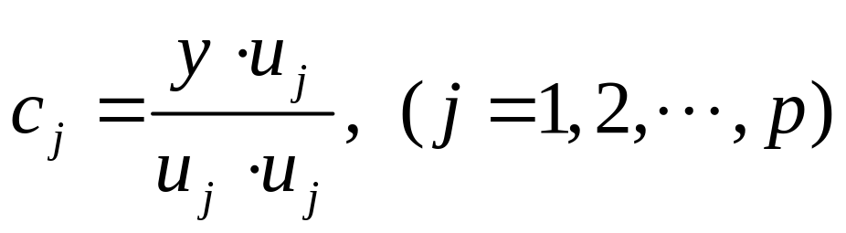
THEOREM 5
Let {u₁, u₂, …, u_{p}} be an orthogonal basis for a subspace W of R^{n}. For each y in W, the weights in the linear combination
y = c₁u₁ + c₂u₂ + … + c_{p}u_{p}
are given by

Slide 15
Orthonormal Sets 标准正交组
A set {u₁, u₂, …, u_{p}} is an orthonormal set if it is an orthogonal set of unit vectors.
If W is the subspace spanned by an orthonormal set {u₁, u₂, …, u_{p}} , then
{u₁, u₂, …, u_{p}} is an orthonormal basis
for W, since the set is automatically linearly
independent.

Slide 16
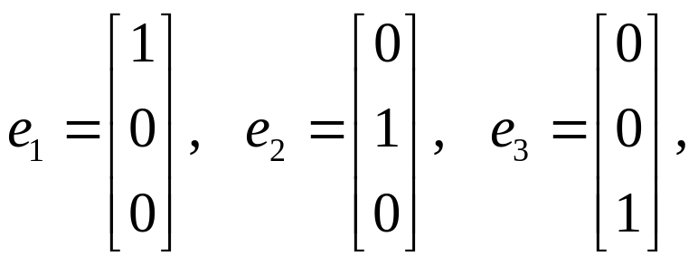

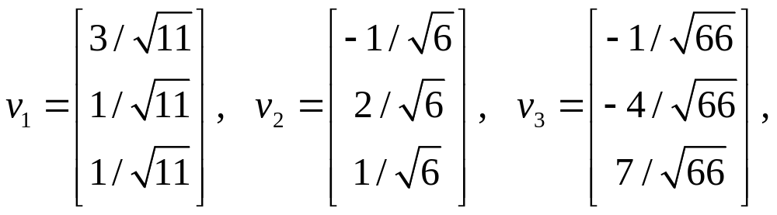

Slide 17
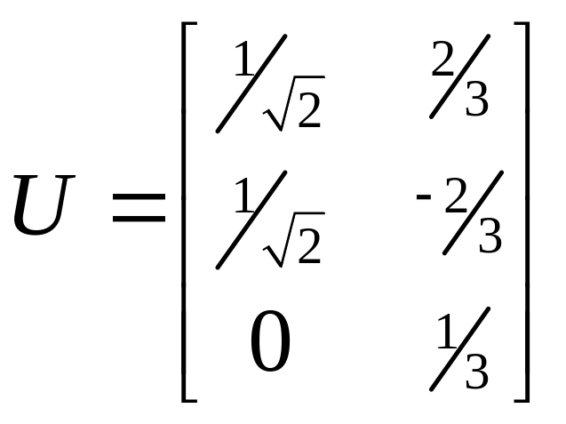
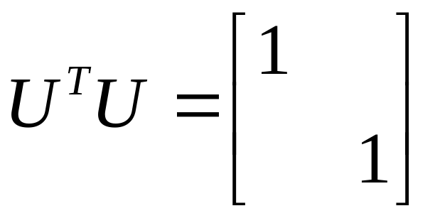
THEOREM 6
An m×n matrix U has orthonormal columns if and only if U^{T}U=I.

Slide 18
THEOREM 7
Let U be an m×n matrix with orthonormal columns, and let x and y be in R^{n}. Then
a. || Ux || = || x ||
b. ( Ux ) • ( Uy ) = x • y
c. ( Ux ) • ( Uy ) = 0 if and only if x • y = 0.

Slide 19
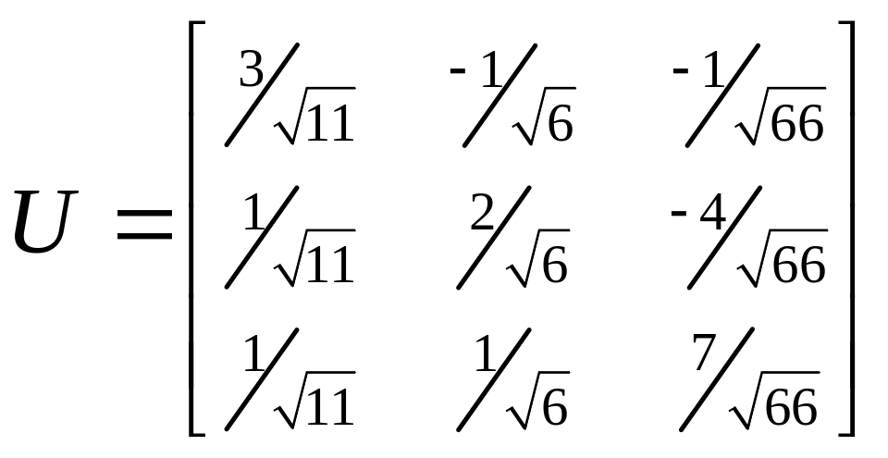
An orthogonal matrix （正交矩阵）is a square invertible matrix U such that U⁻¹ = U ^{T}.
Homework: 6.2 exercises 2, 18, 19

Slide 20
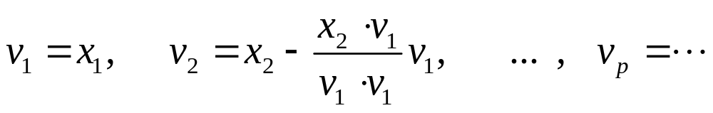
6.4 The Gram-Schmidt process
格莱姆-施密特过程
THEOREM 11
The Gram-Schmidt Process
Given a basis {x₁, x₂, …, x_{p}} for a subspace W of R^{n}, define
then {v₁, v₂, …, v_{p}} is an orthogonal basis for W.

Slide 21
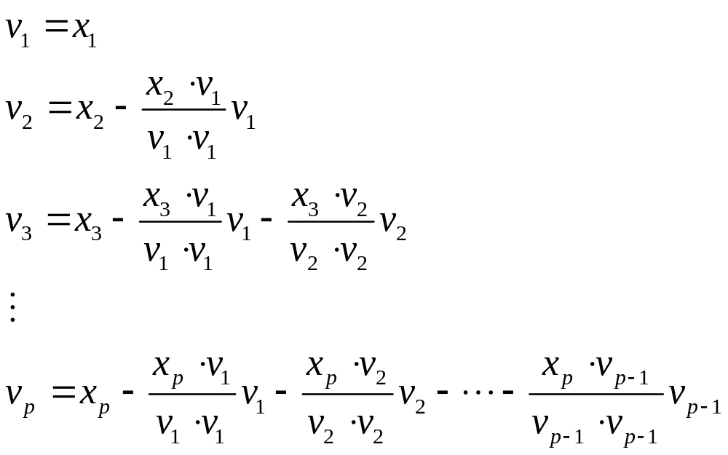

Slide 22
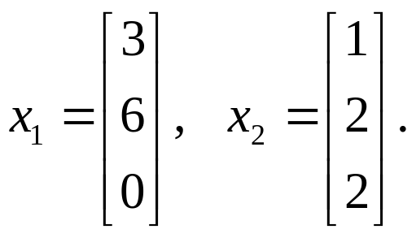

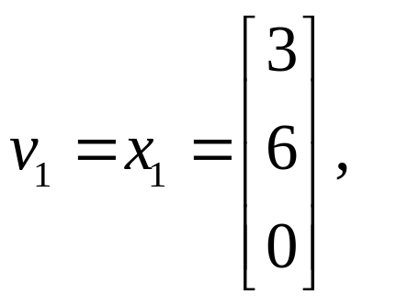
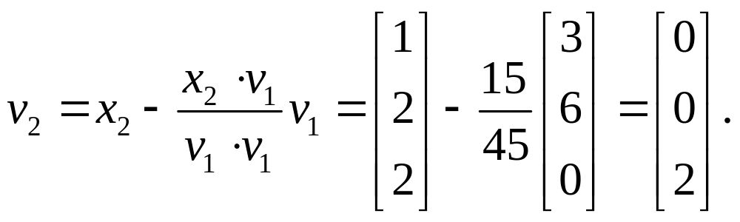
{v₁, v₂} is an orthogonal basis for Span{x₁, x₂}.

Slide 23
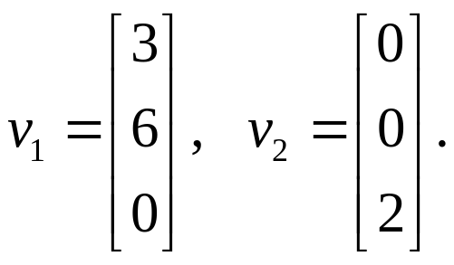
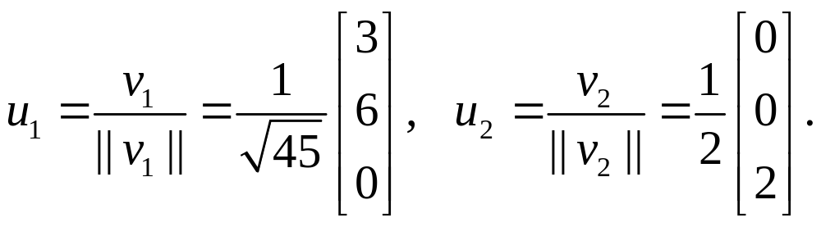
Orthonormal Bases 标准正交基
Homework: 6.4 Exercises 2, 6

