Slide 1
Chapter 7 Symmetric Matrices and Quadratic Forms
7.1 Diagonalization of symmetric matrices
对称矩阵的对角化
7.2 Quadratic forms 二次型

Slide 2
7.1 Diagonalization of symmetric matrices
对称矩阵的对角化

Slide 3
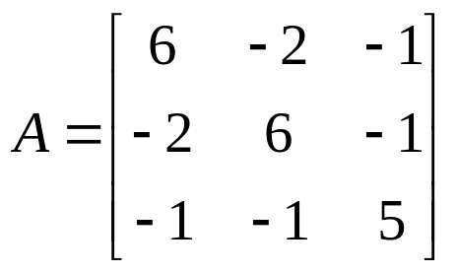
A symmetric matrix is a matrix A such that
A^{T} = A.
EXAMPL2 If possible, diagonalize the matrix

Slide 4
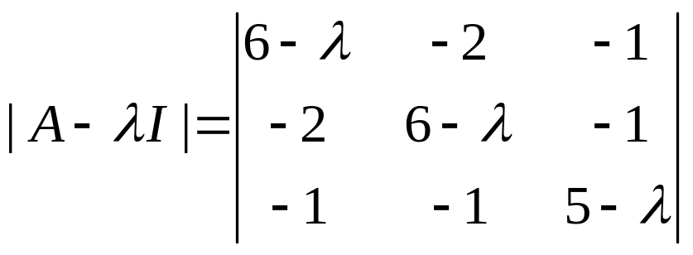
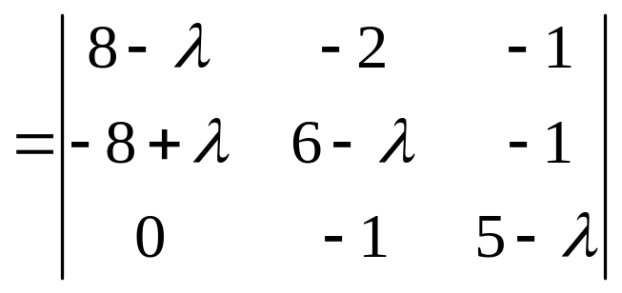
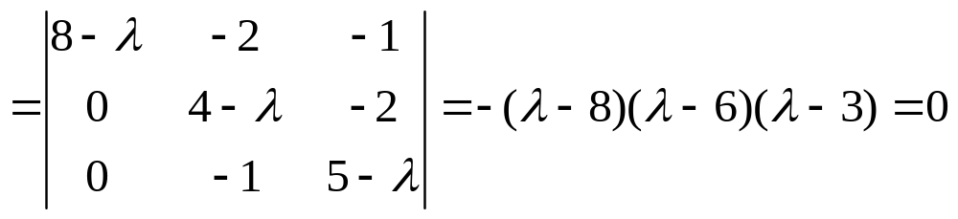
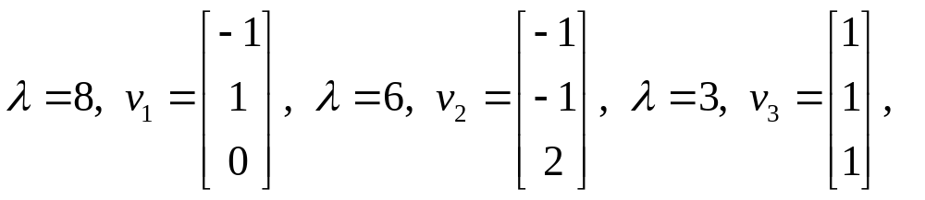
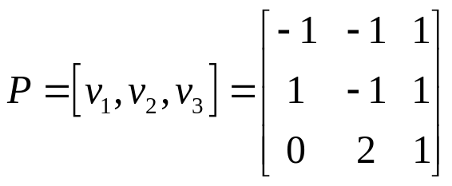
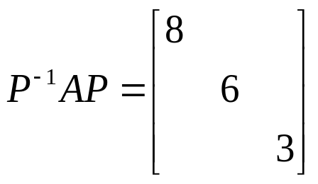
Solution
Let
then

Slide 5
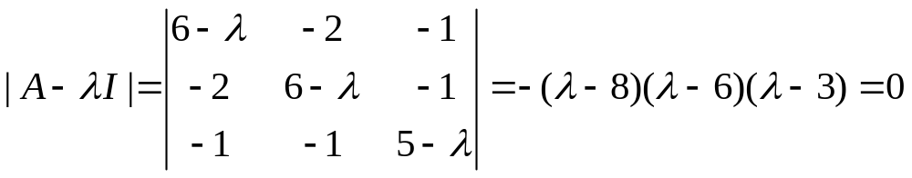
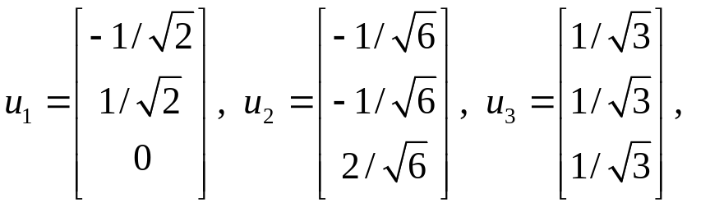
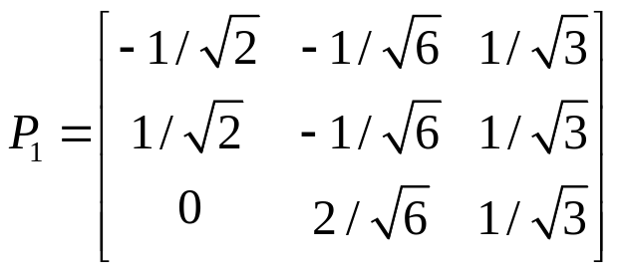
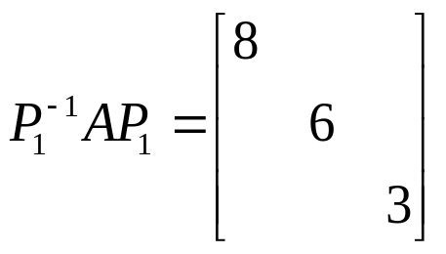
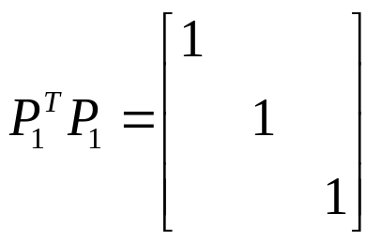
Solution
Let
then
and

Slide 6
A matrix A is said to be orthogonally diagonalizable if there are an orthogonal matrix P and a diagonal matrix D such that
A = PDP^{T} = PDP⁻¹.

Slide 7
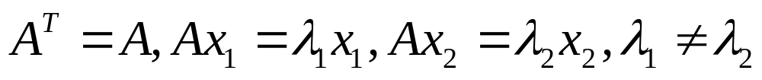
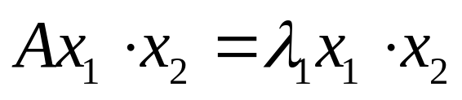
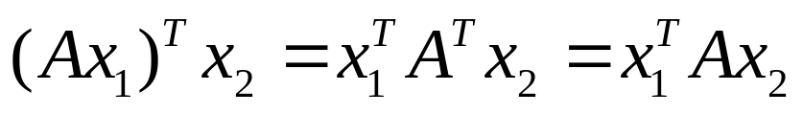
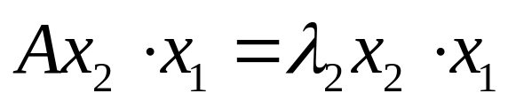
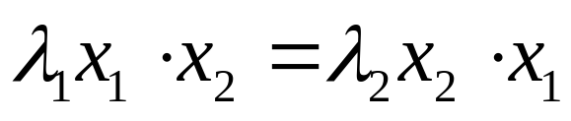
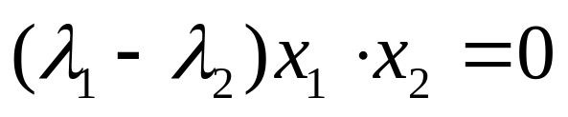
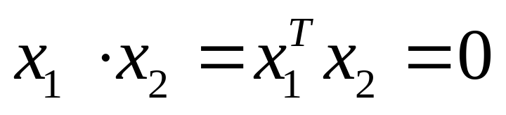
THEOREM 1
If A is symmetric, then any two eigenvectors from different eigenspaces are orthogonal.

Slide 8
THEOREM 2
An n×n matrix A is orthogonally diagonalizable if and only if A is a symmetric matrix.
(proof omitted)

Slide 9
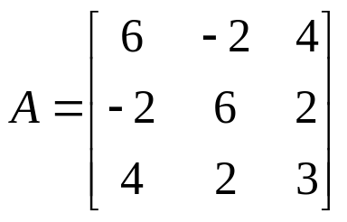

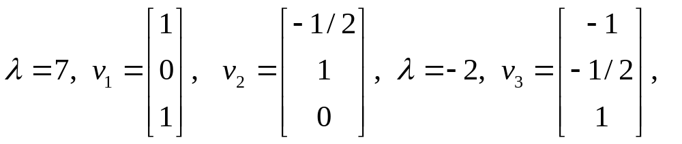
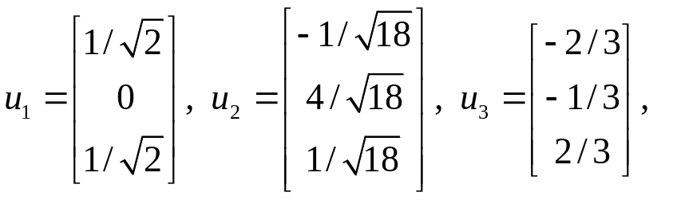
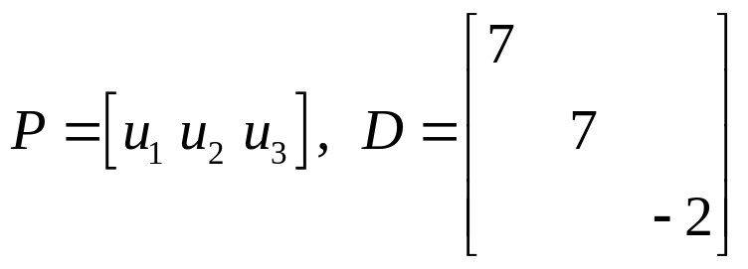

EXAMPLE 3
Let,
then

Slide 10
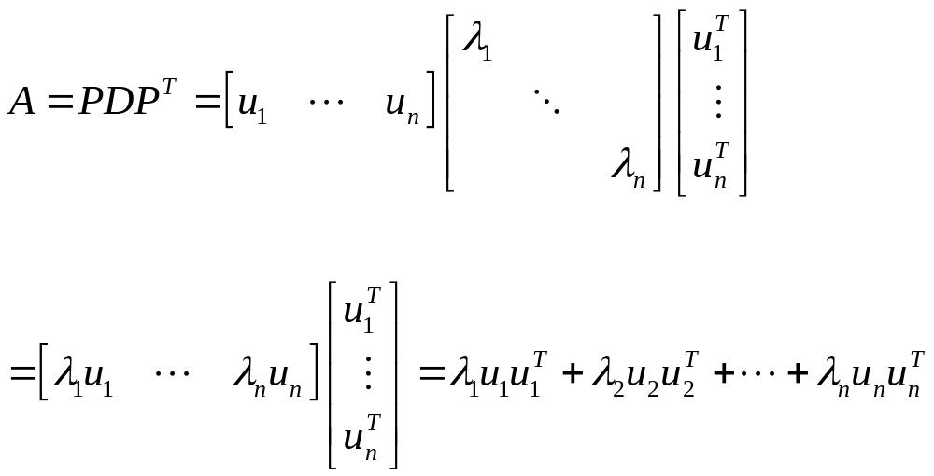
Spectral Decomposition 谱分解
HOMEWORK: 7.1 EXCERCISES 8, 16

