Slide 1
Chapter 7 Symmetric Matrices and Quadratic Forms
7.1 Diagonalization of symmetric matrices
对称矩阵的对角化
7.2 Quadratic forms 二次型

Slide 2
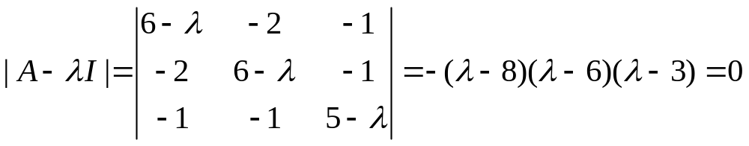
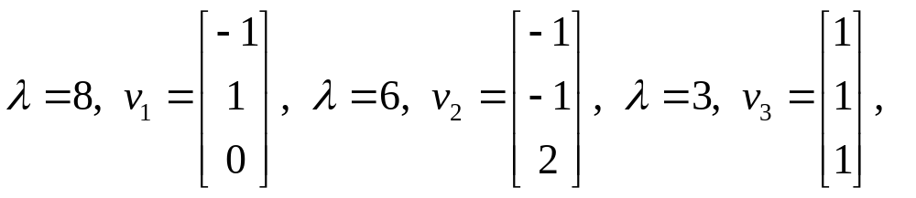
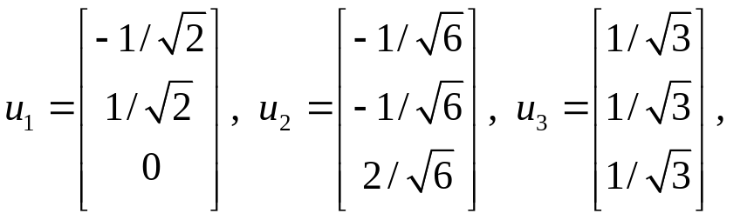
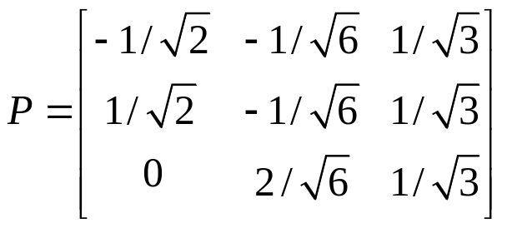
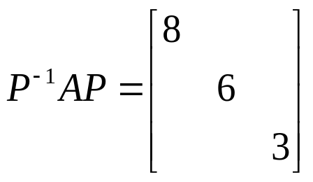
Solution
Let
then

Slide 3
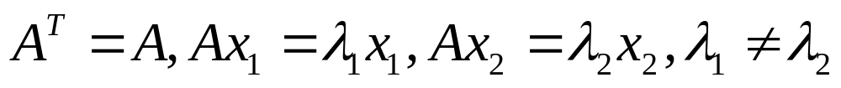
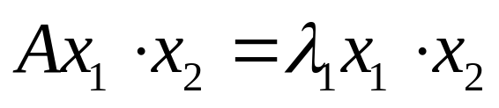
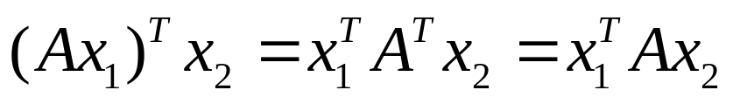
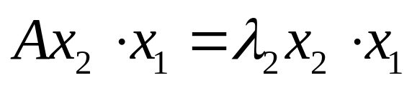
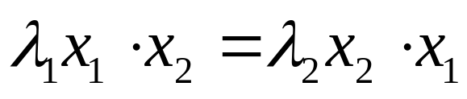
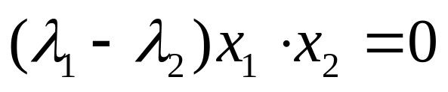
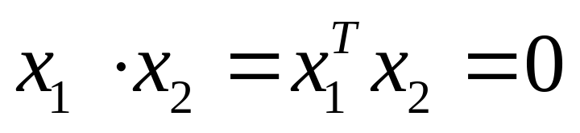
THEOREM 1
If A is symmetric, then any two eigenvectors from different eigenspaces are orthogonal.

Slide 4
THEOREM 2
An n×n matrix A is orthogonally diagonalizable if and only if A is a symmetric matrix.
(proof omitted)

Slide 5
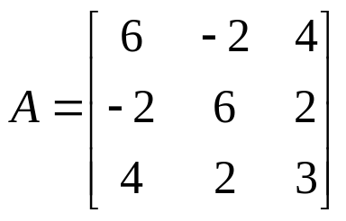
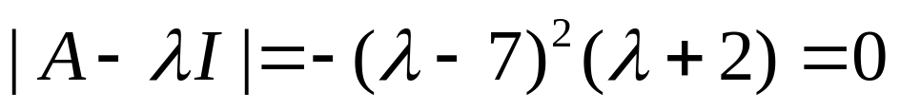
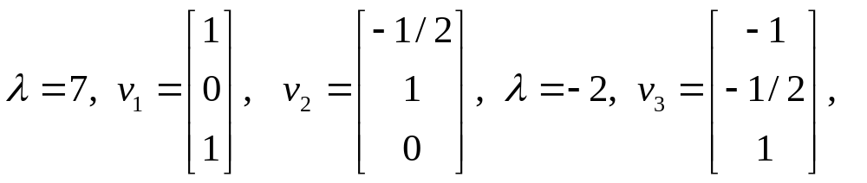
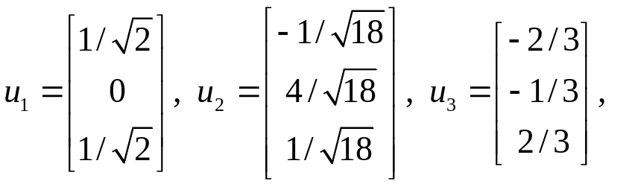
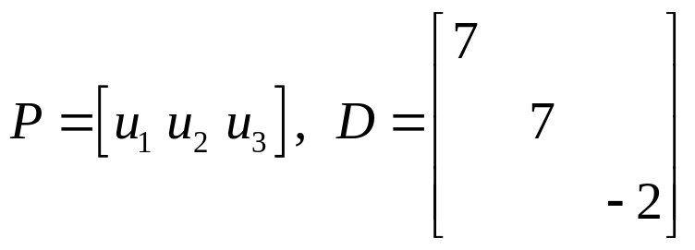

EXAMPLE 3
Let,
then

Slide 6
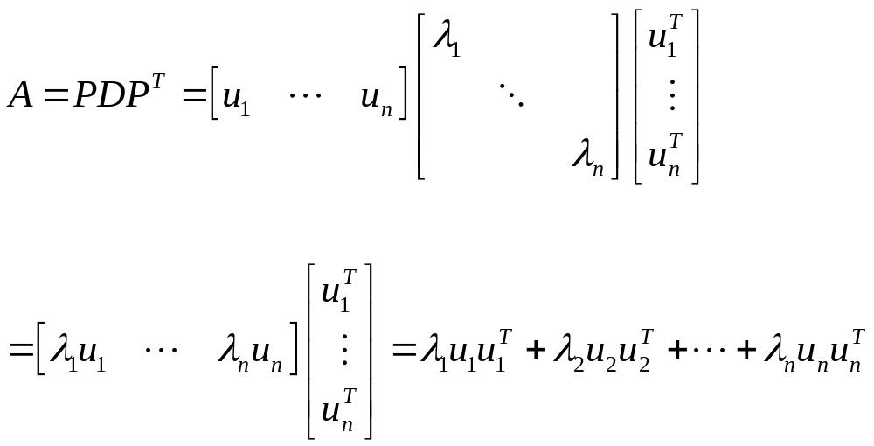
Spectral Decomposition 谱分解

Slide 7
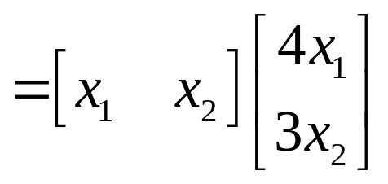
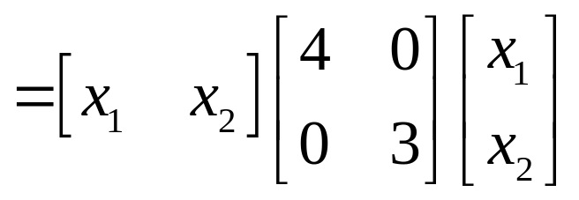
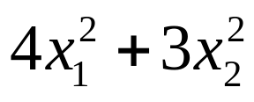
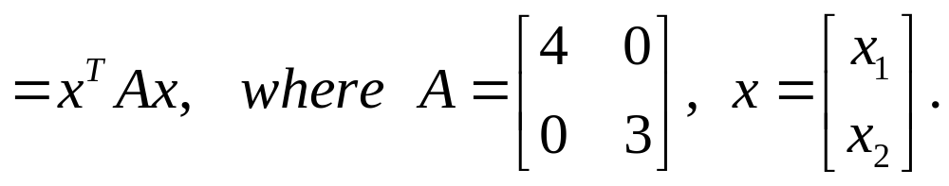
7.2 Quadratic forms 二次型
EXAMPLE 1

Slide 8
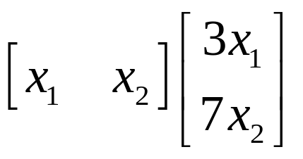
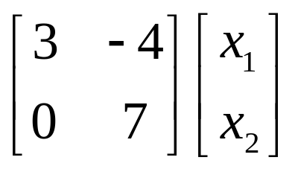
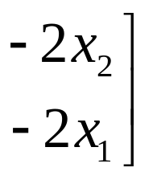
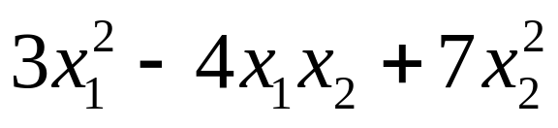
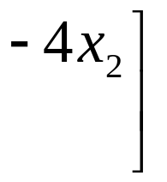
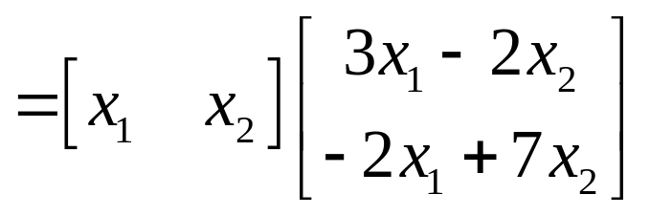
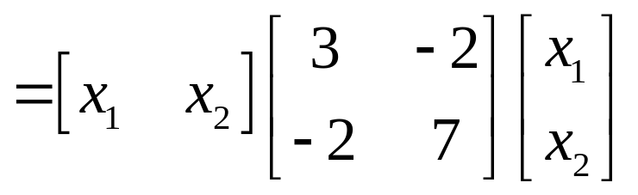
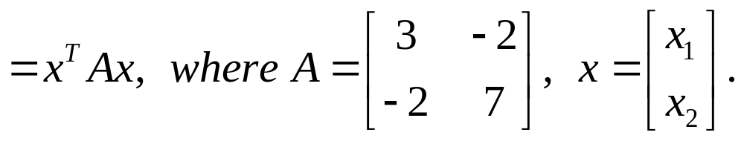

Slide 9
A quadratic form on R^{n} is a function Q defined on R^{n} whose value at a vector x in R^{n} can be computed by an expression of the form
Q( x ) = x^{T}Ax,
where A is an n×n symmetric matrix.
The matrix A is called the matrix of the quadratic form.

Slide 10
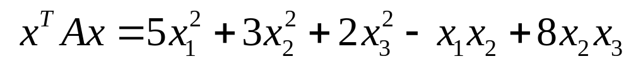
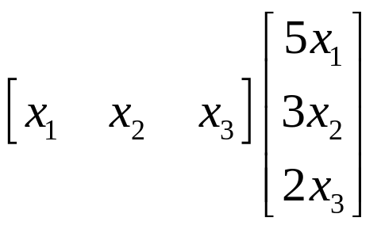
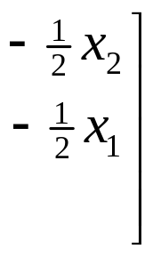
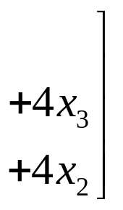

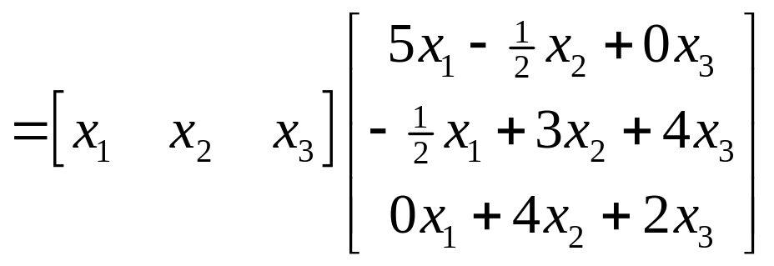
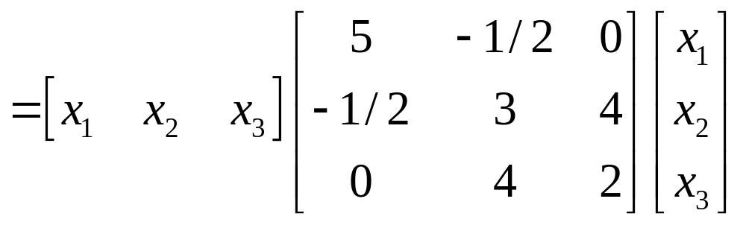
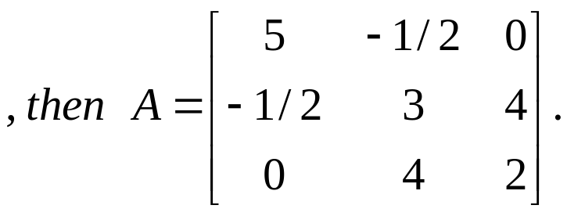
A=?

Slide 11
THEOREM 4
The Principal Axes Theorem 主轴定理
Let A be an n×n symmetric matrix. Then there is an orthogonal change of variable, x = Py, that transform the quadratic form x^{T}Ax into a quadratic form y^{T}Dy with no cross-product term.

Slide 12
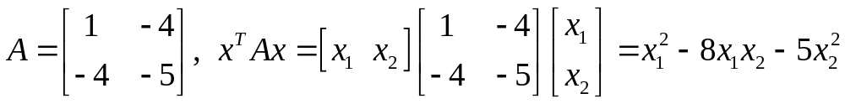
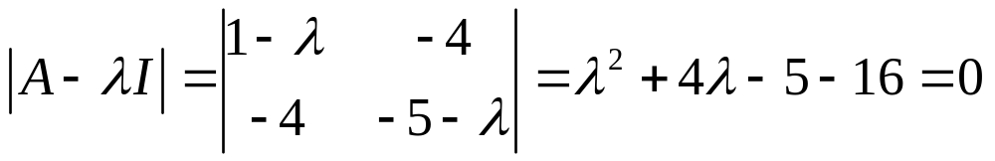
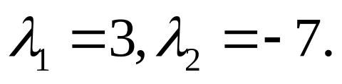
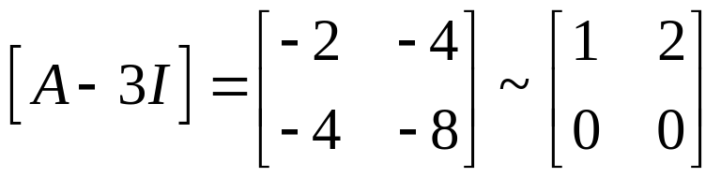
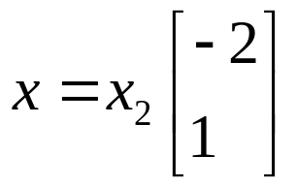
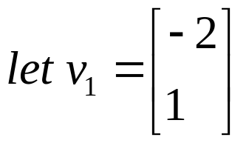
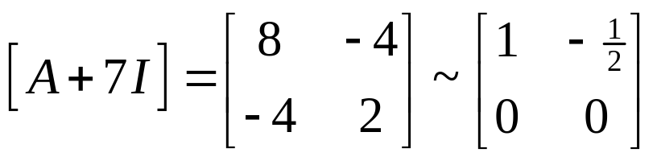
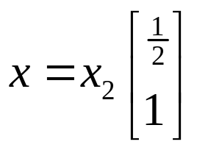
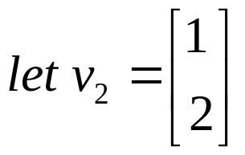

Slide 13
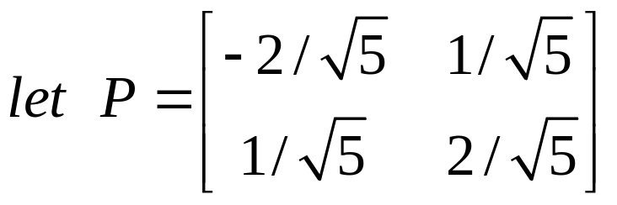
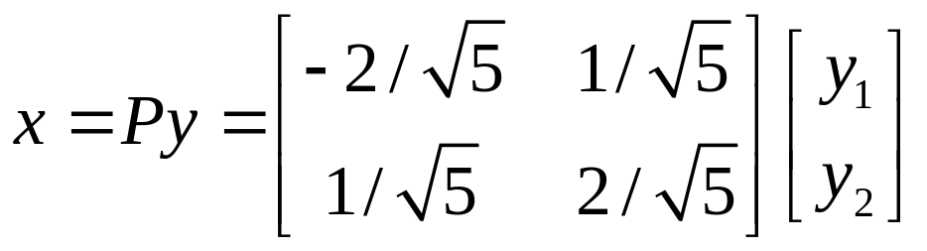
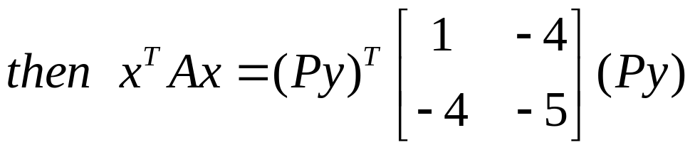
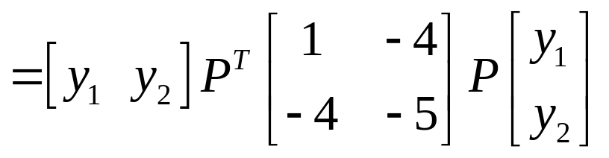



Slide 14










Slide 15







Slide 16
Classifying quadratic forms
DEFINITION 正定，负定，不定
A quadratic form Q is:
a. positive definite if Q(x) > 0 for all x ≠ 0.
b. negative definite if Q(x) < 0 for all x ≠ 0.
c. indefinite if Q(x) assumes both positive and negative values.

Slide 17
THEOREM 5
Quadratic Forms and Eigenvalues
Let A be an n×n symmetric matrix. Then a quadratic form x^{T}Ax is:
a. positive definite if and only if the Eigenvalues of A are all positive,
b. negative definite if and only if the Eigenvalues of A are all negative, or
c. indefinite if and only if A has both positive and negative Eigenvalues.

Slide 18




A positive definite matrix A is a symmetric matrix for which the quadratic form x^{T}Ax is positive definite.
HOMEWORK: 7.2 EXCERCISES 9, 12

