Slide 1

Labelling User-System Conversations
Valence Case
Milind Choudhary
Contact: mxc210096@utdallas.edu
+1 (945) 246-0648

Slide 2
Dataset and Evaluation Metrics
Dataset: User Satisfaction Simulation (Subset of SGD Dataset)Annotated task-oriented conversations between humans and a virtual assistant.
URL: user-satisfaction-simulation
Evaluation Metrics:
UAR: Unweighted Average Recall
Kappa Score: Inter-annotator agreement
Spearman Rho Coefficient: Correlation of predicted and true labels

Slide 3
Data Preparation & Analysis
Key Insights: Imbalance towards an average rating of 3
Voting as a tiebreaker between annotators
Statistical Overview: Mean of gold labels: 3.09
Standard deviation: 0.44
Minimum: 1, Maximum: 5
Preprocessing:
Extract turn-by-turn conversations
Calculate mode of annotations

Slide 4
Non-LLM Based Models
Preprocessing: TF-IDF, input text length as features
Models Used:
Logistic Regression (baseline)
Support Vector Classifier (SVC) with tuned hyperparameters
Random Forest (RF) with hyperparameter tuning
XGBoost with learning rate and depth adjustments

Slide 5
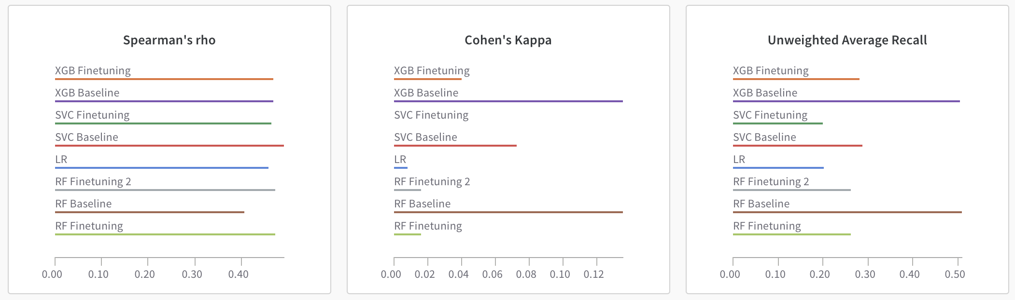
Results (Non LLM Based)

Slide 6
LLM Based Models & Results
Preprocessing:
Dataset converted to JSON for OpenAI-based models
Prompts:
P1: 0-shot prompt for initial predictions
P2: Statistically informed prompt
P3: Shortened statistical input prompt
Models: GPT-3.5, GPT-4o mini
Results:
Compared performance of LLMs and traditional models using UAR, Kappa, Spearman Rho

Slide 7
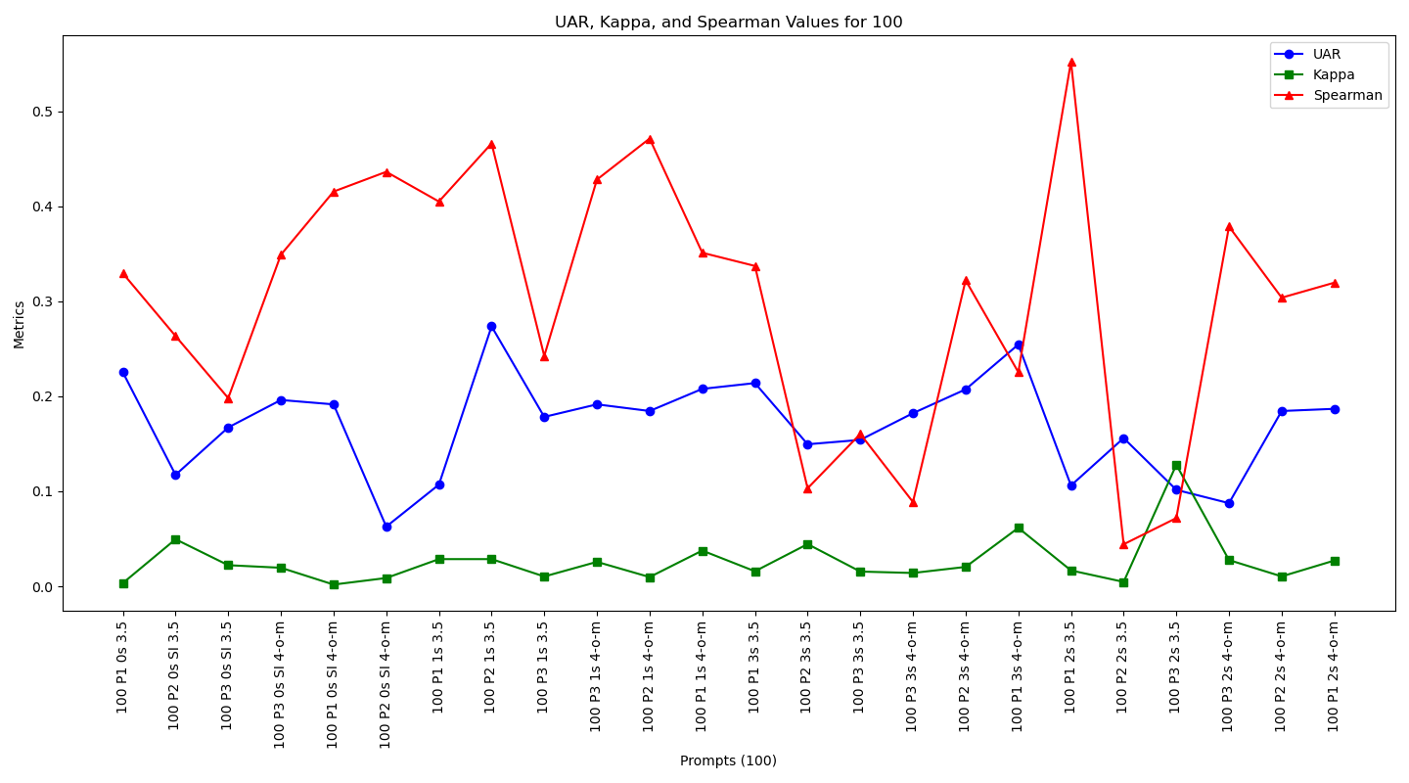
Results (LLM Based [Prelimnary])

Slide 8
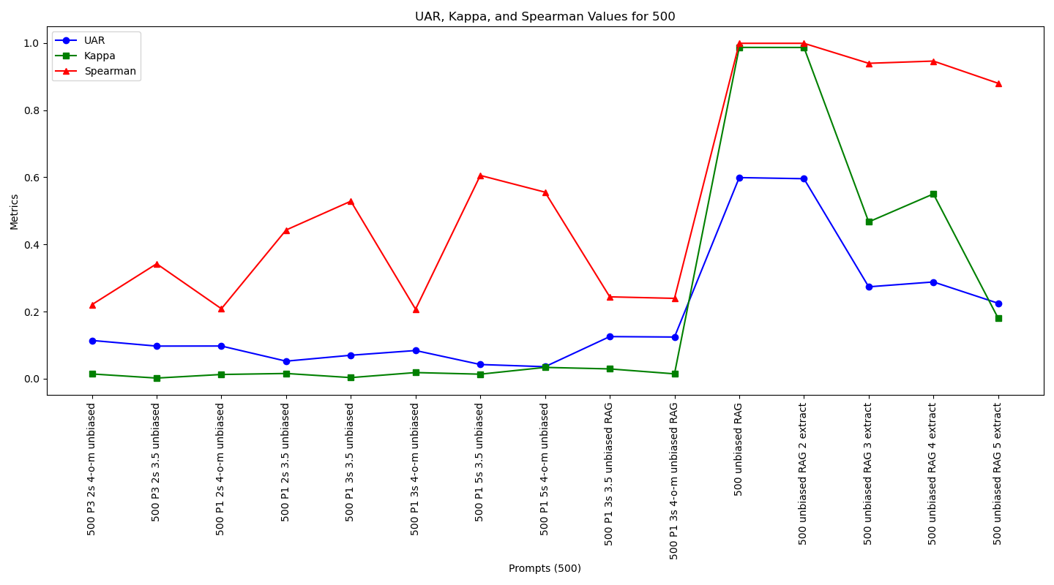
Results (LLM Based [Full Subset])

Slide 9

Future Direction
The RAG-based approach can be furthered using metadata like chunking using the scores
The LLM based models can be finetuned
Lighter LLM Models can be implemented and integrated with RAG-based approach.
The finetuning will be done using LoRA

