Slide 1
NYC Taxi FarE prediction
using CATBoost
Milind Kulkarni (50495311)

Slide 2
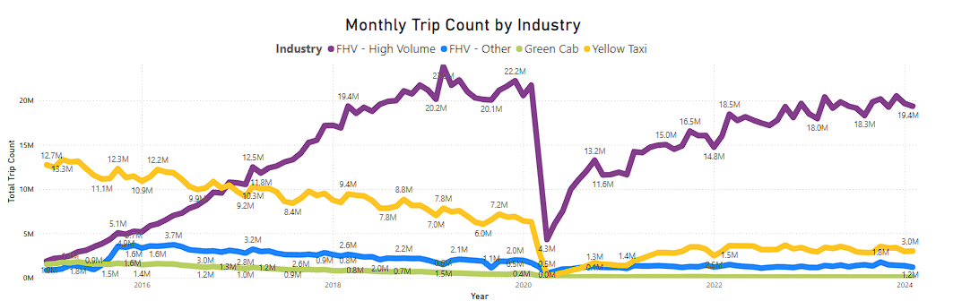
Introduction
Over 200,000 TLC licensees complete ~1,000,000 trips each day
The NYC State has ~15000 yellow taxis
JFK Airport is 70% of yellow taxi’s drop-off point.
Taxi fares are regulated by the Taxi and Limousine Commission.

Slide 3
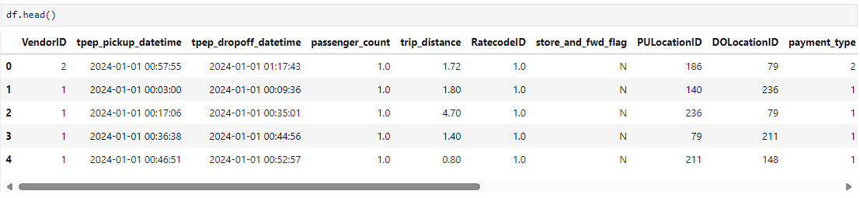
NYC Taxi Data: Acquisition and Sample
Acquired from official NYC TLC website
Consists of Jan & Feb 2024
Covers 5972150 trips
19 columns (ex shown below)

Slide 4
NYC Taxi Data: EDA
Describe and identify datatypes of various columns
Drop the columns that are not required
Filter out data that has 0 fare for the trip
Update the rate_card for trips with 0 or less distance
Transform pickup and drop-off times to timestamps
Create a trip_duration column based on above timestamps
Create day_of_the_week and plot for day-wise analysis
Plot data hour-wise to identify daily traffic and busiest day

Slide 5
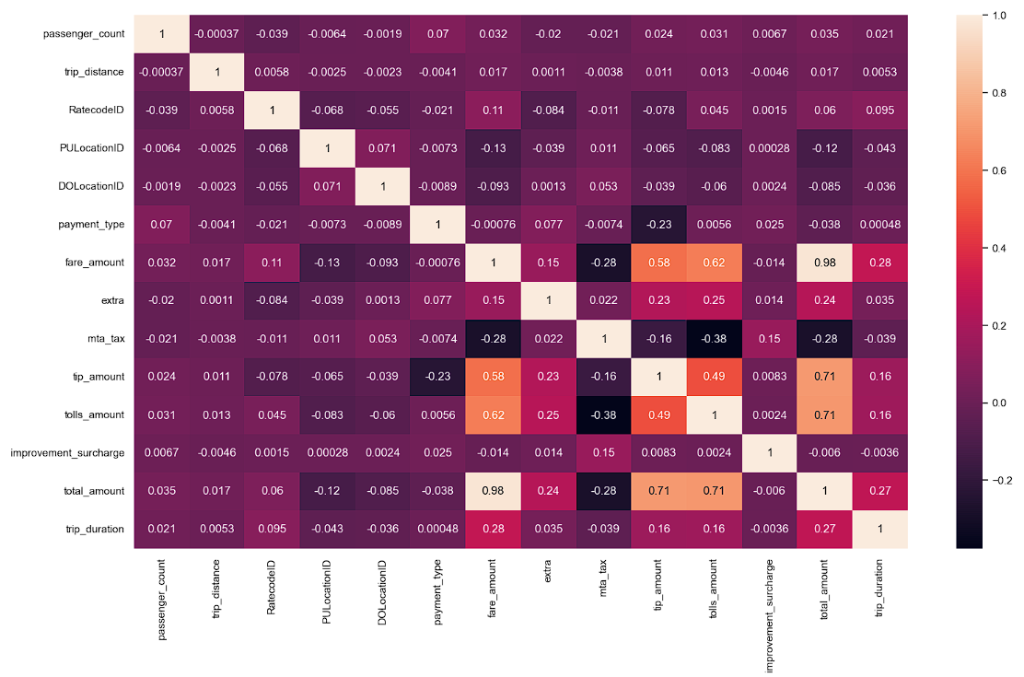
NYC Taxi Data: Correlation Heatmap

Slide 6
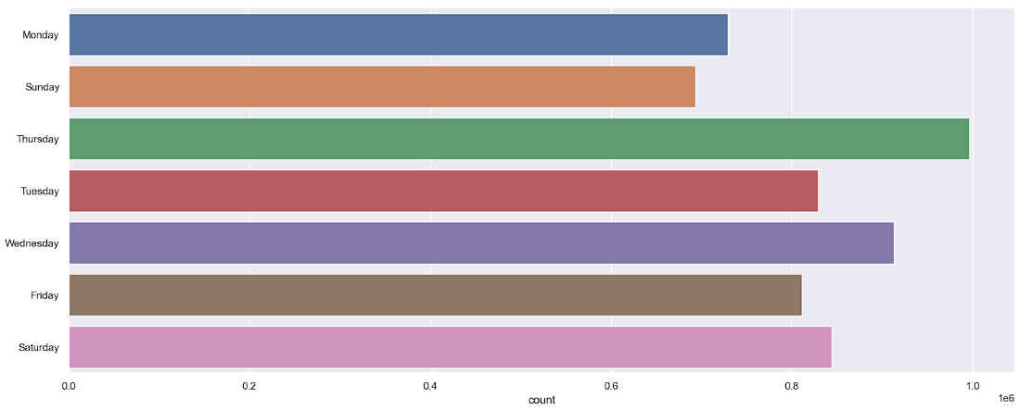
NYC Taxi Data: Day-wise Plot

Slide 7
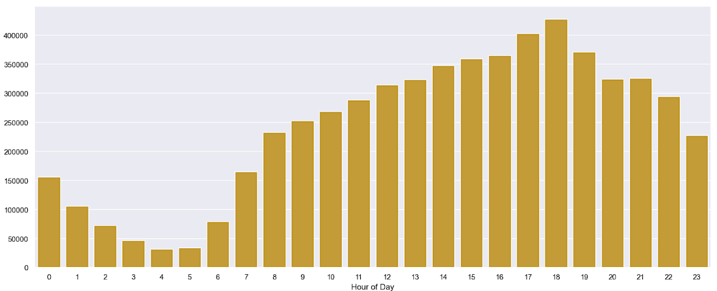
NYC Taxi Data: Hour-wise Plot

Slide 8

CATBoost: What is it?
CATBoost - Categorical Boosting algorithm developed by Yandex
High-performing gradient boosting library
Key Features:
Seamless handling of categorical and numerical data
Automatically deals with missing values
Efficiently processes large datasets
Technical Overview:
Based on decision trees and uses gradient boosting
Has symmetric tree structure for faster, consistent decision making
Reduces overfitting through built-in regularization techniques.

Slide 9
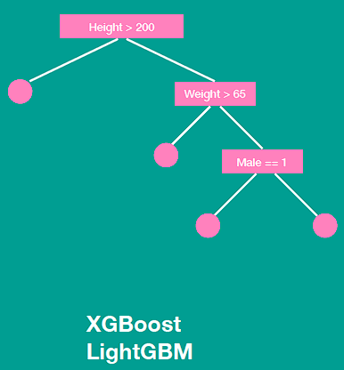
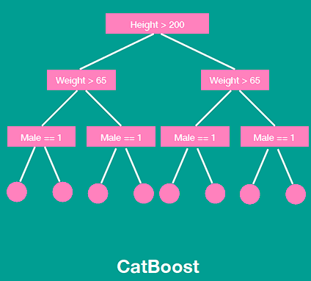
CATBoost: In-depth
Gradient Boosting
Sequentially corrects errors
Minimizes residuals of the combined ensemble
Decision Tree structure, optimizes loss function
Ordered Target Statistics:
Converts categorical features to numerical
Uses stats instead of one-hot, preserves information
Preserves order while computing, prevents leakage
Has L2 regularization to prevent overfitting
Additional regularization on individual trees
Notes:
CATBoost is built on the principle of gradient boosting, where new models (typically decision trees) are added sequentially to correct errors made by previous models.
Each new model is trained to minimize the residuals (errors) of the combined ensemble of all previous models.
Like other gradient boosting methods, CATBoost uses decision trees as base learners.
Each tree is constructed to optimize the loss function by focusing on the most difficult-to-predict instances.
The uniform structure of symmetric trees allows for highly efficient memory usage and faster computations during training.
During prediction, the uniformity of symmetric trees allows for quicker traversal from the root to the leaf node.
This results in faster prediction times, making CATBoost particularly suitable for applications requiring real-time or near-real-time predictions.
Since each split at a given level is consistent, it simplifies the process of determining the optimal splits and reduces computational overhead.
Since all nodes at the same level use the same splitting rule, the decision boundaries created by symmetric trees are more consistent and easier to interpret.
This consistency can lead to more robust models, especially in scenarios with noisy or sparse data.
The simpler, more regular structure of symmetric trees helps in generalizing better to unseen data, as the model is less likely to create overly complex trees that fit the training data too closely.

Slide 10
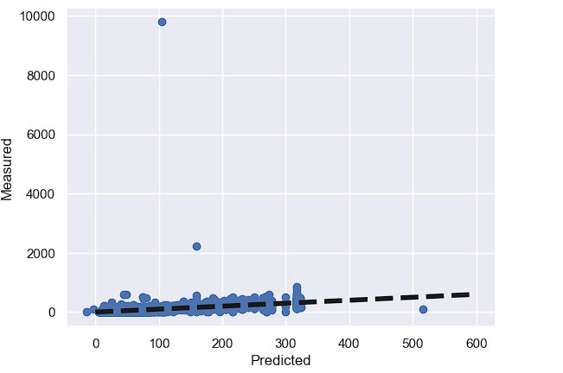
CATBoost: Results
Mean Absolute Error: 2.67
Root Mean Squared Error: 9.15
Mean squared error: 83.69
R2 Score: 0.83
XGBoost: Results
Mean Absolute Error: 2.67
Root Mean Squared Error: 9.11
Mean squared error: 83.04
R2 Score: 0.84
Notes:
An MAE of 2.672 suggests that, on average, the model's predictions deviate from the actual values by approximately 2.672 units.
An RMSE of 9.148 indicates that the typical error (the standard deviation of the prediction errors) is about 9.148 units.
An MSE of 83.686 tells you about the average squared error the model
An R² of 0.834 suggests that approximately 83.4% of the variability in the dependent variable can be explained by the model's inputs.
The R² score indicates a good fit, with the model explaining a significant portion of the variance in the target data

Slide 11
Thank you

