Slide 1
ExcelR Solutions
A Project Presentation on
BOOK RECOMMENDATION SYSTEM
Presented by
Arunima K
Aswathi Suraj Nair
Dinesh B Sawale
Kushal Hiralal Niveriya
Milind Dattatray Mali
Spoorthy V ☺

Slide 2
CONTENTS
PROBLEM STATEMENT
DATA OVERVIEW
DATA PREPROCESSING
EXPLORATORY DATA ANALYSIS
CONCLUSION BASED ON EDA
MODEL BUILDING
EVALUATION
DEPLOYMENT OF MODEL

Slide 3
PROJECT Objective
Generate the features from the dataset and use them to recommend the books accordingly to the users.
Content
Books:- Books are identified by their respective ISBN. Invalid ISBNs have already been removed from the dataset. Moreover, some content-based information is given (Book-Title, Book-Author, Year-Of-Publication, Publisher), obtained from Amazon Web Services. Note that in case of several authors, only the first is provided. URLs linking to cover images are also given, appearing in three different flavours (Image-URL-S, Image-URL-M, Image-URL-L), i.e., small, medium, large. These URLs point to the Amazon web site.
Users:- Contains the users. Note that user IDs (User-ID) have been anonymized and map to integers. Demographic data is provided (Location, Age) if available. Otherwise, these fields contain NULL-values.
Ratings:- Contains the book rating information. Ratings (Book-Rating) are either explicit, expressed on a scale from 1-10 (higher values denoting higher appreciation), or implicit, expressed by 0.

Slide 4
Data overview:
1.USERS:-
User-ID: Unique ID of each user
Location: Location of the user
Age: Age of the user
2.BOOKS:-
ISBN: The International Standard Book Number is a unique numeric Identifier
Book-Title: Title of Book corresponding to an ISBN
Book-Author: Author of the book
Year-Of-Publication: Year of Publication of the book
Publisher: Publisher of the book
Image-URL-S: Small cover image url to a book
Image-URL-M: Medium cover image url to a book
Image-URL-L: Large cover image url to a book
3.RATINGS:-
User-ID: Unique ID of each user
ISBN: The International Standard Book Number is a unique numeric Identifier
Book-Rating: Book-Rating are either explicit, expressed on a scale from 1-10
(higher values denoting higher appreciation), or implicit, expressed by 0

Slide 5
Exploratory data analysis

Slide 6
Books data
In books data all the column values are in object data type.
Missing values are found in Book-Author, Publisher, Image-URL-L.
In Book-Author and Publisher column, null values are replaced with correct values.
After inspecting the values in year-of-publication wrong inputs that is string values are found so it is replaced with the right inputs.
Later the year-of-publication data type is changed to int data type.
We have checked the year-of-publication which is greater than 2022 and is equal to 0.
There are 4621 rows which has year of publication 0 or greater than 2022 for such huge amount of data we cant put all the exact correct values in the dataset so that we replaced all such incorrect year of publication with "median" values

Slide 7
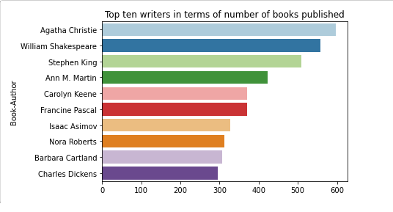
Checking the top 10 writers in terms of number of books published.
Agatha Christie is the writer who published more number of books.

Slide 8
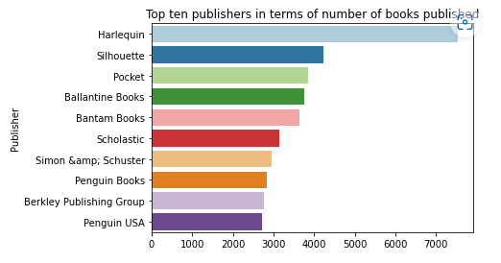
Top ten publishers in terms of number of books published
Harlequin is the publisher who published more number of books.

Slide 9
We have checked the duplicated values in books and dropped the rows whose entire column values are repeated.
Then by typing books.info we get to know all the information of book dataset and there are no null values are found.

Slide 10
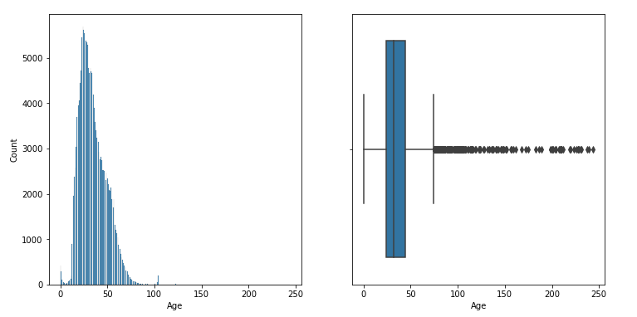
users
State and City columns are dropped from the users dataset because it was not necessary.
There are no duplicate values in the users dataset.
Later we checked the missing values in the users data, almost 40% data of the age column is missing
We observed that the maximum age in the age column is 244 which is certainly outlier.

Slide 11
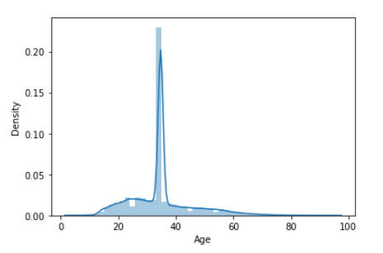
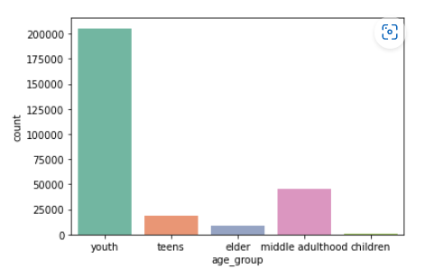
We have replaced the outliers in the age column with mean values.
After imputation 0 percentage of missing values are found.
Later we defined the age group of users

Slide 12
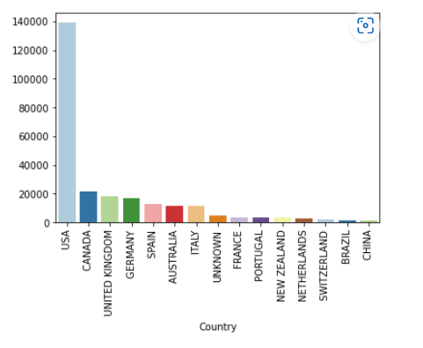
Here we can observe the maximum number of users in the countries through bar chart.
The USA has more number of users among all countries.

Slide 13
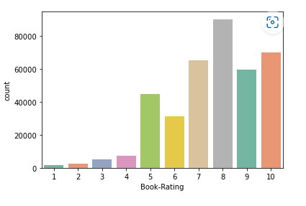
RATING DATA
There are no null values in the ratings dataset.
There are no duplicate values.
Number of unique userID is 105283 and number of unique ratings is 340556. This means that many users are buying multiple books. Also some books are really famous and hence are bought by multiple users.
We have seen 10 most popular books through rating data, which includes both implicit and explicit rating.
We only need most popular explicitely rated books.

Slide 14
Merging the dataset
for the rating dataset, we are only taking the explicit rating dataset.
shape of the merged dataframe is (377892, 13).
There are no null values found in the dataframe.
Number of users who have rated the books are 67063.
Number of books in the dataframe are 146930.

Slide 15
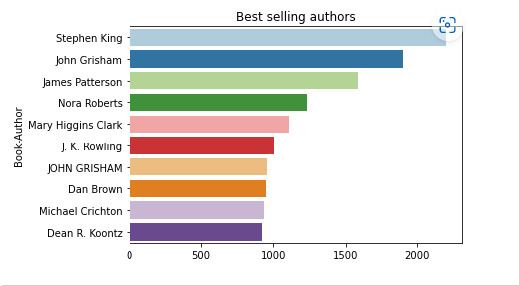
EDA
The best selling authors are
The best selling authors is “Stephen King”

Slide 16
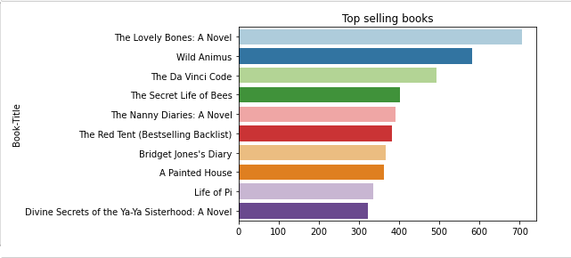
Top selling books are
“The Lovely Bones : A Novel” is highest selling book

Slide 17
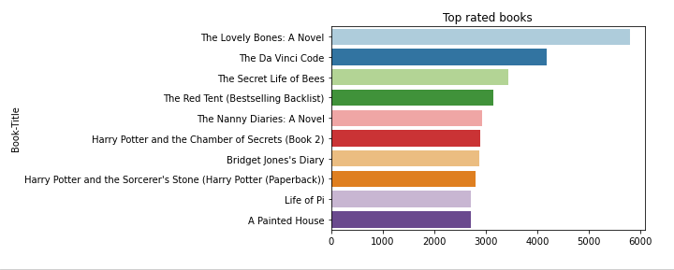
Top rated books are
“The Lovely Bones :A Novel” is also high rated books globally.

Slide 18
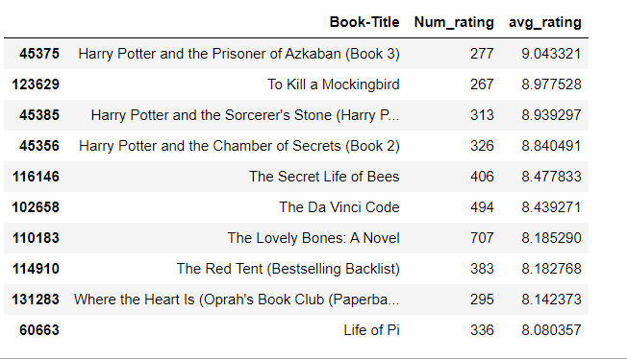
Books having highest Average Rating
Above listed are top 10 books having highest average ratings

Slide 19
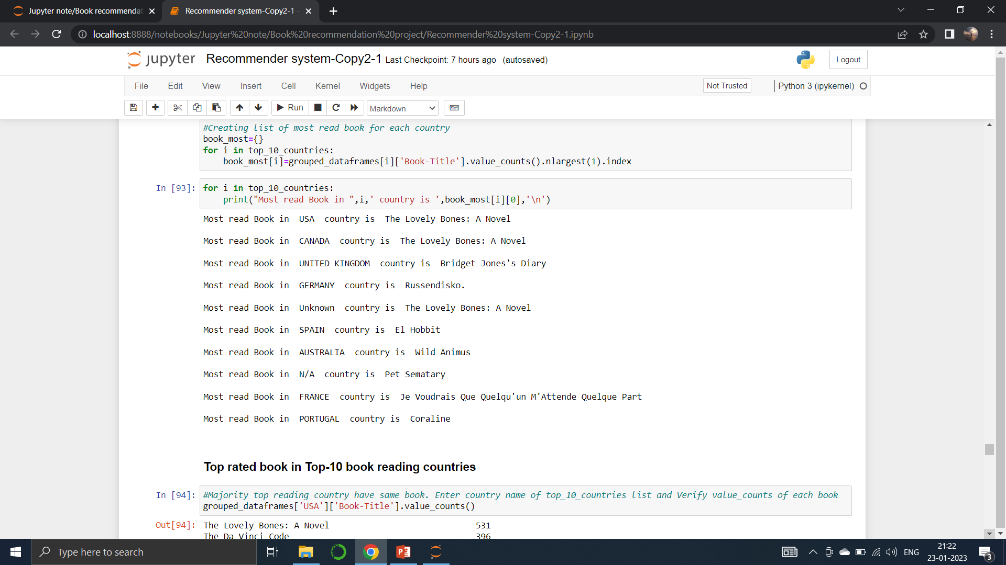
Most read book Top 10 users countries

Slide 20
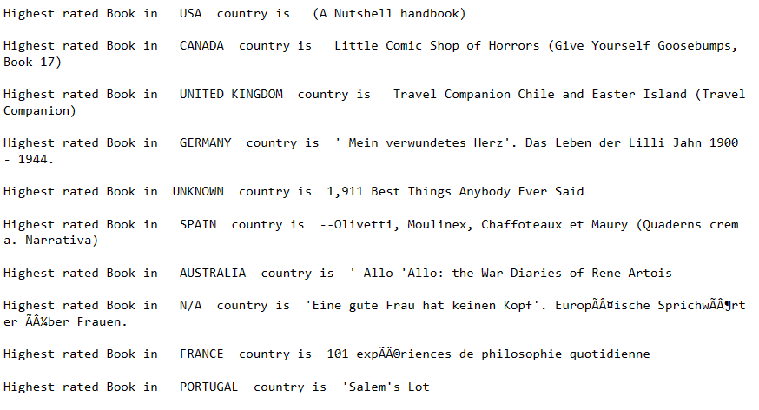
Top Rated book Top 10 users countries

Slide 21
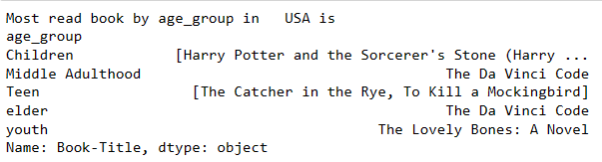
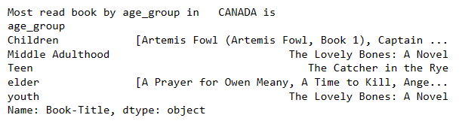
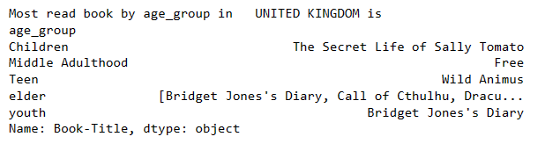
IN USA :
Most read book in different age group in top few countries
IN CANADA:
IN UK :

Slide 22
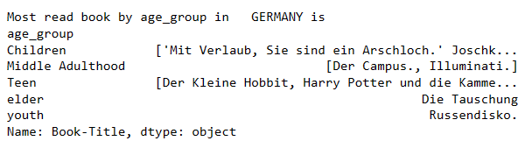
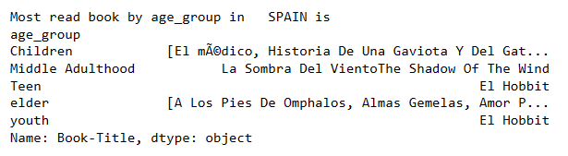
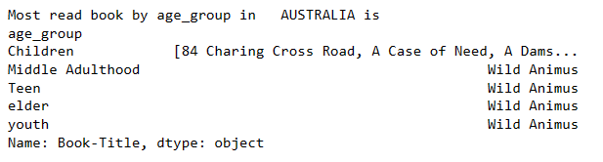
IN GERMANY :
IN SPAIN :
IN AUSTRALIA :

Slide 23
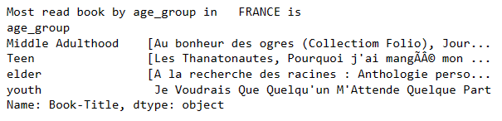
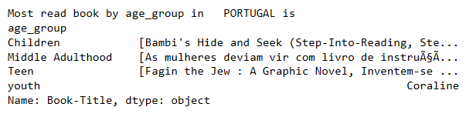
IN FRANCE:-
IN PORTUGAL:-

Slide 24
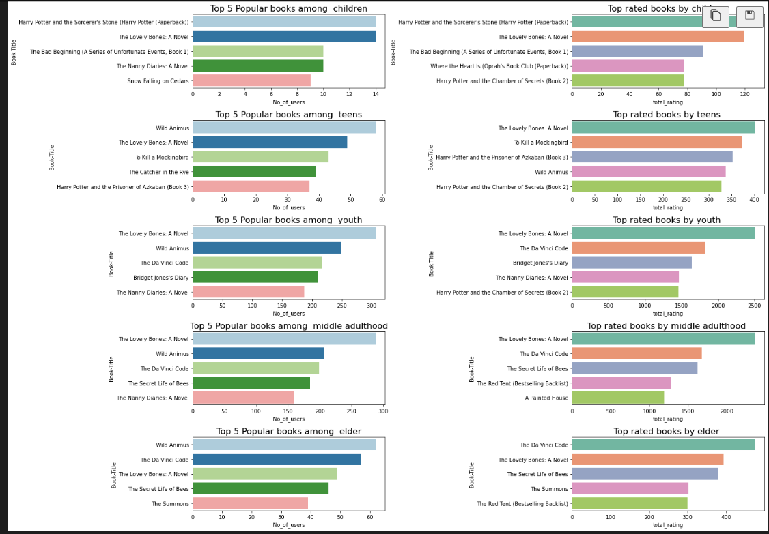
Top 5 popular books among children, teens, youth, adulthood and elder.
Top 5 rated books among children, teens, youth, adulthood and elder.

Slide 25
Conclusion based on EDA
Most of the users give the rating 5 or above to the books.
The majority of readers are in the age between 25 and 40.
Stephen King is the most popular Author.
The majority of the users who given the ratings are from United States (US)
Agatha Christie is the writer who published more number of books.
Harlequin is the publisher who published more number of books.
The lovely bones: A Novel is most popular book.
Lovely bones: A Novel is also highly rated book by the users of all the age group.
Harry Potter and the Prisoner of Azkaban (Book 3) got the highest average ratings.
USA, CANADA, UK, GERMANY, SPAIN,AUSTRALIA, FRANCE, PORTUGAL are the top book reading countries.
Wild Animus referees to the most read books in AUSTRALIA for all age group except children.
In most cases the choices of books are different in every country, so the location plays a major role in selection of books

Slide 26
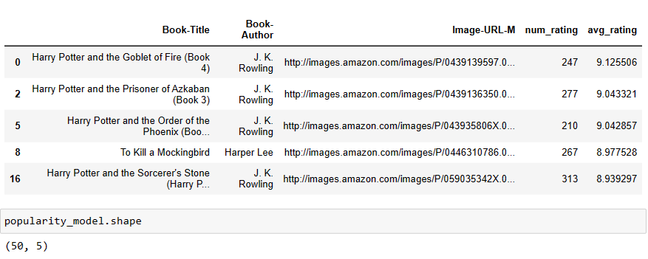
Model building
General Recommendation(Popularity Based Recommendation system)
For the General Recommendation we consider the only books upon which number of rating is more than 200.
Thus we get Top 50 Books upon which number of ratings is more than 200

Slide 27
Model Building- User based recommendation system
A user-based recommendation system is a type of recommendation engine that generates recommendations based on the behaviour and preferences of similar users. The idea behind this approach is that users who have similar tastes and preferences in the past are likely to have similar preferences in the future.
To make this model again we consider the books upon which number rating is more than 250 and the users have given at least one rating.

Slide 28

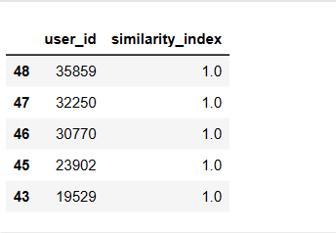
Pearson Correlation
The Pearson correlation coefficient ranges from -1 to 1. A value of -1 indicates a perfect negative linear correlation, a value of 1 indicates a perfect positive linear correlation, and a value of 0 indicates no linear correlation between the two variables. Positive correlation means that as one variable increases, the other variable also increases, and vice versa for negative correlation
Based on similarity index we found out similar users to any target User ID.
In order to suggest the books highly rated by similar users and not yet read by target user ID
For Example.

Slide 29
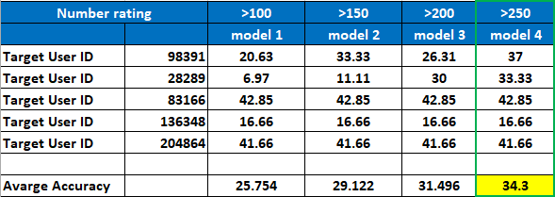
Evaluation of model
For evaluation of model we did the following steps
We find the recommended books to sample User ID at four different condition based on number of ratings greater than 100,150,200,250.
Based on among the recommended books how many books are already red by sample user ID
To check the accuracy of the model we take the ratio of common books and total number of recommended books with the help of excel sheet

Slide 30

Deployment
For the deployment we use stream lit.
https://arunimak21-book-recommender-app-su6gzz.streamlit.app/

Slide 31
Thank You…

