Slide 1


Building and Deploying Microservices with Spring Boot, Angular, and AWS EC2
Milinda Nandasena

Slide 2
Agenda
Application Overview
Technologies/ Tools
High Level Architecture
Demo
2

Slide 3
Application Overview
Epic | Story | Description
Car Microservice | Car Data Retrieval | List available cars, view details of a specific car, filter cars based on location.
Location Microservice | Location Data Retrieval | List available locations, view details of a specific location.
Reservation Microservice | Reservation Booking | Make reservations for specifying start and end dates.
 | Reservation Management | View existing reservations, cancel reservations.
API GateWay Service | Providing Single Entry Point | Single entry point to access backend services via frontend.
Discovery Service | Enhanced Service Instance Tracking | Keep track of all the service instances and route the requests to available service instance when needed.
Frontend Development | Home Page | Create a homepage for the application.
 | Display Car List | Develop a page to display a list of available cars.
 | Search for Location | Implement a search feature for locations.
 | View Car Details | Design a page to view detailed information about a specific car.
 | Reservation | Create a reservation page with the ability to make and cancel reservations.
3

Slide 4
Angular 11
Spring boot 2.7
Java 8
Spring Cloud API Gateway
Spring Eureka Service Registry
Apache Maven 3.8.1
MySQL 8.0
AWS EC2
Apache Httpd Server
VS Code
WinSCP
Heidi SQL
Technologies/ Tools
4

Slide 5
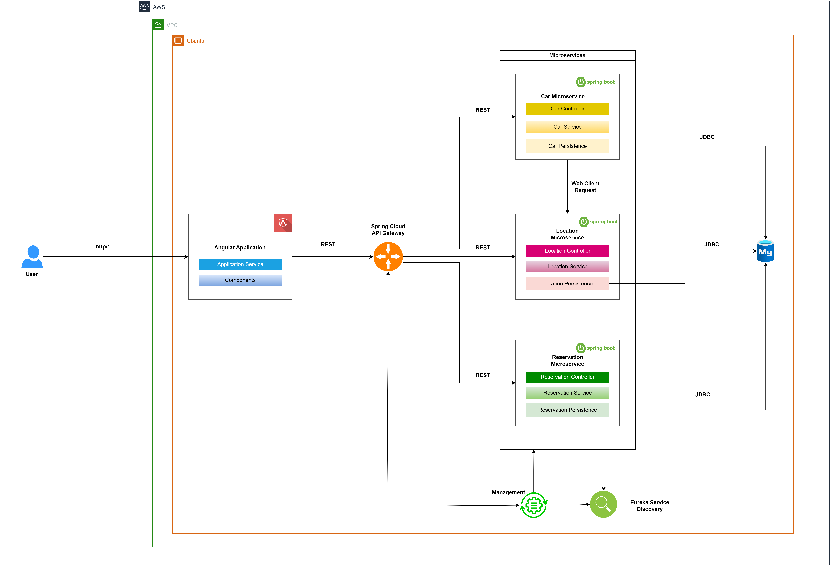
High Level Architecture
5

Slide 6
Demo
6

Slide 7
Thank you!

