Slide 1

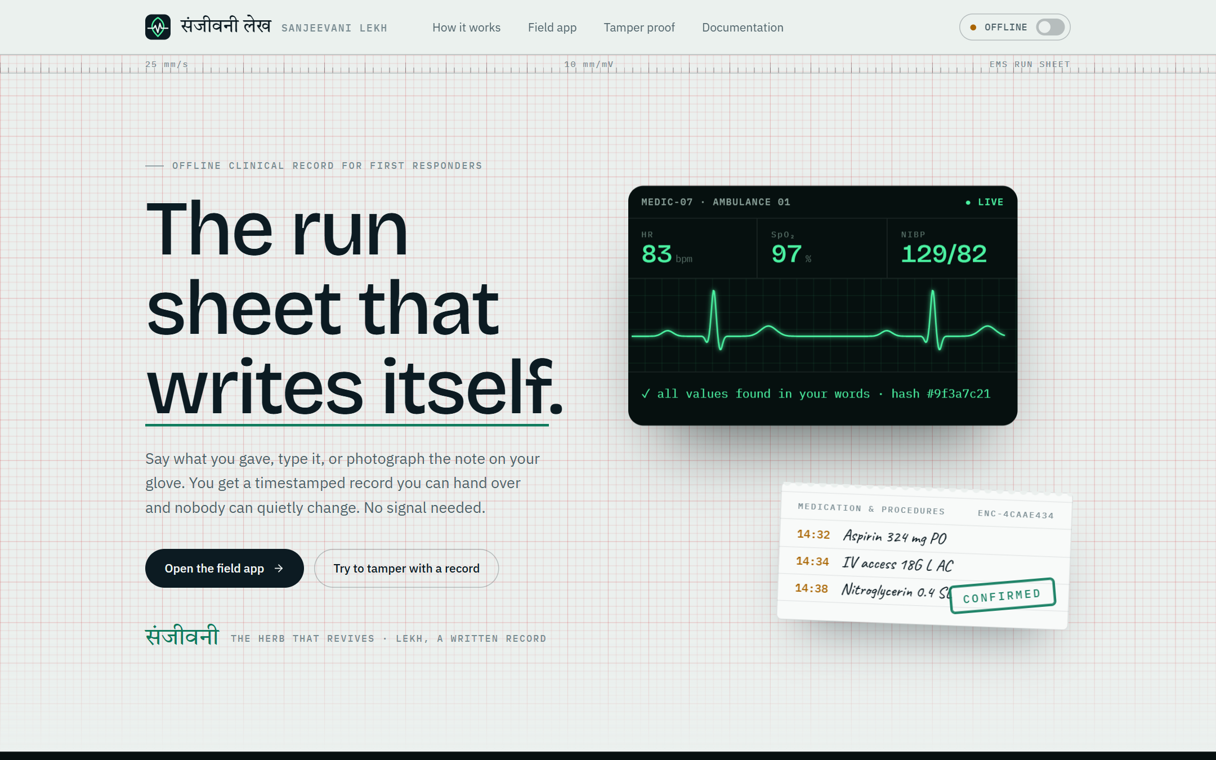
VIRTUSA JATAYU 2026
Sanjeevani Lekh
Offline-first clinical record for first responders
Speak, type or photograph a field note. Get a verified, tamper-evident record and a printable handover.
Milind Verma | Nikhil Agrawal | Gaurav Kumar | Riya Mehta
Notes:
Sanjeevani Lekh turns a responder's spoken, typed or photographed note into a structured record that is checked, confirmed by a human and sealed so it cannot be quietly changed. It works offline, with an optional online mode.

Slide 2



The problem on the scene
Notes end up on gloves
Details come from memory
Nothing proves what happened
Drugs and procedures are given fast. The details land on gloves, tape, scraps of paper, or stay in memory.
Doses and times written down afterwards are often wrong.
Nobody can later show exactly what was given, and when.
The receiving hospital may not know a drug was already given.
Notes:
Responders have no time to write while treating a patient. That leads to missing, late or remembered details, and to no reliable proof of what happened.

Slide 3






From a spoken note to a sealed record
Capture
Extract
Verify
Confirm
Seal
Hand over
voice, text or photo
medications and procedures
against the original words
a responder signs off
SHA-256 chain
printable PDF
Never guess
A human confirms
Offline first
A value must appear in the responder's words, or it is flagged.
Flagged items are accepted or removed before sealing.
Works on the device. Cloud mode is optional, with a local fallback.
Notes:
Six steps from capture to handover. Three design principles run through all of them: never guess, a human confirms, and offline first with an optional cloud mode.

Slide 4
System architecture
RESPONDER DEVICE
CLOUD (OPTIONAL)
Browser app (React): landing, field app, docs
FastAPI backend
routes, extraction, validation, FHIR mapping, reports
Groq
online mode only
Whisper
voice
TrOCR
photos
Ollama
local LLM
Clinical NER
cross-check
Dashboard (Next.js)
Supabase
synced audit log
SQLite audit log: append-only, hash-chained
Notes:
Everything on the left runs on the responder's device: the browser app, the FastAPI backend, the local engines and the SQLite log. Groq is used only in online mode. Supabase and the dashboard are an optional supervisor view.

Slide 5
Technology
Layer | Technology
Backend | Python, FastAPI, Pydantic, SQLite (WAL), Jinja2, ReportLab
Speech | whisper.cpp or local Whisper; Groq Whisper online
Handwriting | TrOCR (trocr-base-handwritten) and EasyOCR
Language model | Ollama, default qwen3:8b; Groq openai/gpt-oss-120b online
Clinical NER | samrawal clinical-ner and Bio_ClinicalBERT (optional)
Responder app | React 18, Vite, Lenis smooth scroll
Dashboard | Next.js 14 with the Supabase client
Notes:
The stack is deliberately small: Python and SQLite on the device, React for the interface, and optional cloud pieces. About 3,900 lines of backend code, 6,600 lines of interface code and 1,300 lines for the dashboard.

Slide 6
From note to record
1 Capture
voice, text, photo
2 Transcribe
Whisper or OCR
3 Extract
Groq, Ollama or rules
4 Validate
10 plain-Python rules
8 Seal
SHA-256 hash chain
7 Confirm
responder ID required
6 Review
resolve every flag
5 Cross-check
optional clinical NER
Then: handover report (HTML and PDF), and an optional sync to the supervisor dashboard.
Notes:
Each step either passes a value on or raises a flag. The responder cannot confirm until every flag is resolved. After sealing, the handover report is generated from the confirmed record.

Slide 7


Three ways in
Voice
Typed text
Photo of a note
Speech becomes text on the device with whisper.cpp or a local Whisper pipeline. Online mode uses Groq Whisper.
Shorthand is fine. "nitro point four under the tongue" becomes nitroglycerin 0.4, sublingual.
Handwriting is read locally with TrOCR and EasyOCR. Low-confidence lines are flagged.
Uploaded audio and images are deleted from disk right after processing.
Notes:
All three routes end in the same draft. Normalisation turns spoken numbers, times, routes and brand names into standard forms.

Slide 8
Never guess
Every value must appear in the responder's own words.
Missing stays missing: it is flagged, never filled in.
Each item keeps its source words for review and audit.
An optional second model looks for anything the extractor skipped.
THE RESPONDER SAID
"14:32 gave aspirin 324 mg PO chewed. 14:38 nitro point four under the tongue."
Aspirin
324 mg | PO | 14:32
matches note
Nitroglycerin 0.4 | SL
Unit was not spoken. The responder must confirm it.
Notes:
In this example the responder never said a unit for the nitroglycerin. The system does not choose one. It flags the item and the responder decides.

Slide 9
Ten validation rules, no AI
source_text_not_found
Words are not in the note
missing_dose
A medication has no dose
missing_unit
Dose given without a unit
unit_inferred
Unit not in the item's words
missing_route
No route stated
missing_time
No time stated (info only)
unknown_drug
Not in the 17-drug list
dose_out_of_range
Outside the reference range
spoken_correction
"sorry", "I mean": check the dose
duplicate_item
Same administration twice
Amber blocks confirmation until resolved. Blue is information only.
Notes:
These checks are plain Python in validate.py and run on every draft whichever engine produced it. The reference list covers 17 common emergency drugs with expected units, routes and dose ranges.

Slide 10
Online and offline, one draft either way
1 Groq (online mode)
cloud chat model and hosted Whisper
ONLINE / OFFLINE switch
in the app bar, sent with every request
fails
No key means offline
2 Local Ollama model
on the device, JSON-schema output
the backend never calls the cloud without GROQ_API_KEY
The engine is recorded
unreachable
shown on the review screen and stored in the sealed record
3 Built-in rules
instant, less capable
Online mode sends note text and audio to Groq. Photos are always read locally.
Notes:
The backend always produces a draft. Cloud first when allowed, then the local model, then plain rules. Validation, review and the audit log are always local. Because online mode uses a third party, it should only be used with data that may leave the device.

Slide 11
A chain that shows tampering
Record 1
Record 2
Record 3
raw text, FHIR-lite items, engine, reviewer, time
raw text, FHIR-lite items, engine, reviewer, time
raw text, FHIR-lite items, engine, reviewer, time
prev_hash: GENESIS
prev_hash: hash of 1
prev_hash: hash of 2
hash: SHA-256(all + prev)
hash: SHA-256(all + prev)
hash: SHA-256(all + prev)
No UPDATE
No DELETE
Verify on demand
SQLite triggers abort edits to any content column
the log is strictly append-only
GET /audit/verify recomputes every hash
Notes:
Each record includes the hash of the one before it, so changing an earlier record changes every hash after it. The database itself refuses updates and deletes, and the verify route recomputes the chain. This detects tampering. It does not prove when a record was created, because timestamps come from the device clock.

Slide 12
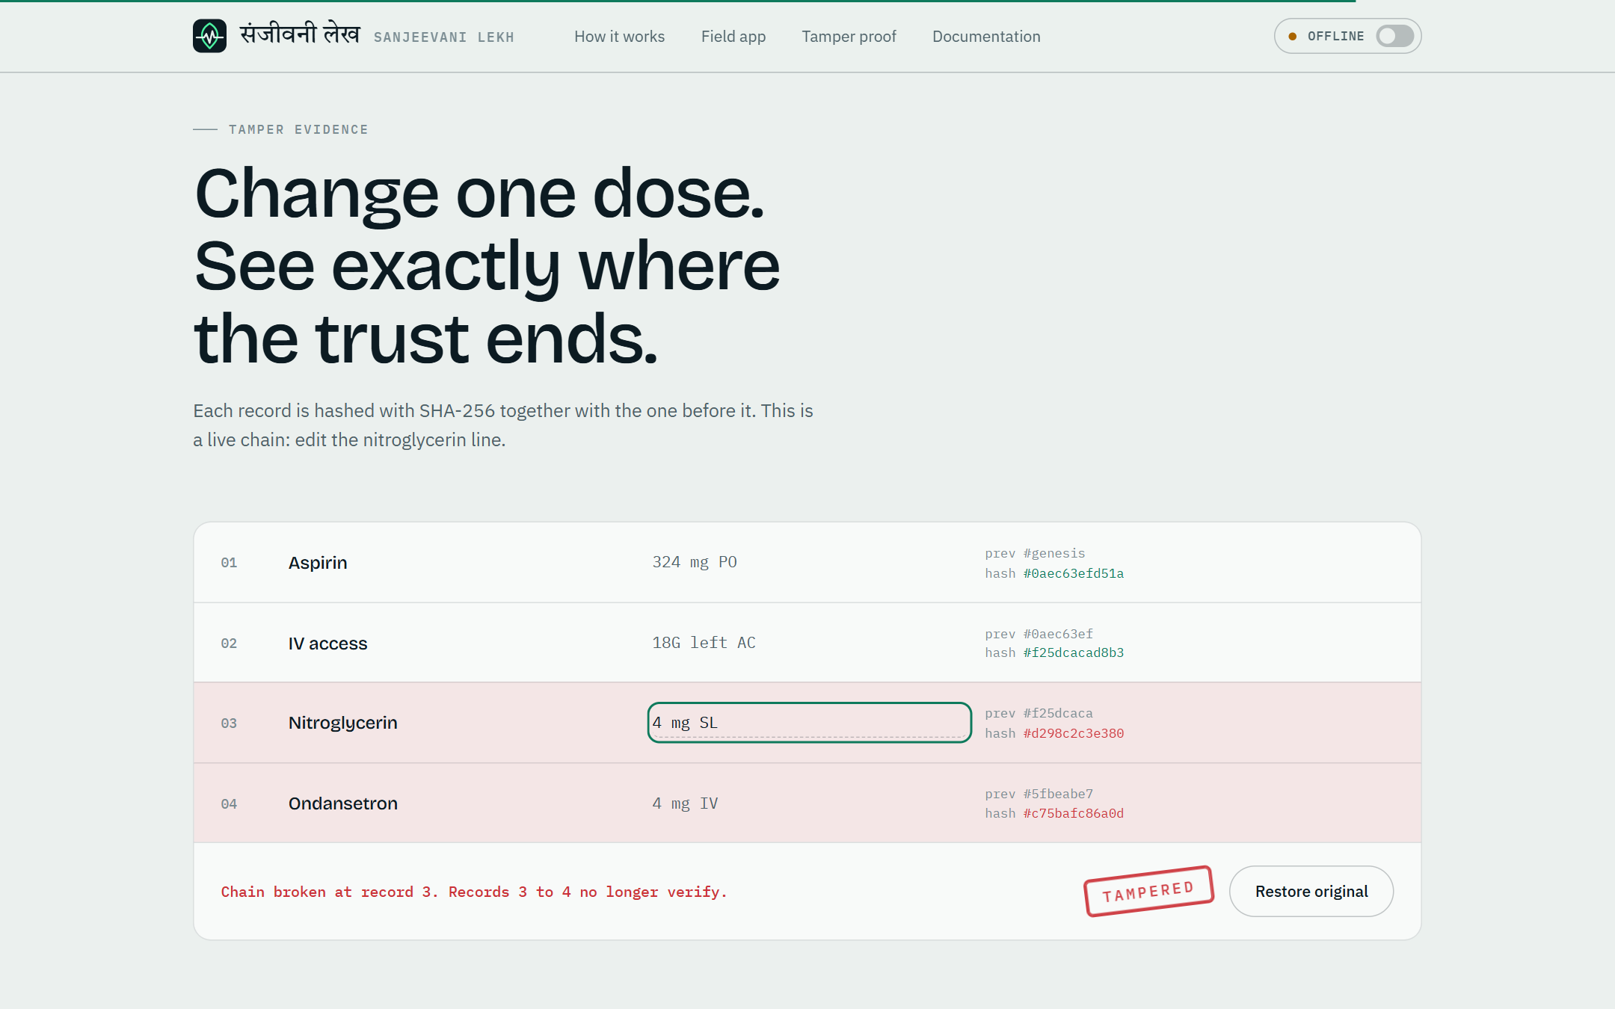
Try to tamper with a record
A real SHA-256 chain runs in the browser on the landing page.
Edit the nitroglycerin line and record 3 and every record after it stops verifying.
The chain shows exactly where trust ends.
Notes:
This is the live demo on the landing page. Change one dose and the chain reports the first broken record.

Slide 13
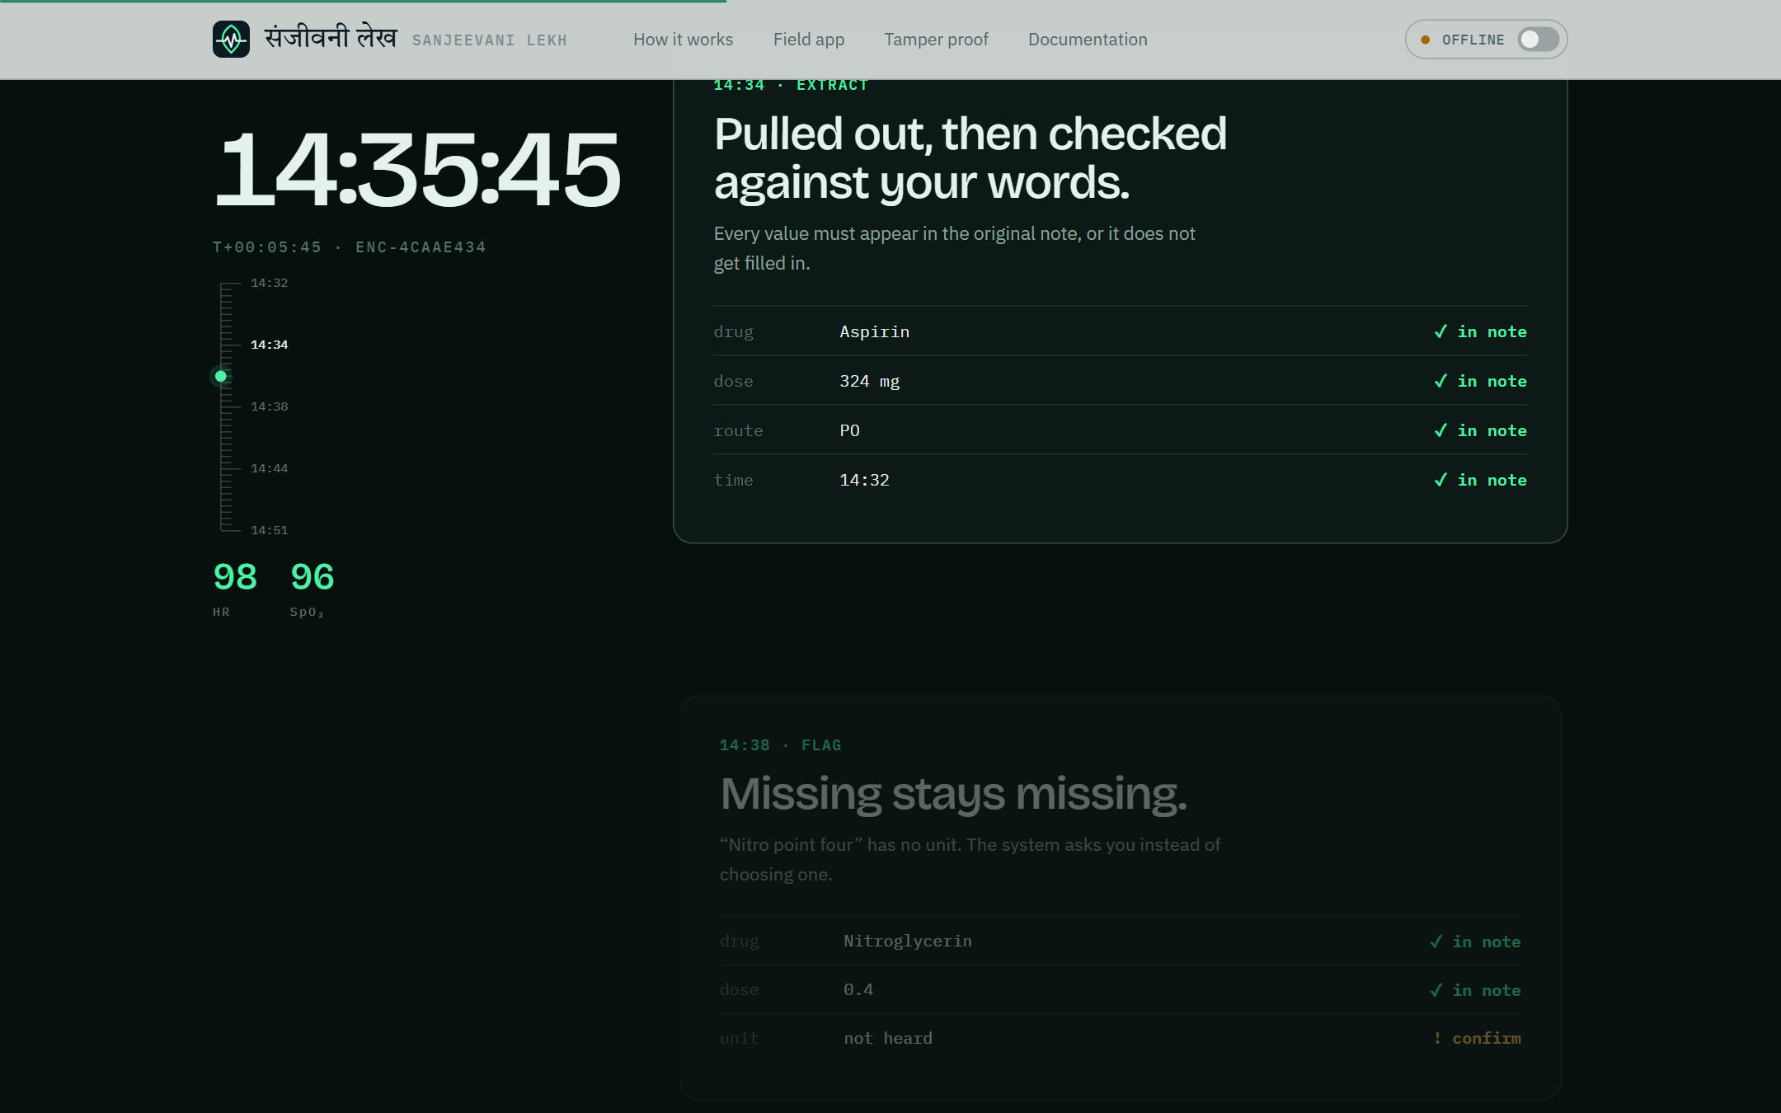
Landing page
A live monitor and a run sheet that fills as an example note is dictated.
A scroll-driven timeline of one call, 14:32 to 14:51, showing what the system does at each step.
Notes:
The landing page explains the product with live demonstrations rather than a feature list. The look is one identity across all screens: ECG paper, ink, herb green, amber for needs-a-person.

Slide 14
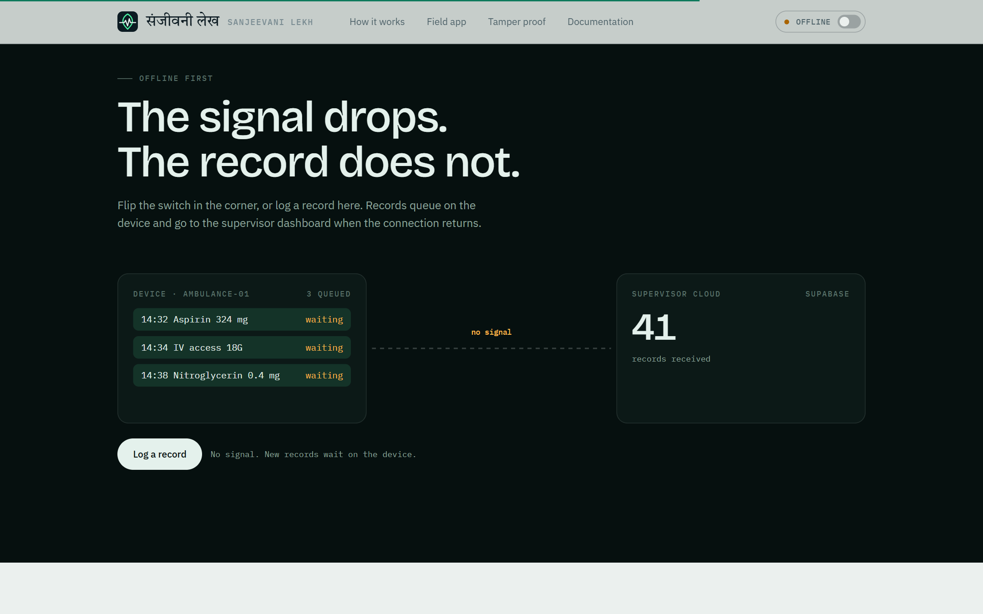
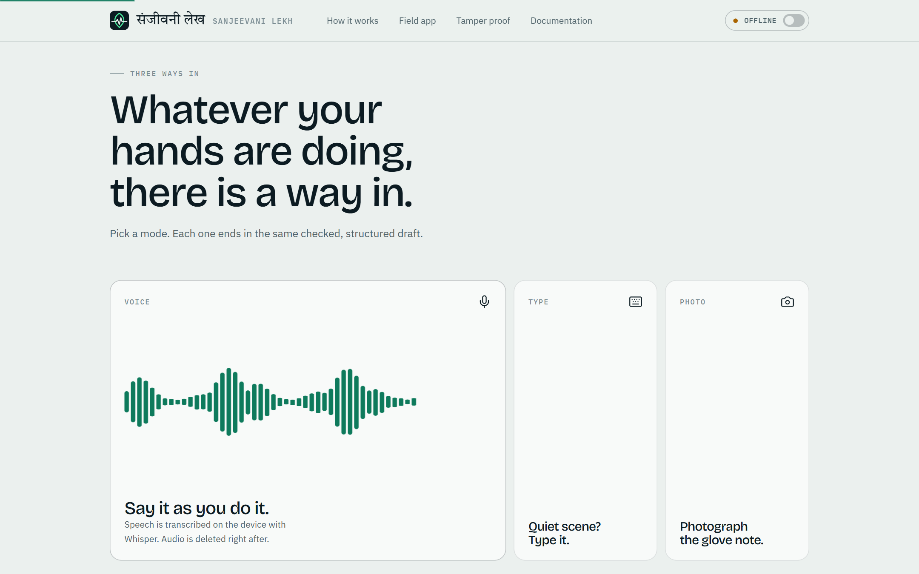
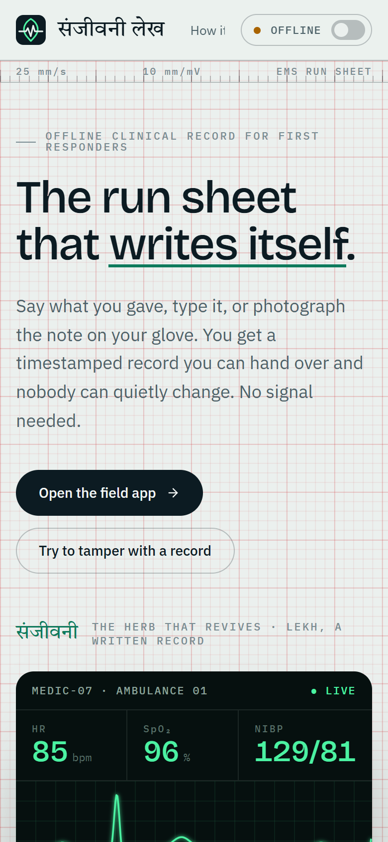
Offline demo, modes, mobile
Records queue on the device while offline and sync when the switch goes online.
Voice, typed text or a photo: three ways in, one checked draft.
Phone width
Notes:
The offline switch in the top bar simulates losing the connection: records queue on the device and travel to the cloud when you go online. The page also works at phone width.

Slide 15
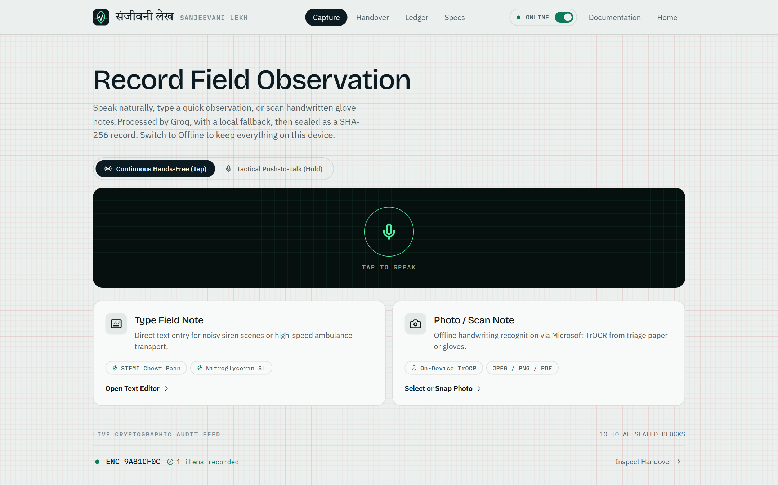
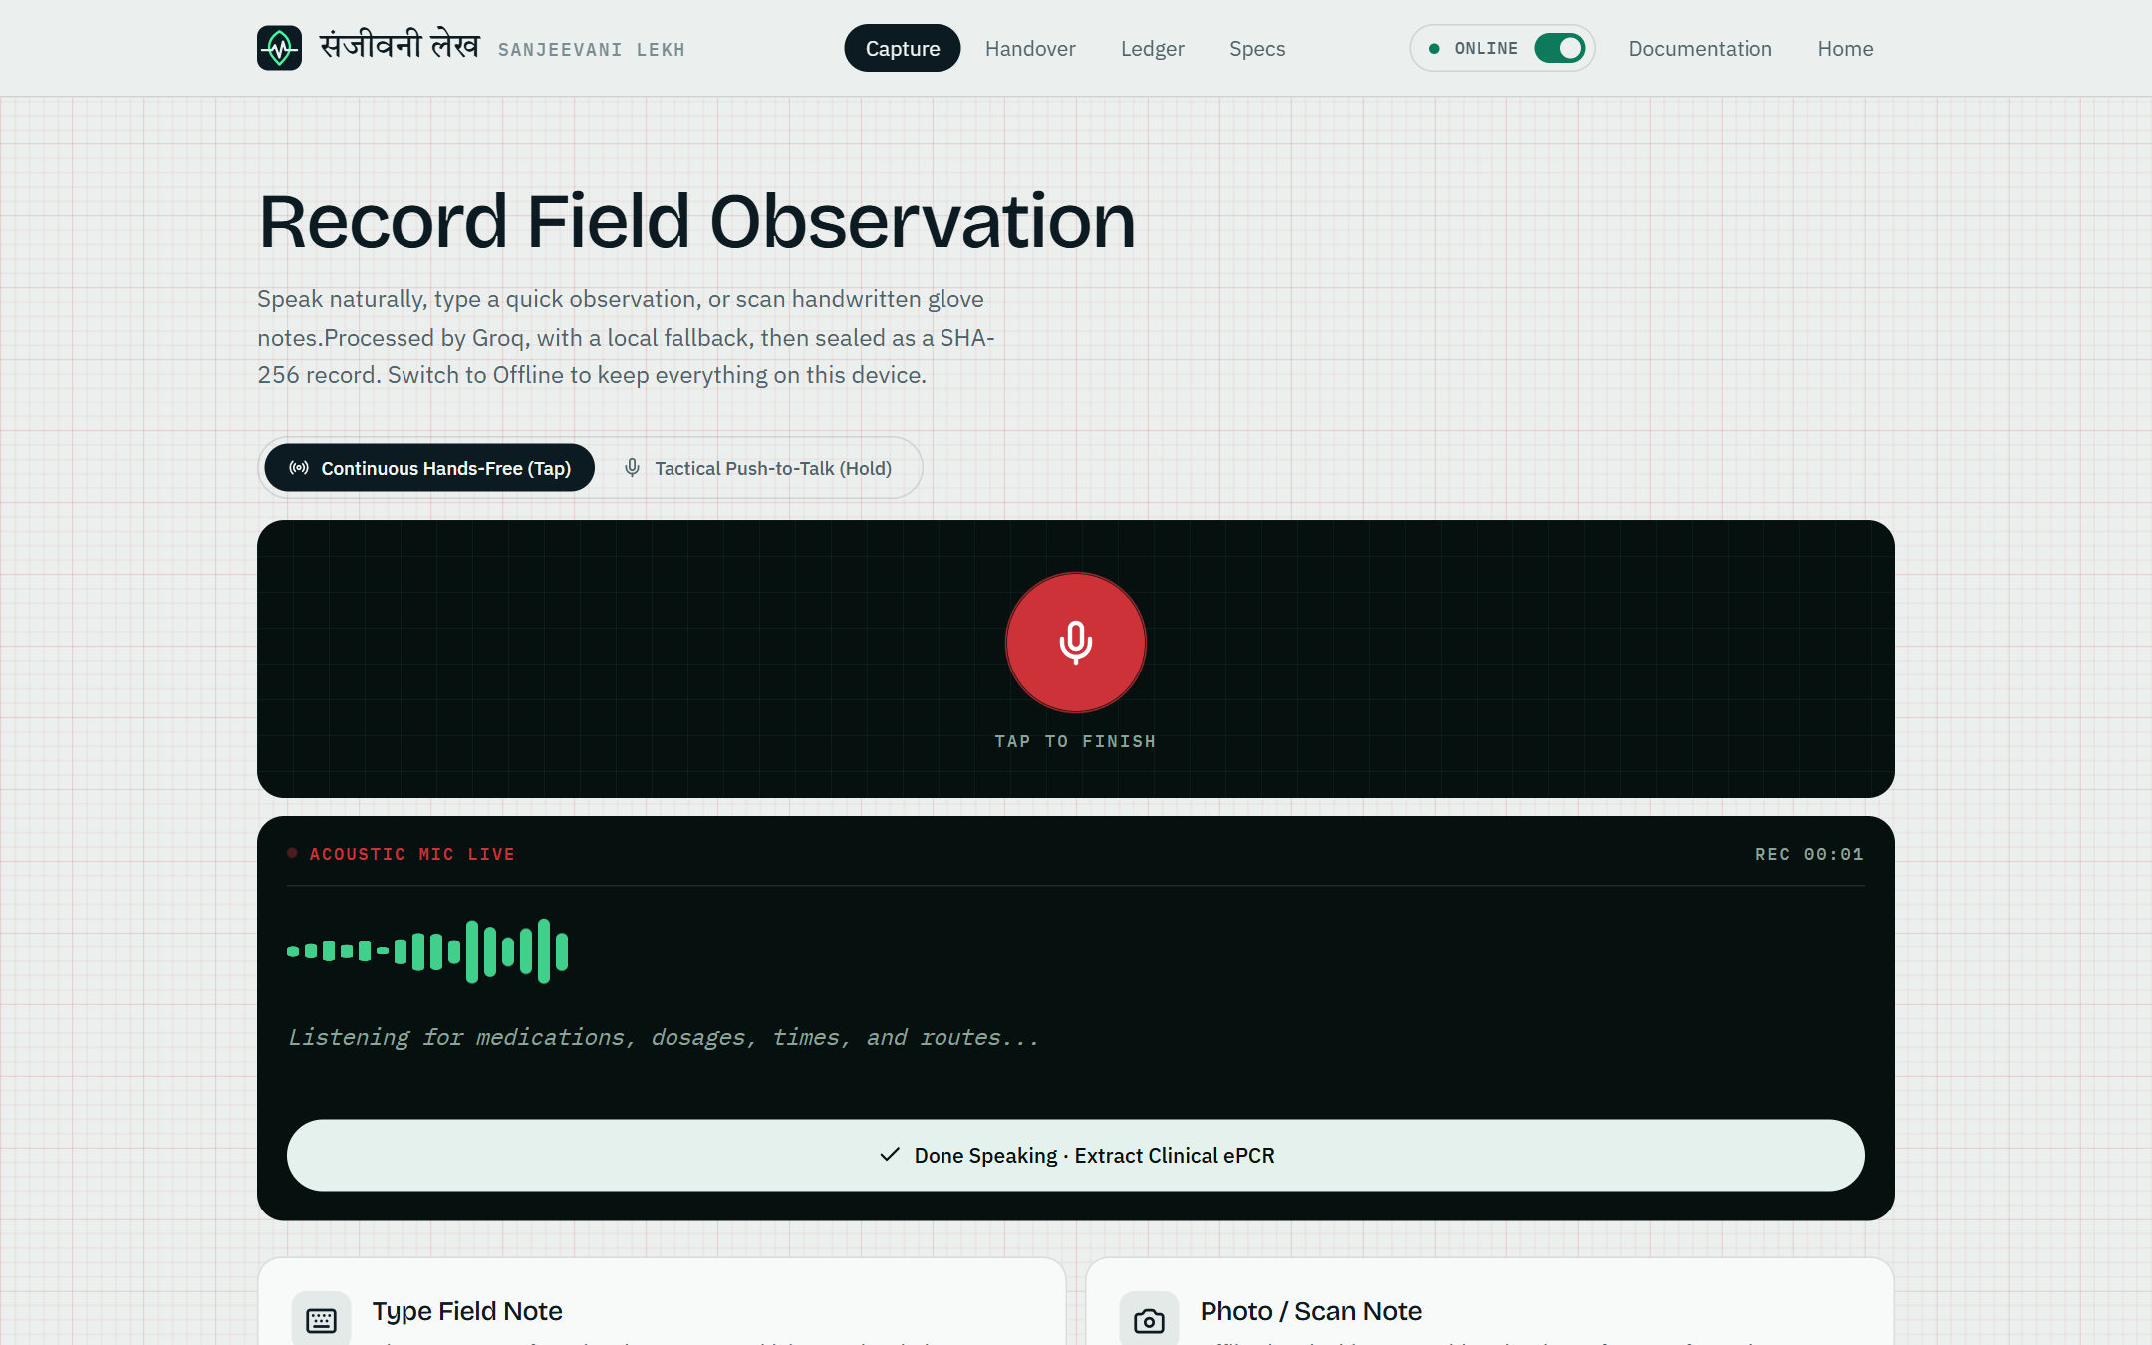
Field app: capture
Record, type or photograph. The ONLINE / OFFLINE switch sits in the bar.
While recording, a live waveform and transcript show on a monitor-style panel.
Notes:
The capture screen is built for one-handed use. The dark panel is used only where something is live.

Slide 16
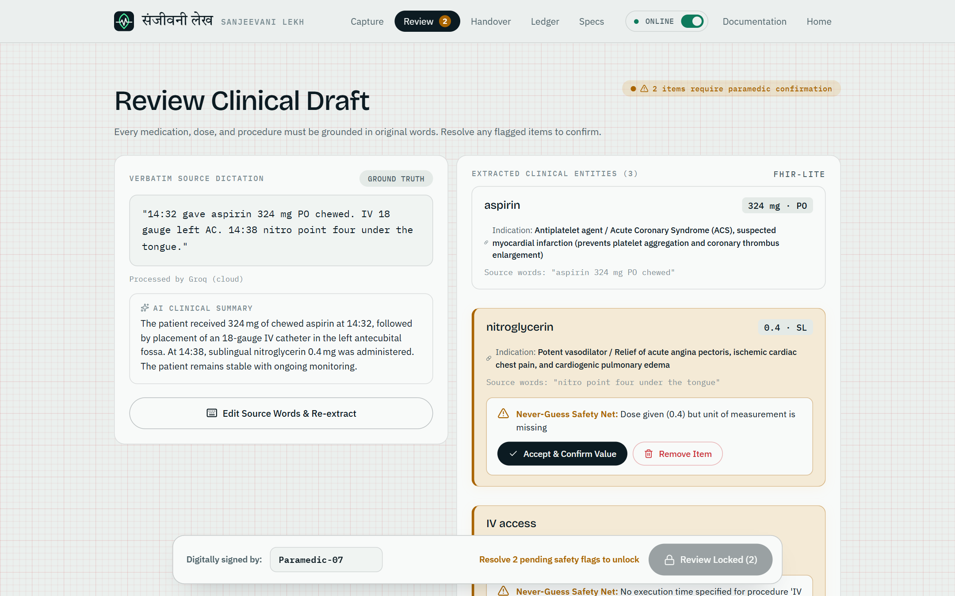
Review: flags stay loud
Side by side
the original words next to the extracted items
Reasons shown
each flag says what is missing or uncertain
Confirm stays locked
until every flag is accepted or the item removed
Notes:
This is the heart of the product. The responder sees what they said and what the system extracted, and cannot seal the record while anything is flagged.

Slide 17
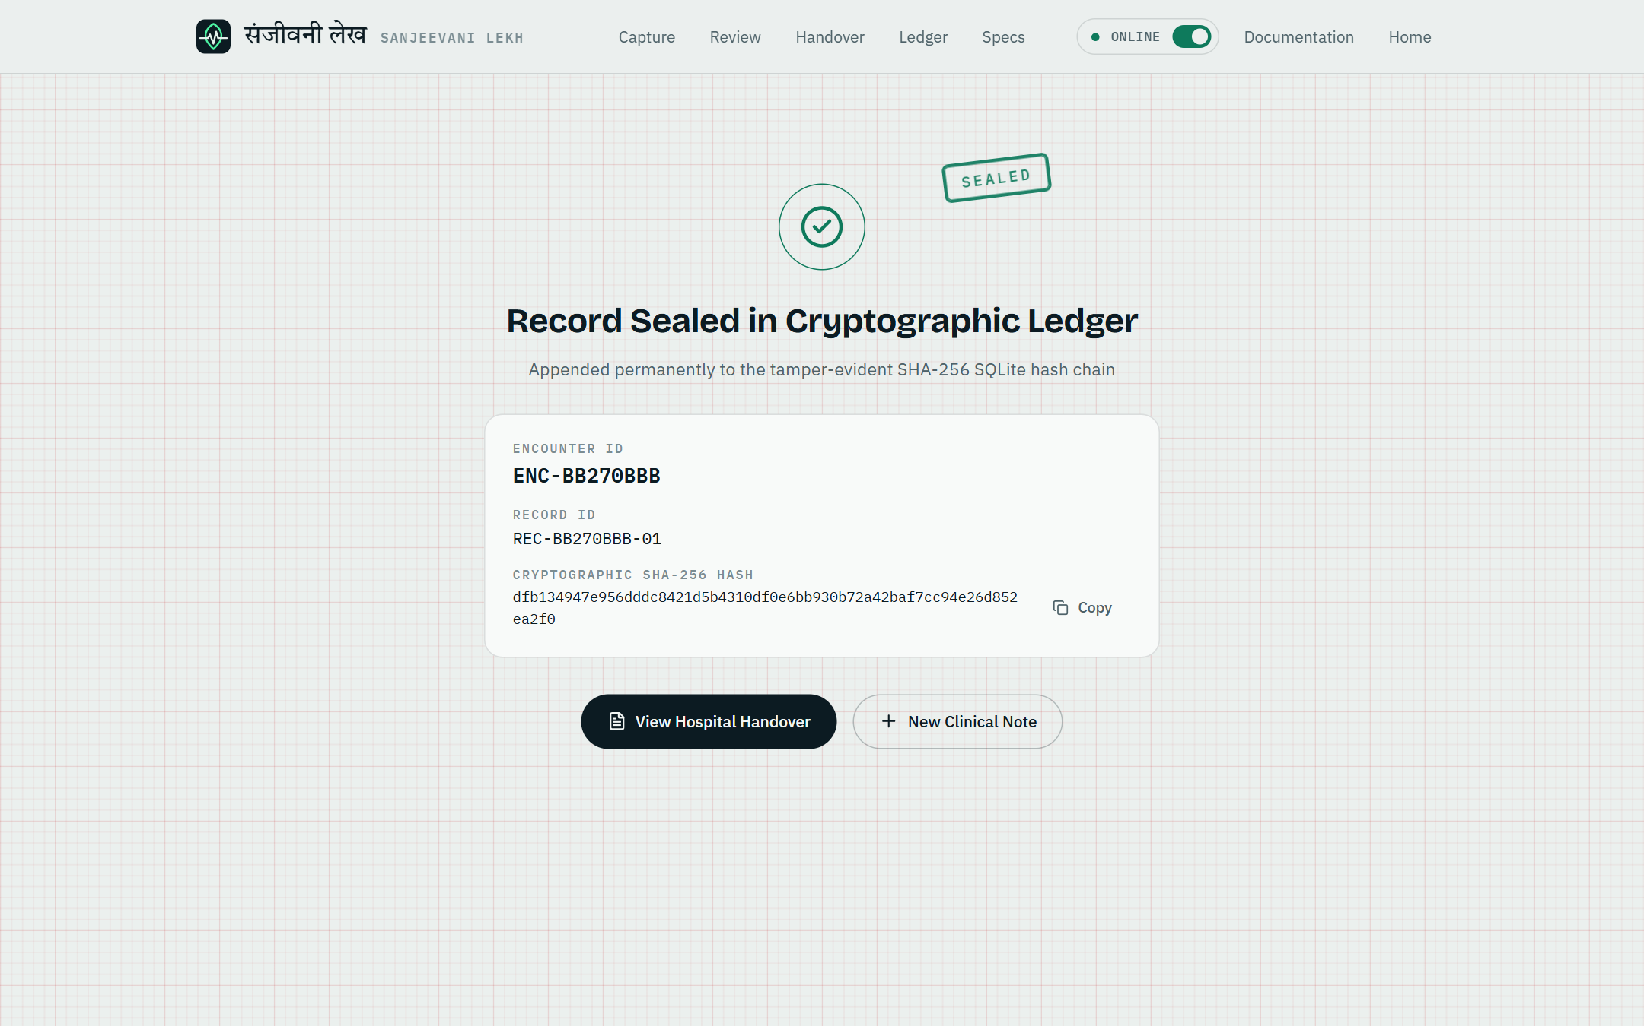
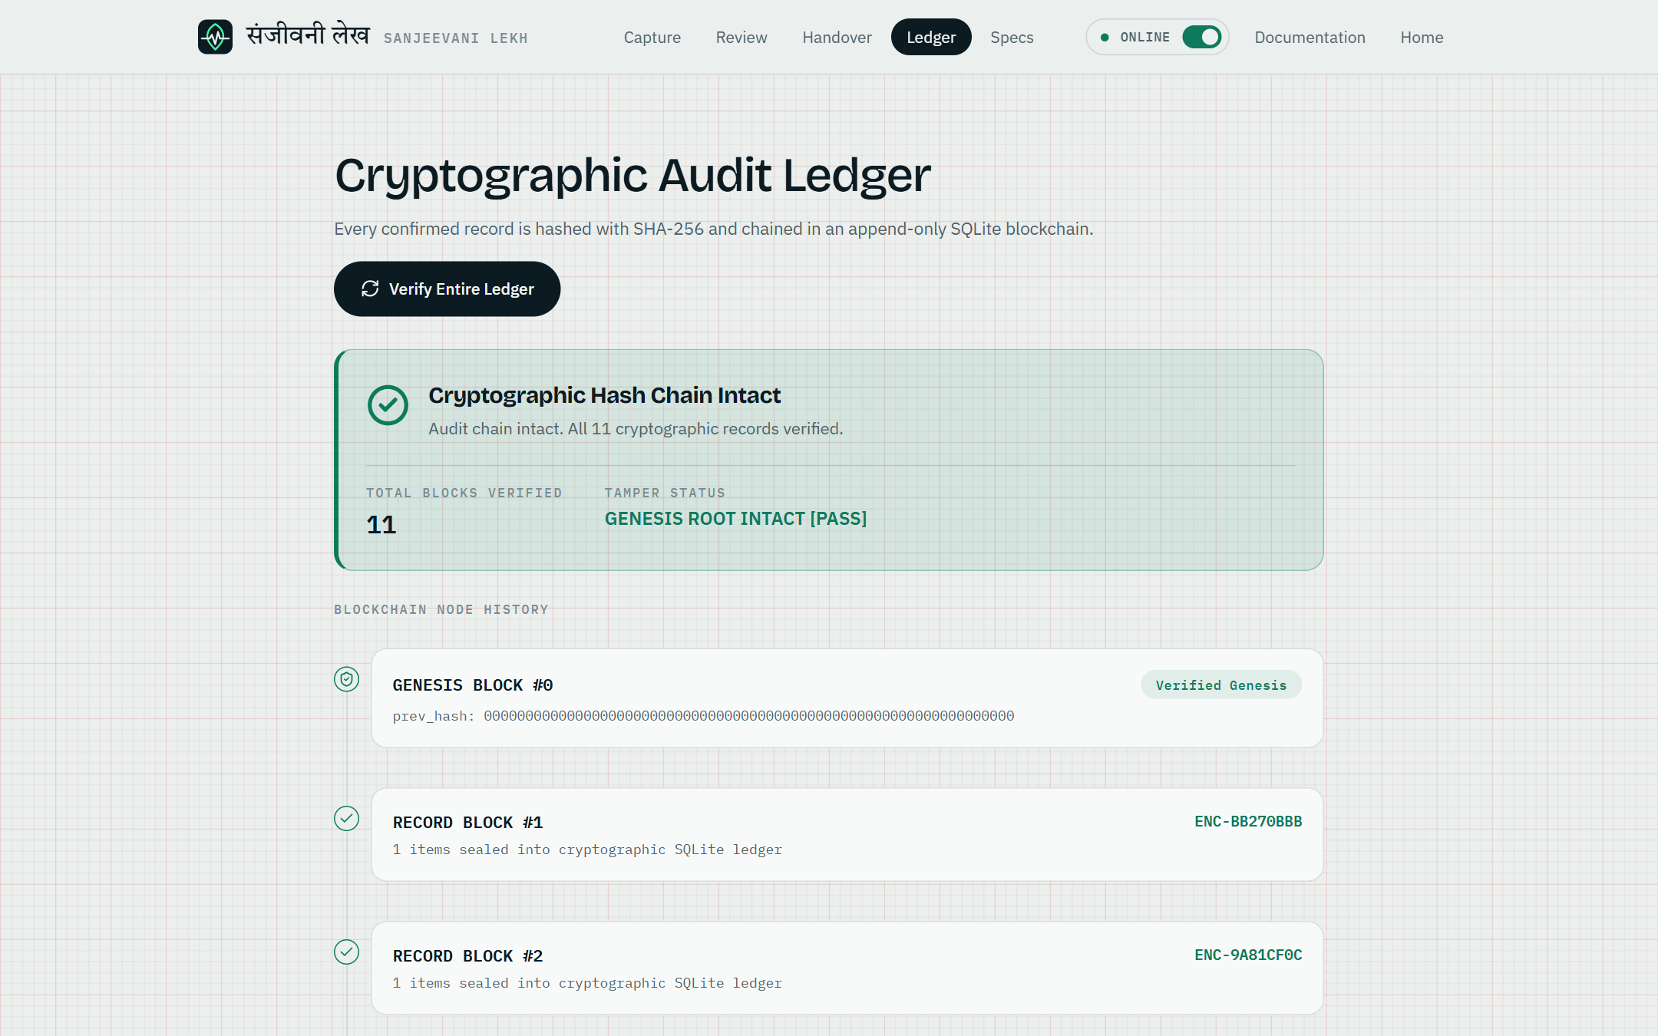
Seal and ledger
Sealing shows the record ID and the SHA-256 hash, with a stamp.
The ledger re-verifies the whole chain on demand.
Notes:
After confirming, the app shows the new hash. The ledger screen re-checks every record in the chain.

Slide 18
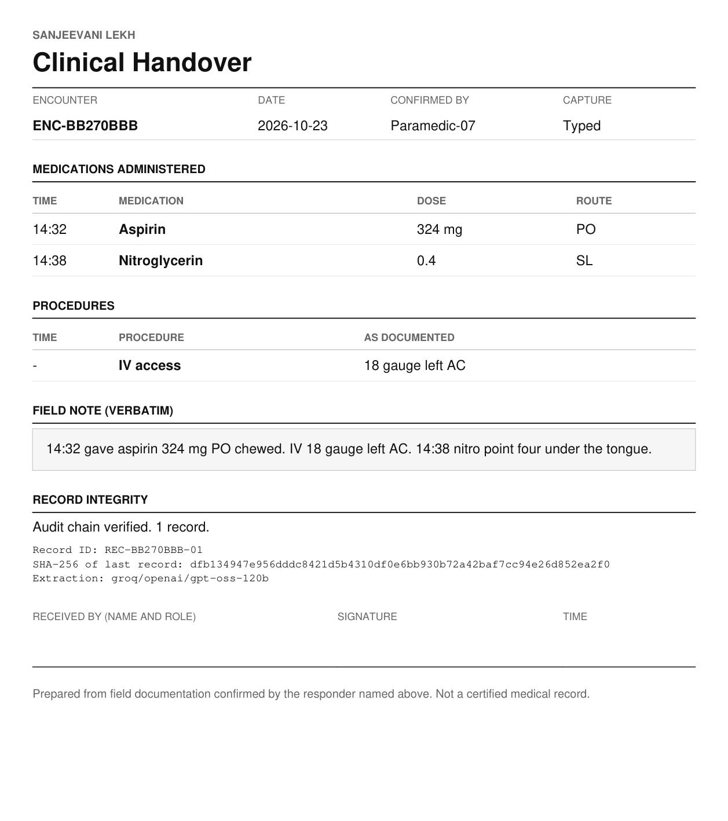
Handover report
Encounter, date, who confirmed it, how it was captured
Medications and procedures in time order
The verbatim field note
Record ID and the full SHA-256 hash
A sign-off box for the receiving clinician
Plain, one page, no machine-written narrative.
Notes:
The handover is a plain clinical form. It contains only what is in the confirmed record, including the hash so the receiving team can check it later. We left out the machine-written summary on purpose because it is not reviewed by the responder.

Slide 19
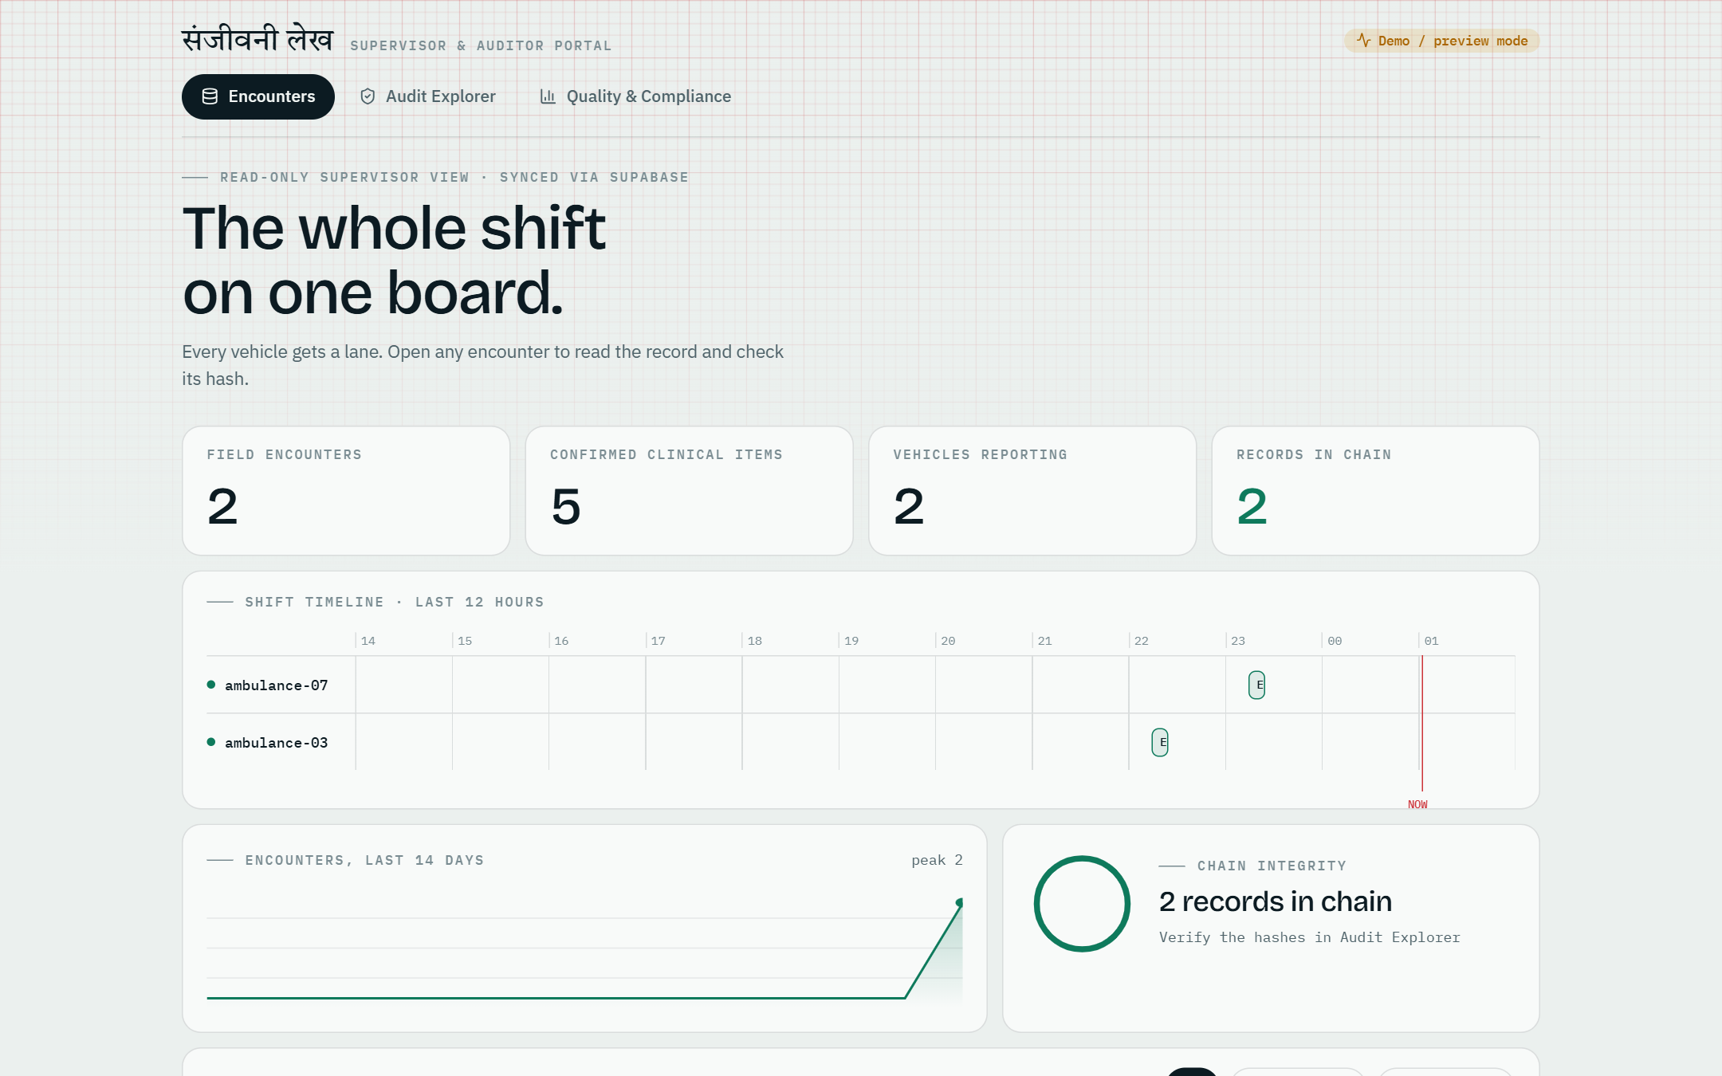
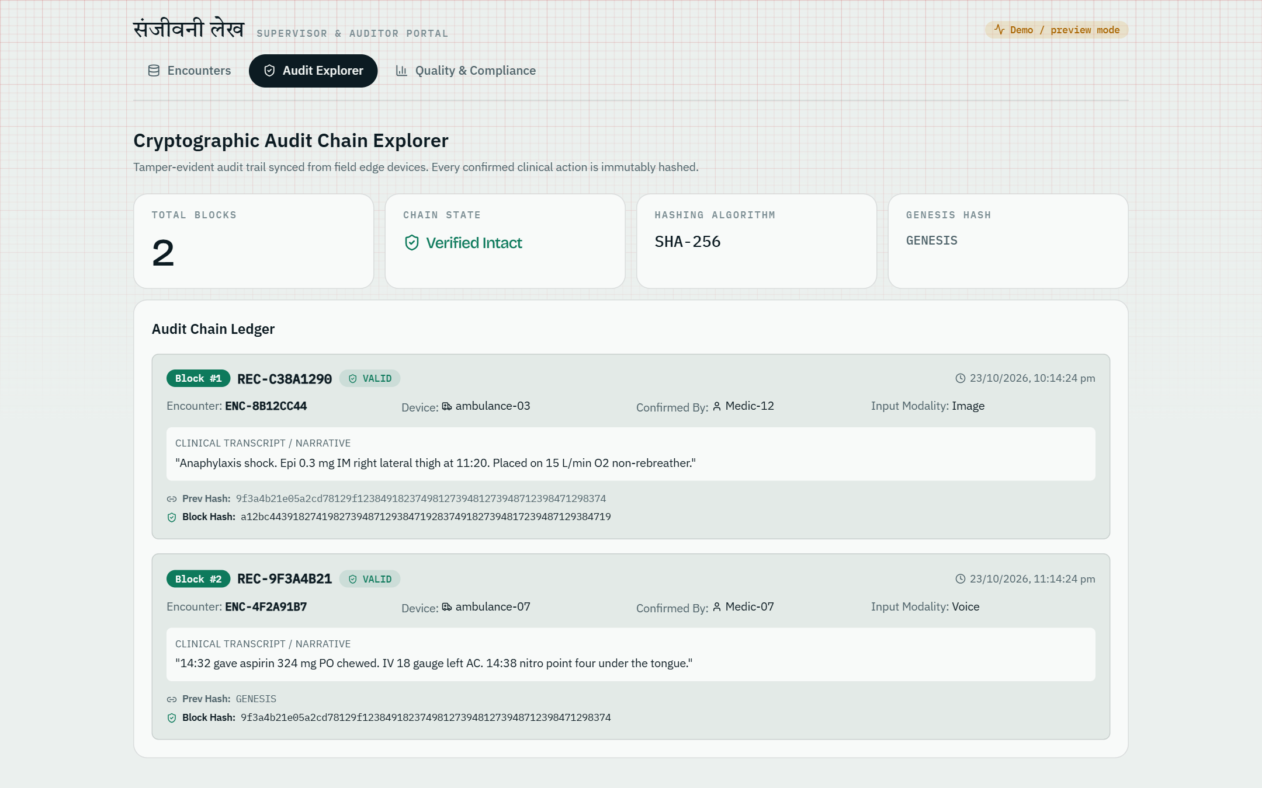
Supervisor dashboard
Read-only: counts, a shift board with one lane per vehicle, a 14-day sparkline and the encounter table.
Audit explorer: every synced block with its previous hash and block hash. Shown with sample data.
Notes:
The dashboard reads the synced audit_log from Supabase. Without credentials it shows built-in sample data and says so in its header.

Slide 20
One design language
Ink 0C1B22
Paper EBF0EE
Herb 0E7A5C
Phosphor 4BF2A2
Flag A96400
Alert CC3238
A leaf (the Sanjeevani herb) with a heartbeat through it.
Headings: Bricolage Grotesque. Text and data: IBM Plex Sans and Mono. Wordmark: Tiro Devanagari.
ECG paper for the record, a dark monitor panel only where something is live.
Notes:
The landing page, the field app, the documentation and the dashboard share one identity, which makes the product feel like one tool.

Slide 21
Measured on 20 synthetic notes
Score, percent
Medications
rules 24 of 27 (6 extra); Groq 27 of 27 (0 extra)
Procedures
rules 10 of 15 (7 extra); Groq 13 of 15 (1 extra)
Speed
rules about 0.1 s; Groq about 1.4 s
Small synthetic set written by the team. The local Ollama model was not measured here.
Notes:
These are measured with the project's own evaluation script and the same validation rules, run against the built-in rule-based extractor and the Groq model. Twenty notes is a small sample and the rule-based extractor may have been tuned on them, so treat the numbers as indicative. The local Ollama model and Whisper accuracy were not measured.

Slide 22
Testing and quality
94
85
14
20
automated tests
pass in a clean install
test files
benchmark notes
The 7 other tests only need optional model downloads (clinical NER and TrOCR).
Covered: audit chain and triggers, validation rules, extraction fallback, FHIR mapping, routes, reports, sync, and online/offline routing with Groq mocked.
Not covered: browser UI tests, and speech and handwriting accuracy.
Notes:
The suite is forced offline by a shared fixture so a developer's local settings never make a test call the cloud.

Slide 23
Limits and next steps
Today
Reasonable next steps
Not a medical device and not clinically validated
The drug list has 17 drugs; others are flagged
Online mode sends text and audio to a third party
The chain detects tampering; it does not prove time
The dashboard is read-only
Measure the local model and Whisper on the same benchmark
Grow the benchmark beyond 20 notes
Anchor the latest hash outside the device
Add automated browser tests for review and confirm
Broaden the drug reference
Notes:
Being clear about limits matters for a clinical tool. The next steps are suggestions, not built features.

Slide 24
Run it
# backend
cd backend
python -m venv .venv
pip install -r requirements.txt
uvicorn app.main:app --port 8000
# responder app (served by the backend)
cd local-ui && npm install && npm run build
# supervisor dashboard (optional)
cd dashboard && npm install && npm run dev
backend/.env
GROQ_API_KEY for online mode; OLLAMA_BASE_URL and LLM_MODEL for offline
PROCESSING_MODE
auto, or offline to never use the cloud
Open
localhost:8000 for the app, /docs for documentation
Notes:
Python 3 and Node 20 or newer. For offline extraction, an Ollama server with the chosen model. Copy backend/.env.example to .env and fill in what you need.

Slide 25
Thank you
Sanjeevani Lekh: every dose, written down while your hands are busy.
Milind Verma | Nikhil Agrawal | Gaurav Kumar | Riya Mehta
github.com/Milindverma24/Virtusa_Jatayu2026
Research and portfolio project. Not a medical device.
Notes:
Thank you. Questions welcome.

Slide 26
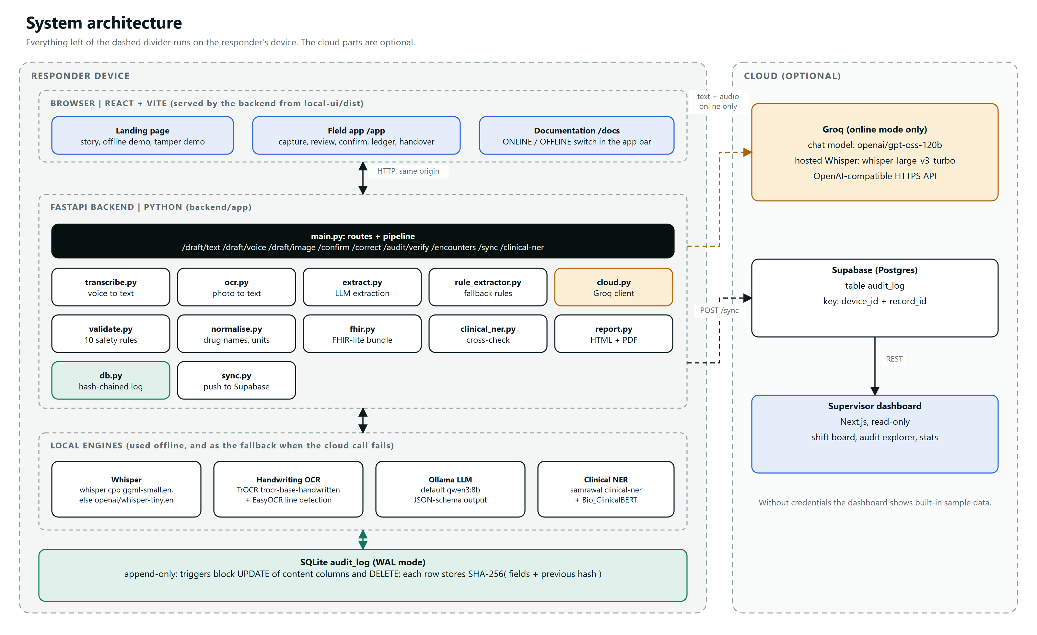
Appendix: detailed architecture
Notes:
Full component-level architecture. The same diagram is in the PDF guide.

Slide 27
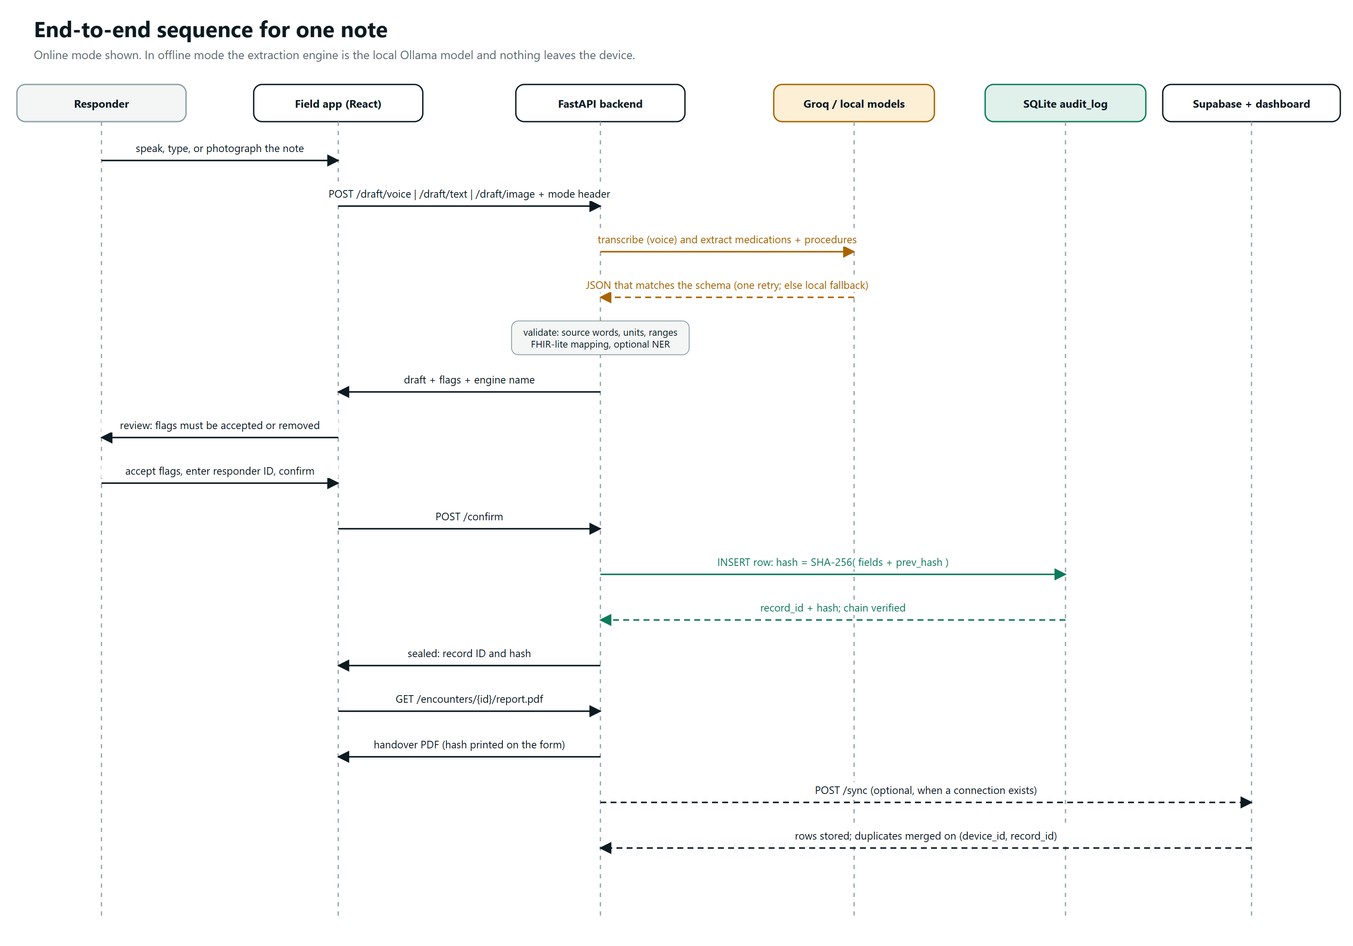
Appendix: end-to-end sequence
Notes:
One note from capture to handover, online mode shown. See the PDF guide for the full-size version.

