Slide 1
Olex2: a portable molecular graphics toolset for crystallography
Oleg V. Dolomanov, Luc Bourhis, Richard Gildea, Horst Puschmann and Judith A.K. Howard
Contact: oleg_dolomanov@hotmail.com
Chemistry Department, Durham University, Durham DH1 3LE
Olex2 is a software for the determination, visualisation and analysis of molecular crystal structures. This software has a portable, mouse-driven, workflow-oriented and fully comprehensive graphical user interface (GUI). Olex2 provides the user with a GUI for structure solution, refinement and report generation as well as novel tools for structure analysis. Olex2 seamlessly links all aspects of the structure solution, refinement and publication process and present them in a single, workflow-driven package – with the ultimate goal of producing an application which will be useful to both chemists and crystallographers.
The Olex2 project
Olex2 core/libraries
Olex2 project has several build targets, namely, console, viewer DLL and the Olex2 GUI. The java applet is a test project for the viewer DLL.
The Olex2 console provides the user with similar tools available in Olex2 GUI, but is run in the text mode. The viewer DLL exports Olex2 graphics capabilities and provides developers with simple interface to visualise crystallographic structures. The implementation example is provided as a Java applet, as well as a simple C++ applications. The Olex2 GUI is the Olex2 application¹.
Olex2 console
Olex2 viewer DLL
Graphical display
Olex2 Java applet
Olex2 GUI
Python library
HTML GUI
Crystallographic library
Asymmetric Unit
Cell parameters
Current Olex2 crystallographic library is based on Asymmetric Unit, Unit Cell and the Lattice objects. File input and output operations are handled by the XFile object. After a file is loaded, the model contains such important data as inter-atomic interactions and full (including symmetric equivalent) connectivity table. This information is very important for the structure analysis. The library can be used to analyse and process large sets of crystallographic files to extract such information as connectivity graphs and atomic environment. It can also be used to modify the loaded model and write the result back to file.
Space group
CAtoms
Ellipsoids
Format handlers
Fragments
Lattice
XFile
Bonds
Operators
Unit Cell
SAtom
Ellipsoids
Current development
Although current Olex2 object model is very flexible for structure analysis and graphics applications, the structure refinement aspects of the model are not well designed and require some clumsy coding. To tackle the structure solution and refinement aspects, a new object model for crystallographic library is proposed. The model should allow comprehensive manipulation of the refinement parameters by the programmer with current target to cover Shelx² refinement model.
Although the syntax of Shelx input files is fairly simple to interpret, the object oriented description and manipulation of the refinement model is more complicated. Currently some work has been done on the abstraction of Shelx refinement model to replace existing (asymmetric unit - unit cell - lattice) framework. The new implementation is based on the idea of complex scatterer, which is a single/multiple simple scatterer associated with thermal displacement parameter(s) (TDP), site (coordinates) and occupancy. A complex scatterer might have its own TDP, or inherit it from pivot atom of a rigid group. The complex scatterer model automatically implies shelx EXYZ and EADP constraints, however different labels for simple scatterers would significantly complicate the API and will not be supported.
An atomic reference data object has recently been compiled using Shelx, cctbx³ and web sources and provides the programmer with various radii for structure representation and bond search as well as x-ray and neutron scattering data.
1. http://www.olex2.org
2. ShelX: G.M. Sheldrick, Acta Cryst. (2008). A64, 112-12
3. CCTBX: http://cctbx.sourceforge.net
We gratefully acknowledge Durham University and the EPSRC for financial support.

Slide 2
Olex2: a portable molecular graphics toolset for crystallography
Oleg V. Dolomanov, Luc Borhis, Richard Gildea, Horst Puschmann and Judith A.K. Howard
Contact: oleg_dolomanov@hotmail.com
Chemistry Department, Durham University, Durham DH1 3LE
This poster is about the architecture of the Olex2 crystallographic library and model manipulation from within the program. In general, the program design heavily exploits event (actions) and event handlers. This approach significantly shortens the amount of code to be written to perform tasks and also allows performing the synchronisation of the program states on different levels, which can be demonstrated on the following example. Considering that graphical and the crystallographic libraries are independent they are merged on another level where an object derived from a graphical object and thus having inherited its functionality also holds a pointer to a crystallographic object, which provides data to be displayed. When a crystallographic model is reloaded, the pointers to previous crystallographic objects are no more valid and the states of different libraries have to be synchronised. This is done by the crystallographic library, which fires OnFileLoad event. The other libraries, when want to be notified of such events plug themselves into the corresponding event queue and handle the program state change.
Olex architecture, modules and relations
Chemical
data
Standard
Crystallographic
Graphical
Application
data/events
XLIB architecture
GUI
data/events
Asymmetric Unit
Space group
Operators
Asymmetric Unit
Olex2 input/output operations are controlled by the XFile object, the methods of which allow registering different file format handlers (FFH). Every FFH must implement the “Adopt” method, which implements transparent file format interchange mechanism. The XFile object fires events when the model is loaded and saved to a file. These events are exploited by the application layer to synchronise states of the graphical and crystallographic libraries. The “lattice” property of XFile is the entry point to access and manipulate objects of the crystallographic model.
CAtoms
Ellipsoids
Cell parameters
Lattice
XFile
Format handlers
Fragments
Unit Cell
Bonds
SAtom
Operators
Ellipsoids
The function of the asymmetric unit is to hold a set of symmetry independent atoms and to provide functionality of a container. It also holds a set of symmetry operators of the space group and cell parameters. The unit cell contains an expanded list of symmetry operators and ellipsoids, generated by these operators. It also provides the functionality for evaluating shortest distances between atoms considering the symmetry operators. The lattice provides interface for growing and packing atoms as well as it contains all the atoms generated by these operations. Atoms hold a list of symmetry operators used to generate them and a reference to the ellipsoid in the unit cell and to the original atom in the asymmetric unit.
The library is straight forward to use and some examples are posted alongside the source code. It is distributed under open source licence and can be used for prototyping and developing crystallographic applications. To get the source code of the library please contact us, as we still doing some refactoring and its content not completely settled.
The use of the library will significantly shorten the time required for the development of any crystallographic applications as it provides ready to use input/output operations, completely self sufficient and independent on other libraries, and written in a portable way relying on a POSIX operating system.
Model manipulation in Olex2
Alternatively, the user can access the Olex2 model using the embedded Python interpreter. In the combination with exported built in functionality and custom macros this allows using Olex2 GUI to formulate the input to another procedure/program. Moreover, using he model manipulation functionality it is possible to update/modify the model
A successful example of using Python interpreter is a cctbx refinement procedure, which reads the crystallographic model from Olex2 and updates updates it after every refinement cycle, thus allowing to do pre/post-processing of the model during the refinement.
Currently the Python interpreter is plugged at the macro processing level, but in the future we planning to expose the application logic/data directly.
Python interpreter
Console
User input
Macro processing
Application logic
GUI
Display
Crystallographic model
Graphical model

Slide 3
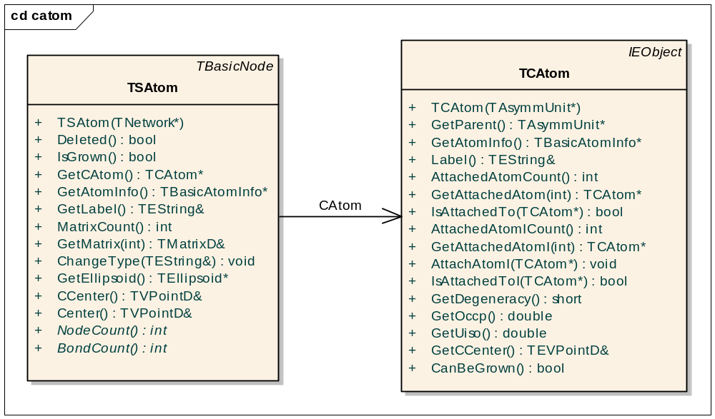
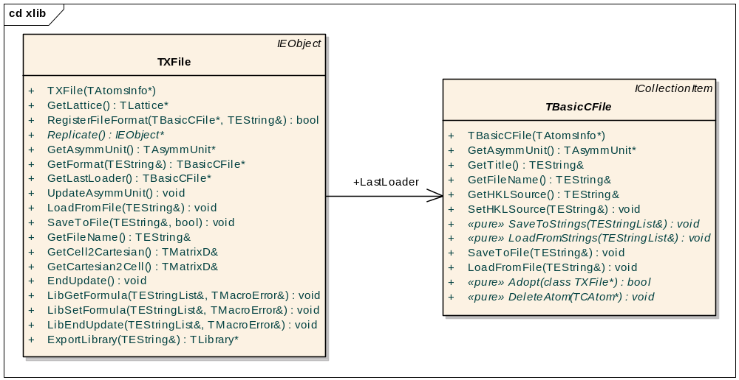
Asymmetric Unit
Space group
Operators
Asymmetric Unit
CAtoms
Ellipsoids
Cell parameters
Lattice
XFile
Format handlers
Fragments
Unit Cell
Bonds
SAtom
Operators
Ellipsoids
Python interpreter
Console
User input
Macro processing
Application logic
GUI
Display
Crystallographic model
Graphical model

Slide 4
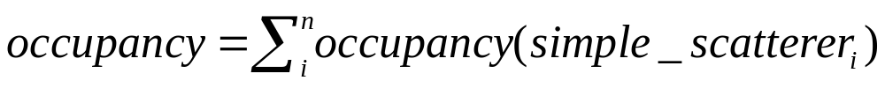
Simple scatterer₁
Simple scatterer₂
…
Simple scatterer_{n}
Complex
Scatterer
Coordinates
Occupancy
TDP (own/inherited)
Complex scatterers
Rigid Groups
Refinement
Model
Restraints
Linear equations
Although the syntax of shelx input files is fairly simple to interpret, the object oriented description and manipulation of the refinement model is more complicated. Currently some work has been done on the abstraction of shelx refinement model to replace existing (asymmetric unit - unit cell - lattice) framework, which was mostly designed for the graphics/ structure analysis application. The new implementation is based on the idea of complex scatterer, which is a single/multiple scatterer associated with thermal displacement parameter(s) (TDP) and site (coordinates). A scatterer might have its own TDP, or inherit it from pivot atom of a rigid group. The complex scatterer model automatically implies shelx EXYZ and EADP constraints, however different labels for simple scatterers are would significantly comlecate the API and not supported.
An atomic reference data object has recently been compiled using shelx, cctbx and web sources and provides the user with various radii for structure representation and bond search as well as x-ray and neutron scattering data.
Olex2 core/libraries
Olex2 console
Olex2 viewer DLL
Olex2 Java applet
Olex2 GUI
Graphical display
HTML GUI
Python Library

