Slide 1
Target Setup
Power Supply
ECU
P
Laser Sensor
Wifi-Module
Motor-1
Motor
Driver-1
NRF-Module
Motor-2
Motor
Driver-2
Motor-3
Motor
Driver-3
Laser Sensor Photo Diode
Wifi-ESP32
RF-NRF
Motor Drivers

Slide 2
Camara Gun Set-up
ECU
IR-Camara
Power Supply
Motor
Motor
Driver
RF-NRF
IR-Camara sensor
RF-NRF
Motor Driver
Aurdino-NANO

Slide 3
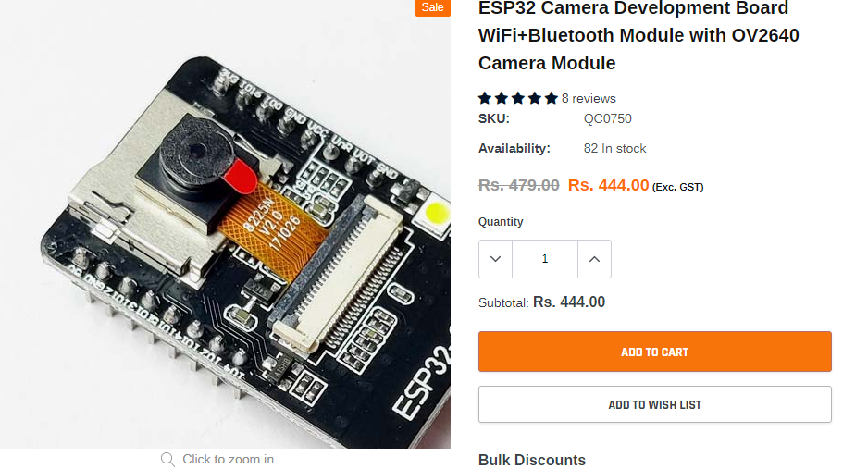
ESP32 camera sensor

Slide 4
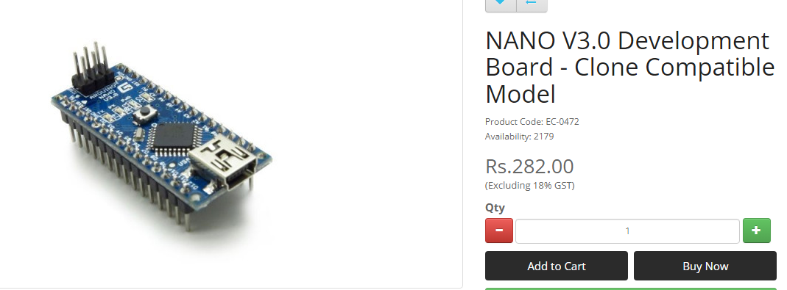
Aurdino NANO

Slide 5
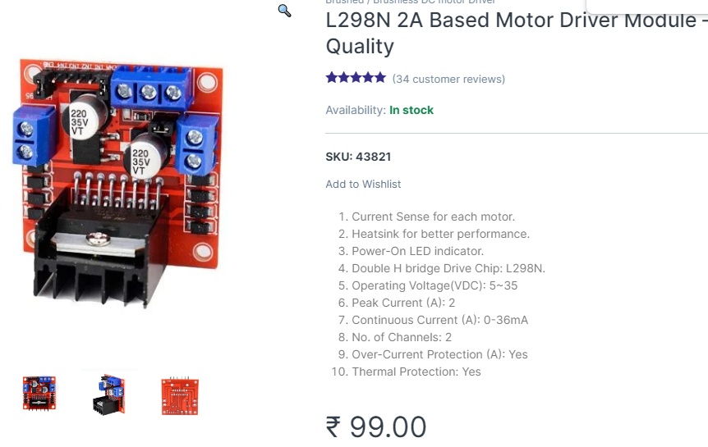
L298N Motor Driver

Slide 6
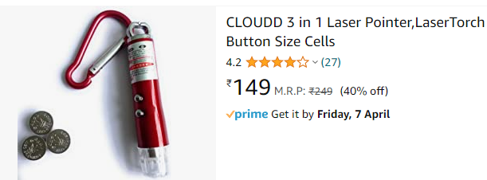
Laser light

Slide 7
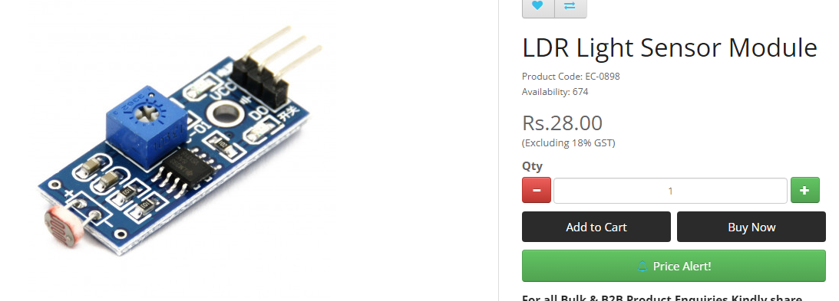
LDR sensor

Slide 8
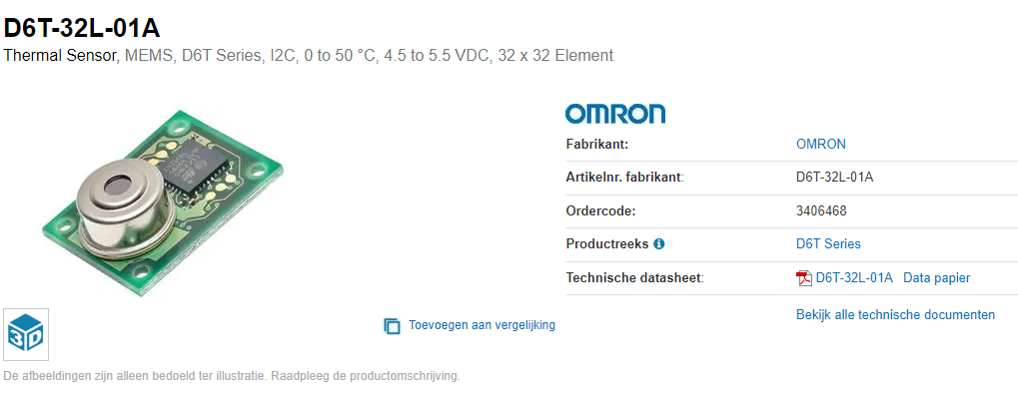
Omaran D6T - Thermal image sensor

Slide 9
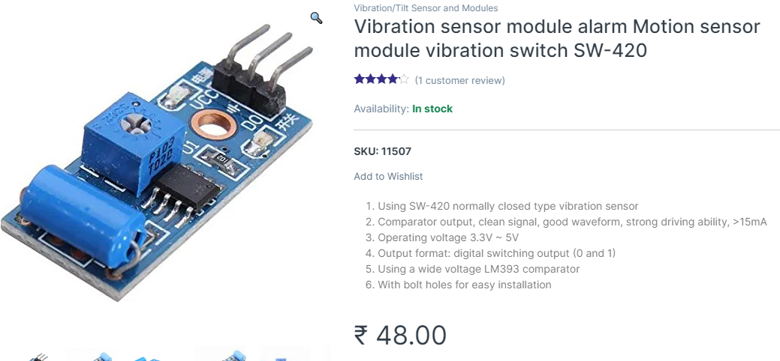
Vibration sensor

Slide 10
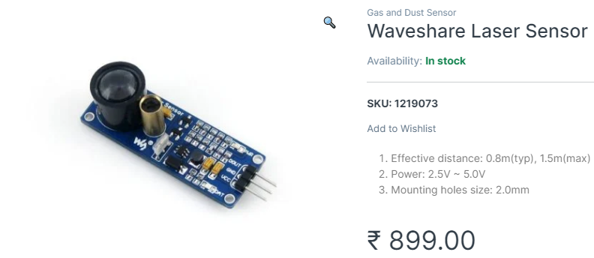
Wave Laser Sensor

