Slide 1
Binary Phase Shift Keying
(BPSK)
Done By,
Kishore P(2018504544)
Rohith Varon S S(2018504590)
Krishnakumar R(2018504549)

Slide 2
Definition of Phase Shift Keying?
PSK is a digital modulation process of modulating the frequency of the carrier signal(reference signal) with respect to the input message signal.
Input signal – 0’s and 1’s
Depending on the number of symbols used....
BPSK
QPSK
8-PSK

Slide 3
Binary Phase Shift Keying:
BPSK is a two phase modulation scheme, where the 0's and 1's in a binary message are represented by two different phase states in the carrier signal: for binary 1 and for binary 0.
Symbol Set: { s1(t), s2(t) } ; ‘0’ → s1(t), ‘1’ → s2(t)
Quadrature Phase Shift Keying:
QPSK is a form of Phase Shift Keying in which two bits are modulated at once, selecting one of four possible carrier phase shifts (0, 90, 180, or 270 degrees). allows QPSK the signal to carry twice as much information as ordinary PSK using the same bandwidth.
Symbol Set: { s1(t), s2(t), s3(t),s4(t) }

Slide 4
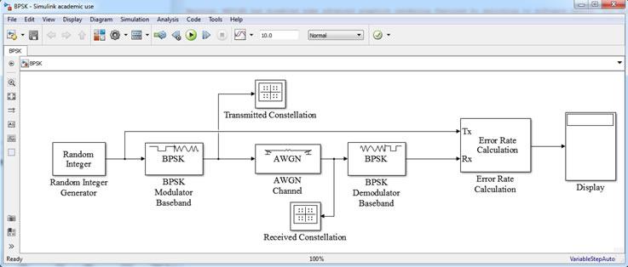
BPSK Simulation Model using Block Diagrams:

Slide 5
Real Time Application Of BPSK:
It is most robust modulation technique due to the fact that binary 1 and 0 are separated180 degree phase shift of the carrier, hence withstand severe amount of channel fading.
BPSK modulated data can travel longer distances when transmitted from base station.
They are used in Time or Frequency Synchronization and channel estimation or equalization purpose.
Cellular towers for long distance communication or transmission of the data.
Its requires only two decisions in order to recover original binary information. Hence receiver is very simple compare to other modulation types.
Less no of bits , so less power, hence power efficient modulation.

Slide 6
Disadvantage of BPSK:
One bit is carried by one single analog carrier. Hence data rate in bits per second is same as the symbol rate.
Its is not bandwidth efficient compared to QPSK , 16 QAM, 64 QAM.
It has the highest bandwidth among all other PSK modulation schemes.

Slide 7
Simulation of BPSK:
Modulation with the carrier Signal.
Passing the signal through the AWGN (Additive White Gaussian Noise).
Prediction using the Maximum livelihood Decision.
Demodulation of the received signal using Butterworth filter.
Plotting the BER vs SNR Graph.
Signal Constellation of the transmitted signal.

Slide 8
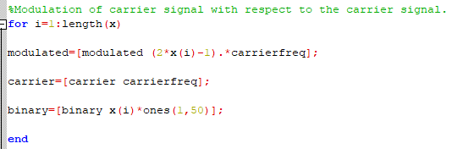
Modulation of the input signal and Mapping the input signal:

Slide 9
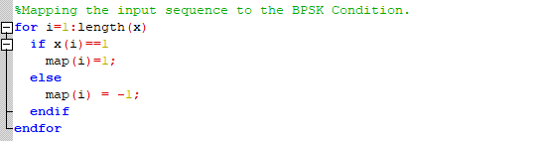
Mapping the symbols to plot the Signal Constellation of the BPSK:

Slide 10
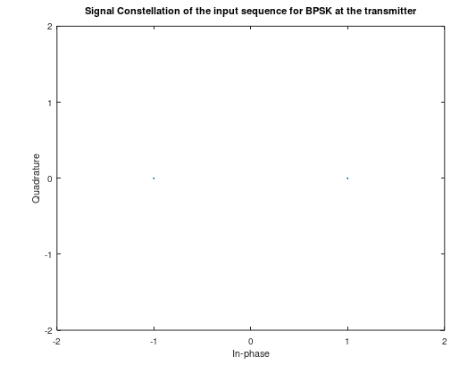
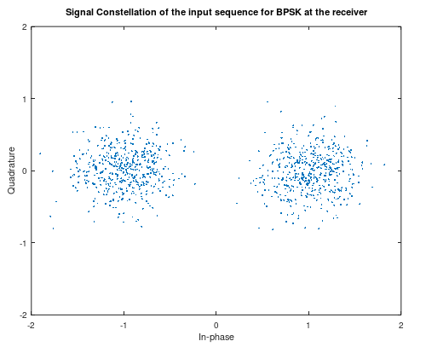
Signal Constellation at the receiver and the transmitter:

Slide 11
Additive White Gaussian Noise Channel:
1) The Power Spectral Density (PSD) of white noise is constant for all frequencies ranging from −∞ to +∞.
2) The noise is additive, i.e., the received signal is equal to the transmitted signal plus noise. This gives the most widely used equality in communication systems.
r(t)=s(t)+w(t)
3) It has the less BER than the FADING Channel (Rayleigh and Rician Channel).

Slide 12
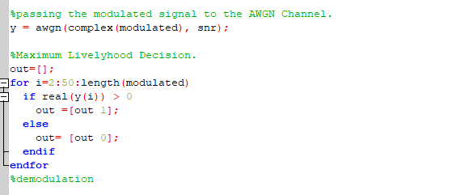
AWGN Channel and Decision Making:

Slide 13
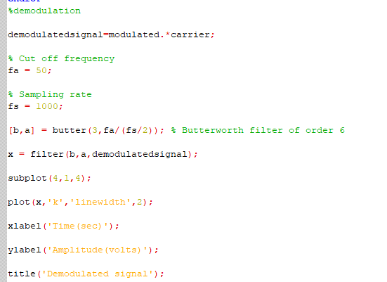
Demodulation of the Received Signal:

Slide 14
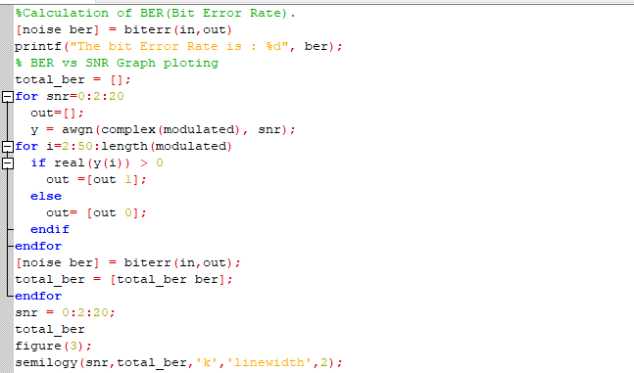
BER vs SNR plotting:

Slide 15
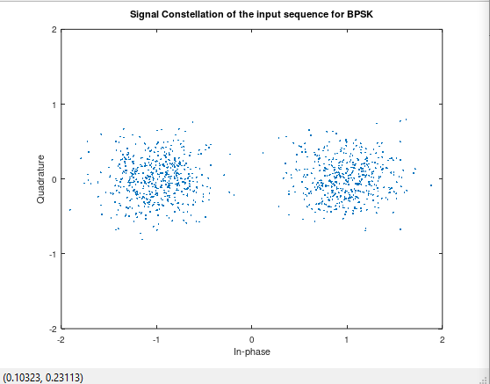
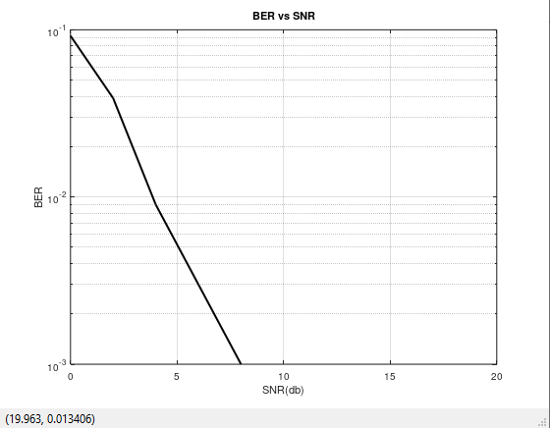
Constellation Diagram:
When SNR = 8

Slide 16
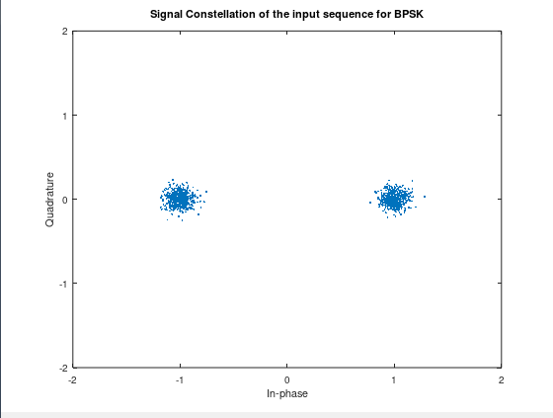
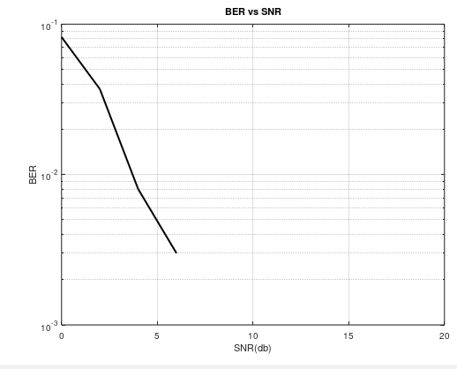
When SNR = 20
Input sequence is 1000 bits: for various snr (for snr = 0:2:20)

Slide 17
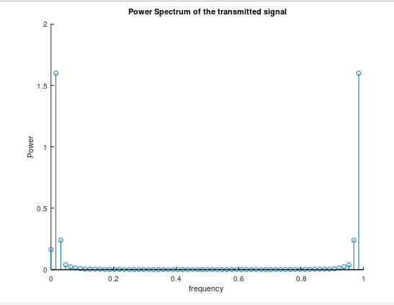
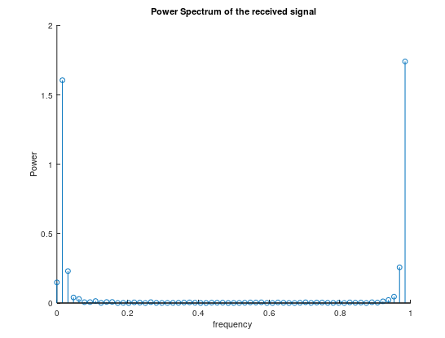
Power Spectral Density:

Slide 18
References:
https://www.allaboutcircuits.com/textbook/radio-frequency-analysis-design/radio-frequency-modulation/digital-phase-modulation-bpsk-qpsk-dqpsk/
https://www.youtube.com/watch?v=zVNtiV0SRJ8
https://www.tutorialspoint.com/digital_communication/digital_communication_phase_shift_keying.htm
Project Link:
https://github.com/Militiaking/CommunicationLinkProject.git

Slide 19
Thank You

