Slide 1





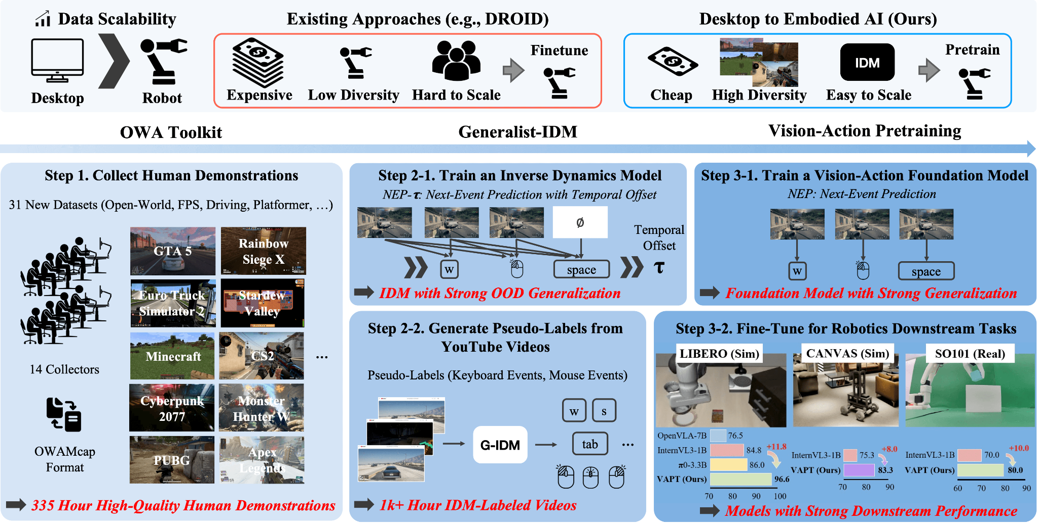
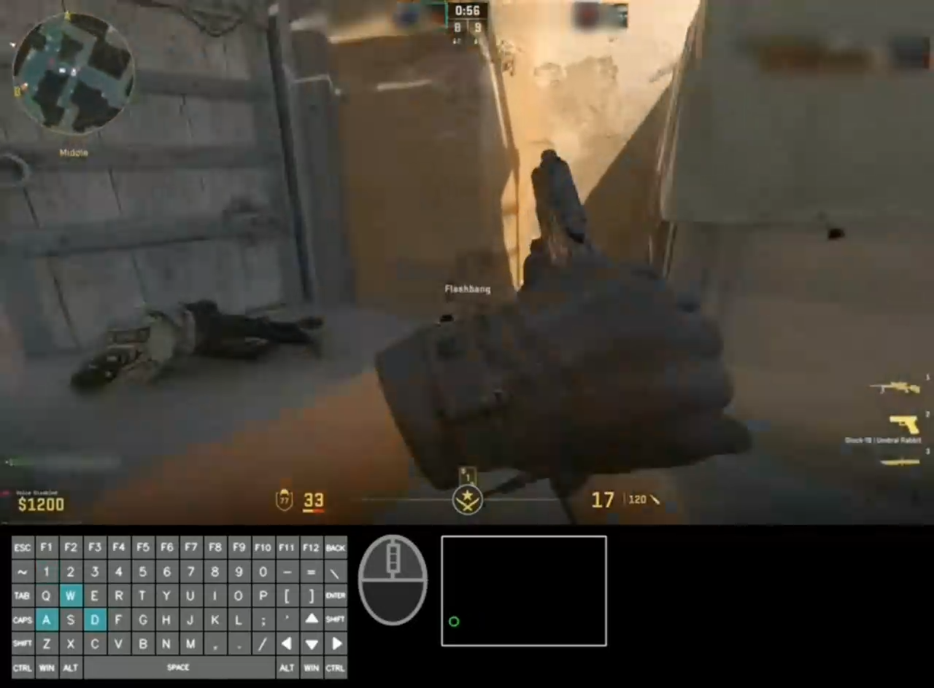
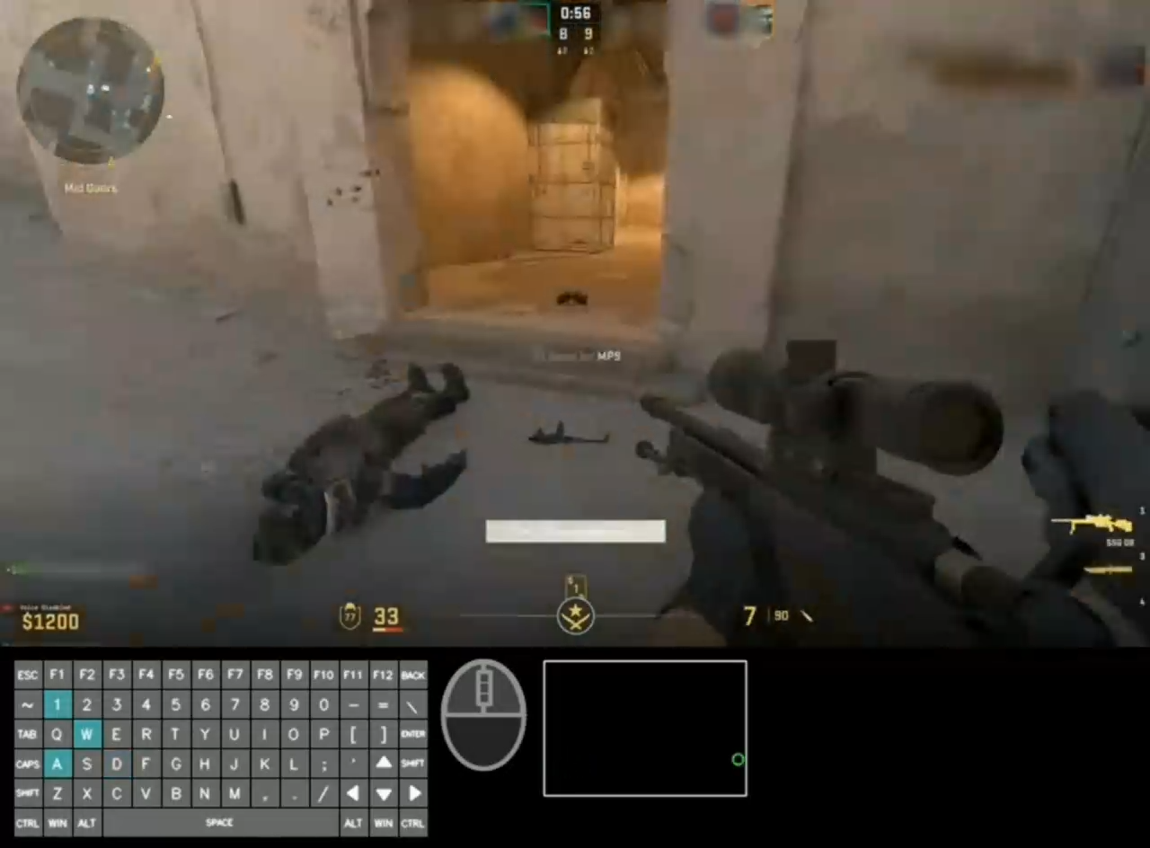
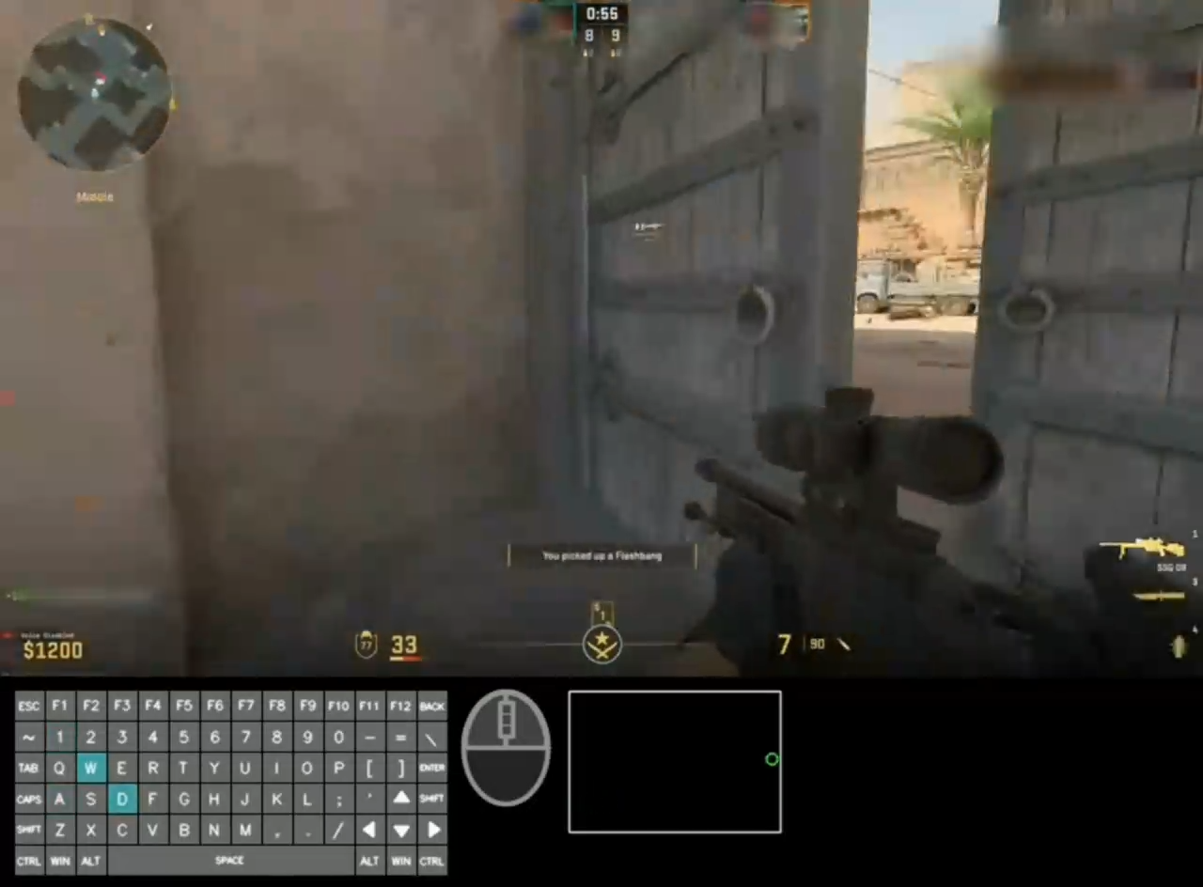
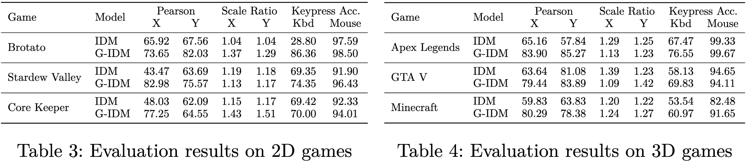
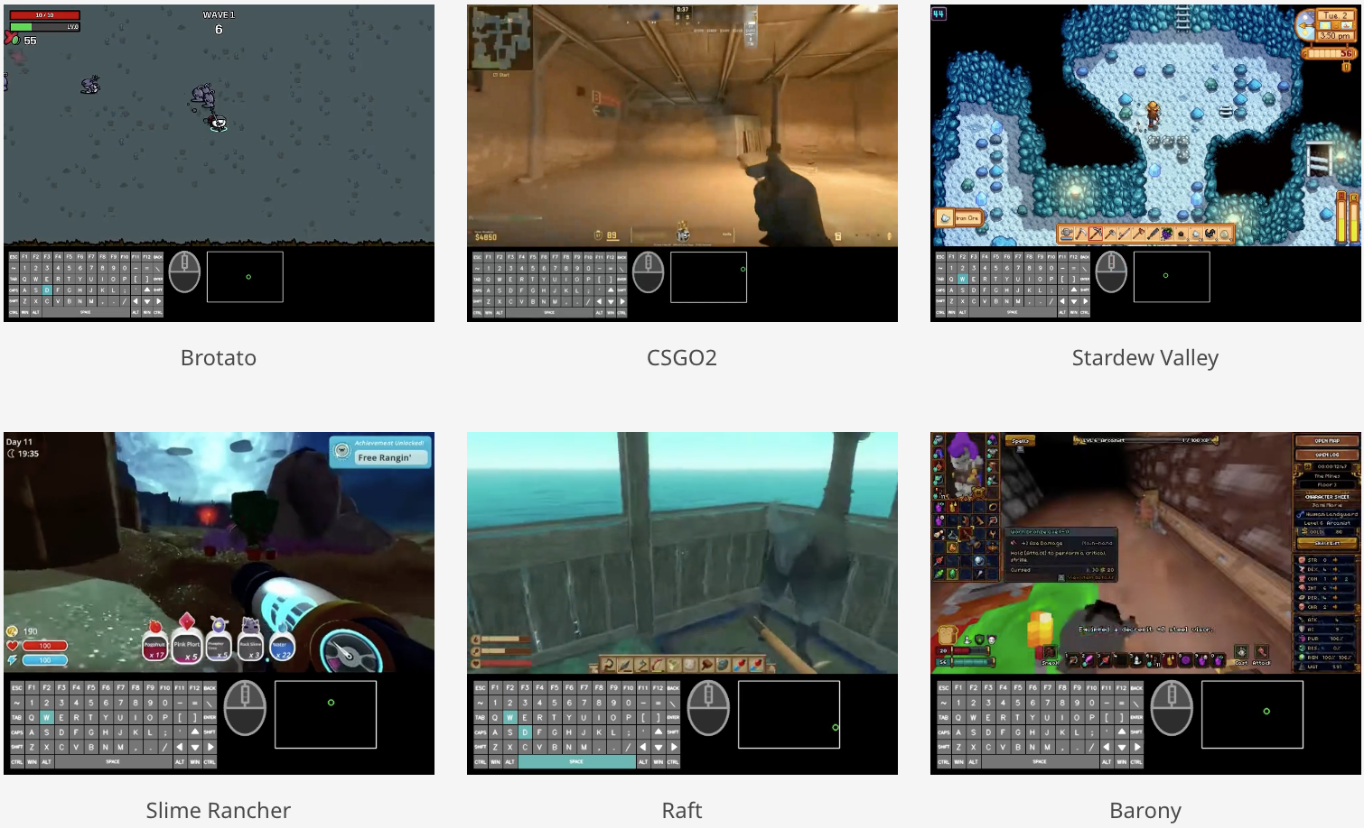
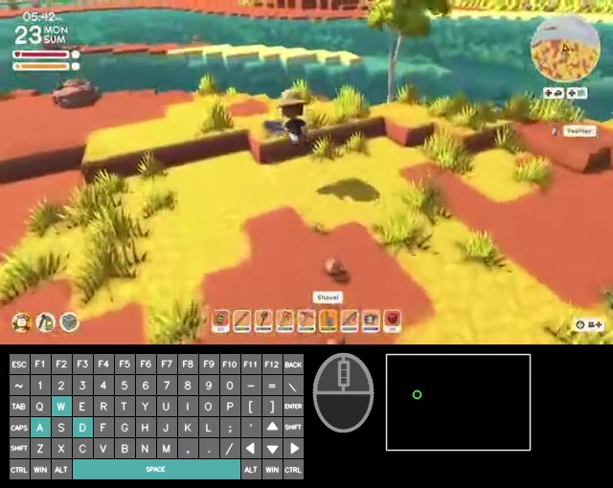
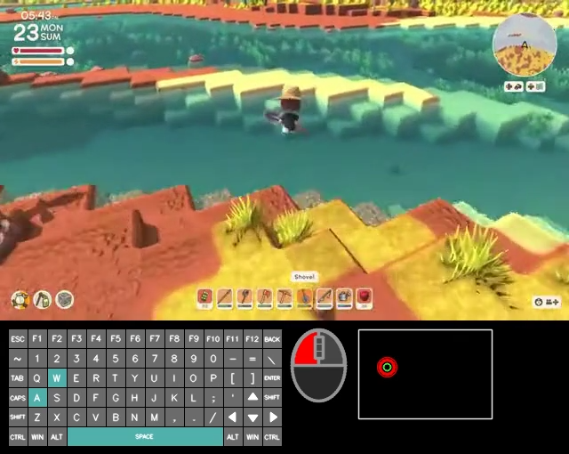
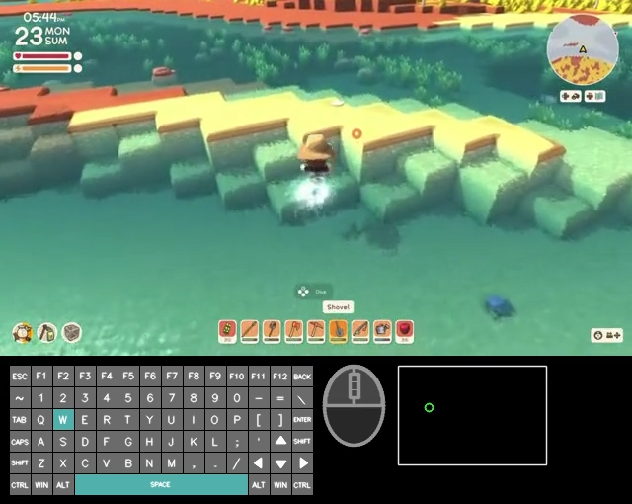
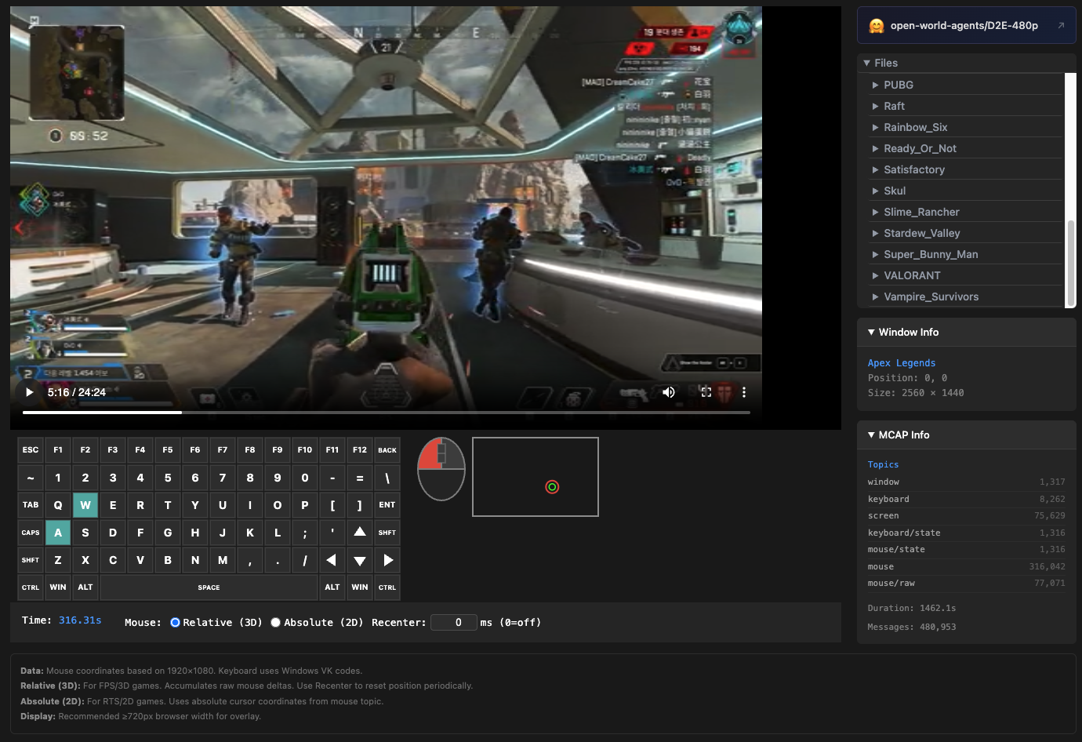
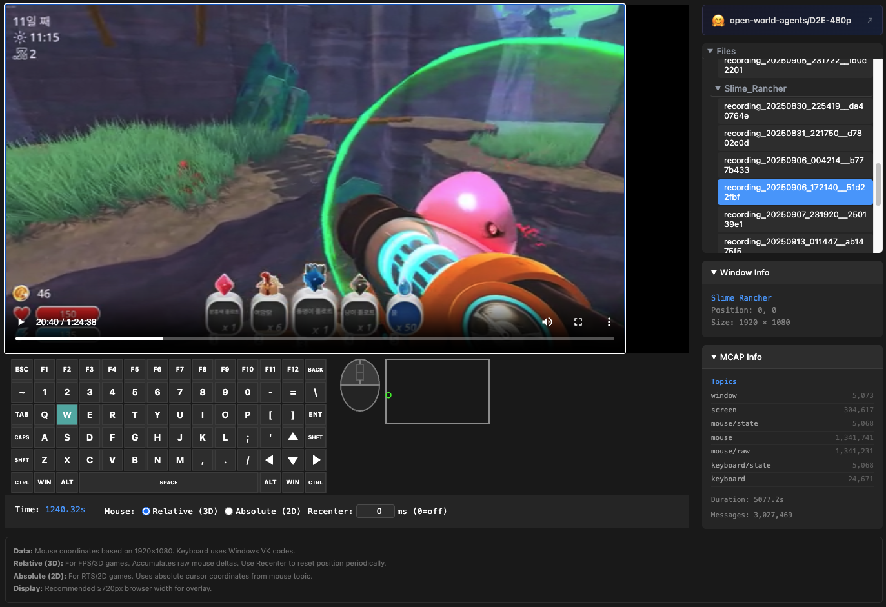
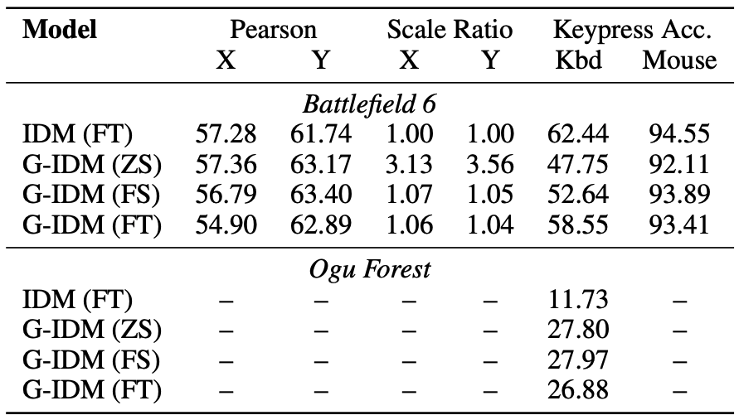
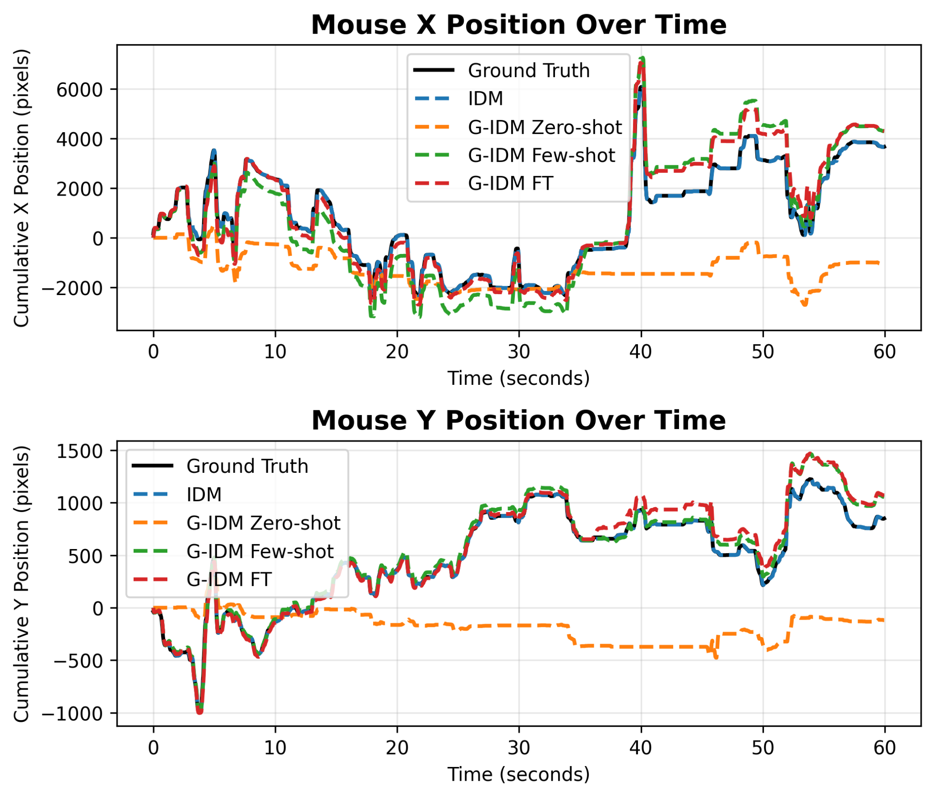
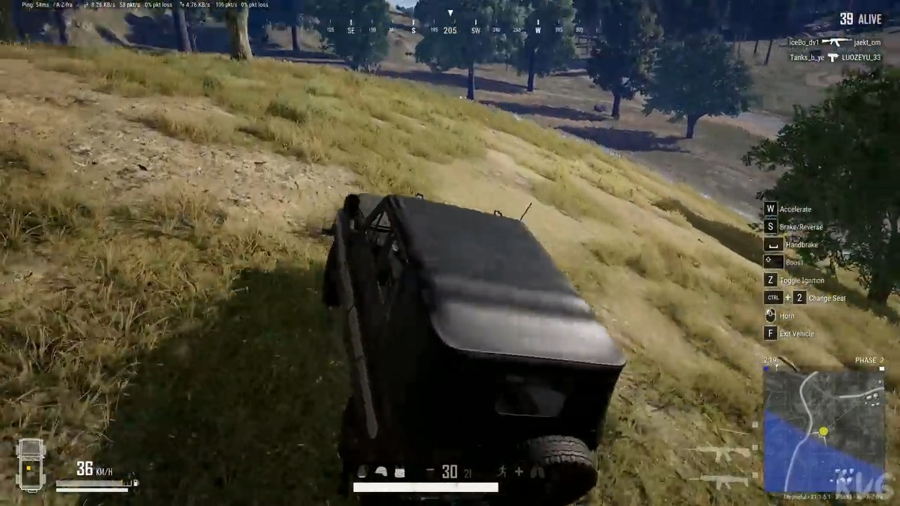
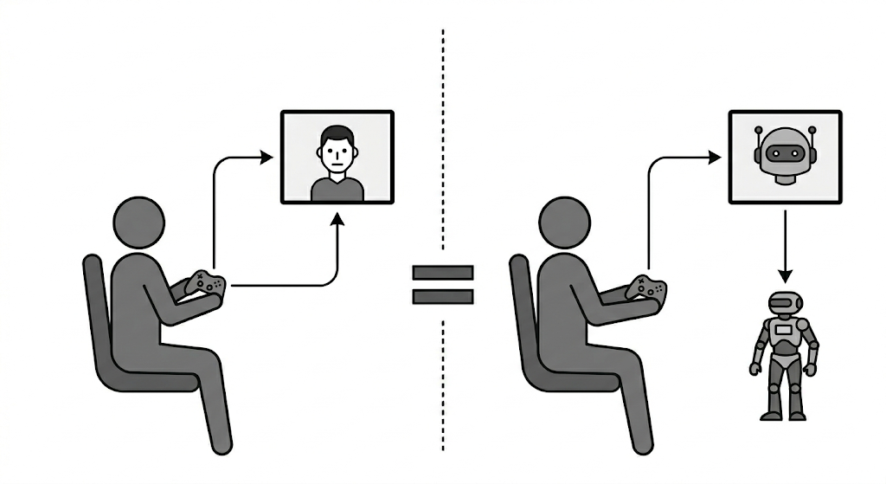
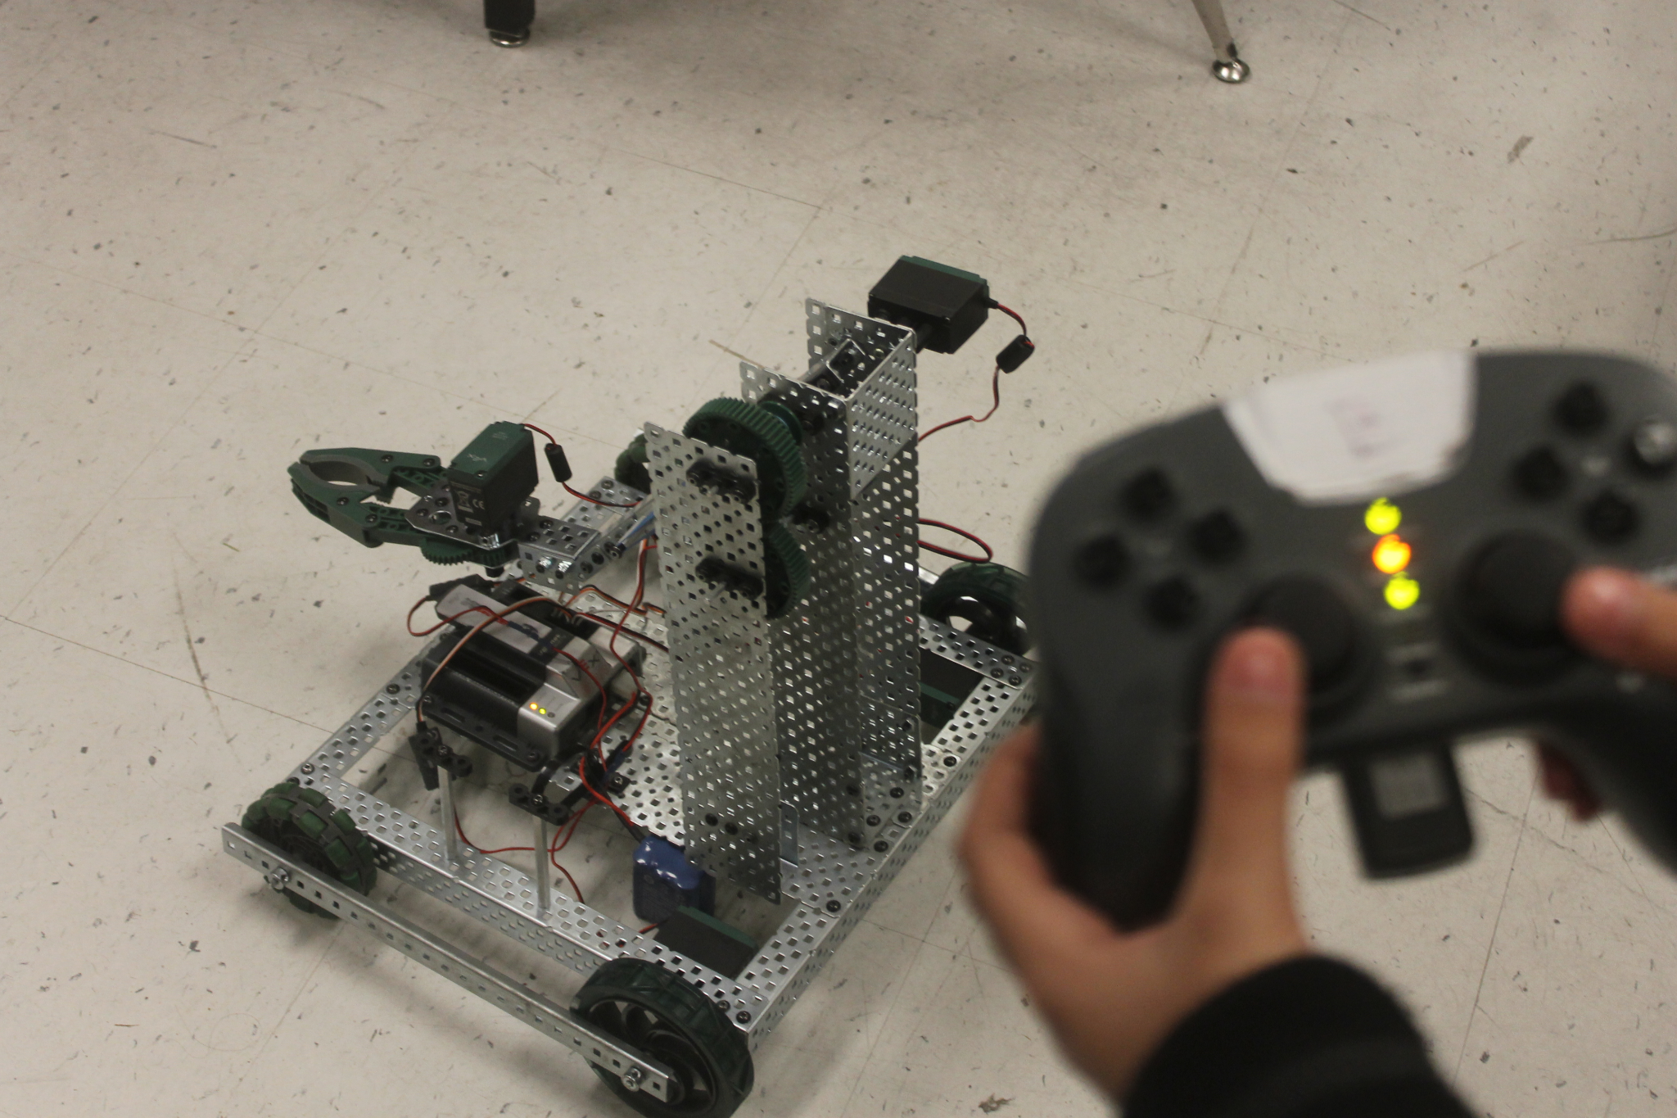
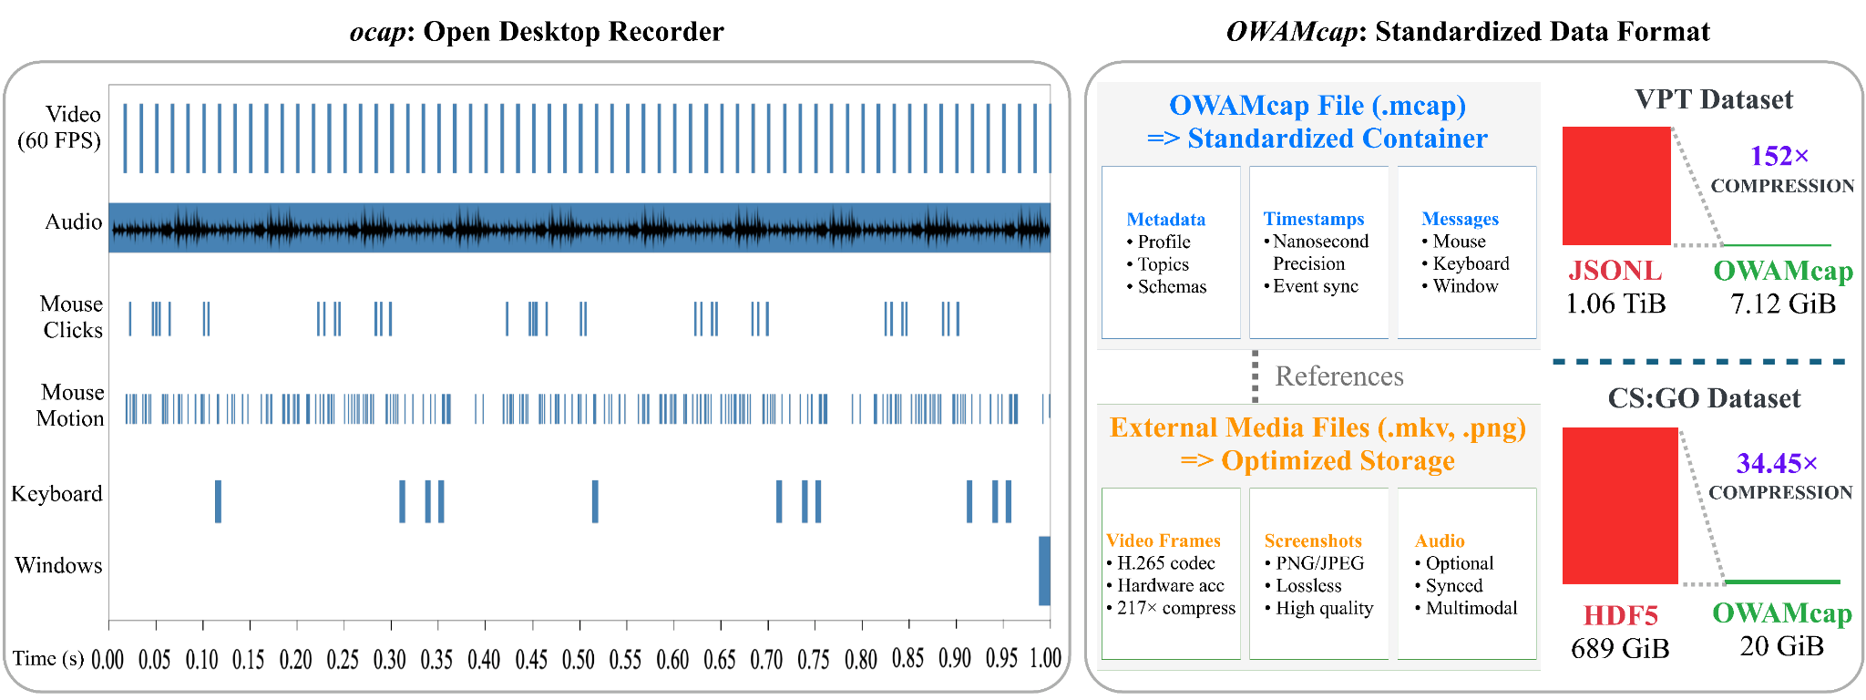
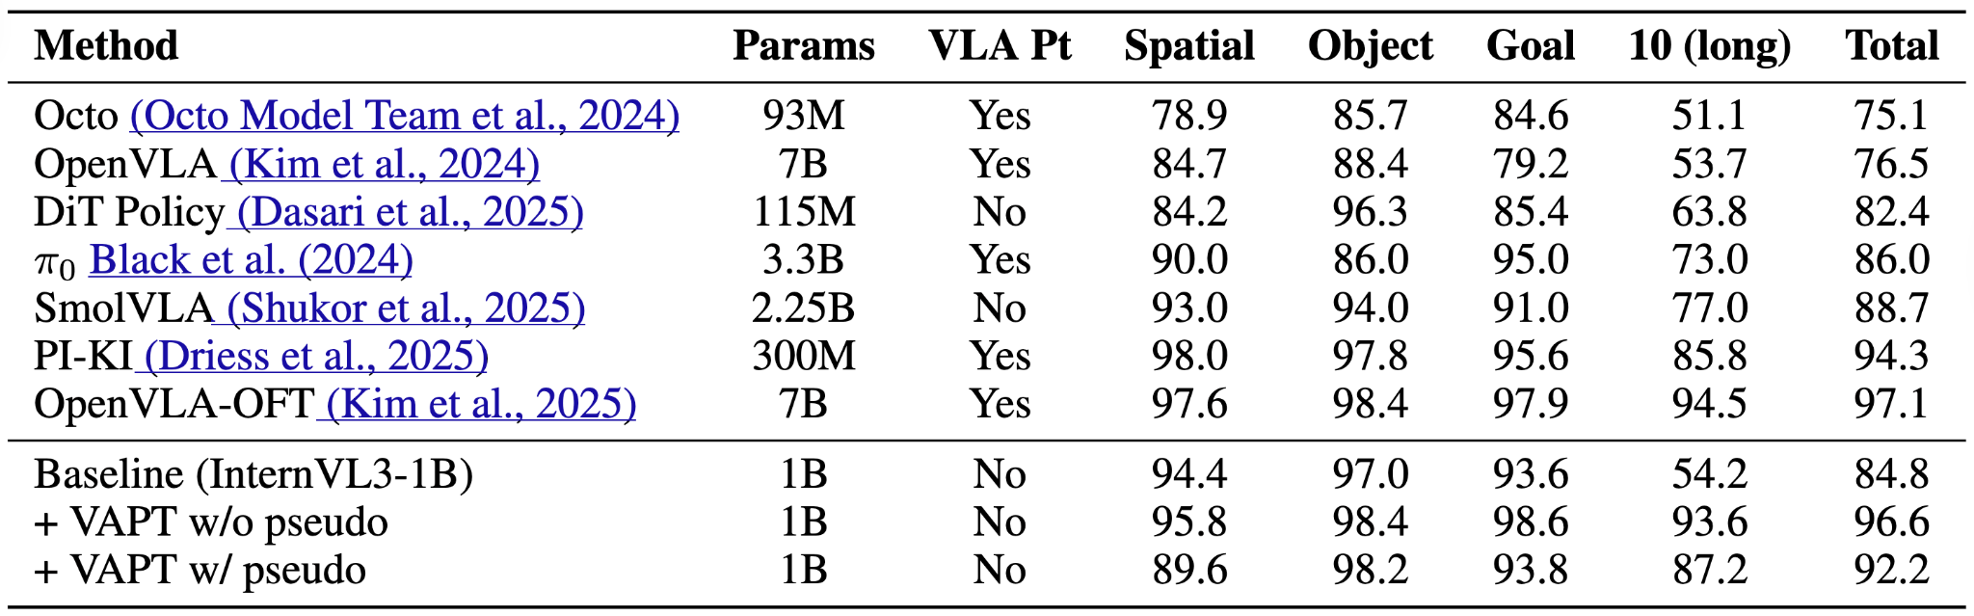
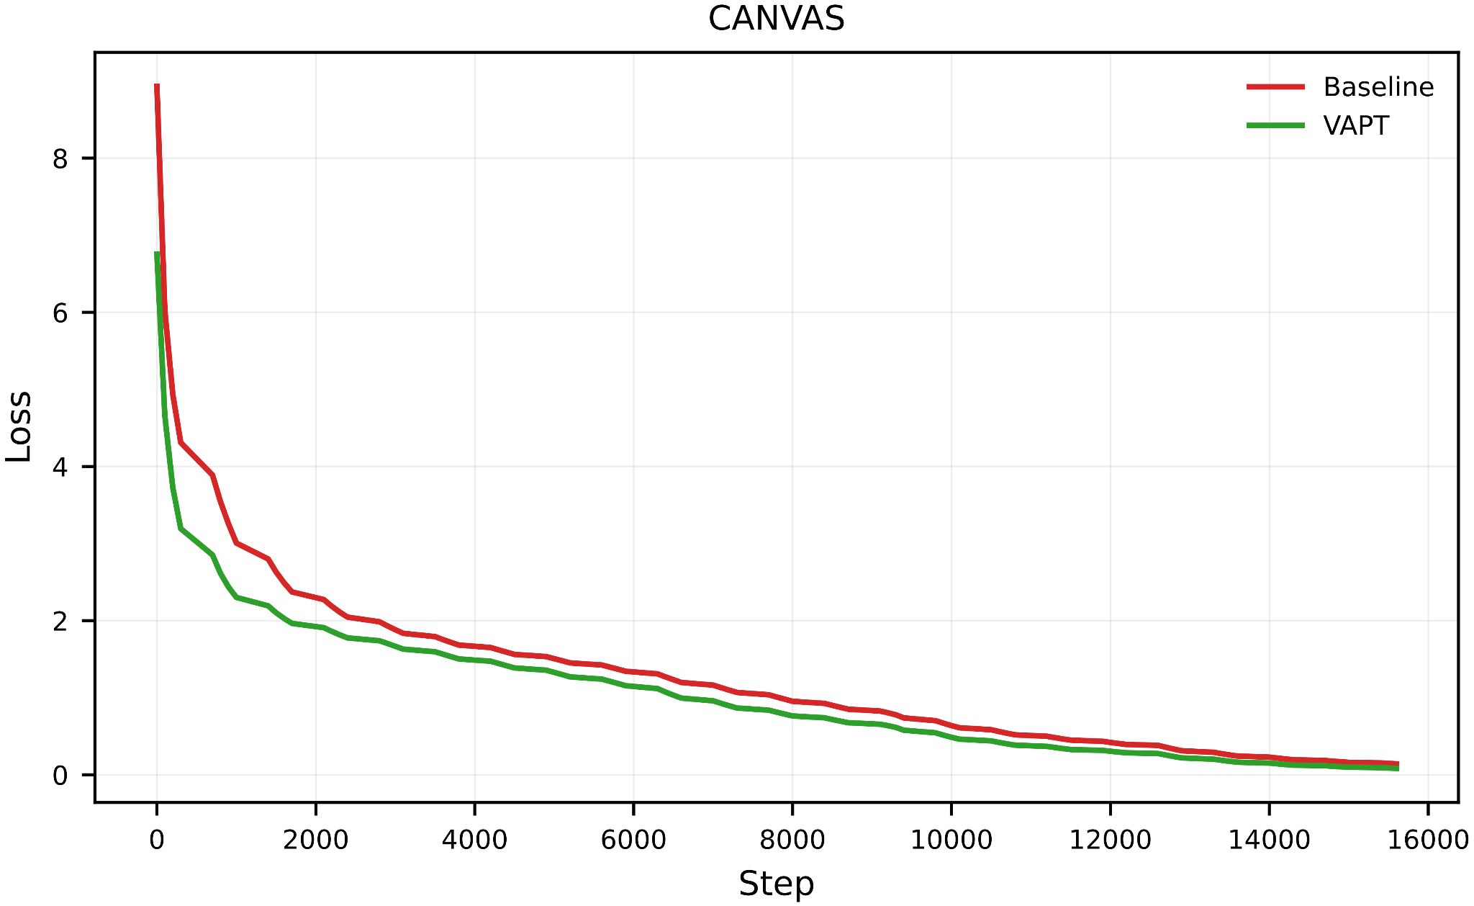
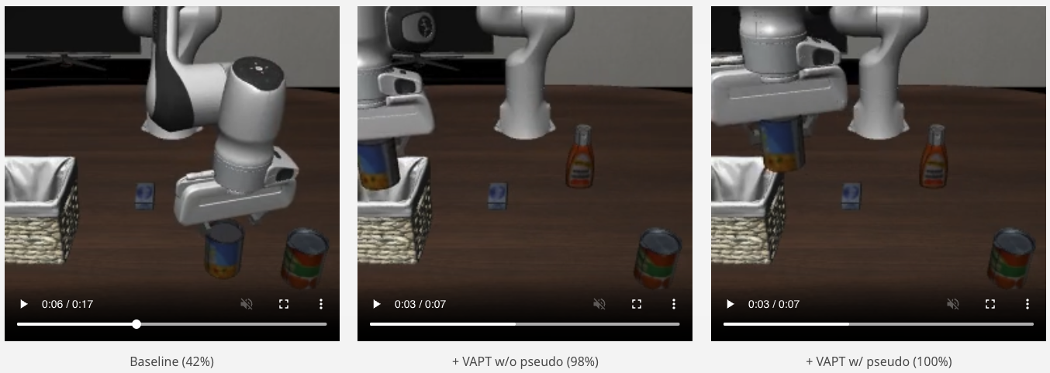
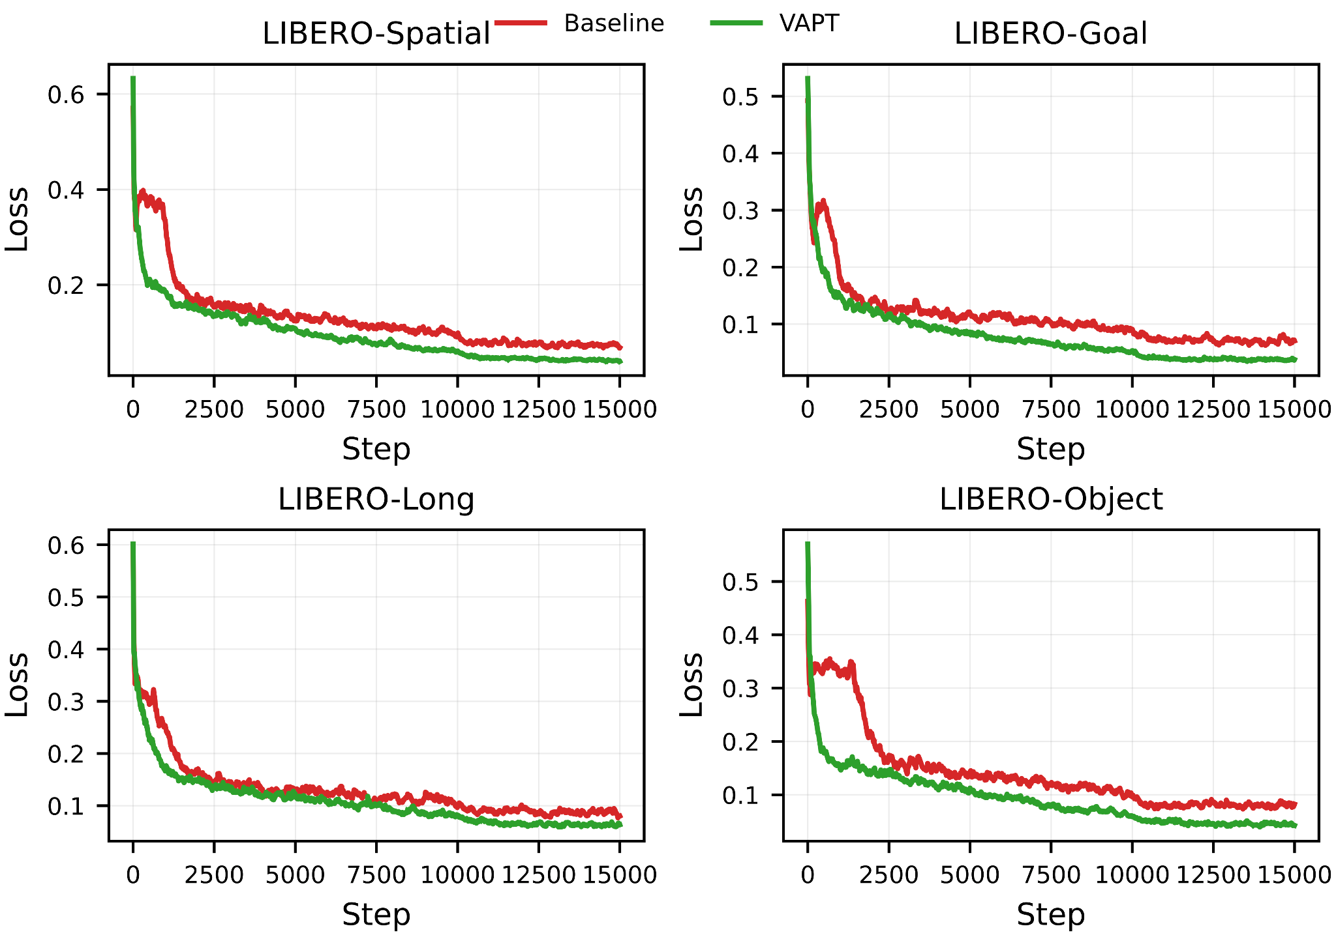
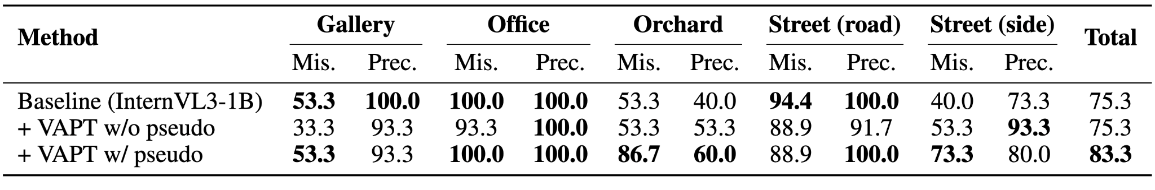
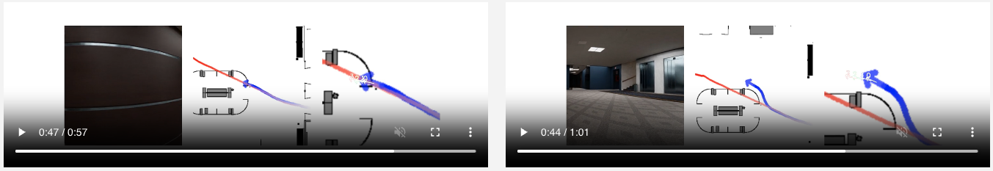


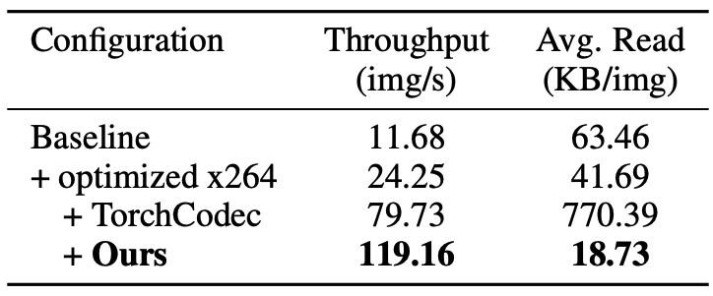
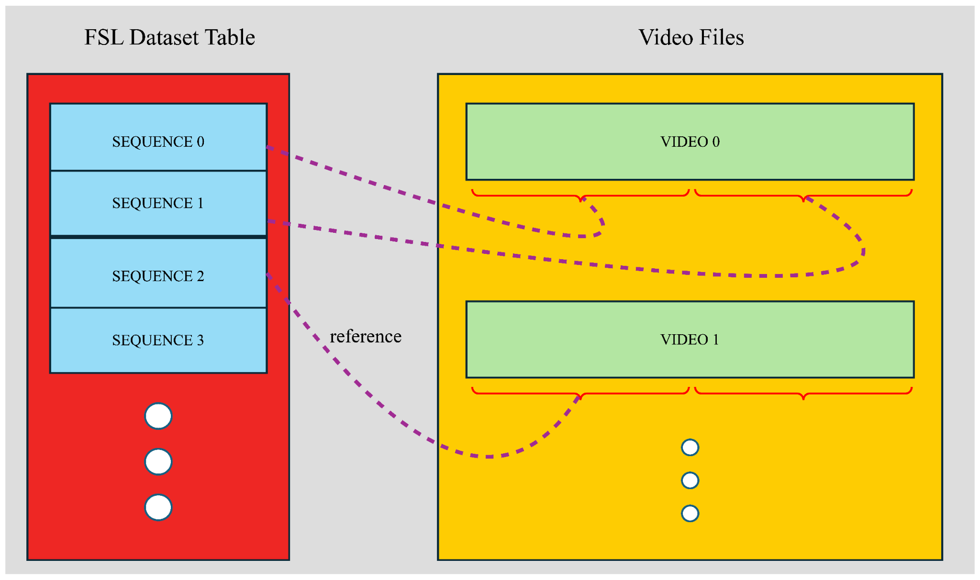
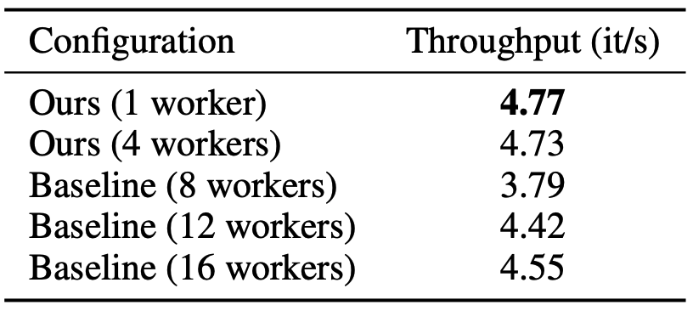
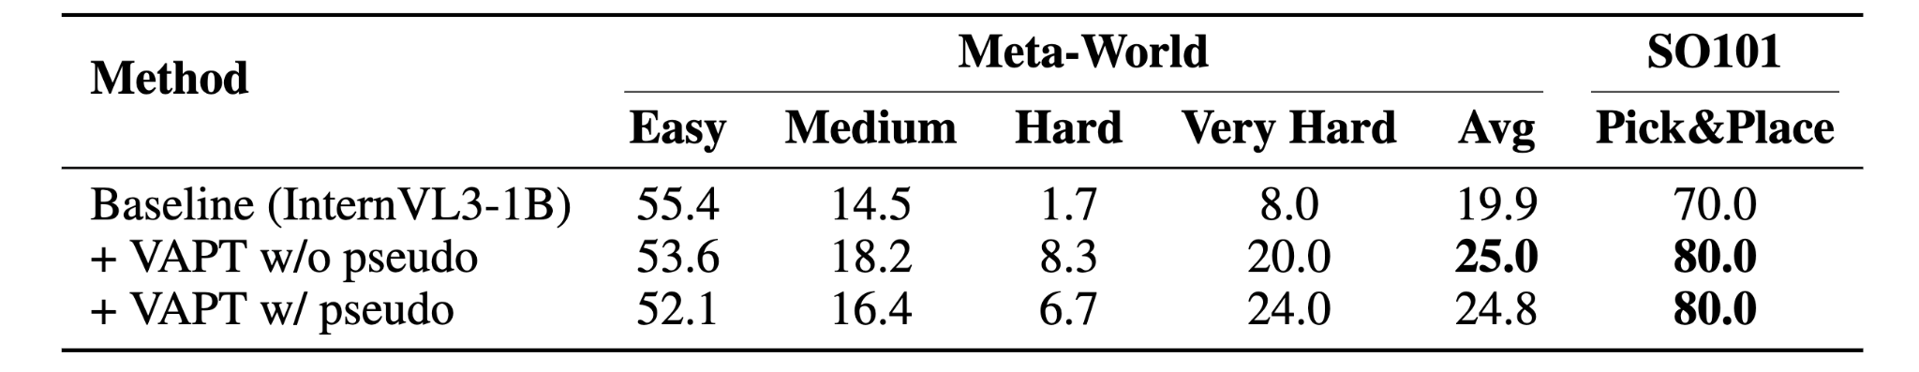
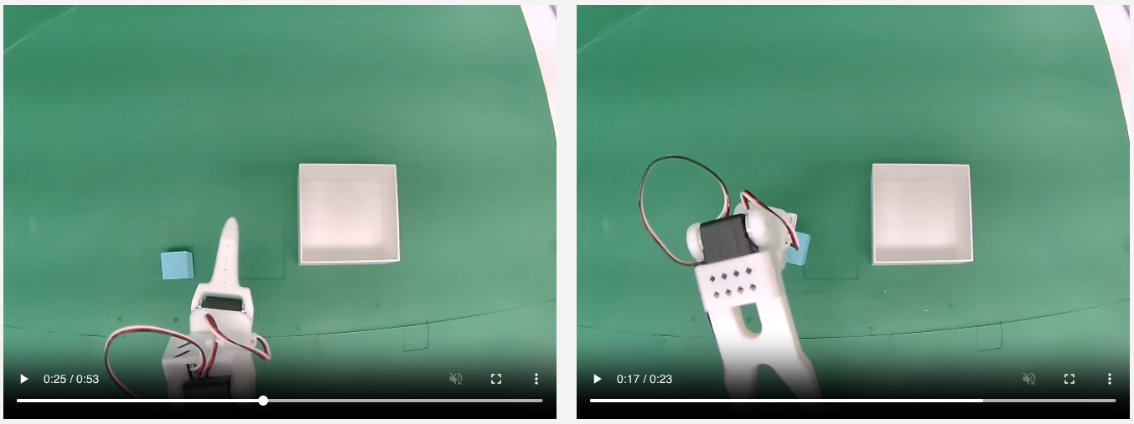
D2E: Scaling Vision-Action Pretraining on Desktop Data for Transfer to Embodied AI
Suhwan Choi*, Jaeyoon Jung*, Haebin Seong*, Minchan Kim, Minyeong Kim, Yongjun Cho, Yoonshik Kim, Yubeen Park, Youngjae Yu†, Yunsung Lee†
* Indicates equal contribution
† Indicates co-corresponding
Why Desktop Data?
Overview
Generalist-IDM
1. Data Scalability
Weapon Change and Get Ready to Battle (CSGO2)
G-IDM Evaluation Results on 2D Games
Brotato
CSGO2
Stardew Valley
Jump as Far as Possible to Minimize Slow-Speed Swimming (Dinkum)
Slime Rancher
Raft
Barony
Pseudo-Labeling Sequence Example from In-the-Wild YouTube
G-IDM Evaluation Results on 3D Games
G-IDM Pseudo-Label Results on YouTube Game Videos
2. Gaming Is Teleoperating the Protagonist
OWA Toolkit
G-IDM Prediction Trajectory of Battlefield 6
HF Dataset Visualizer (Publicly Available)
G-IDM Out-of-Distribution Performance
Why Transfer Works?
One model, all games:
G-IDM outperforms per-game specialists and pseudo-labels 1K+ hours of YouTube gameplay for ~$800 (G-IDM training cost).
Action Modality Alignment
VAPT trains on vision-action trajectories
→ Learns how observations map to control
Goal-Directed Sequential Reasoning
Visual grounding + temporal planning
→ Same skills as robotic control
High Diversity
Games across 2D/3D, FPS/TPS/top-down
→ General-purpose control priors
Evaluation Results of D2E
Training Stability
Baseline
(42%)
+VAPT w/o pseudo (98%)
+VAPT w/ pseudo (100%)
Training Loss Curves for CANVAS (Navigation)
From screen to GPU: synchronized 60Hz capture, 152× compression, and 10× faster training
LIBERO Manipulation Results
Data Pipeline
worv-ai.github.io/d2e/
Inference & evaluation code
Datasets + interactive viewer
Live demo on HF Spaces
Pretrained model weights
CANVAS Navigation Results
Baseline
+VAPT w/ pseudo
🤗
Optimized x264 Parameters
FSLDataset Construction
Adaptive Batch Decoding
Meta-World & SO101 Real-World Results
Baseline
+VAPT w/ pseudo
Training Loss Curves for LIBERO
All resources (codes, models, datasets) are publicly available
Training Throughput (InternVL3-1B)
96.6% LIBERO, 83.3% CANVAS
1.3K hours of desktop gaming data pretrain a 1B model that matches 7× larger robotics models
More Stable Training
VAPT shows immediate convergence

