Slide 1

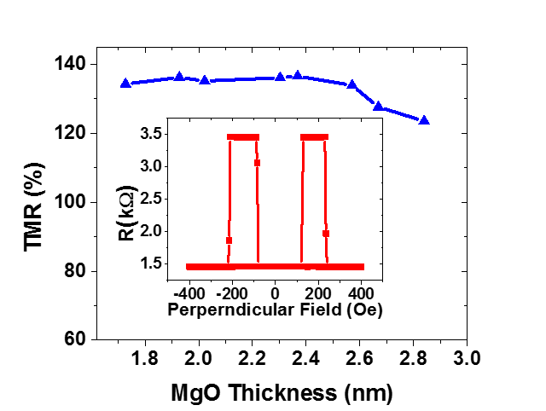

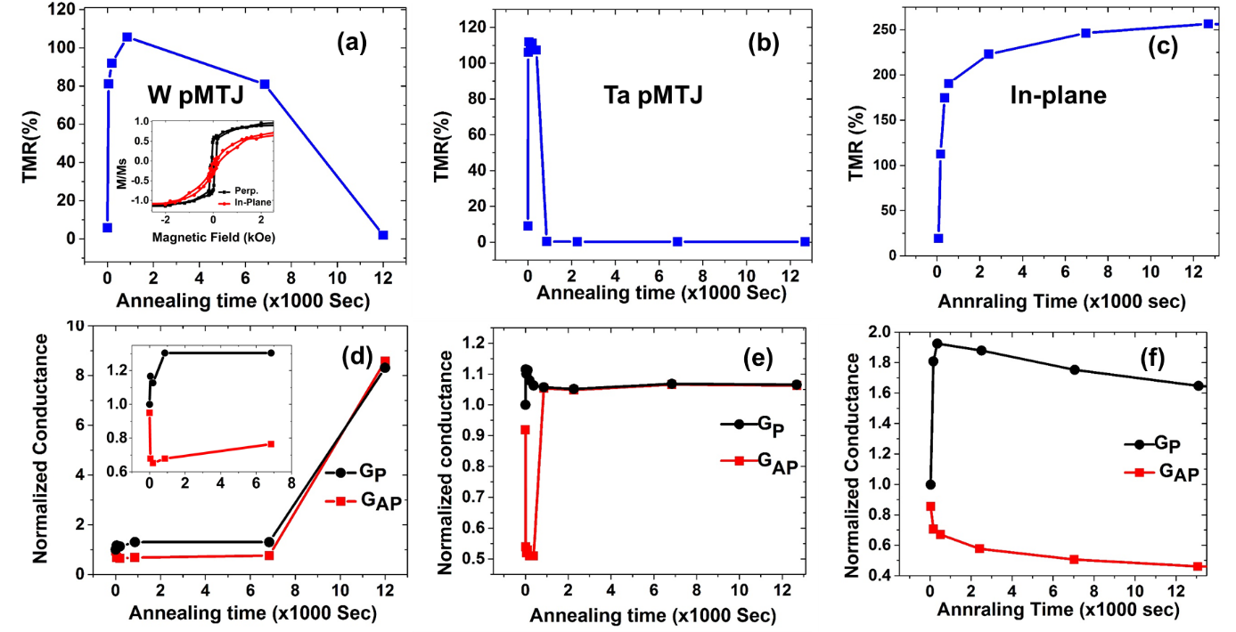
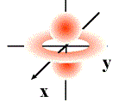
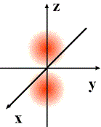
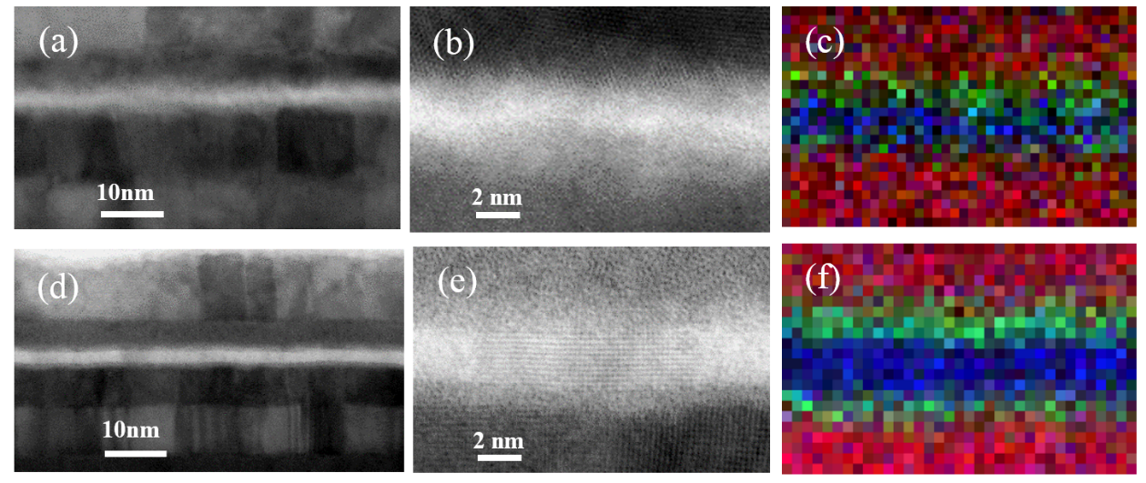
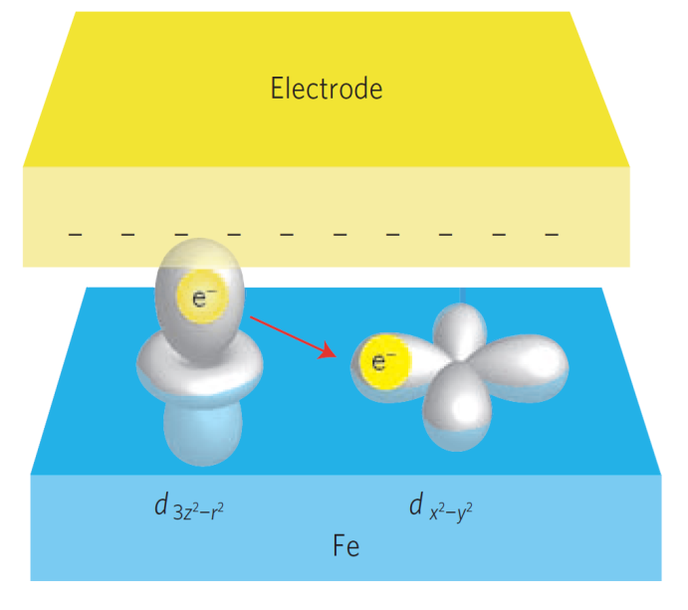
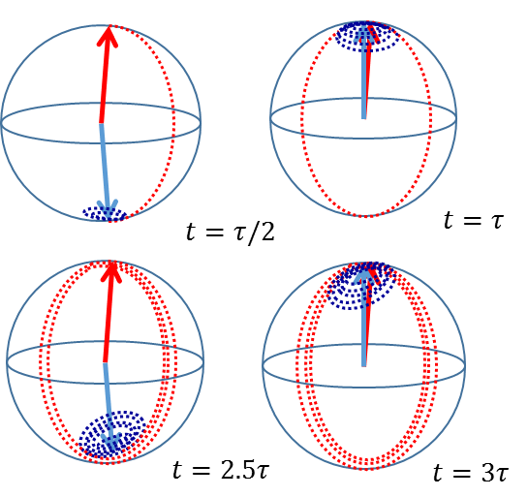


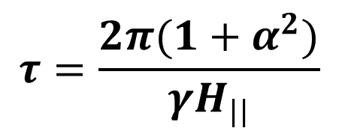

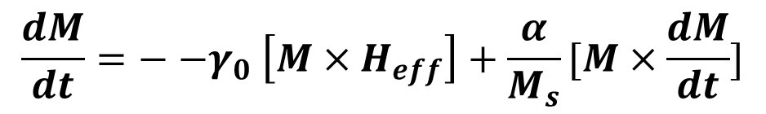
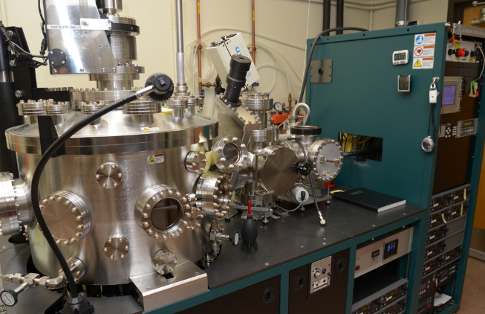
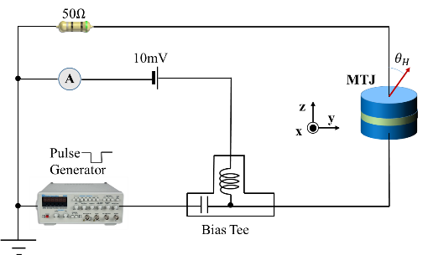
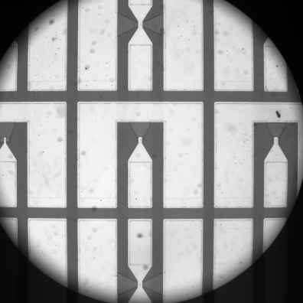
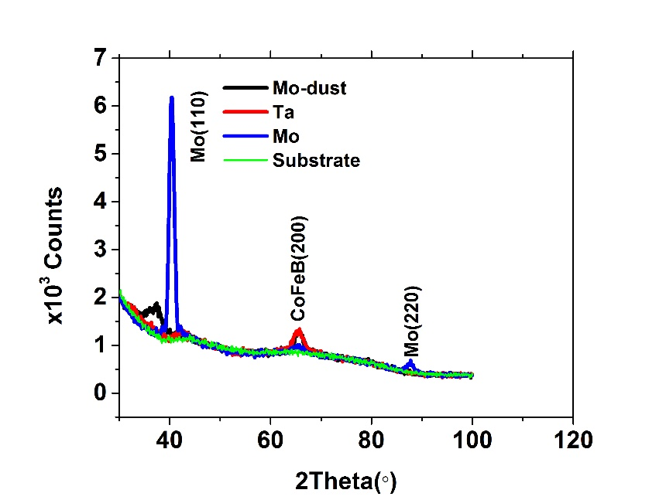
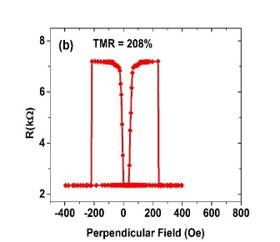
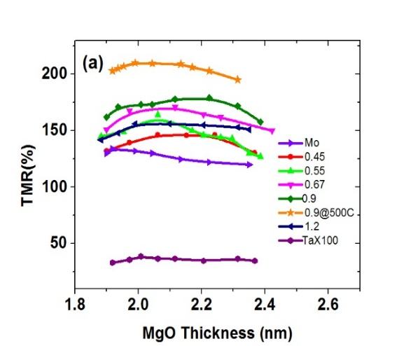

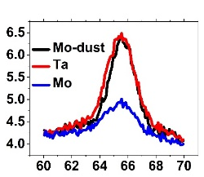

Perpendicular Magnetic tunnel Junctions and
Voltage Controlled Precessional Switching
Meng Xu¹, Hamid Almasi¹, C. L. Sun², H. Parraga¹, Y. Xu¹, X. Li³, T. Newhouse-Illige¹, C. Bi¹,
P. Khalili Amiri^{3,4}, K. L. Wang³, P.M. Voyles², and W. G. Wang¹
Department of Physics, University of Arizona
2. Department of Materials Science and Engineering, University of Wisconsin
3.Department of Electrical Engineering, UCLA
4. Inston, Inc., Los Angeles
BACKGROUND
Nanosecond reversal of magnetization has been demonstrated in CoFeB/MgO/CoFeB magnetic tunnel junctions with perpendicular anisotropy( pMTJ). Thanks to the voltage controlled magnetic anisotropy (VCMA) effect, nanosecond voltage pulses applied on the pMTJ introduces a temporal change of magnetic easy axis in the free layer, which induces precessional motion of magnetization on the time scale of nanosecond. This mechanism is regarded as a promising way to reduce the switching energy in pMTJs for next generation spintronic memory or logic applications. However, the much appreciated sub-femtojoule energy consumption per bit is still out of reach because of unavoidable joule heating.
I. INTRODUCTION
A. Origin of iPMA at CoFeB/MgO interface
B. pMTJ with W buffer layer
Band specific coefficient (~ 0.2 for Co)
Spin-orbital coupling constant
W could be a good choice of heavy metal layer
in terms of high formation energy with Fe:
Evolution of TMR, G_{P} and G_{AP} reveals less coherent tunneling was
built up in pMTJs compared to MTJs with in-plane anisotropy.
T_{AN}= 420ºC
Bruno, Phys. Rev. B 39, 865-868 (1989)
Weller et al, Phys. Rev. Lett. 75, 3752-3755 (1995)
Annealed 10 min at
Fe-HM | Exp. | Theory
Zr | - | -37 to -13
Nb | -21 | -9 to -23
Mo | -4.7 to 3.3 | -1 to -3
Ru | - | -7 to -3
Ta | -19 | -22 to -9
W | -2.5 to 0.4 | 0
Hf | - | -30 to -11
Fe
out-of-plane/ in-plane orbital moments
MgO(100)
Fe 3d-z²
O 2pz
Fe
Niranjan et. al. Appl. Phys. Lett. 96, 222504 (2010)
Shimabukuro et. al. Physica E 42, 1014-1017 (2010)
Yang et. al. Phys. Rev. B 84, 054401(2011)
W
Large TMR above 130% was achieved in W/CoFeB/MgO pMTJs
Hybrid of Fe 3d with O 2p_{Z} at interface
m_{l}(001)>m_{l}(100) via SOC induces PMA
Mg
Compared to Ta-pMTJs, W-pMTJs R drop faster during extended high
temperature annealing.
B. Voltage controlled magnetic anisotropy
Fe
W-pMTJ shows larger roughness
W interdiffuses into MgO barrier more easily
Ta
Junctions were annealed at 420ºC for 3.5h
Mg
C. VCMA and switching measurement
Voltage controlled magnetic anisotropy (VCMA)
through charge transfer through different orbitals
and spin-orbit coupling at interface
18 fJ with switching probability of 99% at 400ps
Nature Nanotechnology 4, 158 - 161 (2009)
TMR=142%
C. Voltage induced precession
MR curve measured at from normal
Switching data measured at from normal
D. Field dependent switching measurement
When a nanosecond scale voltage pulse is applied to sufficiently small MTJ, magnetic
easy axis becomes in plane and Larmor precession is induced through LLG equation.
TMR=130%
All pulses are -2V in amplitude,
1ns in duration
II. FABRICATION AND MEASUREMENT
Large modulation of switching energy by changing the field angle, 7.7 fJ switching
with 82% probability can be achieved by this method with -1.8V and 500ps pulses
Ru(14)
Ru(20)
Ru(20)
IV. HIGHLIGHTS
Ta(5)
Ta(10)
W(10)
CoFeB(1.5)
CoFeB(1.5)
CoFeB(1.5)
Significantly improved TMR and thermal stability in pMTJ by Mo dusting
Fabricated MTJs with W buffer layer and studied its structural evolution during annealing using TEM
CoFeB/MgO/CoFeB MTJ nanopillar(D=100nm) with high TMR(142%), thermal stability
over 40 and large voltage effect was fabricated to achieve ultrafast precessional
switching.
Large modulation of switching energy by tuning static magnetic field.
MgO(1-3)
MgO(1-3)
MgO(1-3)
CoFeB(0.85)
CoFeB(0.85)
CoFeB(0.85)
Ta(10)
Ta(4)
Ta(10)
W(10)
Ru(6)
Ru(8)
Ru(8)
Ta(3)
Ta(6)
W(6)
Si/SiO2
Si/SiO2
Si/SiO2
Magnetron Sputtering
Metallic layers grown by DC sputtering at 2mTorr
MgO barrier grown by RF sputtering at 0.6-1 mTorr
Standard photolithography and nanosphere lithography to fabricate nanopillars with D=100nm
III. RESULTS AND DISCUSSION
V. NEXT STEPS
A. pMTJ with insertion of Mo-dusting layers
Reduce switching energy by enhancing VCMA efficiency and reducing damping.
Explore VCMA effect based on voltage controlled Rashba spin-orbit effect, which can be tuned by different under layers.
Further enhance TMR, PMA. Study precessional switching in smaller devices.
Ta(8)/CoFeB(5)/MgO
Mo(8)/CoFeB(5)/MgO
Ta(8)/Mo(0.9)/CoFeB(5)/MgO
Heat of Formation (kJ/mol)
Fe-HM | Exp. | Theory
Zr | - | -37 to -13
Nb | -21 | -9 to -23
Mo | -4.7 to 3.3 | -1 to -3
Ru | - | -7 to -3
Ta | -19 | -22 to -9
W | -2.5 to 0.4 | 0
Hf | - | -30 to -11
ACKNOWLEDGMENTS
Dusting dramatically help with TMR
Record high TMR (208%) in voltage-controllable pMTJs
New approach to simultaneously improve TMR, PMA and VCA
This work was supported in part by C-SPIN, one of the six centers of STARnet, a Semiconductor Research Corporation program, sponsored by MARCO and DARPA.
Mo has strong 110 texture: bad for CoFeB
Ta is amorphous: but small formation energy
with Fe
Mo dusting combines advantages of both

