Slide 1
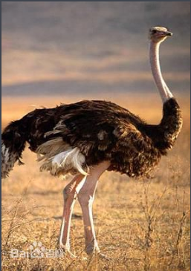
THE PRETEND MASTER——OSTRICH
Grade five Class tow--------------Mike

Slide 2
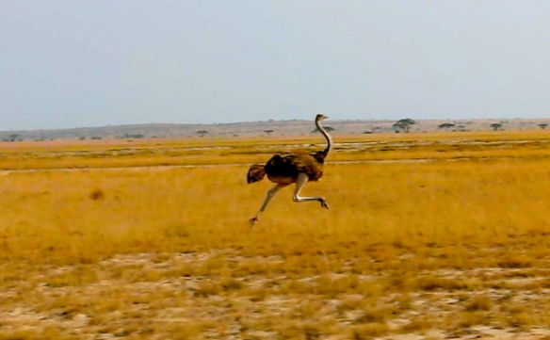
The ostrich run very fast
The ostrich is the faster the all birds and some are faster then people. Its speed is 72 kilometers per hour.

Slide 3
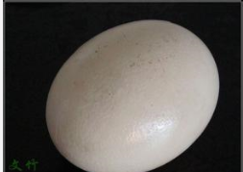
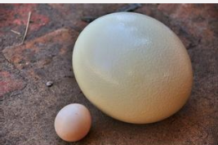
The ostrich’s egg
The ostrich lays the biggest egg in the world; ostrich eggs are very big .
Ostrich eggs are three times as large as eggs and The ostrich egg weighs 30 times as much as an egg.

Slide 4
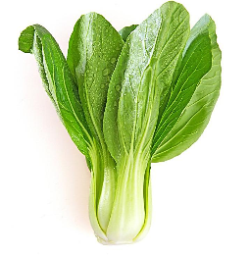
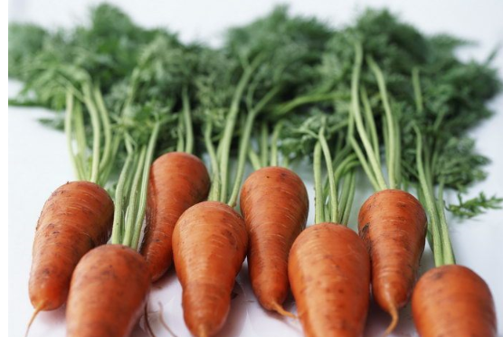
The ostrich’s food
Ostriches are omnivorous animals , they eat some meet and vegetables they carrot and greens.

Slide 5
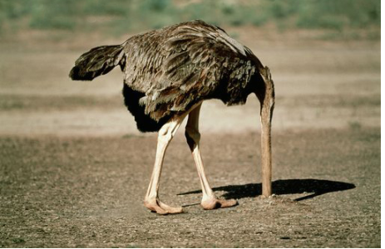
The ostrich’s self - protection
When the advent of danger is coming. The ostrich will hide its head in the earth it is like a small hill so we call it pretend master.

Slide 6
Thank you
For the listening

