Slide 1
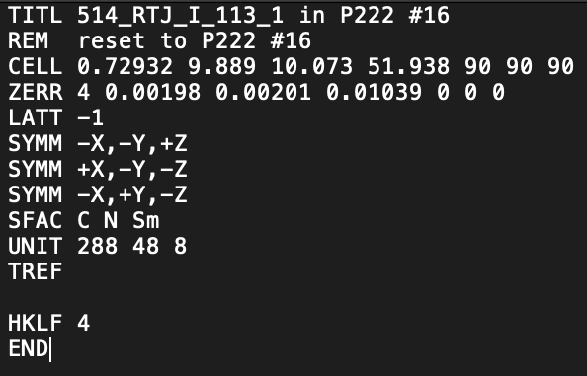
CELL wavelength, UC
ZERR Z (estimated # formula units per cell), estimated error in UC dimensions – might be able to just use all zeros here – SHELXL refinement updates this anyway
LATT lattice type - negative if the structure is non-centrosymmetric
SYMM symmetry operator: X, Y, Z is assumed and thus omitted.
SFAC atom names in order of scattering factors to be employed by program
UNIT # of each type of atom in UC in SFAC order
TREF tells SHELX I want to use direct methods
HKLF ”n” reflection file reading instructions
n = 4 is general purpose for SMX
n = 3 for MX IR or anomalous
.ins file (shelx input)
*
*
User input
*
*
WEB: International tables for crystallography
User input
SMX defaults
* Found in XSCALE.HKL
http://www.chem.gla.ac.uk/~louis/software/wingx/hlp/ch_12.htm

