Slide 1
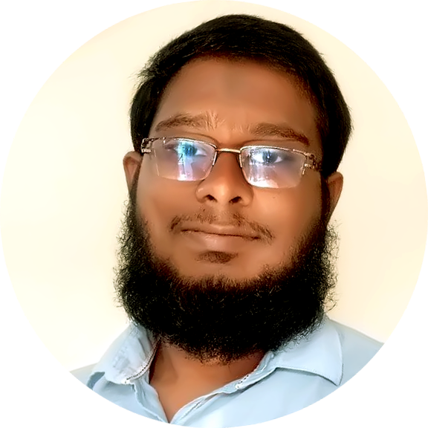



Md. Sohan Millat Sakib
FULL STACK WEB DEVELOPER
Phone Number:
+8801613931087
E-mail Address:
millatsakib.01@gmail.com
Website:
https://millatsakib.github.io/
Address
About Me

