Slide 1
Overview
What is the current trend of Space launch
How will it impact both coasts
What is mission assurance
Why mission assurance standards needs to be kept the same
Our recommendations to each squadron to prepare for more Space flight

Slide 2
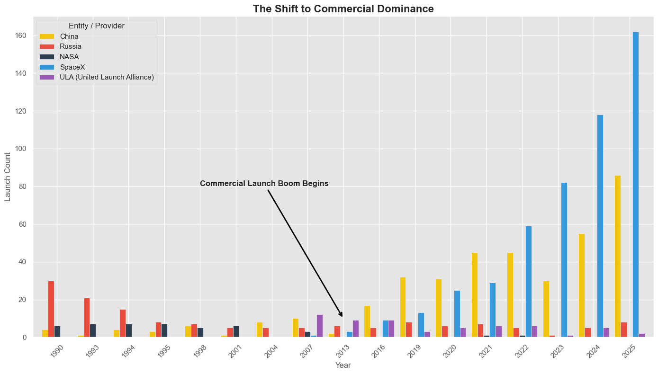

Slide 3
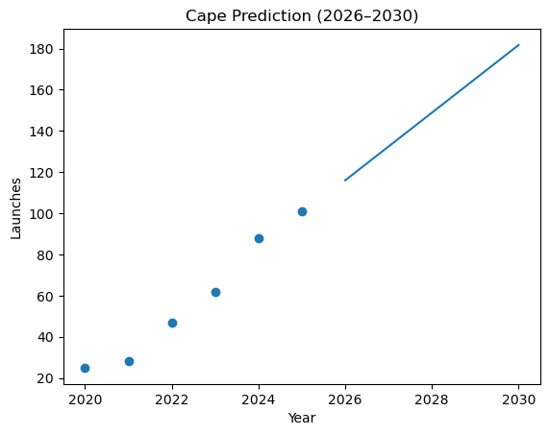
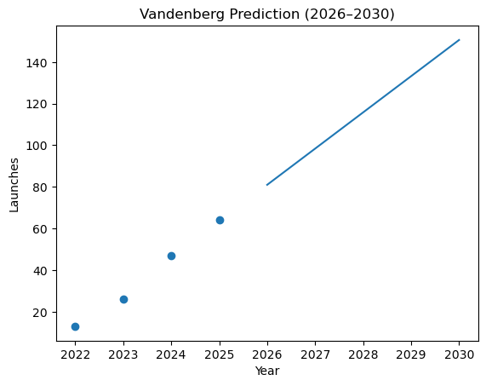

Slide 4
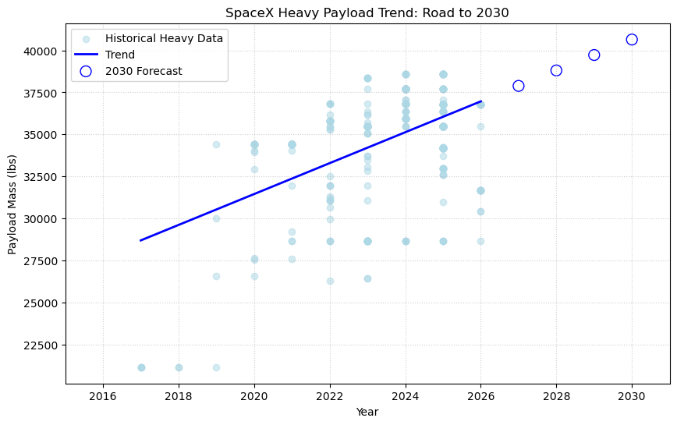

Slide 5
Recommendations
More launch sites in the future dedicated to heavy space launch payload missions
More people to support increase of missions(10 personnel minimum per mission per coast, double if 2 missions are happening at once)
Same level of mission assurance needed(Failures can still happen)

