Slide 1
Python Presentation:
Citi Bike Trip Data For The Month Of June 2024
By: Manuel Villar
July 2024

Slide 2
Understanding Citi Bike
Citi Bike is the largest bike-sharing program based in New York City, operating with over 25,000 bikes.
It has more than 1,500 stations spread throughout Manhattan, Queens, Brooklyn, the Bronx, Hoboken, and Jersey City.
As of 2023, there are 180,000 annual subscribers.
The all-time record for ridership in a single month occurred in August 2023, when the system had 4.07 million rides.
Citi Bike is available for use 24 hours/day, 7 days/week, 365 days/year.

Slide 3
Methodology
Use one month’s worth of data (June) from the NYC City Bike open dataset, which can be found at https://s3.amazonaws.com/tripdata/index.html. The data timeline spans from May 27, 2024, to June 30, 2024.
Analyzed the dataset to identify the most frequented stations, compare usage rates between members and casual users, and determine which type of bike is most popular.
Showcase visualizations.

Slide 4
Understanding the data
The dataset, split into 5 CSV files and packaged in a .zip file, contains 4,783,576 rows across 13 columns. The columns are as follows:
ride_id: Unique identifier for each ride.
rideable_type: Specifies the bike type, either electric or classic.
started_at: Start station of the ride.
ended_at: End station of the ride.
start_station_name: Name of the start station.
start_station_id: Unique ID for each start station.
end_station_name: Name of the end station.
end_station_id: Unique ID for each end station.
start_lat: Latitude of the start station.
start_lng: Longitude of the start station.
end_lat: Latitude of the end station.
end_lng: Longitude of the end station.
Member_casual: Indicates whether the rider is a member or a casual user.

Slide 5

EDA: COMBINING MULTIPLE CSV FILES
This step is necessary to work with a complete dataset.

Slide 6
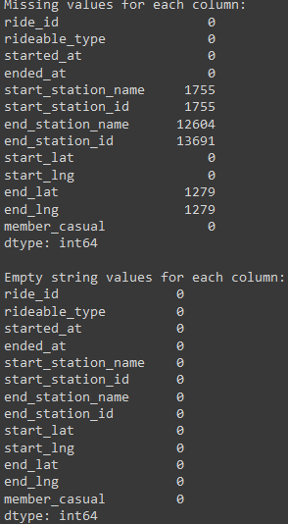

EDA: replacing all missing values with ‘unknown’
Identifying missing values and empty strings.
Replacing missing values with ‘Unknown”

Slide 7
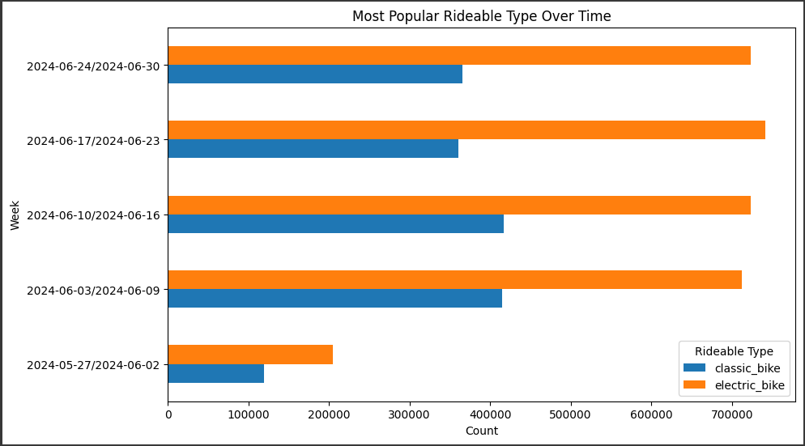
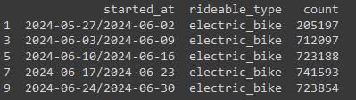
Visualization of the most popular bike type type over time
the ‘electric_bike’ has emerged as the preferred choice among users, being chosen on average 40% more frequently than the ‘classic_bike’.

Slide 8
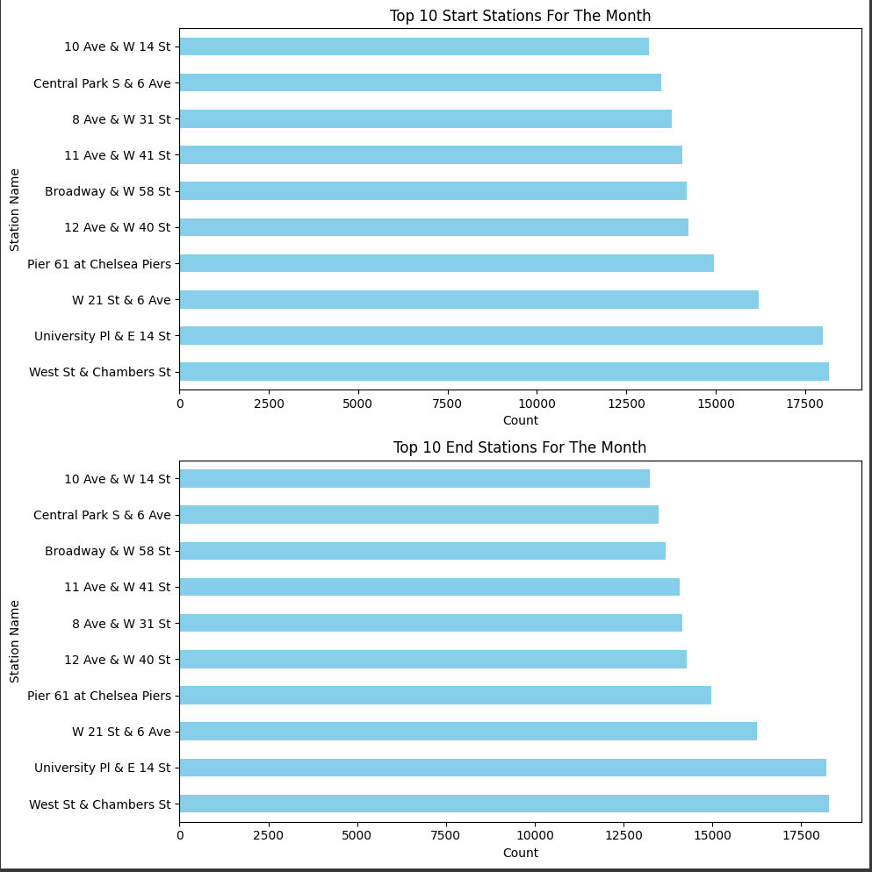
Visualizing the most popular stations
the station ‘West St & Chambers St’ stands out as the most frequented start and end point for bike rides, followed closely by ‘University PL & E 14 ST’. These stations, being popular hubs, indicate high traffic areas and potential focal points for future service enhancements.

Slide 9
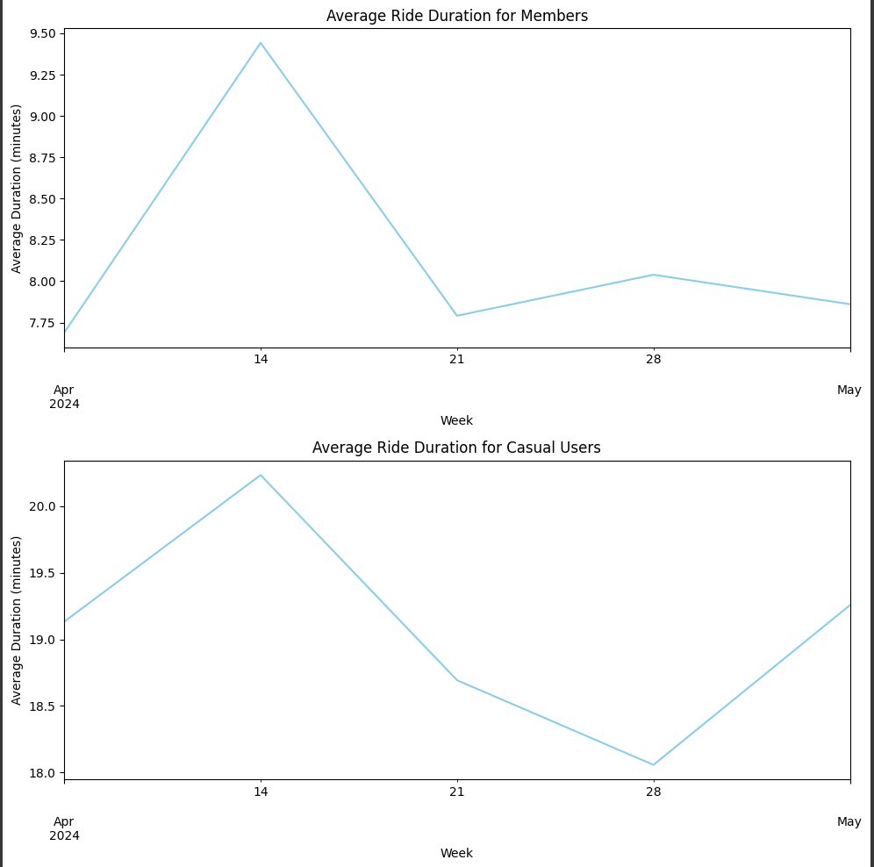
Visualization of the average ride duration
It has been observed that ‘casual’ users tend to use the Citi Bike service for twice as long on average compared to ‘member’ users. While this could potentially be a cause for concern, further data is needed to understand the reasons behind this trend. Based on the current data, one could infer that members, possibly due to their familiarity with the bike stations and the city in general, tend to make shorter trips.

Slide 10

Thank you for your time!

