Slide 1
ML Modeling for Bank loan Project 1
By: Theng foo yin​

Slide 2


Agenda
ML
Introduction
Project Objective
EDA – Visualization
Data Processing- Cleanings
Modelling
Summary

Slide 3
Introduction
In the financial sector, lenders or Banks evaluate the creditworthiness of borrowers prior to extending loans or credit lines in order to assess the risk associated with lending money. This assessment helps lenders make informed decisions about whether to approve the loan, what interest rate to charge, and what terms to offer.
Recognizing individuals who are at risk of being unable to meet their debt commitments presents a significant obstacle. The presence of a guideline or system that aids in thoroughly evaluating borrowers and subsequently diminishes financial risks while maintaining a strong lending portfolio would be highly advantageous.
In this Capstone project, the dataset is a subset of data from project Bajaj Finserv and due to privacy polices, certain columns have been deleted from the dataset.

Slide 4
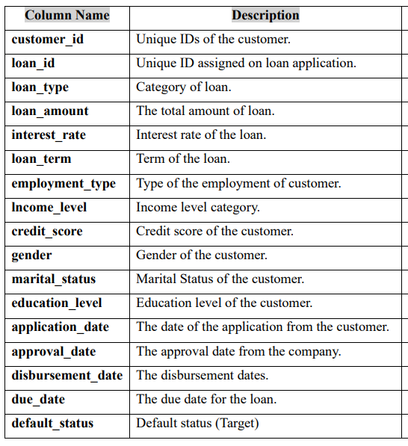
Project Objective
Objective: This project aims to construct a predictive model capable of precisely categorizing borrowers into two groups: defaulters and non-defaulters. This categorization will be based on a diverse range of financial and demographic variables.

Slide 5
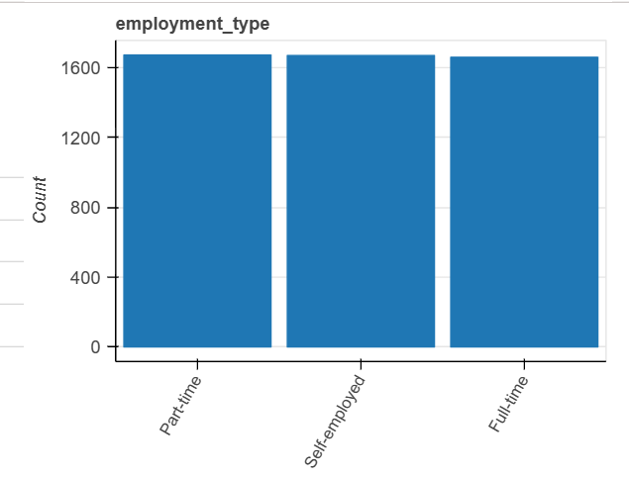
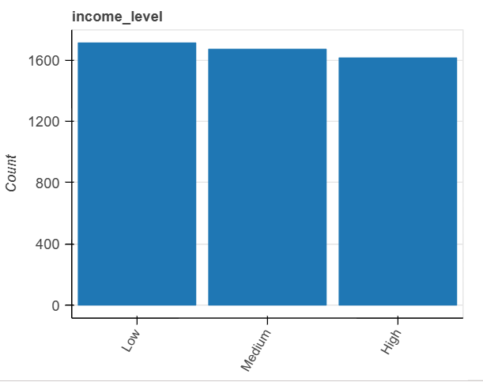
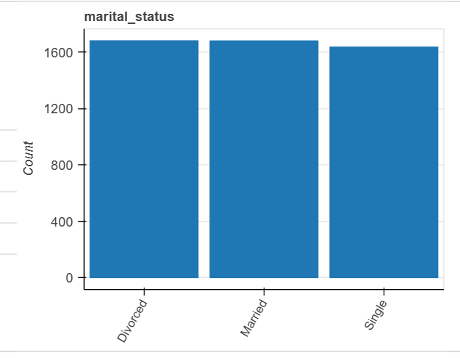
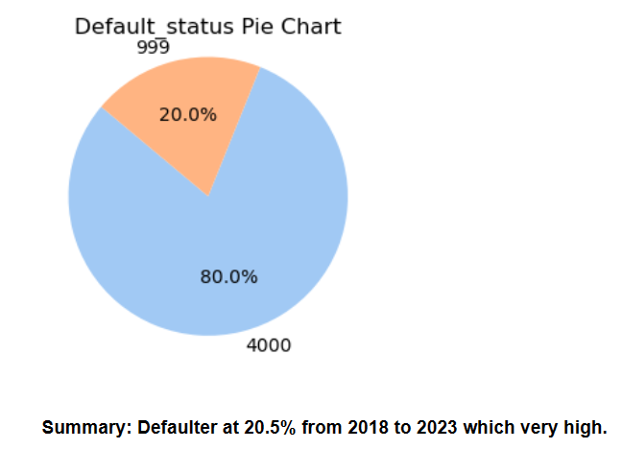
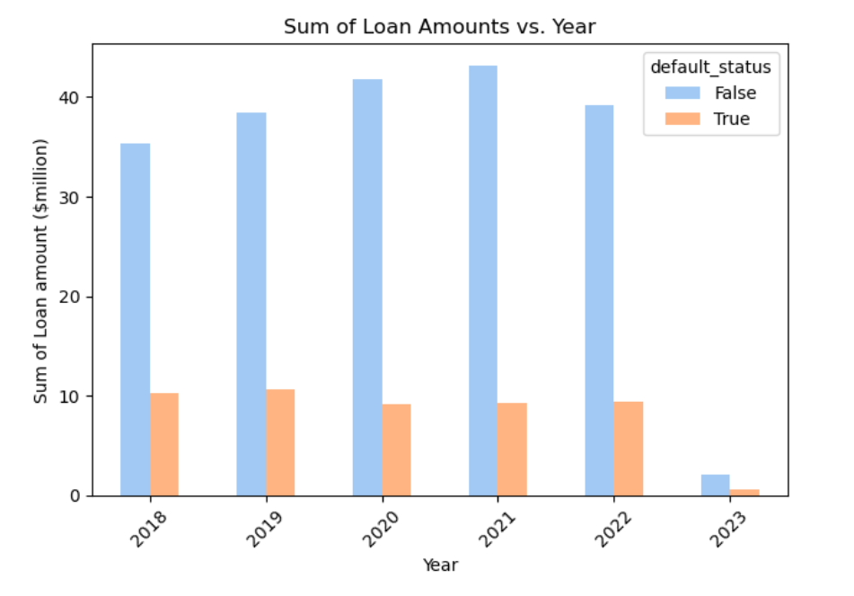
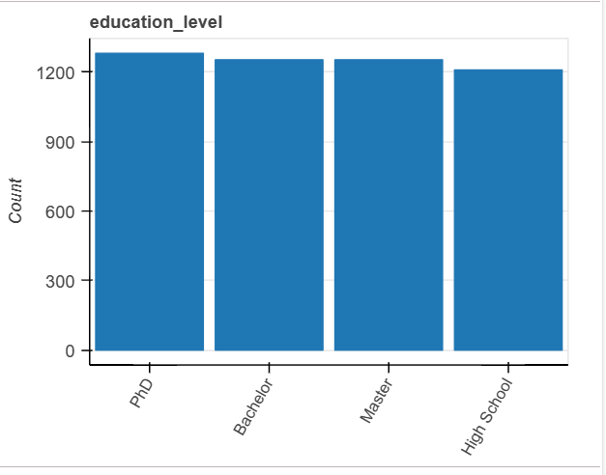
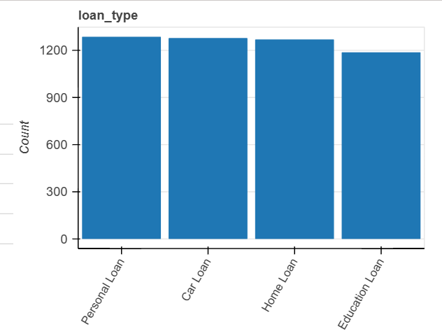
Data Exploratory Analysis (EDA)
What is Education loan Employment type?
Default rate at about 20% year to year. From 2018 to 2023
Sum of Loan count Bar chart.
Employment type: Part-time, Full time, and self-employment took similar count of loan.
Income level: Low took more loan count than Med and High.
Education level: PHD took the most count of loan and high school took lesser loan of count.
Maritial status: Divorced and Married took slightly more loan count than Single
Loan type: Education Loan marginally low count than all.
Summary: Not feasible to conclude. May have a better visualization if Age column is available.
Low income relate to Single?
Interlink?

Slide 6
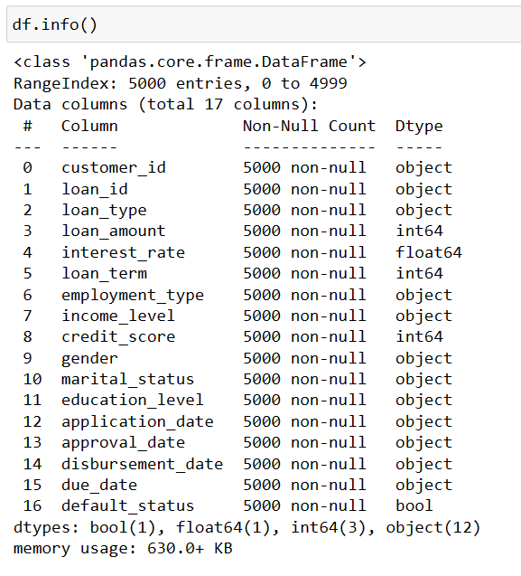
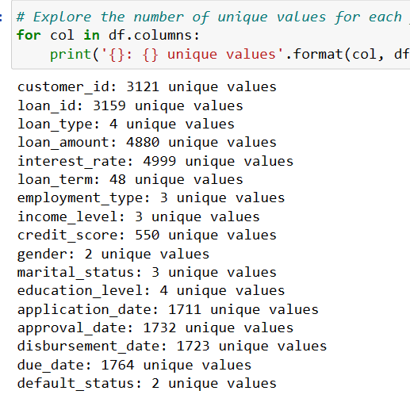
Data Preprocessing (DP)
Total count of entries 5000, with 17 columns
Dtype: Object/int64/float64/bool. Convert to Datetime
All Non-Null, No missing value.
Unique value existed. Customer_id and loan_id have different (by 38) unique value.
Called out duplication for customer_id and Loan_id
Result shown unlikely with assumption of per customer_id and loan_id for one family.
Reason: Gender, Loan years, interest rate are different across duplicate command called out for Loan_id or Customer_id.
Conclusion: it is not a duplication entries and should not be drop.
Datetime conversion
Notes:
loan_id: 3159 unique values> customer_id: 3121 unique values. Different by 38 duplication of customer_id in loan_id. Customer took 2nd loan? Bank reuse ID number or error?

Slide 7
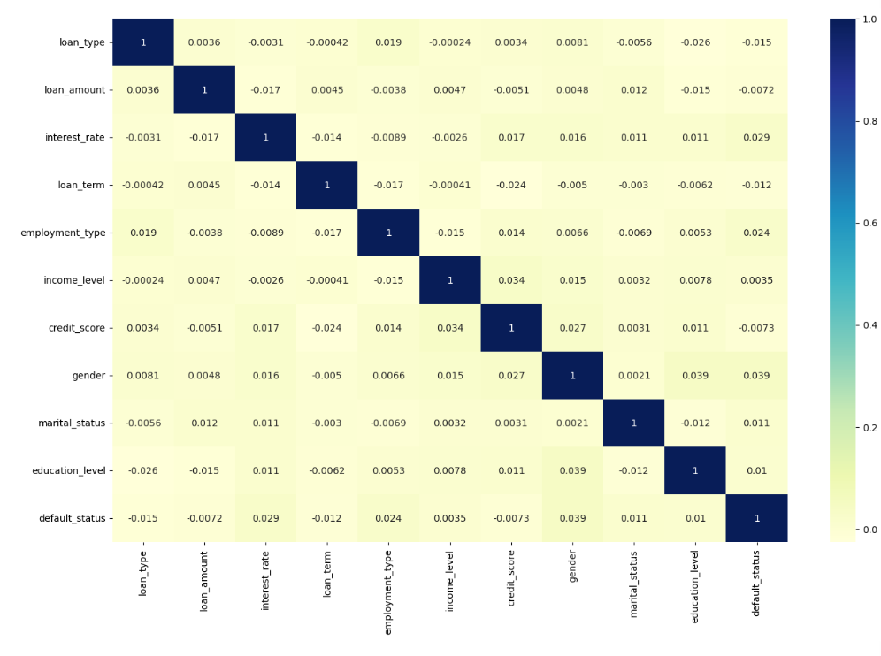
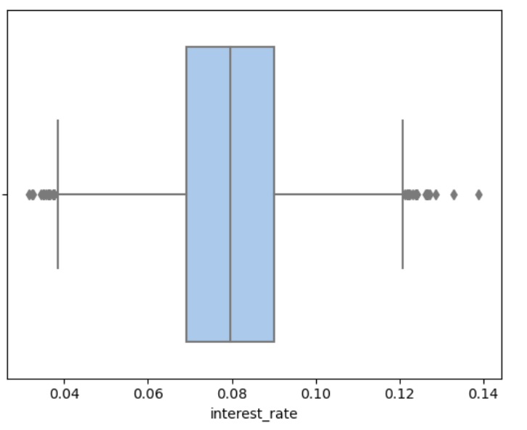
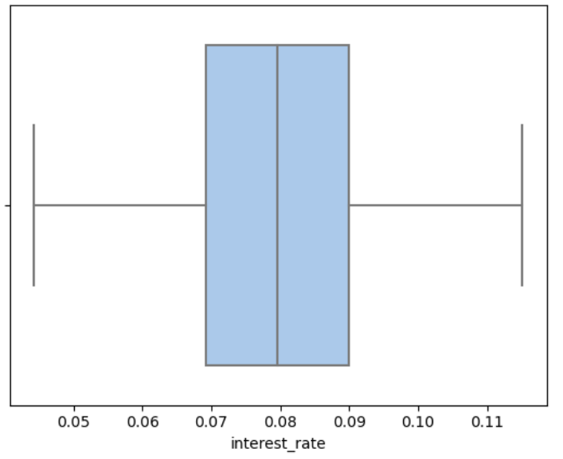
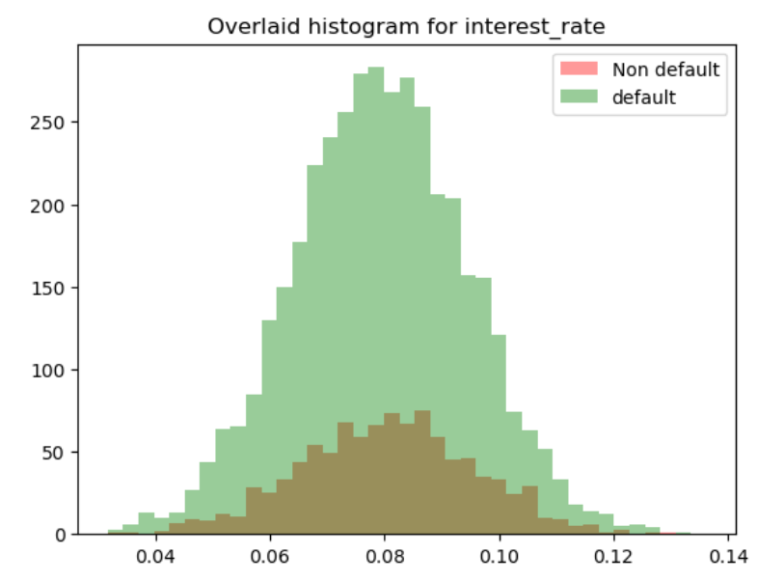
Data Preprocessing(Drop outlier)
Check and Remove Outliers – only for interest rate
Drop: Customer_id, loan_id, all year and date.
Convert all categorical features to numeric levels
Including Target “Default_status” where True = 1, False = 0
Relationship between Target and feature: low correlation value with
Interest rate,
Employment type,
Gender,
have the closer relation, but not a strong relationship.
StandardScaler on feature test and train data.

Slide 8
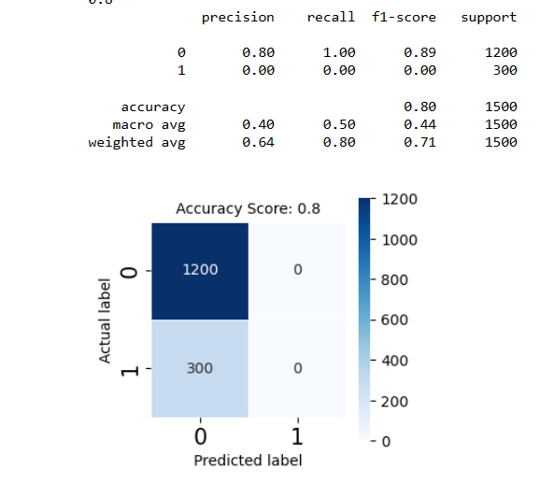
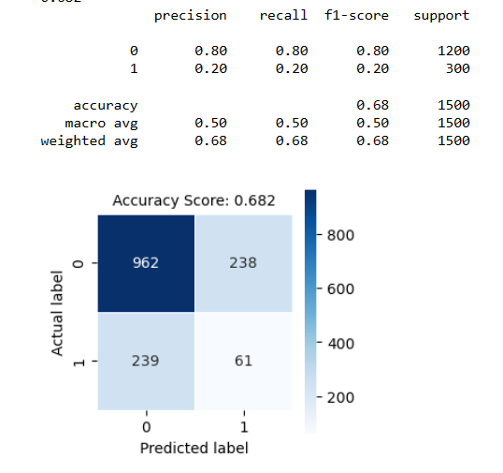
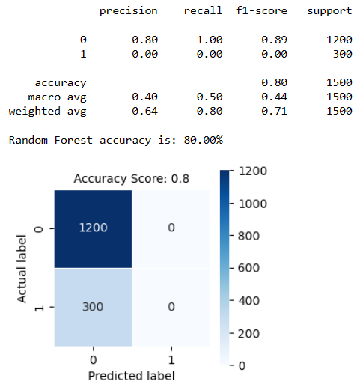
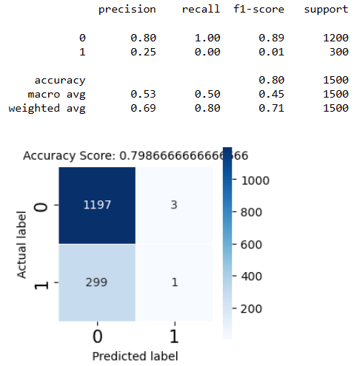
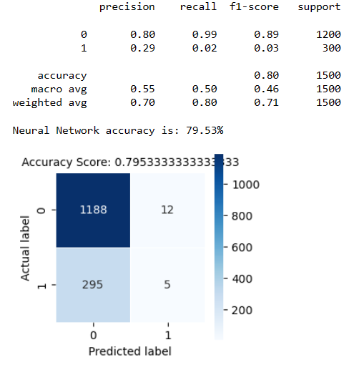
Create ML model
Logistic Regression
Decision tree
Random Forest
XGBoosting
Neural Network

Slide 9
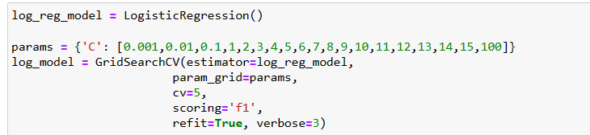
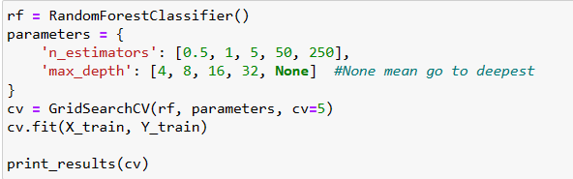

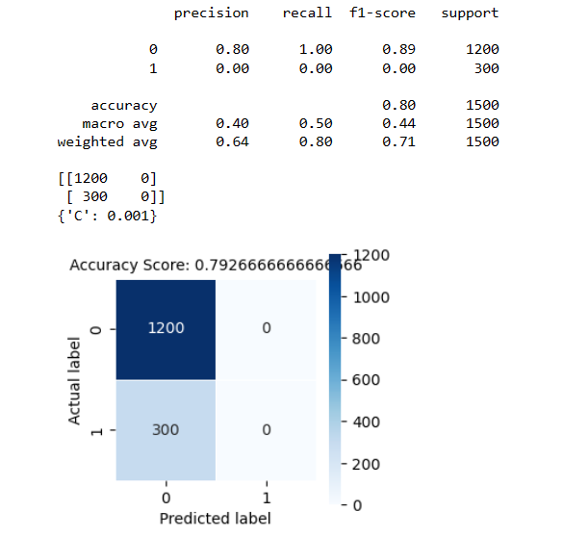
Modeling - Techniques to improve the accuracy Hyperparameter tuning
Logistic Regression
Random Forest

Slide 10
Summary
Overall accuracy of model.
80% both model: Logistic Regression and Random Forest.
After hyperparameter tuning, model still cannot achieve > 90% because:
Data Complexity - inherent noise affecting the accuracy
Feature Selection – Inaccurate, irrelevant, leak of important features can lead to suboptimal predictions.
Which feature in the dataset are important in predicting the target?
Overall weak correlation, but the best are Interest rate, employment type and gender.
Recommendation
To Improve Data Quality by to add below features
Credit History
Extensive elaboration on Income level. From 3 to 5 levels
Employment stability – how long service in their company.
Debt to income ratio
Age of borrower

Slide 11
Thank you
By: Theng foo yin​

Slide 12
Business opportunities are like buses. There's always another one coming.
“
”
Richard Branson

