Slide 1


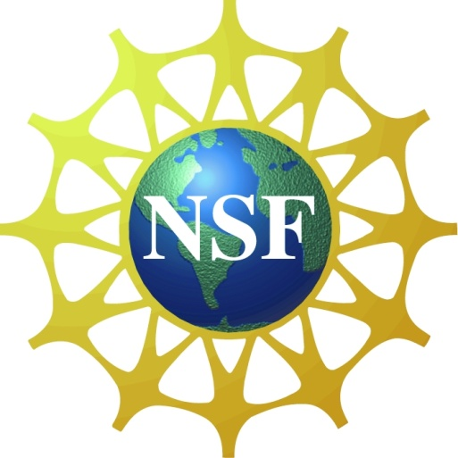

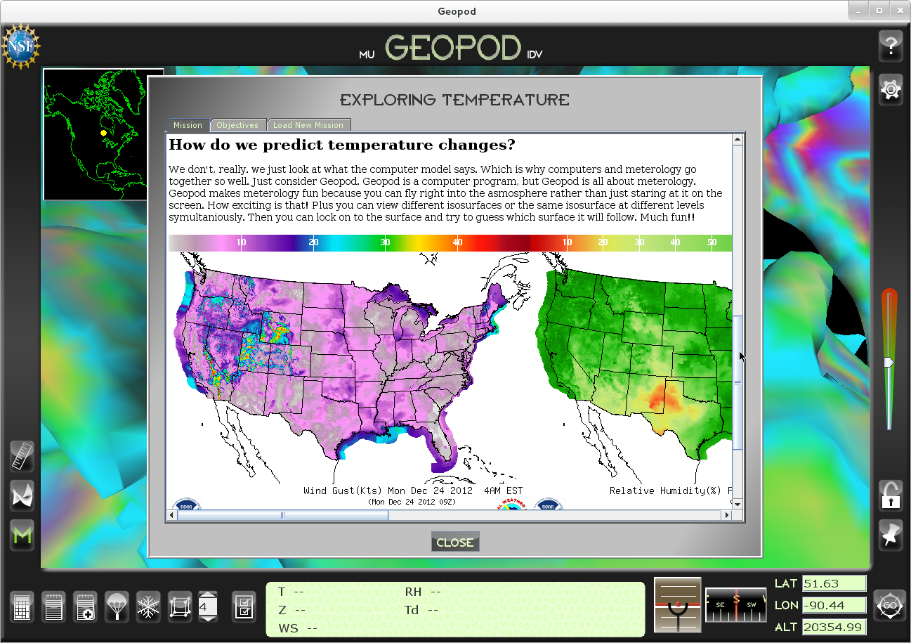
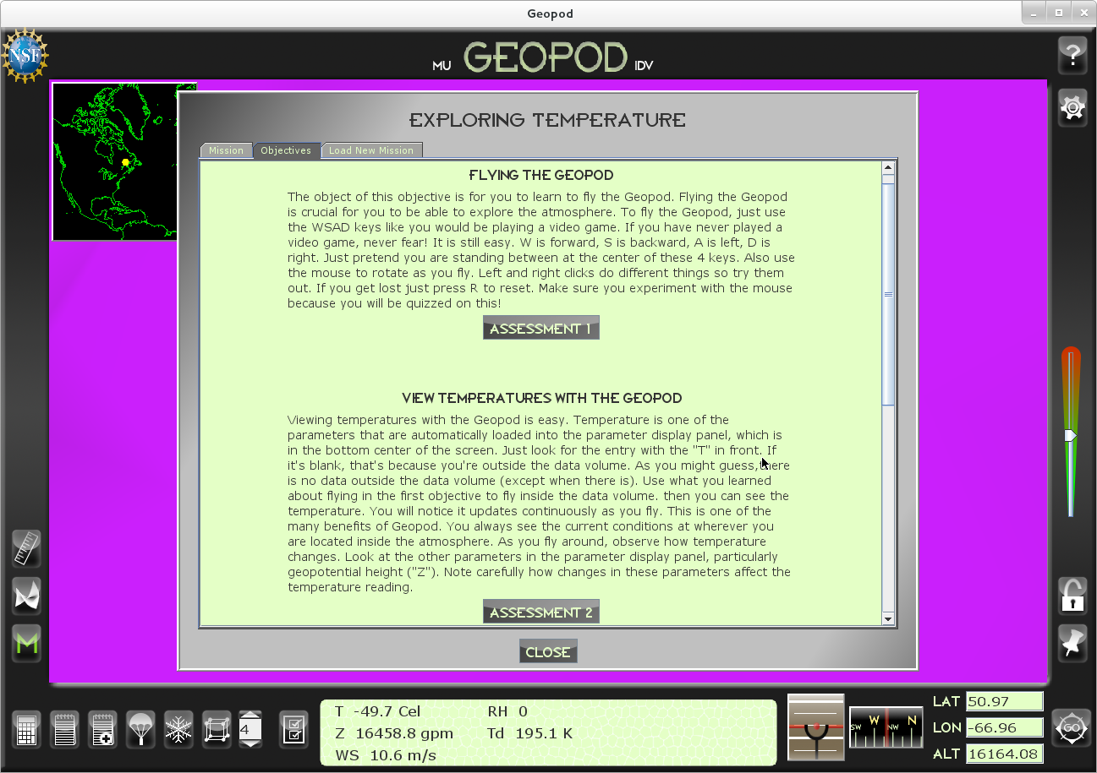
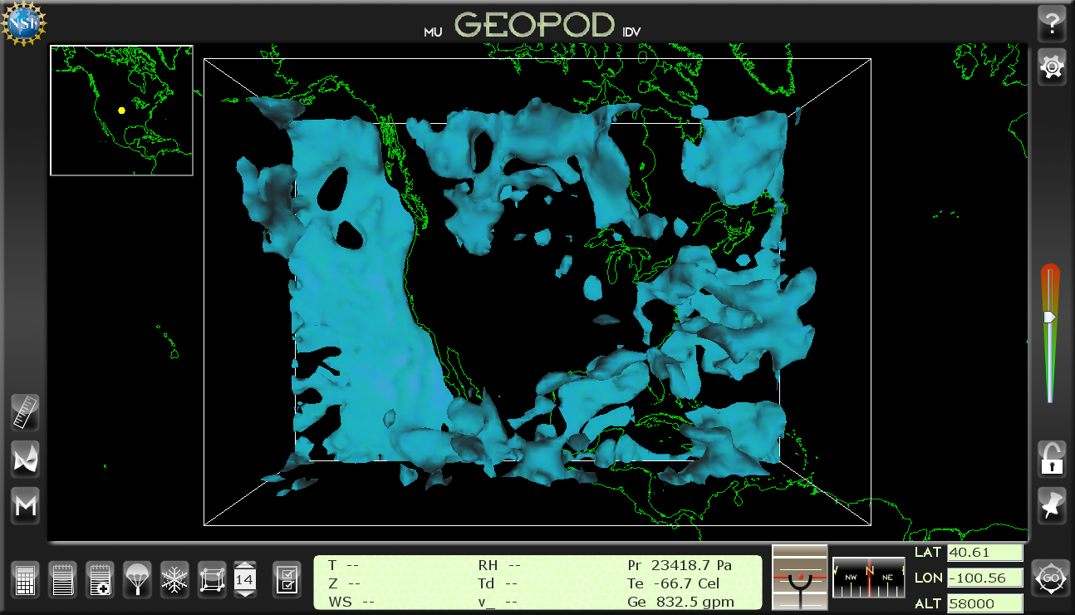
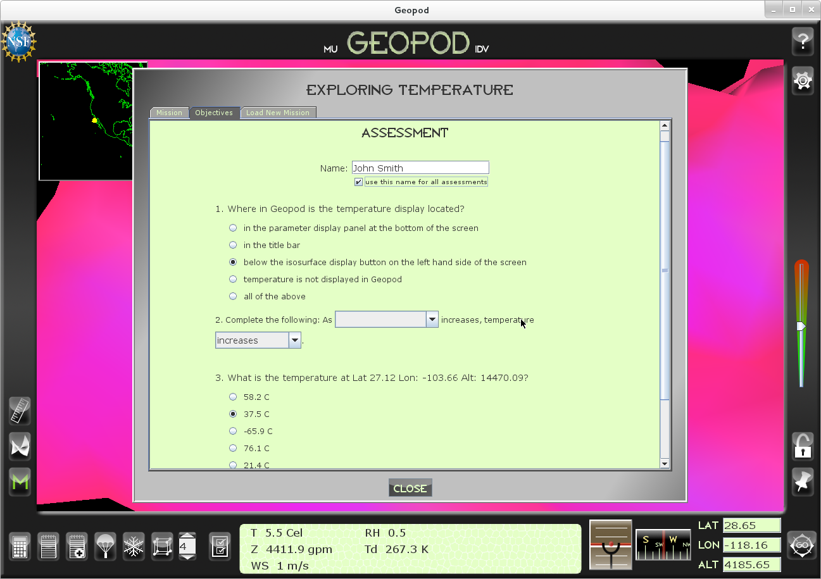
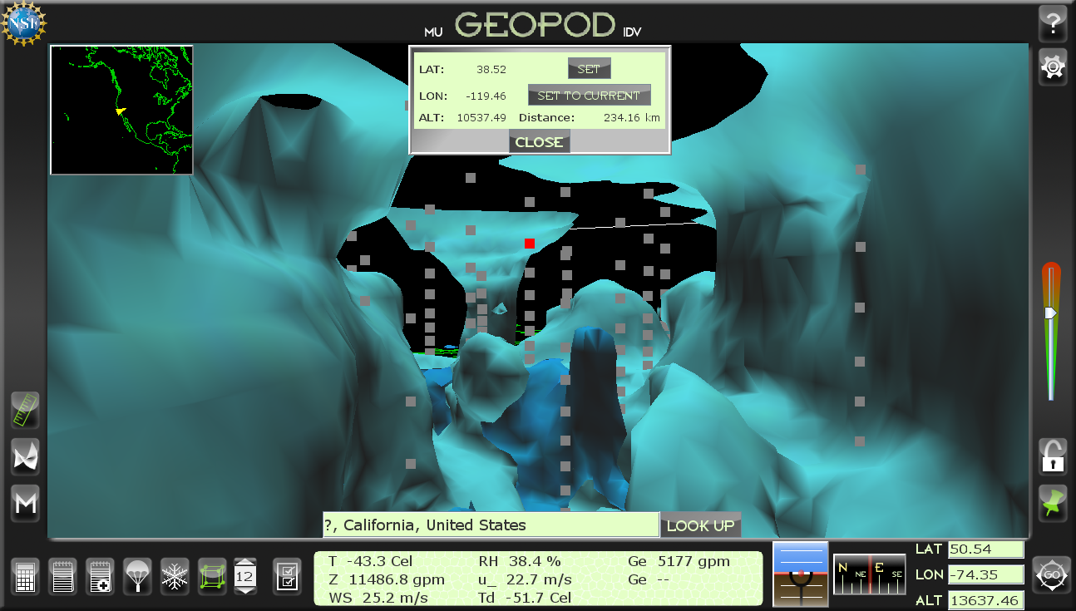
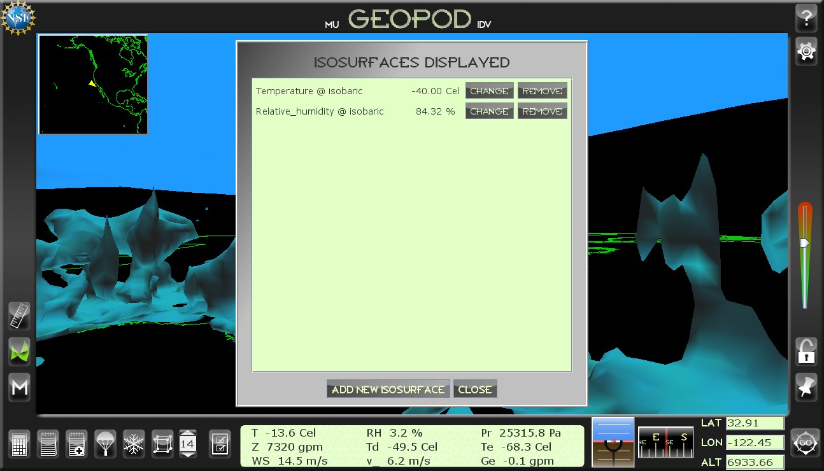
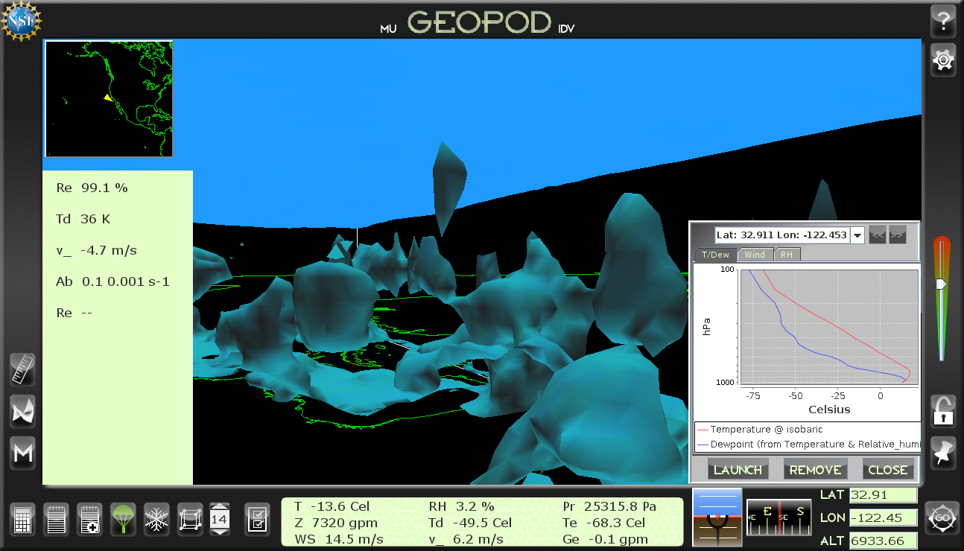
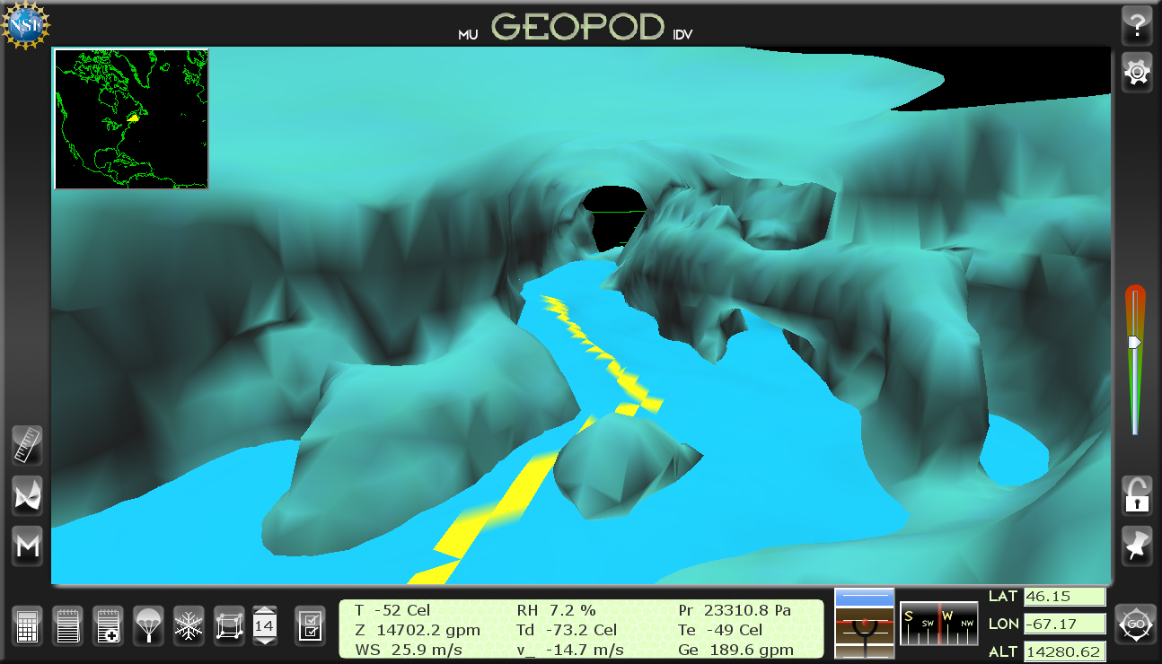
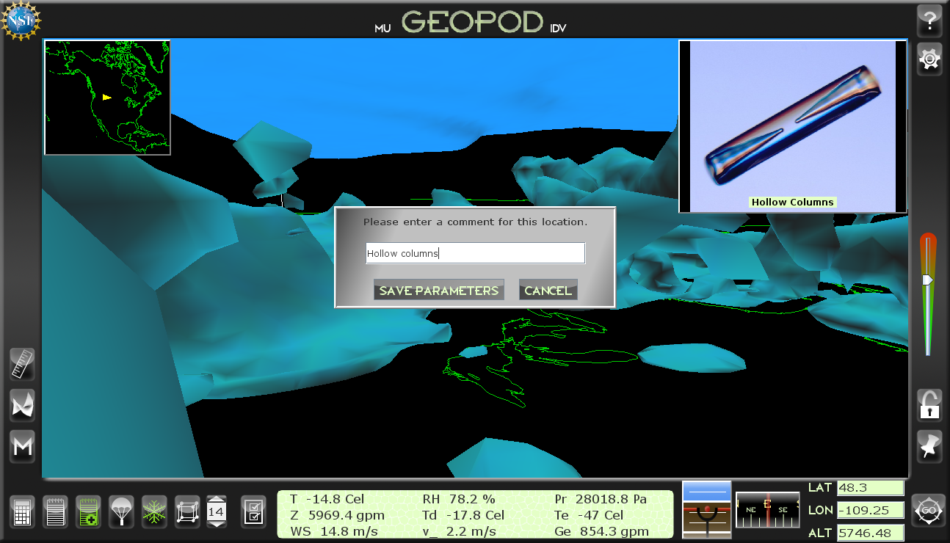
GEOpod: A Navigable Authentic Immersion Environment to Enhance Student Learning
Obetz, Neil T., Young, Lindsey M., Zoppetti, Gary M.*, Yalda, Sepideh*, Clark, Richard D.*, and Macklin, Kathleen J.*
Departments of Earth Sciences and Computer Science
Millersville University, Millersville, PA, 17551
Introduction
Mission Subsystem
Geopod is an interactive application that allows a user to navigate a 3D volume of observations, radar imagery, or gridded fields generated by a numerical weather prediction system (e.g., GFS, WRF, and NAM). As such, Geopod is authentic and physically consistent; it is not a simulation. It significantly leverages the Unidata Program Center's open source Java-based visualization software, the Integrated Data Viewer (IDV), to import and render meteorological data.
The mission subsystem allows educators to create and distribute missions which their students can access directly from Geopod. Using the Mission Builder website, instructors can combine background material with objectives and assessment questions to produce missions precisely tailored to their class goals, or adapt missions already created by other instructors. Students can then view missions, complete their objectives, and respond to assessment questions all while using Geopod.
Background information designed to familiarize student with mission goals.
Objectives give students a list of tasks that promote hands-on learning.
Assessments measure students’ mastery of mission concepts.
A top-down view of the 3D data volume.
The Data Volume
Meteorological Features
Geopod provides the user with the unique experience of flying through the data volume, as opposed to the third-person perspective that IDV offers. This intuitive, engaging interaction style is designed to appeal to students and motivate them to explore the data volume and gain a comprehensive understanding of meteorological concepts. Geopod provides a number of useful devices and features to facilitate and enhance this exploration process, while maintaining a clean, easy-to-use interface which is accessible to novices and experts alike.
Navigation features include keyboard and mouse controls, a compass, a speed slider, an autopilot system capable of traversing isosurfaces, forward and reverse geocoding, and a settings manager.
Customizable display panels with drag-and-drop capability are available to display meteorological parameters. A noted-locations system allows users to comment on and save parameter values at points of interest. A particle imaging device shows crystal formations or water droplets when available, and the dropsonde device gives vertical profiling. A grid point displayer also reveals the underlying dataset and a distance calculator measures distance between data points. An isosurface display manager allows users to view and edit multiple isosurfaces.
Users can view particle formation and note the location.
Users can navigate and explore multiple isosurfaces at a time.
Dropsonde of temperature and dew point. Parameter panel can display up to 20 parameter values.
Shows the trace of Geopod’s path after locking onto an isosurface.
Google geocoding shows location, distance calculator displays distance, and grid point displayer lets users investigate data points.

