Slide 1
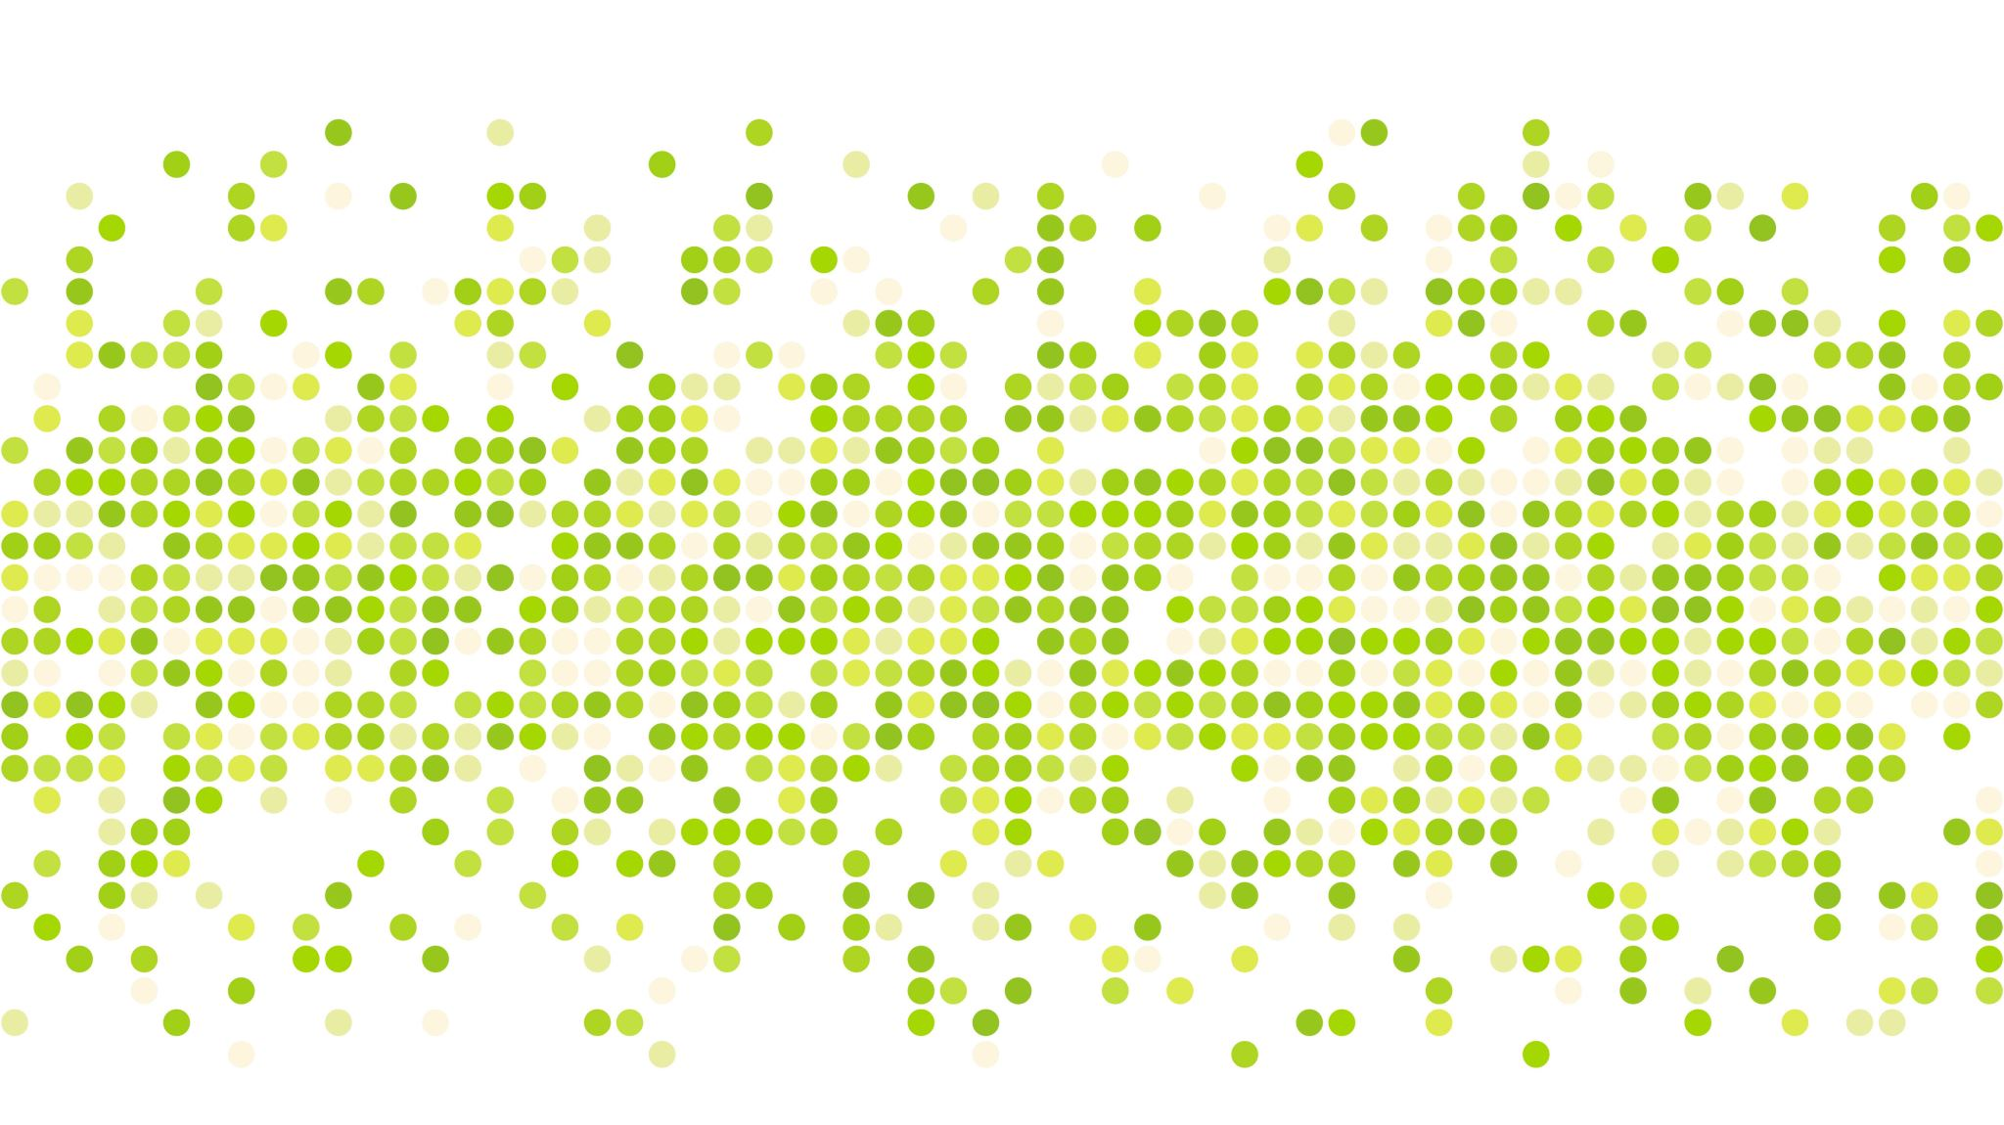
Report Generator
Nick Miller, Ahmed Darwich, Andrew Murphy
Dr. Xiao
Intro to Parallel Processing Final Project

Slide 2

Data
JSON String sent from Web Socket
Converted to:
XML
CSV
XMLS
XMLM
XLT
XLTM

Slide 3
Example Conversion
JSON
XML
{ "race" :
{ "entries" : [
{ "id":11, "name":"Johnson, Smith, and Jones Co." },
{ "id":22, "name":"Sam \"Mad Dog\" Smith" },
{ "id":33, "name":"Barney & Company" },
{ "id":44, "name":"Johnson's Automotive" }
] }
}
<?xml version="1.0" encoding="UTF-8" ?>
<race>
<entries>
<id>11</id>
<name>Johnson, Smith, and Jones Co.</name>
</entries>
<entries>
<id>22</id>
<name>Sam &quot;Mad Dog&quot; Smith</name>
</entries>
<entries>
<id>33</id>
<name>Barney &amp; Company</name>
</entries>
<entries>
<id>44</id>
<name>Johnson&#x27;s Automotive</name>
</entries>
</race>

Slide 4

Algorithm
Written in C#
Server Class with an Event Handler listening for input from websocket
Each thread than converts the data to the output
Each JSON is converted to each data type
Write output to respective file with correct filename.

Slide 5

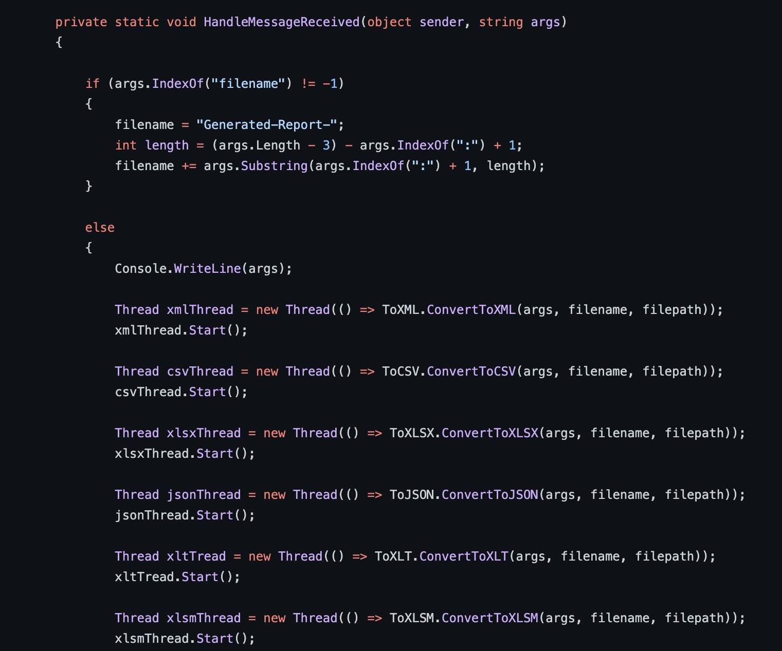
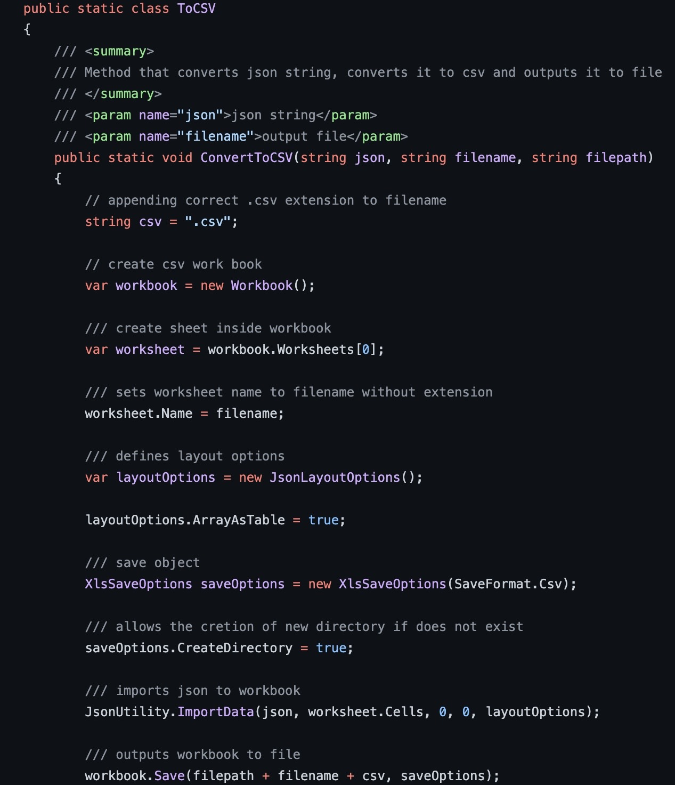
Implementation
Main
ToCSV

Slide 6
Conclusion
Very fun project to work on
Data Manipulation is the future so the experience of working with different data formats was beneficial
C# skills improved (little to no experience before throughout group)

Slide 7
DEMO
Any questions?

