Slide 1
Writing Extension Modules
To Be Interruptible
Zack Weinberg
<zack@millionconcepts.com> or <zack@owlfolio.org>
PyCon 2025
Notes:
Allow me to introducing myself...

Slide 2
Interruptible?
>>> import random
>>> def f(n=100000000):
... return [random.random()
... for _ in range(n)]
...
>>> f()
^CTraceback (most recent call last):
File "<stdin>", line 1, in <module>
File "<stdin>", line 2, in f
KeyboardInterrupt
>>>
>>> import numpy as np
>>> rng = np.random.default_rng()
>>> def g(n=1000000000):
... return rng.random(n)
...
>>> g()
^CTraceback (most recent call last):
File "<stdin>", line 1, in <module>
File "<stdin>", line 2, in g
KeyboardInterrupt
>>>
< 0.1 s
3.5 s

Slide 3
What went wrong
NumPy didn’t call PyErr_CheckSignals inside its loop
Common bug in compiled-code extensions
This talk is about:
  Why extensions need to do that
  Why, today, many extensions don’t do that
  How we can make it easier to do that

Slide 4
Audience Background Check
Raise your hand if...
You’ve written code in a compiled language
  C or assembly, specifically
You’ve written a compiled extension for CPython
  Using the C-API directly, no helper libraries
You’ve written a multithreaded program
You’ve written a signal handler
You know the difference between thread safety
and async signal safety

Slide 5
What Control-C Does¹
Starts out like any other keystroke
Converted to an asynchronous signal, SIGINT
SIGINT delivered to Python interpreter, out of band
Python interpreter reacts by raising KeyboardInterrupt
Normal exception handling for KeyboardInterrupt
¹ Except on Windows
Notes:
Whole bunch of steps from the keyboard that we’re gonna skip over, until we get to the terminal line discipline, inside the kernel, just before characters would be sent to Cpython as regular input, catches ASCII code hex 03 and turns it into an out of band notification called an asynchronous signal. SIGINT. SIG for signal, INT for interrupt.
When that signal is delivered to Cpython, it reacts by raising KeyboardInterrupt, which is handled like any other Python exception.
But there’s a catch, exactly how does it react?
The handler for the C-level signal just sets a flag, and the interpreter doesn’t look at that flag until we get back to a point where it’s safe to raise a Python exception.
At the latest, when we get back to the main interpreter loop.

Slide 6
Signal Delivery During Execution
>>> def f(n=100000000):
... return [random.random()
... for _ in range(n)]
...
>>> f()
^C
Program received signal SIGINT
pymalloc_pool_extend (pool=…, size=1)
at Objects/obmalloc.c:1361
(gdb)
>>> rng = np.random.default_rng()
>>> def g(n=1000000000):
... return rng.random(n)
...
>>> g()
^C
Program received signal SIGINT
random_standard_uniform_fill ()
at 0x00007ffff00b23a7
(gdb)

Slide 7
Signal Delivery During Execution
>>> def f(n=100000000):
... return [random.random()
... for _ in range(n)]
...
>>> f()
^C
Program received signal SIGINT
pymalloc_pool_extend (pool=…, size=1)
at Objects/obmalloc.c:1361
(gdb) signal SIGINT
Continuing with signal SIGINT.
Breakpoint 2, signal_handler
(sig_num=2)
at ./Modules/signalmodule.c:347
(gdb)
>>> rng = np.random.default_rng()
>>> def g(n=1000000000):
... return rng.random(n)
...
>>> g()
^C
Program received signal SIGINT
random_standard_uniform_fill ()
at 0x00007ffff00b23a7
(gdb) signal SIGINT
Continuing with signal SIGINT.
Breakpoint 2, signal_handler
(sig_num=2)
at ./Modules/signalmodule.c:347
(gdb)

Slide 8
Signal Delivery During Execution
Breakpoint 2, signal_handler
(sig_num=2)
at ./Modules/signalmodule.c:347
(gdb) backtrace
#0 signal_handler (sig_num=2)
#1 <signal handler called>
#2 pymalloc_pool_extend (…)
#3 pymalloc_alloc (…)
#4 _PyObject_Malloc (…)
#5 _PyLong_FromMedium (…)
#6 PyLong_FromLong (…)
#7 _PyEval_EvalFrameDefault (…)
#8 PyEval_EvalCode (…)
(etc. etc.)
Breakpoint 2, signal_handler
(sig_num=2)
at ./Modules/signalmodule.c:347
(gdb) backtrace
#0 signal_handler (sig_num=2)
#1 <signal handler called>
#2 random_standard_uniform_fill ()
#3 __pyx_f_5numpy_6random_7_common_double_fill ()
#4 __pyx_pw_5numpy_6random_10_generator_9Generator_15random ()
#5 method_vectorcall_FASTCALL_KEYWORDS (…)
#6 _PyObject_VectorcallTstate (…)
#7 PyObject_Vectorcall (…)
#8 _PyEval_EvalFrameDefault (…)
#9 PyEval_EvalCode (…)

Slide 9
How did we get here???
(gdb) backtrace
#0 signal_handler (sig_num=2)
#1 <signal handler called>
#2 pymalloc_pool_extend (…)
...
(gdb) up
#1 <signal handler called>
(gdb) disassemble
Notes:
So I’m going to show you assembly language.

Slide 10
How did we get here???
(gdb) backtrace
#0 signal_handler (sig_num=2)
#1 <signal handler called>
#2 pymalloc_pool_extend (…)
...
(gdb) up
#1 <signal handler called>
(gdb) disassemble
Assembly dump of __restore_rt:
=> <+0>: mov $SYS_rt_sigreturn,%rax
<+7>: syscall
(gdb)
Notes:
That special stack frame belongs to a function called dunder restore rt. It’s not part of Cpython. It’s not even in the C library. It’s in the “vDSO”, machine code pasted into every process’s address space by the kernel.
All it does is make a system call. “When the signal handler is done executing, tell the kernel it’s done,” that’s what this means.

Slide 11
How did we get here???
(gdb) backtrace
#0 signal_handler (sig_num=2)
#1 <signal handler called>
#2 pymalloc_pool_extend (…)
...
(gdb) up
#1 <signal handler called>
(gdb) disassemble
Assembly dump of __restore_rt:
=> <+0>: mov $SYS_rt_sigreturn,%rax
<+7>: syscall
(gdb) up
#2 pymalloc_pool_extend (…)
(gdb) disassemble
Assembly dump of pymalloc_pool_extend:
...
<+470>: mov %edi,0x8(%rdx)
<+473>: mov %ecx,0x28(%rdx)
=> <+476>: movq $0x0,(%rdi)
<+483>: jmp <+412>
...
Notes:
Up one more. Back to pymalloc pool extend. The little arrow on the left points to the instruction that GDB thinks will be executed next, when we come back to this frame.
What do you not see in this assembly dump?
That’s right, there’s no call instruction.
This is the black magic of signal delivery.
The kernel “preempted” execution of CPython at some arbitrary point, happens to have been inside pymalloc pool extend, faked two stack frames to make the CPU behave as if there was a call to dunder restore rt from just before that movq, and a call to the signal_handler function from just before the first instruction of dunder restore rt.
And then it resumed execution of Cpython at the first instruction of signal handler.
Who thinks it’s safe for Cpython to run the code that throws KeyboardInterrupt right now? Literally right now, interrupting the guts of pymalloc?
It’s not.
That’s why signal handler just sets flags.

Slide 12
The black magic of signal delivery
(gdb) up
#1 <signal handler called>
(gdb) disassemble
Assembly dump of __restore_rt:
=> <+0>: mov $SYS_rt_sigreturn,%rax
<+7>: syscall
(gdb) up
#2 pymalloc_pool_extend (…)
(gdb) disassemble
Assembly dump of pymalloc_pool_extend:
...
<+470>: mov %edi,0x8(%rdx)
<+473>: mov %ecx,0x28(%rdx)
=> <+476>: movq $0x0,(%rdi)
<+483>: jmp <+412>
...
Kernel “preempted” execution of pymalloc_pool_extend
  This can occur after
  any machine instruction
Forged two stack frames to make CPU behave as if pymalloc_pool_extend called __restore_rt which called signal_handler
Resumed execution at first instruction of signal_handler
Notes:
Up one more. Back to pymalloc pool extend. The little arrow on the left points to the instruction that GDB thinks will be executed next, when we come back to this frame.
What do you not see in this assembly dump?
That’s right, there’s no call instruction.
This is the black magic of signal delivery.
The kernel “preempted” execution of CPython at some arbitrary point, happens to have been inside pymalloc pool extend, faked two stack frames to make the CPU behave as if there was a call to dunder restore rt from just before that movq, and a call to the signal_handler function from just before the first instruction of dunder restore rt.
And then it resumed execution of Cpython at the first instruction of signal handler.
Who thinks it’s safe for Cpython to run the code that throws KeyboardInterrupt right now? Literally right now, interrupting the guts of pymalloc?
It’s not.
That’s why signal handler just sets flags.

Slide 13
What Control-C Does¹
Starts out like any other keystroke
Converted to an asynchronous signal, SIGINT
SIGINT delivered to Python interpreter, out of band
Python interpreter reacts by raising KeyboardInterrupt
Normal exception handling for KeyboardInterrupt
C signal handler only sets a flag²
Nothing more happens until control returns to the main interpreter loop (PyEval_EvalFrameDefault)
Main loop checks the flag after some bytecode ops
(not every one!)
  If the flag is set, raises KeyboardInterrupt
¹ Except on Windows
² And cancels pending I/O
Notes:
Whole bunch of steps from the keyboard that we’re gonna skip over, until we get to the terminal line discipline, inside the kernel, just before characters would be sent to Cpython as regular input, catches ASCII code hex 03 and turns it into an out of band notification called an asynchronous signal. SIGINT. SIG for signal, INT for interrupt.
When that signal is delivered to Cpython, it reacts by raising KeyboardInterrupt, which is handled like any other Python exception.
But there’s a catch, exactly how does it react?
The handler for the C-level signal just sets a flag, and the interpreter doesn’t look at that flag until we get back to a point where it’s safe to raise a Python exception.
At the latest, when we get back to the main interpreter loop.

Slide 14
Signals inside compiled extensions
import numpy as np
rng = np.random.default_rng()
def f(n=1000000000):
return rng.random(n)
void random_standard_uniform_fill(
bitgen_t *bitgen_state,
npy_intp cnt,
double *out)
{
npy_intp i;
for (i = 0; i < cnt; i++) {
out[i] = next_double(bitgen_state);
}
}
Breakpoint 2, signal_handler (sig_num=2)
at ./Modules/signalmodule.c:347
(gdb) backtrace
#0 signal_handler (sig_num=2)
#1 <signal handler called>
#2 random_standard_uniform_fill ()
#3 __pyx_f_5numpy_6random_7_common_double_fill ()
#4 __pyx_pw_5numpy_6random_10_generator_9Generator_15random ()
#5 method_vectorcall_FASTCALL_KEYWORDS (...)
#6 _PyObject_VectorcallTstate (...)
#7 PyObject_Vectorcall (...)
#8 _PyEval_EvalFrameDefault (...)
...
NumPy
Function call bytecode
Main interpreter loop
Notes:
We’re a long way from the main interpreter loop.
It’s no more safe to raise KeyboardInterrupt here than it would have been from inside pymalloc; signal_handler is just going to set that flag like it did last time.
The difference is, the loop in the previous code sample was carried out by the interpreter, so it had plenty of chances to check the flag. The loop in this example is inside random_standard_uniform_fill.

Slide 15
Why don’t extensions check for signals?
Abstractly simple
  Call PyErr_CheckSignals periodically
  If it returns −1, treat as failure; abandon work, return

Slide 16
int PyErr_CheckSignals()
Part of the Stable ABI.
This function interacts with Python’s signal handling.
If the function is called from the main thread and under the main Python interpreter, it checks whether a signal has been sent to the processes and if so, invokes the corresponding signal handler. If the signal module is supported, this can invoke a signal handler written in Python.
The function attempts to handle all pending signals, and then returns 0. However, if a Python signal handler raises an exception, the error indicator is set and the function returns −1 immediately (such that other pending signals may not have been handled yet: they will be on the next PyErr_CheckSignals() invocation).
If the function is called from a non-main thread, or under a non-main Python interpreter, it does nothing and returns 0.
This function can be called by long-running C code that wants to be interruptible by user requests (such as by pressing Ctrl-C).
Note: The default Python signal handler for SIGINT raises the KeyboardInterrupt exception.

Slide 17
Why don’t extensions check for signals?
Abstractly simple
  Call PyErr_CheckSignals periodically
  If it returns −1, treat as failure; abandon work, return
Not obvious from docs that you need to do this

Slide 18
Checking for signals
void random_standard_uniform_fill(
bitgen_t *bitgen_state,
npy_intp cnt,
double *out)
{
npy_intp i;
for (i = 0; i < cnt; i++) {
out[i] = next_double(bitgen_state);
}
}
void random_standard_uniform_fill(
bitgen_t *bitgen_state,
npy_intp cnt,
double *out)
{
npy_intp i;
for (i = 0; i < cnt; i++) {
out[i] = next_double(bitgen_state);
+ if (PyErr_CheckSignals() < 0)
+ return -1;
}
}

Slide 19
Checking for signals
void random_standard_uniform_fill(
bitgen_t *bitgen_state,
npy_intp cnt,
double *out)
{
npy_intp i;
for (i = 0; i < cnt; i++) {
out[i] = next_double(bitgen_state);
}
}
±void int random_standard_uniform_fill(
bitgen_t *bitgen_state,
npy_intp cnt,
double *out)
{
npy_intp i;
for (i = 0; i < cnt; i++) {
out[i] = next_double(bitgen_state);
+ if (PyErr_CheckSignals())
+ return -1;
}
+ return 0;
}

Slide 20
Why don’t extensions check for signals?
Abstractly simple
  Call PyErr_CheckSignals periodically
  If it returns −1, treat as failure; abandon work, return
Not obvious from docs that you need to do this
Have to decide where and when to do this
Must propagate the −1 return all the way up your call chain

Slide 21
int PyErr_CheckSignals()
Part of the Stable ABI.
This function interacts with Python’s signal handling.
If the function is called from the main thread and under the main Python interpreter, it checks whether a signal has been sent to the processes and if so, invokes the corresponding signal handler. If the signal module is supported, this can invoke a signal handler written in Python.
The function attempts to handle all pending signals, and then returns 0. However, if a Python signal handler raises an exception, the error indicator is set and the function returns −1 immediately (such that other pending signals may not have been handled yet: they will be on the next PyErr_CheckSignals() invocation).
If the function is called from a non-main thread, or under a non-main Python interpreter, it does nothing and returns 0.
This function can be called by long-running C code that wants to be interruptible by user requests (such as by pressing Ctrl-C).
Note: The default Python signal handler for SIGINT raises the KeyboardInterrupt exception.

Slide 22
Checking for signals without holding the GIL
void random_standard_uniform_fill(
bitgen_t *bitgen_state,
npy_intp cnt,
double *out)
{
npy_intp i;
for (i = 0; i < cnt; i++) {
out[i] = next_double(bitgen_state);
}
}
±void int random_standard_uniform_fill(
bitgen_t *bitgen_state,
npy_intp cnt,
double *out)
{
npy_intp i;
+ PyGILState_STATE st;
+ int err;
for (i = 0; i < cnt; i++) {
out[i] = next_double(bitgen_state);
+ st = PyGILState_Ensure();
+ err = PyErr_CheckSignals();
+ PyGILState_Release(st);
+ if (err) return err;
}
+ return 0;
}

Slide 23
Why don’t extensions check for signals?
Abstractly simple
  Call PyErr_CheckSignals periodically
  If it returns −1, treat as failure; abandon work, return
Not obvious from docs that you need to do this
Must propagate the −1 return all the way up your call chain
PyErr_CheckSignals can run arbitrary Python code
  Needs to be safe to run arbitrary Python
  May need to reclaim the GIL (expensive)

Slide 24
A more complicated example
static void kf_work(
kiss_fft_cpx *Fout,
const kiss_fft_cpx *f,
const size_t fstride,
const struct kiss_fft_factor *factors,
const kiss_fft_state *st)
{
kiss_fft_cpx *Fout_beg = Fout;
const uint32_t p = factors->radix;
const uint32_t m = factors->stride;
const kiss_fft_cpx *Fout_end = Fout + p * m;
if (m == 1) {
do {
*Fout = *f;
f += fstride;
} while (++Fout != Fout_end);
} else {
do {
kf_work(Fout, f, fstride * p, factors + 1, st);
f += fstride;
} while ((Fout += m) != Fout_end);
}
Fout = Fout_beg;
switch (p) {
case 2:
kf_bfly2(Fout, fstride, st, m);
break;
case 4:
kf_bfly4(Fout, fstride, st, m);
break;
default:
abort();
}
}

Slide 25
A more complicated example
static void kf_work(
kiss_fft_cpx *Fout,
const kiss_fft_cpx *f,
const size_t fstride,
const struct kiss_fft_factor *factors,
const kiss_fft_state *st)
{
kiss_fft_cpx *Fout_beg = Fout;
const uint32_t p = factors->radix;
const uint32_t m = factors->stride;
const kiss_fft_cpx *Fout_end = Fout + p * m;
if (m == 1) {
do {
*Fout = *f;
f += fstride;
} while (++Fout != Fout_end);
} else {
do {
kf_work(Fout, f, fstride * p, factors + 1, st);
f += fstride;
} while ((Fout += m) != Fout_end);
}
Fout = Fout_beg;
switch (p) {
case 2:
kf_bfly2(Fout, fstride, st, m);
break;
case 4:
kf_bfly4(Fout, fstride, st, m);
break;
default:
abort();
}
}
{
PyGILState_STATE s = PyGilState_Ensure();
int err = PyErr_CheckSignals();
PyGILState_Release(s);
if (err) return err;
}

Slide 26
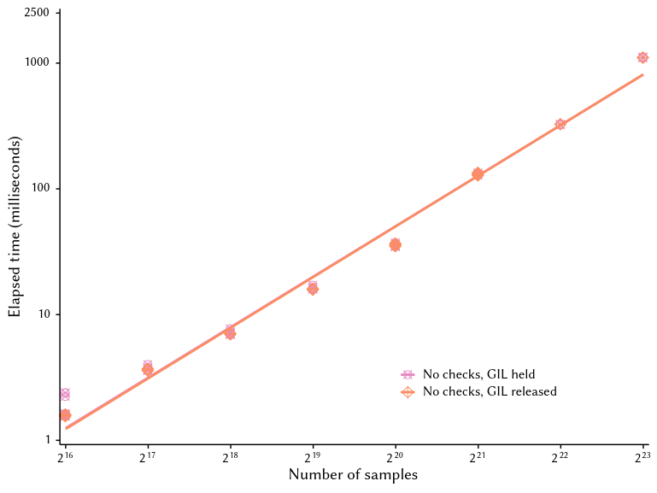
Cost of checking for signals

Slide 27
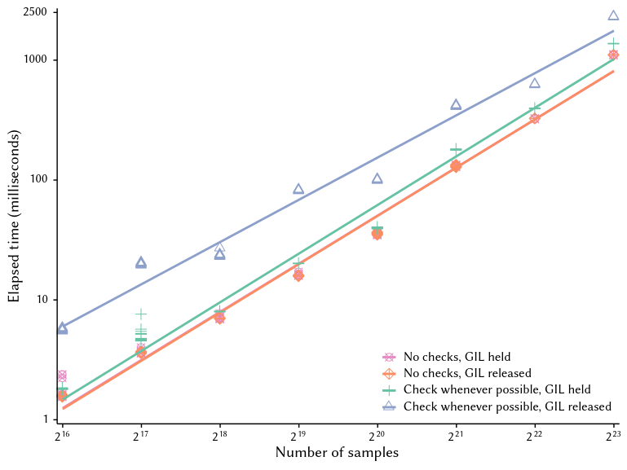
Cost of checking for signals

Slide 28
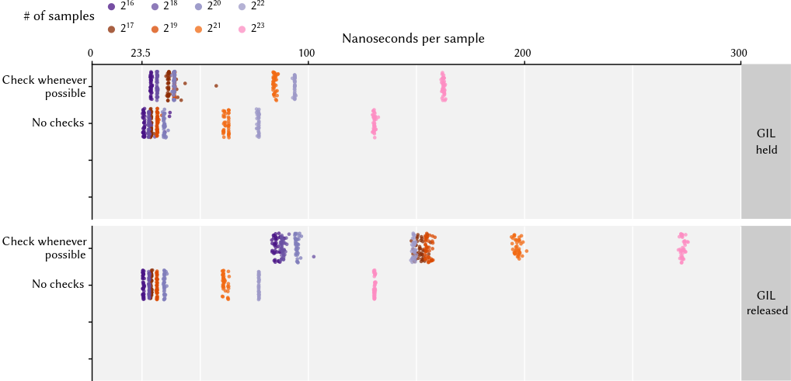
Cost of checking for signals

Slide 29
What if we didn’t check every single time?
static void kf_work(
kiss_fft_cpx *Fout,
const kiss_fft_cpx *f,
const size_t fstride,
const struct kiss_fft_factor *factors,
const kiss_fft_state *st)
{
kiss_fft_cpx *Fout_beg = Fout;
const uint32_t p = factors->radix;
const uint32_t m = factors->stride;
const kiss_fft_cpx *Fout_end = Fout + p * m;
if (m == 1) {
do {
*Fout = *f;
f += fstride;
} while (++Fout != Fout_end);
} else {
do {
kf_work(Fout, f, fstride * p, factors + 1, st);
f += fstride;
} while ((Fout += m) != Fout_end);
}
Fout = Fout_beg;
switch (p) {
case 2:
kf_bfly2(Fout, fstride, st, m);
break;
case 4:
kf_bfly4(Fout, fstride, st, m);
break;
default:
abort();
}
}
{
struct timespec ts;
clock_gettime(CLOCK_MONOTONIC, &ts);
uint64_t now =
ts.tv_sec * NS_PER_S + ts.tv_usec;
if (now - last_check >= ONE_MILLISECOND) {
PyGILState_STATE s = PyGilState_Ensure();
int err = PyErr_CheckSignals();
PyGILState_Release(s);
if (err) return err;
last_check = now;
}
}

Slide 30
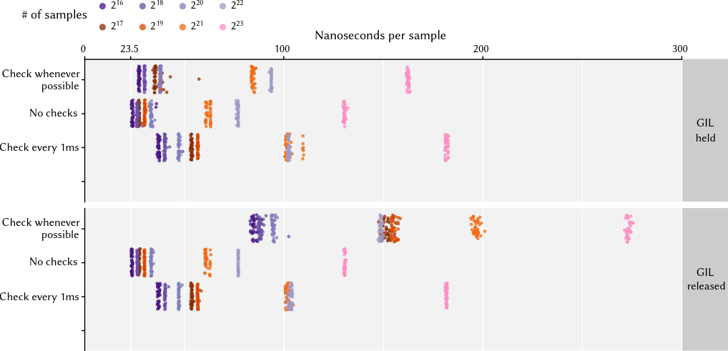
What if we didn’t check every single time?

Slide 31
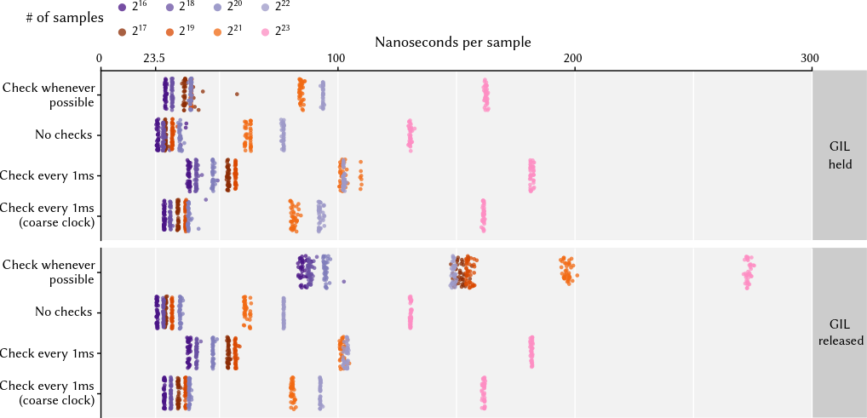
Claw back a little more speed with coarse clock

Slide 32
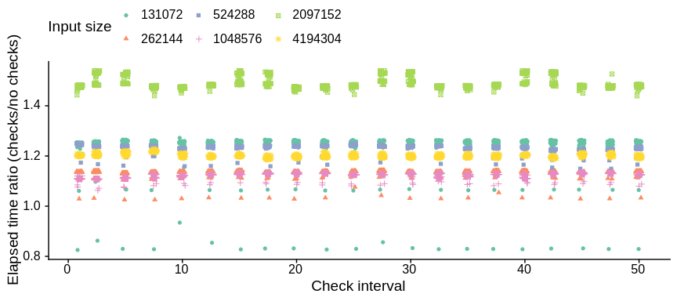
1ms seems tiny but bigger intervals don’t help

Slide 33
Recommendation
#ifndef CLOCK_MONOTONIC_COARSE
#define CLOCK_MONOTONIC_COARSE CLOCK_MONOTONIC
#endif
#define ONE_MS_IN_NS 1000000
#define ONE_S_IN_NS 1000000000
int CheckSignalsOftenEnough()
{
static struct timespec last_check;
struct timespec now;
clock_gettime(CLOCK_MONOTONIC_COARSE, &now);
if ( now.tv_sec < last_check.tv_sec // monotonic clock went backward?!
|| now.tv_sec > last_check.tv_sec + 1 // more than 1s since last check
|| (now.tv_sec == last_check.tv_sec
&& now.tv_nsec > last_check.tv_nsec + ONE_MS_IN_NS) // same second, more than 1ms in ns
|| now.tv_nsec + ONE_S_IN_NS > last_check.tv_nsec + ONE_MS_IN_NS // different second, ditto
) {
last_check = now;
PyGILState_STATE s = PyGilState_Ensure();
int err = PyErr_CheckSignals();
PyGILState_Release(s);
return err;
}
return 0;
}

Slide 34
Recap
CPython interpreter cannot raise KeyboardInterrupt directly from its C-level signal handler
  Must return to main interpreter loop before raising exceptions
  Prompt return needs cooperation from compiled-code extensions
Many extensions do not cooperate
  Need to do this has not been well advertised
  Retrofit requires finicky code changes
  Substantial runtime costs

Slide 35
How can we make this better?
Improve core documentation
  Highlight need to call PyErr_CheckSignals regularly
  Explain how to do so safely
  Explain how to do so efficiently

Slide 36
How can we make this better?
Don’t require GIL to call PyErr_CheckSignals
  Cost of frequent checks is mostly cost of locking
  Signal flag is already an atomic variable! Don’t need GIL to test it
  Have PyErr_CheckSignals claim GIL itself, only if flag is set
  (Still needs to be safe to take GIL at any callsite)
  Proposed for Python 3.14: <<TODO: pull request URL>>

Slide 37
How can we make this better?
Make Cython, Numba, and similar tools insert checks for you
cdef random_standard_uniform_fill(
bitgen gen,
double [:] out,
) nogil:
for i in range(len(out)):
out[i] = next_double(gen)
int __pyx_f_4demo_random_standard_uniform_fill(
bitgen gen,
__Pyx_memviewslice out
) {
Py_ssize_t i;
Py_ssize_t len;
len = __Pyx_MemoryView_Len(out);
for (i = 0; i < len; i += 1) {
i = i;
*((double *) ((out.data + i * out.strides[0]))) =
next_double(gen);
}
return 0;
}

Slide 38
How can we make this better?
Make Cython, Numba, and similar tools insert checks for you
cdef random_standard_uniform_fill(
bitgen gen,
double [:] out,
) nogil:
for i in range(len(out)):
out[i] = next_double(gen)
int __pyx_f_4demo_random_standard_uniform_fill(
bitgen gen,
__Pyx_memviewslice out
) {
Py_ssize_t i;
Py_ssize_t len;
len = __Pyx_MemoryView_Len(out);
for (i = 0; i < len; i += 1) {
i = i;
*((double *) ((out.data + i * out.strides[0]))) =
next_double(gen);
if (CheckSignalsOftenEnough()) return -1;
}
return 0;
}

Slide 39
How can we make this better?
In tools like PyO3, model control-C as async cancellation
#[pyfunction]
async fn random_standard_uniform_fill(
#[pyo3(cancel_handle)] mut cancel: CancelHandle,
gen: BitGen,
out: &mut f64[],
) {
futures::select! {
cancel.cancelled.fuse() => {},
_ => {
for i in 0..out.len() {
out[i] = gen.next_double();
}
}
}
}

Slide 40
How can we make this better?
Brainstorming time!
  Call out additional ideas
  Or ask a question
  One sentence per person

