Slide 1
Group 20
CPSC-233
- Reeyan Maknojiya, Ranadip Chatterjee, Renji Takeda, Shehzan Murad Ali

Slide 2
IDEA : Football Penalty shootout game. CATEGORY: Animation Application / Game.
We intend to make a simple penalty shootout game, which prompts the user to give inputs using the keyboard.
The user will have an option to choose their favourite football player who will take the shot and the goalkeeper, both from a list of players.
The action executed would be to shoot the ball in the goal.
A number (between 1 and 6) is randomly generated to determine where the keeper will dive.
If the goalkeeper guesses it right he saves the shot, else you score!
The player will get a total of 5 chances to score(or miss!).
The score will be updated and maintained immediately after an action.

Slide 3
CLASS DIAGRAM

Slide 4
What we plan to do next…
After this, we plan to improve our game significantly. One of the ideas is to consider factors such as speed of the ball which will also determine if the player scores or misses.
To make the game entertaining, in the final GUI version, we’d like to incorporate player and goalkeeper celebrations.

Slide 5
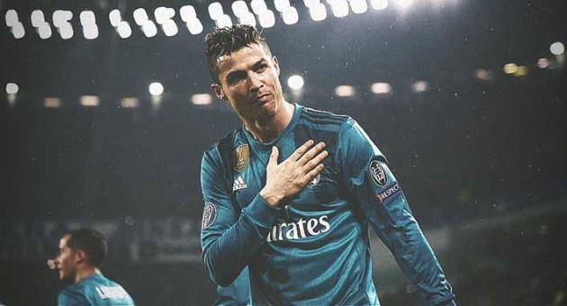
THANK YOU
:)

