Slide 1
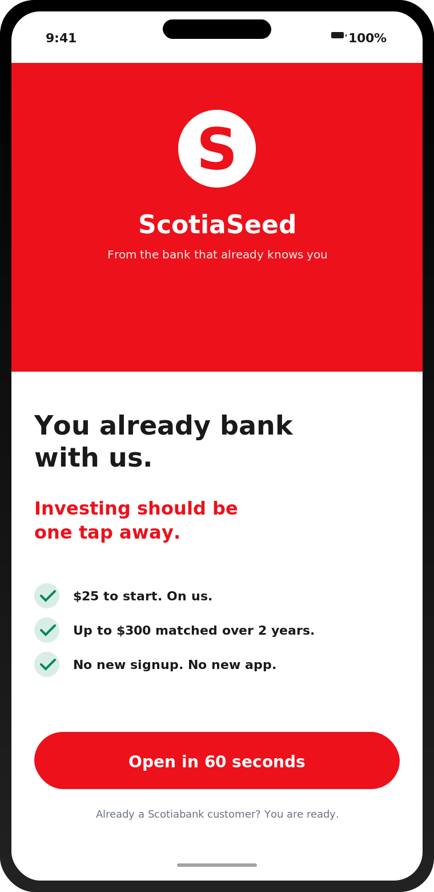
Imagine someone.
She is twenty-two.
Scotia chequing customer since she was sixteen.
Last Tuesday, she opened Wealthsimple.
SCOTIASEED
Closing the Gap. caseHacks 2026.
SCOTIASEED . CASEHACKS 2026
1 / 10

Slide 2
THE GAP
Scotia has the deposit. Wealthsimple has the investor.
Same eighteen to thirty-four cohort. Different relationship. The gap widens every quarter.
WEALTHSIMPLE AUA
OF CANADIANS 18 TO 40
WEALTH TRANSFER, BY 2026
$125B
1 in 5
$1T
Q1 2026. Up 71% year over year.
now use Wealthsimple.
Boomers to younger generations.
Whoever builds investment relationships with younger Canadians now will manage the next trillion.
SCOTIASEED . CASEHACKS 2026
2 / 10

Slide 3
WHY THEY DISENGAGE
It is not the money. It is the confidence.
From the case exhibits. The barriers for 18 to 34 Canadians.
45%
43%
84%
36%
not confident in their investment knowledge
uncertain where to begin investing
feel negative emotions about RRSP contributions
confident in basic retirement mechanics, vs 69% of 55+
"The barrier to first investment among younger Canadians is more often confidence and clarity than it is capital."
Scotiabank case package, page six.
SCOTIASEED . CASEHACKS 2026
3 / 10

Slide 4
OUR INVISIBLE WEDGE
Five things fintechs cannot copy.
Wealthsimple competes on simplicity. We compete on already being there.
01
02
03
04
05
Pre-verified identity
$1.1M protection stack
Native FHSA
Instant internal transfers
Trust where trust is lowest
FINTRAC Method 5 reuses the KYC we already did for chequing. No re-upload. Onboarding drops from 25 minutes to 5.
CDIC on cash, CIPF on securities. Wealthsimple engineered this through partner banks. Scotia has it built in.
The bulk of FHSA contributors are 25 to 34. Solves the housing anxiety and retirement anxiety double bind, in one product.
Round-ups and PAC move in real time. No 1 to 3 day delay. No NSF risk. No external account linking.
82% of 18 to 24 year olds get financial info from social media. Scotia is the credible alternative they already chose.
SCOTIASEED . CASEHACKS 2026
4 / 10

Slide 5
THE MECHANIC
ScotiaSeed. A two-year matched path from zero to investor.
The bonus is the hook. The auto-PAC is the moat. The two-ledger UI is the trust.
$25
$25
$50
$100
$100
Account opened
Education complete
Recurring PAC set up
Month 12 anniversary
Month 24 graduation
Pre-fill from Scotia banking. Five plain questions.
Five short lessons. Five minutes total.
At least $25 a month, proven over 3 months.
Still contributing. Crosses retention cliff one.
Still contributing. Crosses retention cliff two.
$300 lifetime cap. Paid only on engagement. Plus a 2 cent round-up on every Scotia purchase, capped at $50 over the program.
SCOTIASEED . CASEHACKS 2026
5 / 10

Slide 6
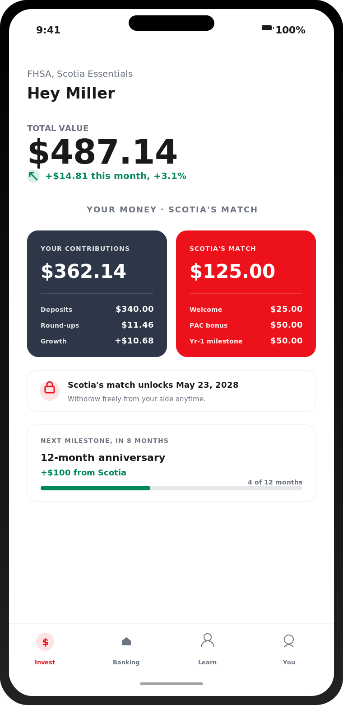
THE HERO UI
Two ledgers. Total trust.
Users see their money and Scotia's match side by side, from day one.
Your money
Deposits, round-ups, growth. Withdraw freely. No clawback, ever.
Scotia's match
Locked for 24 months. Visible from the start. The carrot you can see growing.
The forfeiture rule
Withdraw into Scotia's portion, you have 90 days to restore it. After that, the program ends. No surprises.
Vanguard: 9 in 10 auto-enrolled stay invested at three years. Defaults beat incentives. We use both.
SCOTIASEED . CASEHACKS 2026
6 / 10

Slide 7
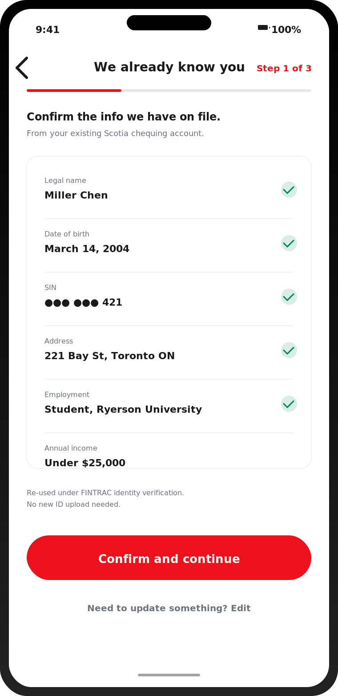
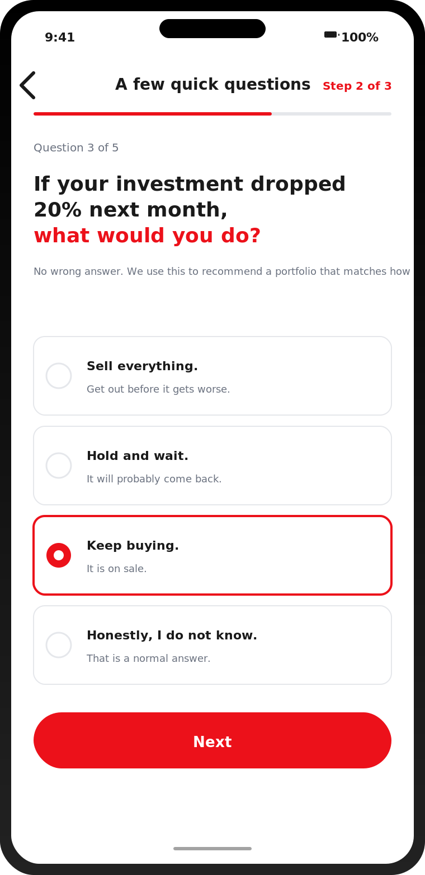
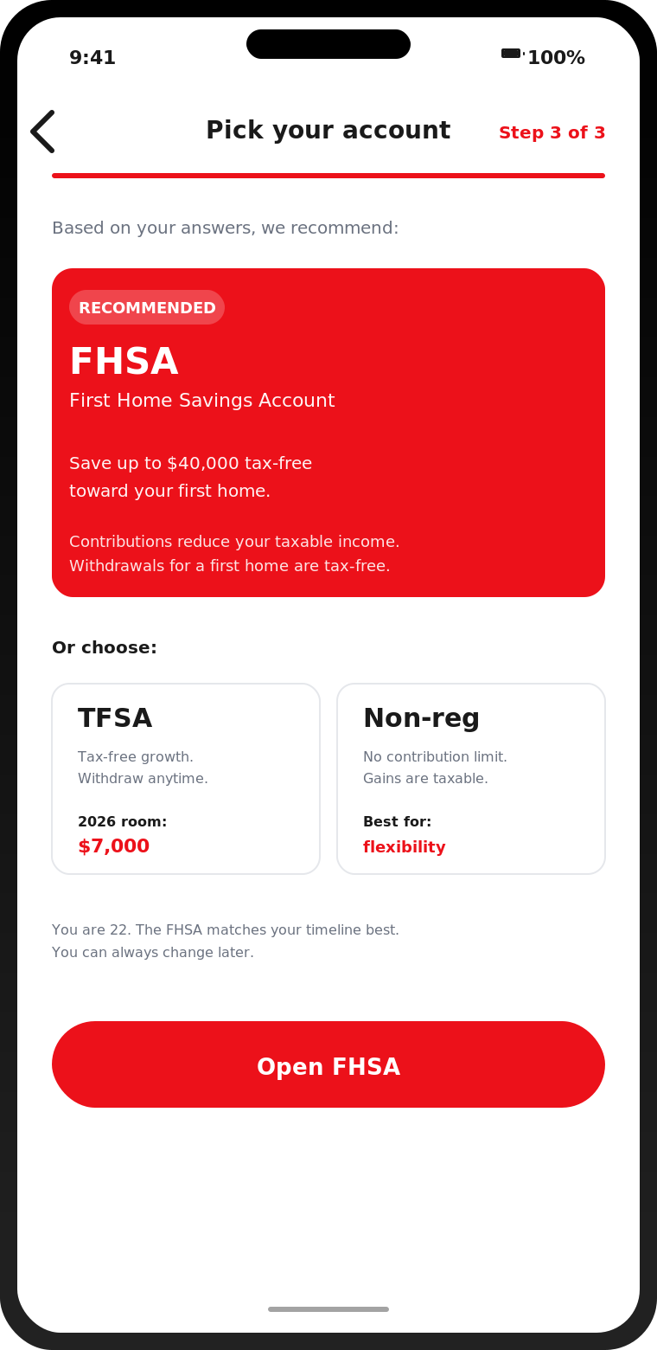
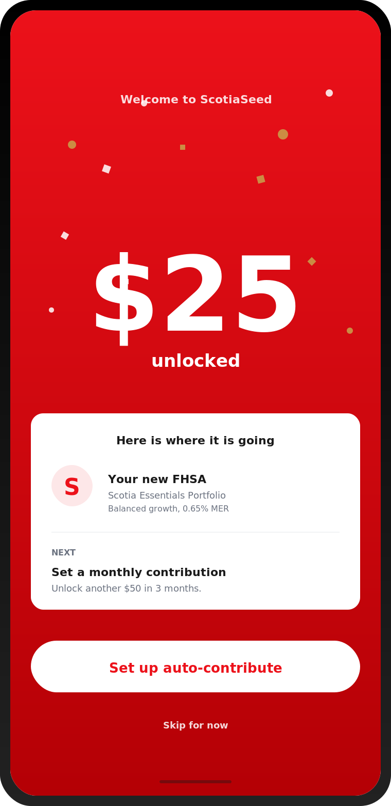
THE FLOW
From chequing customer to invested in under five minutes.
1. Hook
2. Pre-filled KYC
3. Plain-language risk
4. FHSA recommended
5. $25 unlocked
SCOTIASEED . CASEHACKS 2026
7 / 10

Slide 8
THE NUMBERS
$300 in. Three to six thousand out. Defensible.
CUSTOMER ACQUISITION COST. INDUSTRY CONTEXT.
EXPECTED 20-YEAR VALUE PER USER
Banking-industry CLV benchmark
$2,000 to $4,500
FHSA into mortgage attach
plus $1,500
Wealth transfer optionality
embedded
ScotiaSeed effective NPV at 7%
$3,000 to $6,000
10x to 20x ROI on a fully converted user.
Scotia already spends $175 to acquire a student chequing account through July 2026. We redirect $125 more to convert that same person into an investor.
SCOTIASEED . CASEHACKS 2026
8 / 10

Slide 9
ALIGNMENT AND TIMELINE
Two of Scotia's four pillars. Eighteen months to launch.
SCOTIA STRATEGIC PILLAR
SCOTIA STRATEGIC PILLAR
"Earn primary client relationships"
"Make it easy to do business with us"
Convert the deposit relationship into a primary investing relationship, before fintechs do.
Collapse investment account onboarding into a five-minute upgrade of an existing chequing relationship.
18-MONTH ROLLOUT
Q3 2026
Q1 2027
Q3 2027
Q1 2028
Build
Student pilot
Broaden
Full launch
KYC reuse API. Two-ledger UI. Education modules. Forfeiture engine.
20,000 Preferred Package for Students and Youth customers. Validate retention curve.
Roll to 18 to 24 non-students. Iterate on milestone unlock structure.
All 18 to 34. Marketing, social, FHSA hero campaign.
SCOTIASEED . CASEHACKS 2026
9 / 10

Slide 10
Young Canadians are getting
financial advice from TikTok.
Scotia can do better.
ScotiaSeed. The bank that already has them. Converting them into the investors who stay for a lifetime.
THE FIRST STEP IS ON US.
SCOTIASEED . CASEHACKS 2026
10 / 10

