Slide 1

Church Website Design
Jessica Miller

Slide 2
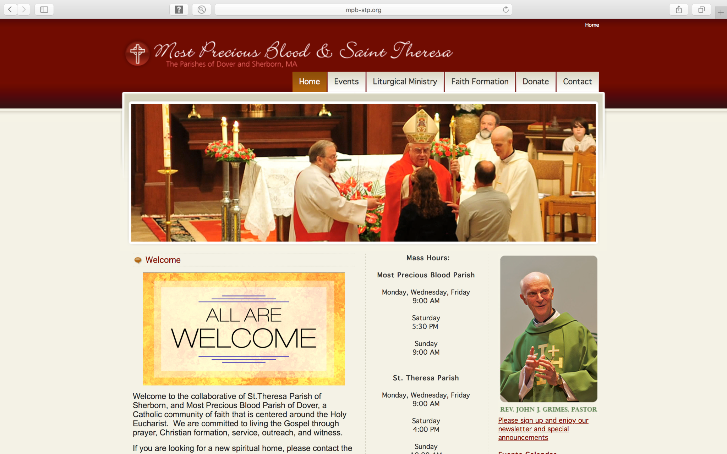
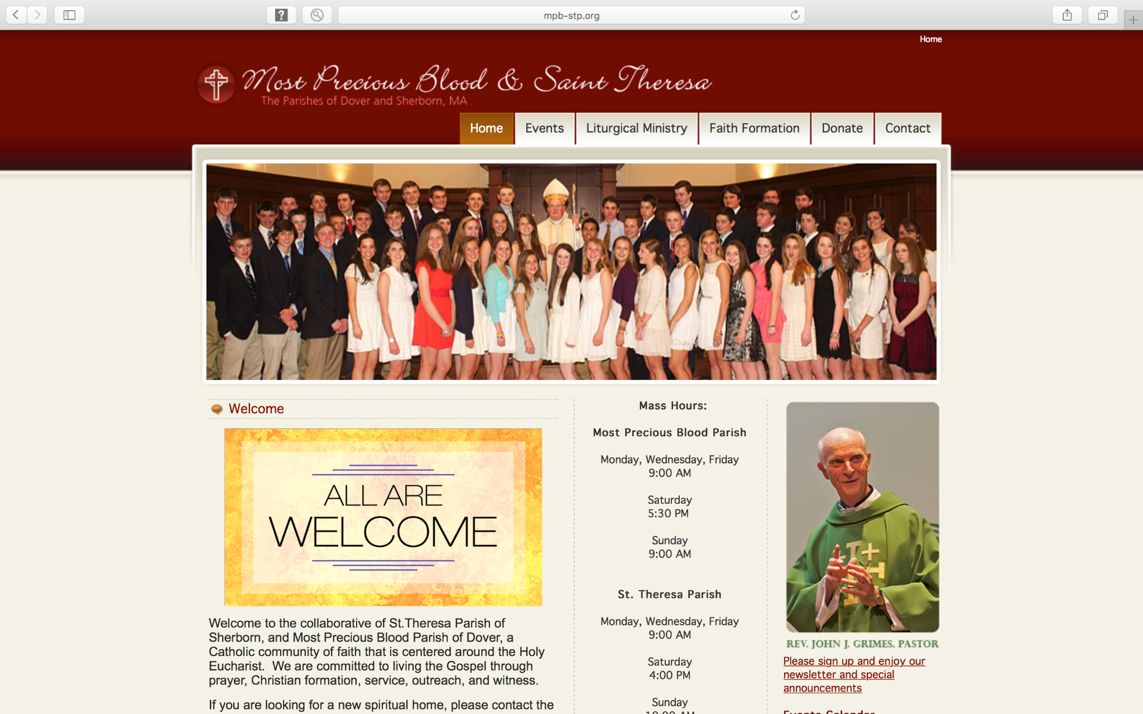
Project overview
The product:
I am revamping the websites for two parishes: The Church of the Most Precious Blood and Saint Theresa of Lisieux Parish. The Archdiocese of Boston has not provided branding guidelines for this project, the second of three planned over a decade. My goal is to add online donation features.
Project duration:
January 2011 to May 2011

Slide 3
Project overview
The problem:
The two parishes work in partnership, but the current website does not show this. It is hard to navigate and lacks visual appeal. The site also needs to meet the Archdiocese of Boston's requirements.
The goal:
Revamp the website to highlight the partnership between the two parishes and make it user-friendly and visually appealing. Built on Joomla, it will allow easy updates and efficient management. The site will be fully responsive, with intuitive navigation, and will meet Archdiocese of Boston standards.

Slide 4
Project overview
My role:
As the UX designer, I led the website redesign to improve the user experience.
Responsibilities:
Interviews, paper and digital wireframing, low- and high-fidelity prototyping, usability studies, accessibility, iterating on designs, and responsive design.

Slide 5
User research
Personas
Problem statements
User journey maps
Understanding
the user

Slide 6
User research: summary
Through user interviews and empathy maps, I gathered key insights into our target audience’s needs, which shaped the objectives for the website redesign. I found that users value the convenience and accessibility of online platforms for discovering and engaging with their community, but confusing navigation quickly turns a good experience into a frustrating one. This makes it hard for them to find information, use the site, and connect with the church.

Slide 7
User research: pain points
1
2
3
Navigation
Interaction
Experience
Navigation issues include confusing menus, poor search, broken links, and difficulty finding information.
Interaction problems include slow loading, cumbersome forms, lack of feedback, and buggy interfaces.
Experience pain points include cluttered design, unclear calls to action, poor content, and lack of trust signals.

Slide 8
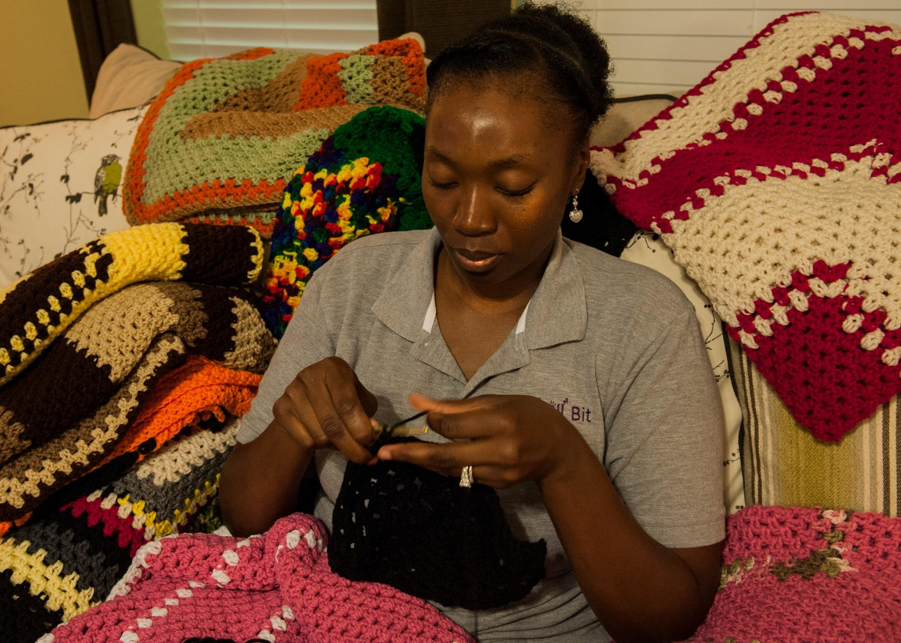
Quote:
"I just want to find what I need quickly."
Persona: Eleanor Vance
Background: Widow, active in community.
Goal: Easily find parish info (services, contacts, events) and donate online.
Frustrations: Difficult navigation, outdated content, cluttered design, poor mobile experience.
Problem statement:
Retired North Andover teacher (62) struggles with her parish's website. Outdated info, poor design, and difficult donations hinder her connection with the church.

Slide 9
Eleanor's Journey Map: Connecting with Her Parish Online
User journey map
Action/Step | Task List | Feeling Adjective | Improvement Opportunity
1. Searching for the Parish Website | Opens Chromebook Types "St. Michael's Church North Andover" into Google Clicks on the first result | Hopeful, Determined | Ensure the church website is easily found in search results (SEO).
2. Navigating the Homepage | Scans the homepage for service times Looks for a "Contact Us" link Tries to find information about upcoming events | Frustrated, Confused | Simplify the homepage design. Clearly display key information like service times and contact details. Improve site navigation (clear menus, intuitive layout).
3. Finding Service Times | Clicks on a "Worship" link Scrolls through a long page of text Eventually finds the service times listed at the bottom | Annoyed, Relieved | Prominently display service times on the homepage or a dedicated "Visit Us" page. Use clear headings and formatting.
4. Trying to Donate Online | Clicks on a "Donate" button Is redirected to a third-party website Finds the donation process confusing and lengthy | Overwhelmed, Hesitant | Simplify the online donation process. Consider integrating donations directly into the website. Offer clear instructions and various payment options. Ensure the process feels secure and trustworthy.
5. Contacting the Church | Clicks on the "Contact Us" link Finds an email address but no phone number Writes an email with a question about an upcoming event | Slightly Frustrated, Resigned | Provide multiple contact options (phone number, email, contact form). Ensure contact information is up-to-date and easy to find.
I created a user journey map of Eleanor's experience using the site to find pain points and improvement opportunities.

Slide 10
Sitemap
Paper wireframes
Digital wireframes
Low-fidelity prototype
Usability studies
Starting
the design

Slide 11
Sitemap
Eleanor struggled with website navigation, so I created a sitemap to address this pain point.
My goal was to improve the site's information architecture for simpler, more user-friendly navigation.
Main Navigation
Home
About Us
Our History
Our Staff
Our Beliefs
Visit Us
Service Times
Location & Directions
What to Expect
Connect Events
Calendar
News & Updates
Contact Us
Give
Online Donations
Other Ways to Give
Footer
Privacy Policy
Terms of Service
Contact Information (address, phone number, email)
Social Media Links (if applicable)

Slide 12
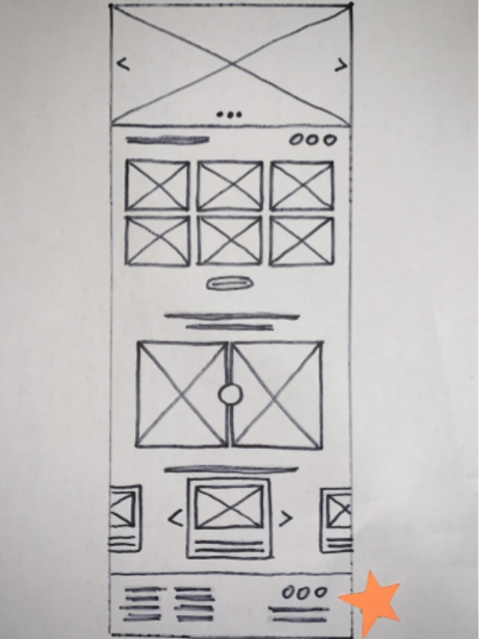
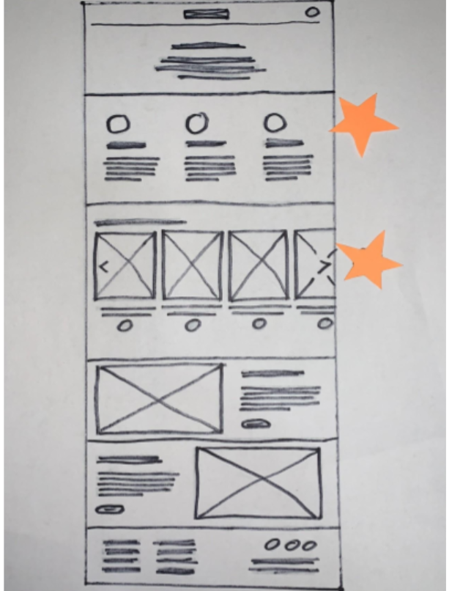
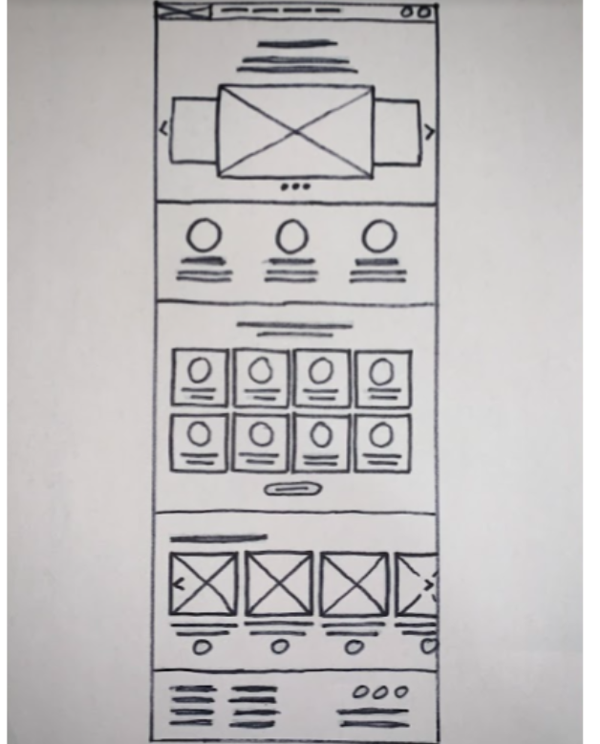
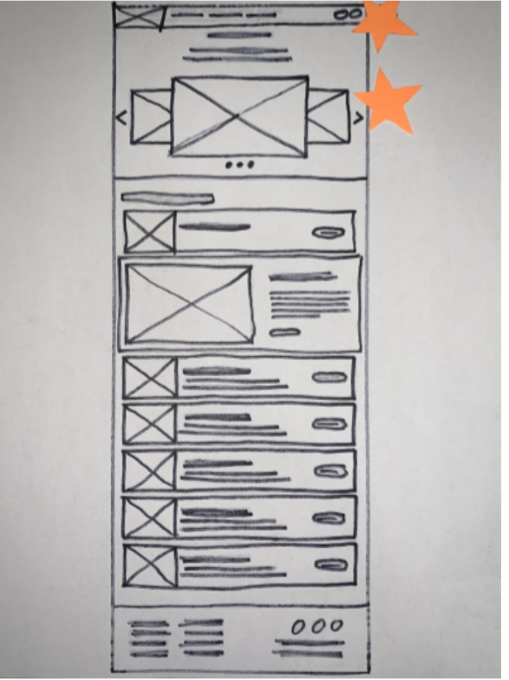
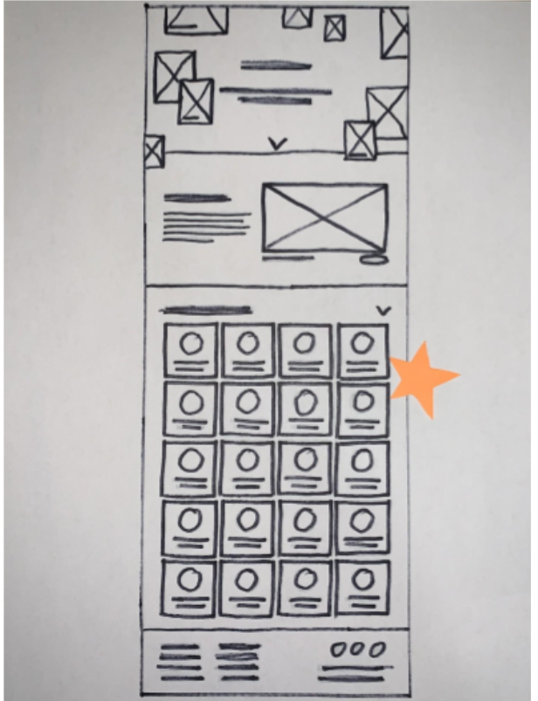
Paper wireframes
To address Eleanor's frustrations, I sketched wireframes for each website screen, prioritizing navigation, information browsing, and donations. The home screen variations (right) make key information quick to find.
Refined paper wireframe
I marked the elements of each sketch with stars to use in the initial digital wireframes.

Slide 13
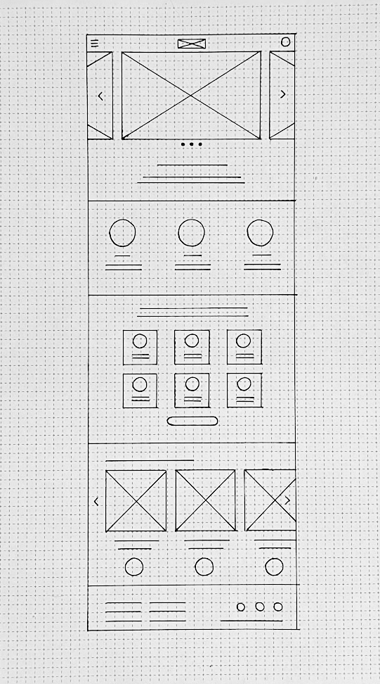
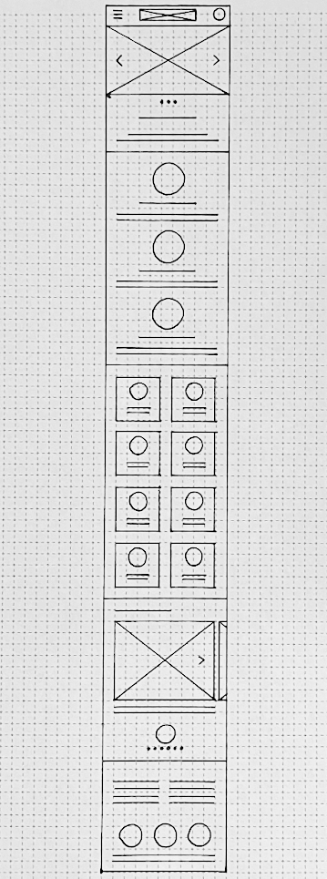
Paper wireframe
screen size variations
I designed for different screen sizes so the site works on any device. Users like Eleanor may access it on a Chromebook, tablet, or phone.

Slide 14
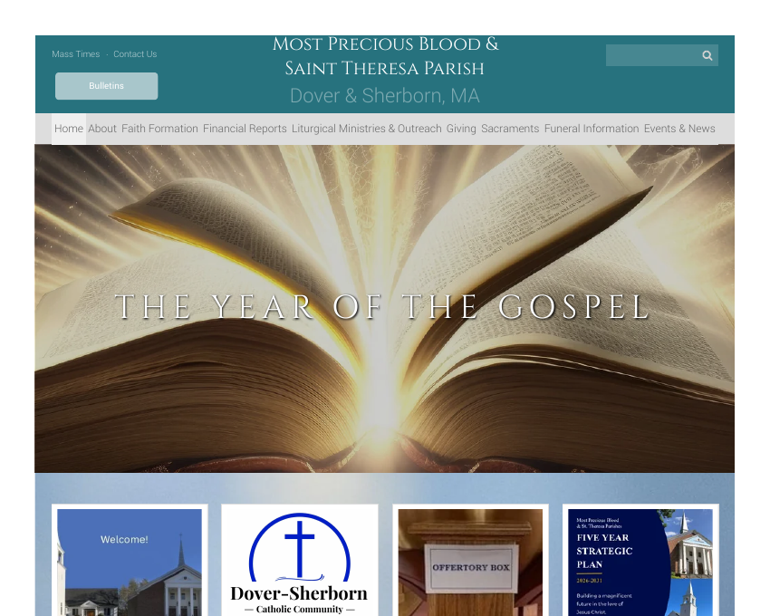
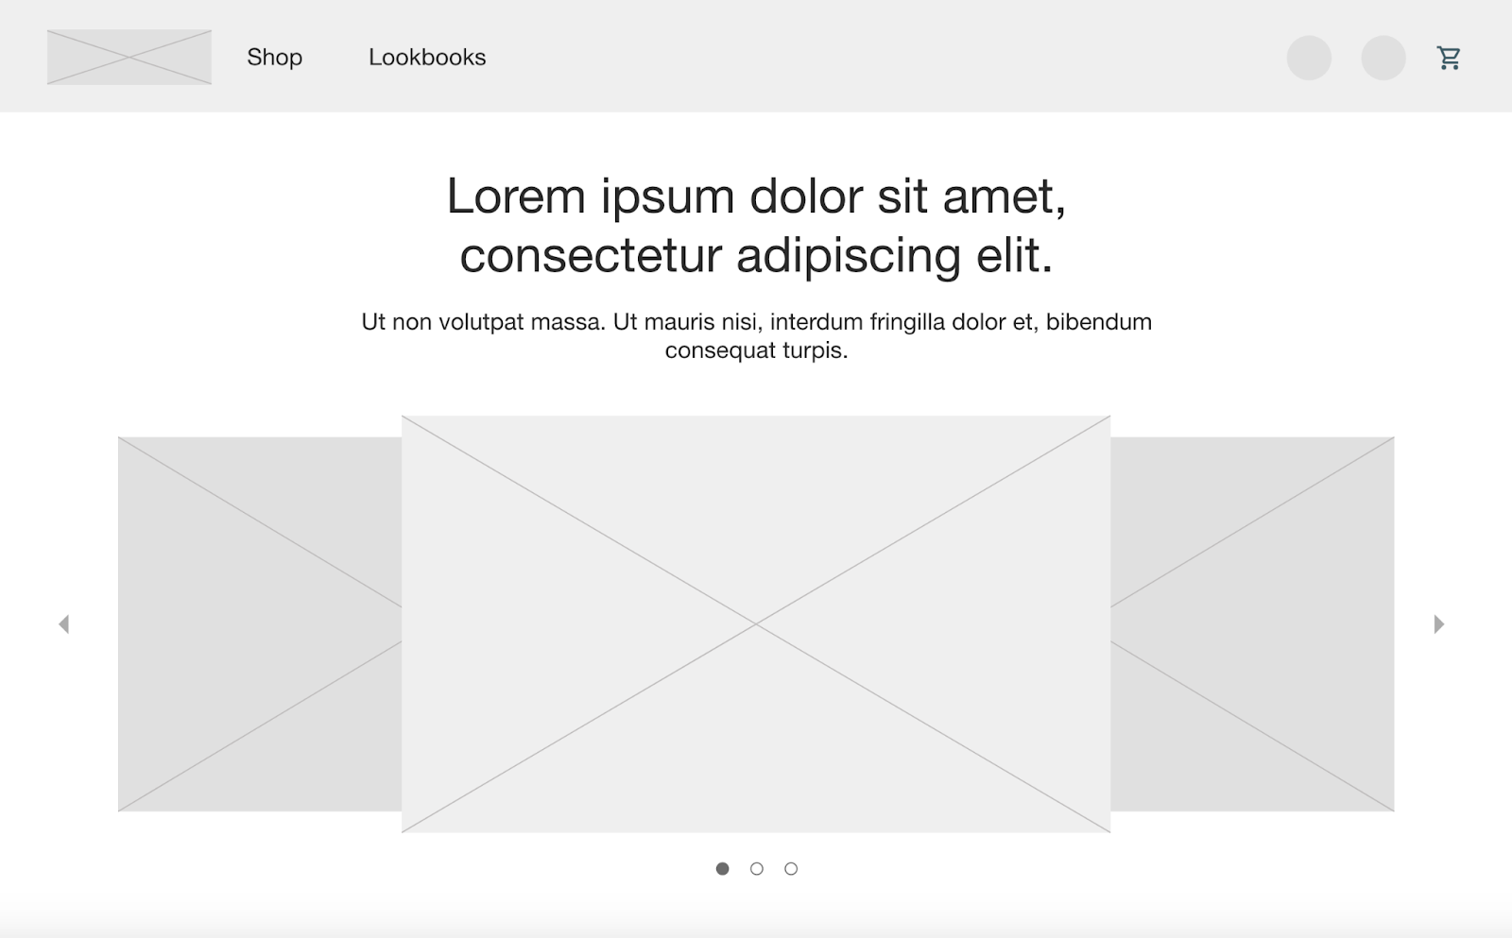
Digital wireframes
Digital wireframes showed how the redesign would ease Eleanor's frustrations and improve her experience. I focused on placing buttons and visual elements on the homepage for easy use.
Homepage with Mass times, parish news, and giving links.
The homepage makes browsing easy with an image carousel and navigation menu.

Slide 15
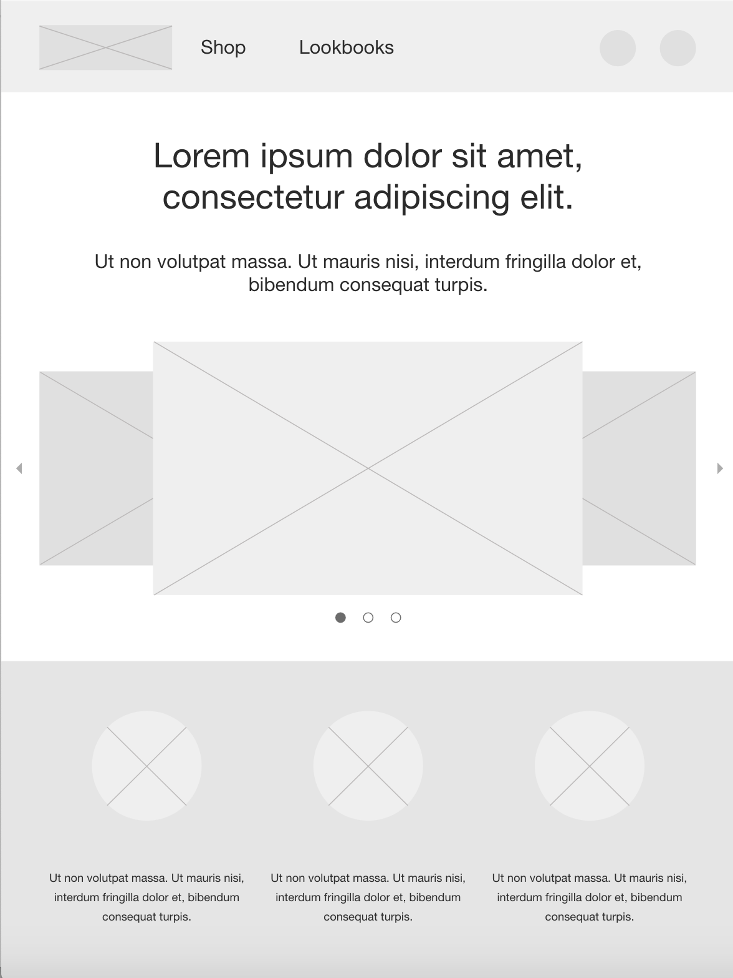
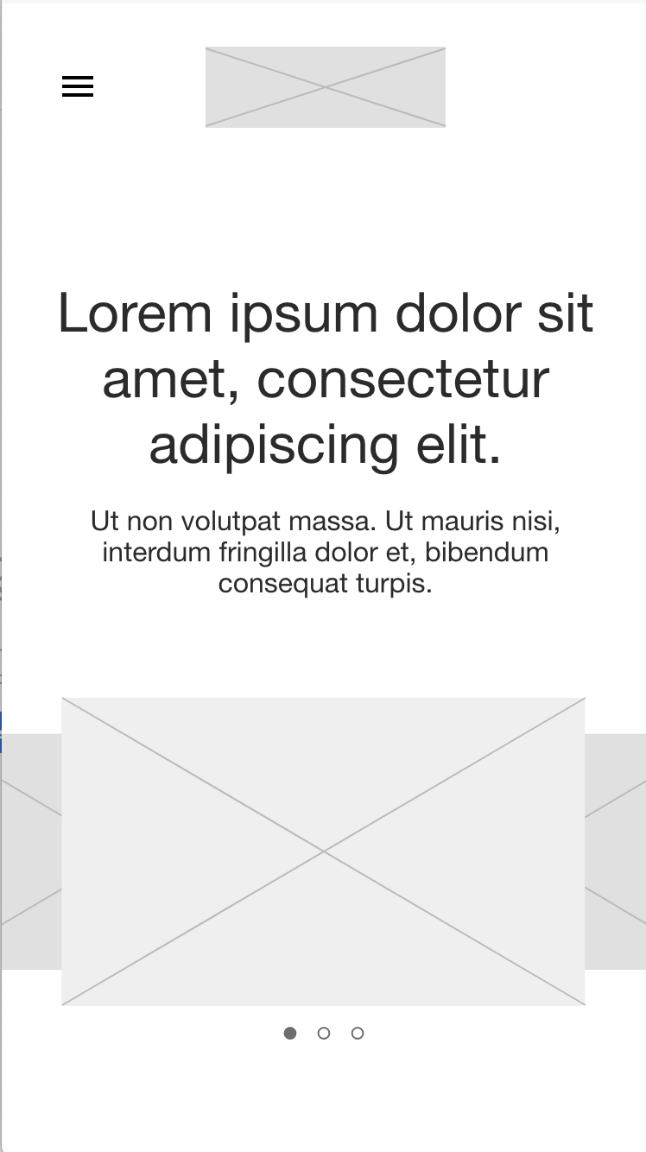
Digital wireframe
screen size variations

Slide 16
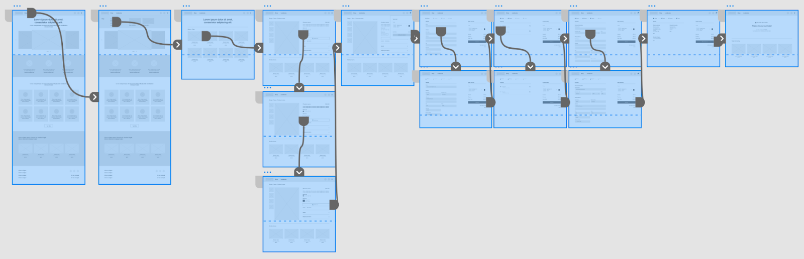
Low-fidelity prototype
I linked all the screens in the primary user flow, from finding church information to donating online. I incorporated team feedback on button placement and page organization, focusing on suggestions that addressed Eleanor's pain points.
View low-fidelity prototype

Slide 17
Usability study: parameters
Study type:
Unmoderated usability study
Location:
United States, remote
Participants:
5
Length:
20-30 minutes

Slide 18
Usability study: findings
These were the main findings from the usability study:
1
2
3
Navigation Confusion
Donation Process Difficulty
Mobile Responsiveness
Participants struggled to find key information, such as service times and contact details. They need clearer navigation and information architecture.
The online donation process was confusing and cumbersome. Multiple participants were frustrated by the multi-step process and unclear instructions.
Several participants on tablets or smaller screens had layout issues and trouble interacting with some elements. This shows a need for better mobile responsiveness.

Slide 19
Refining
the design
Mockups
High-fidelity prototype
Accessibility

Slide 20
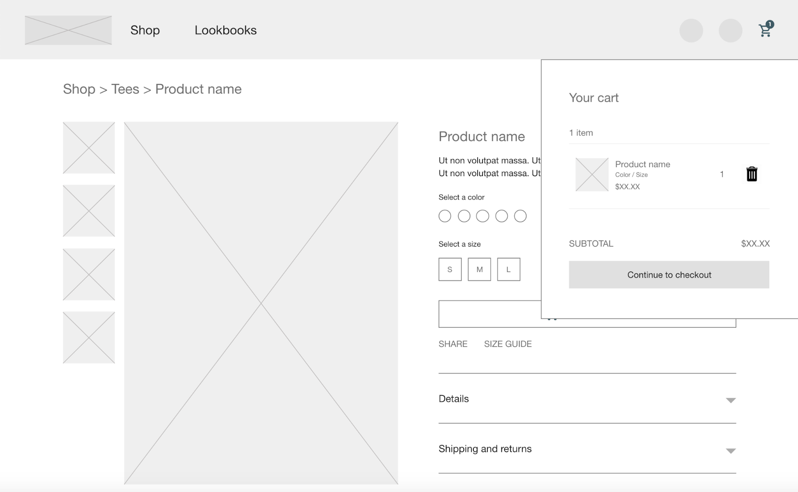
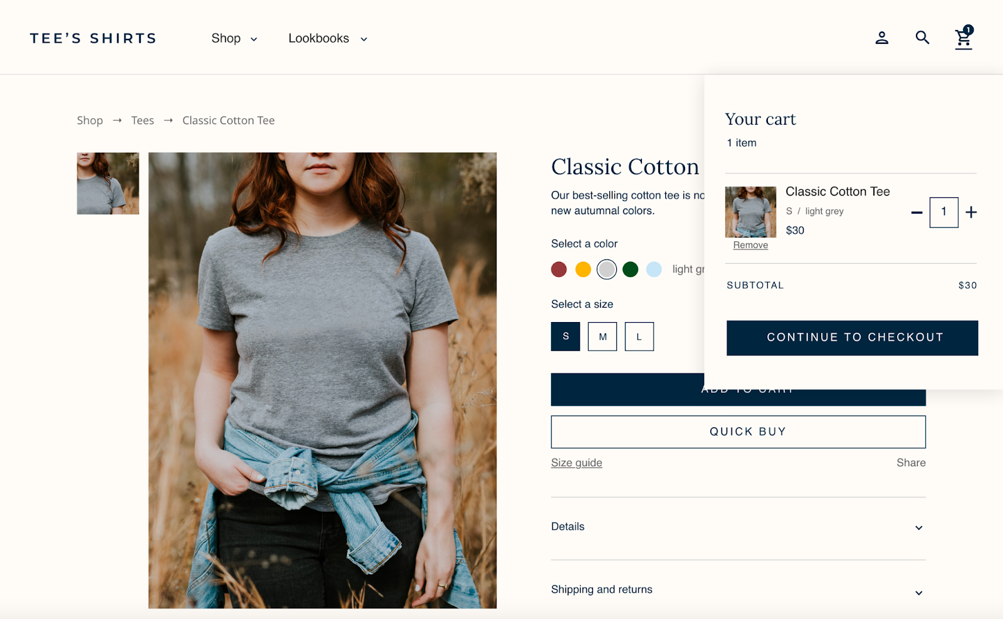
Mockups
Based on usability study insights, I revised the mockups to improve Eleanor's experience. A key change was simplifying the online donation process, which was confusing and too long.
Before usability study
After usability study
Mockup 1 before

Slide 21
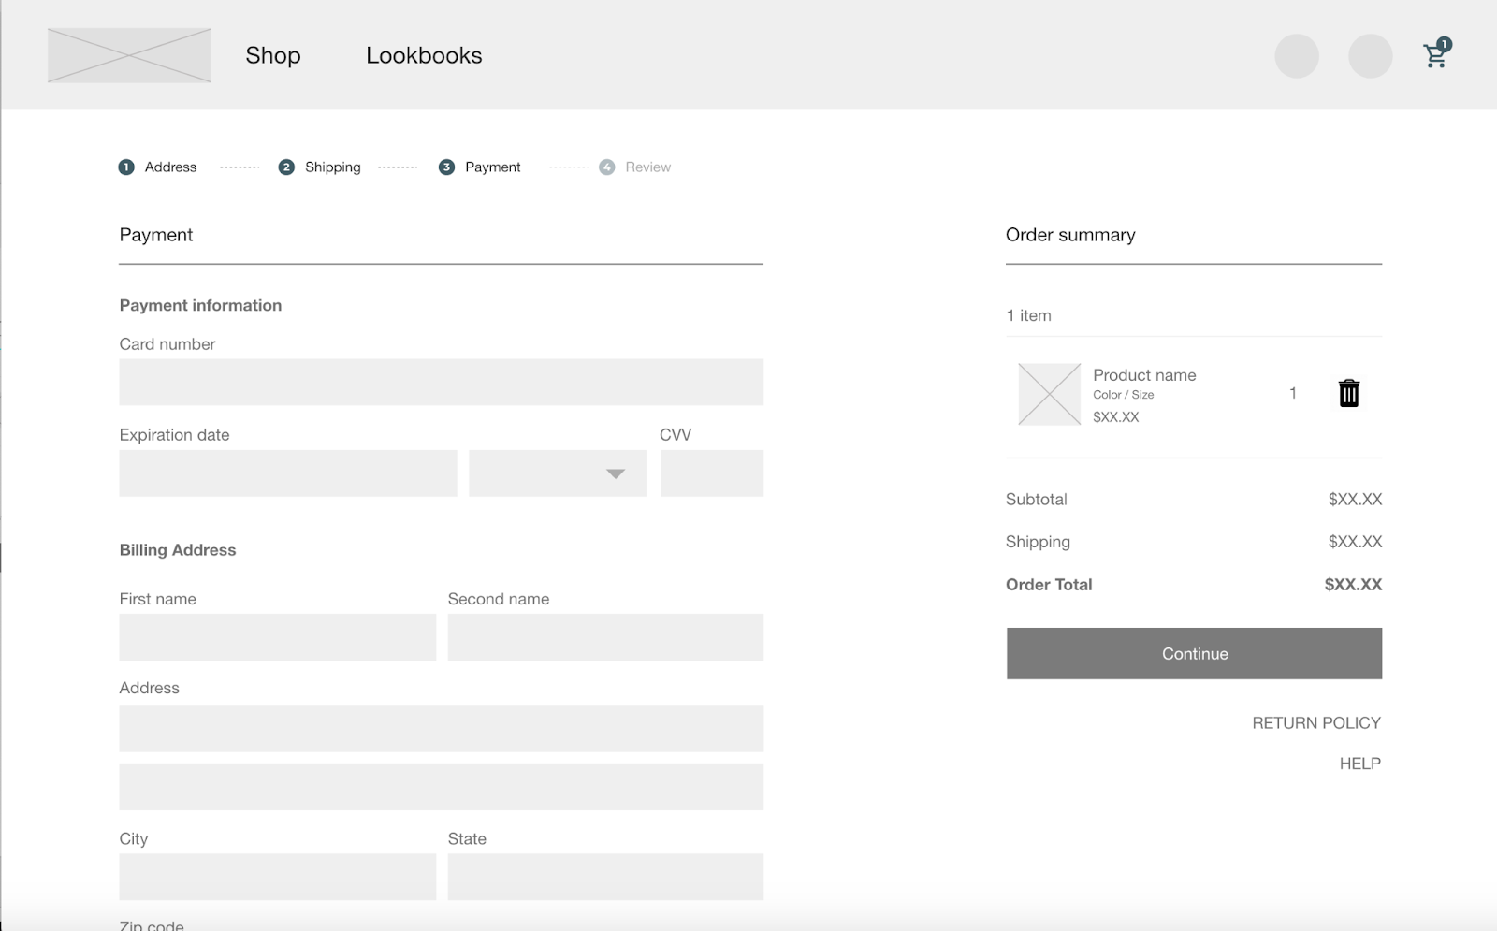
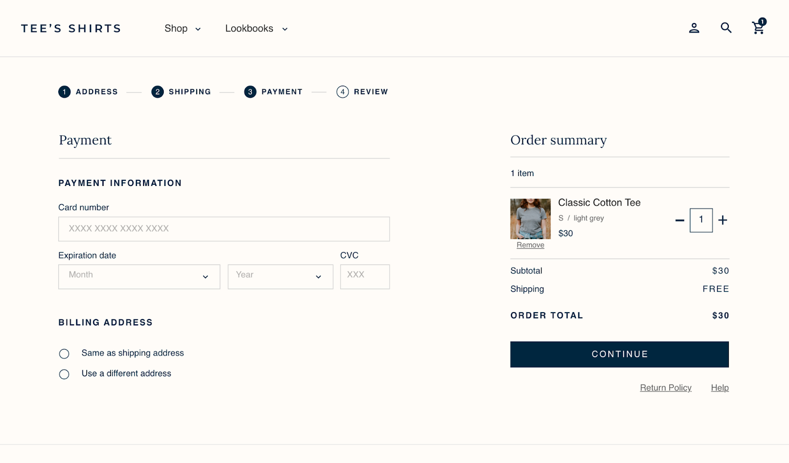
Mockups
To simplify the donation process further for Eleanor, I added a checkbox so she can use the same information for her donation and contact details. This reduces redundant data entry.
Before usability study
After usability study

Slide 22
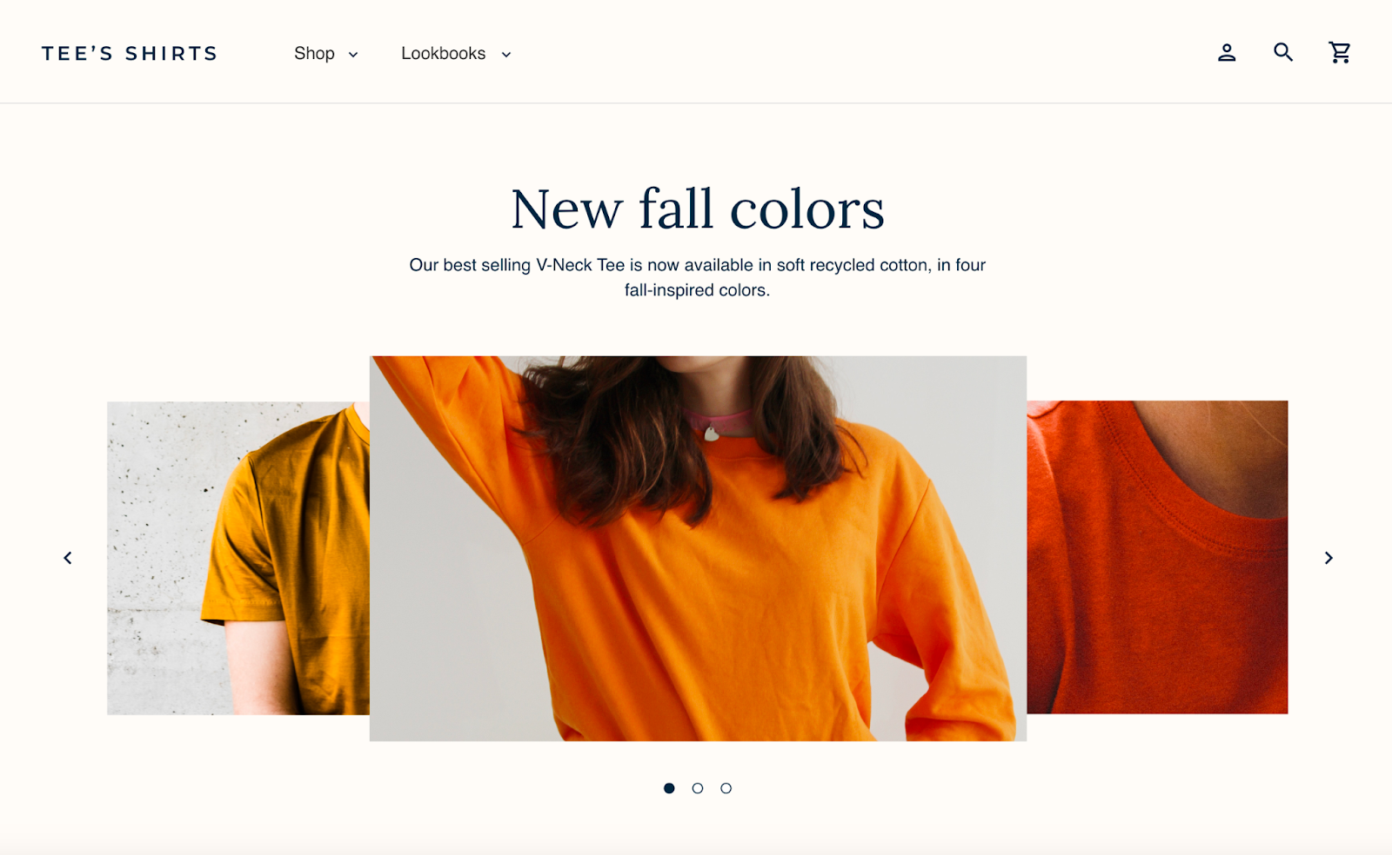
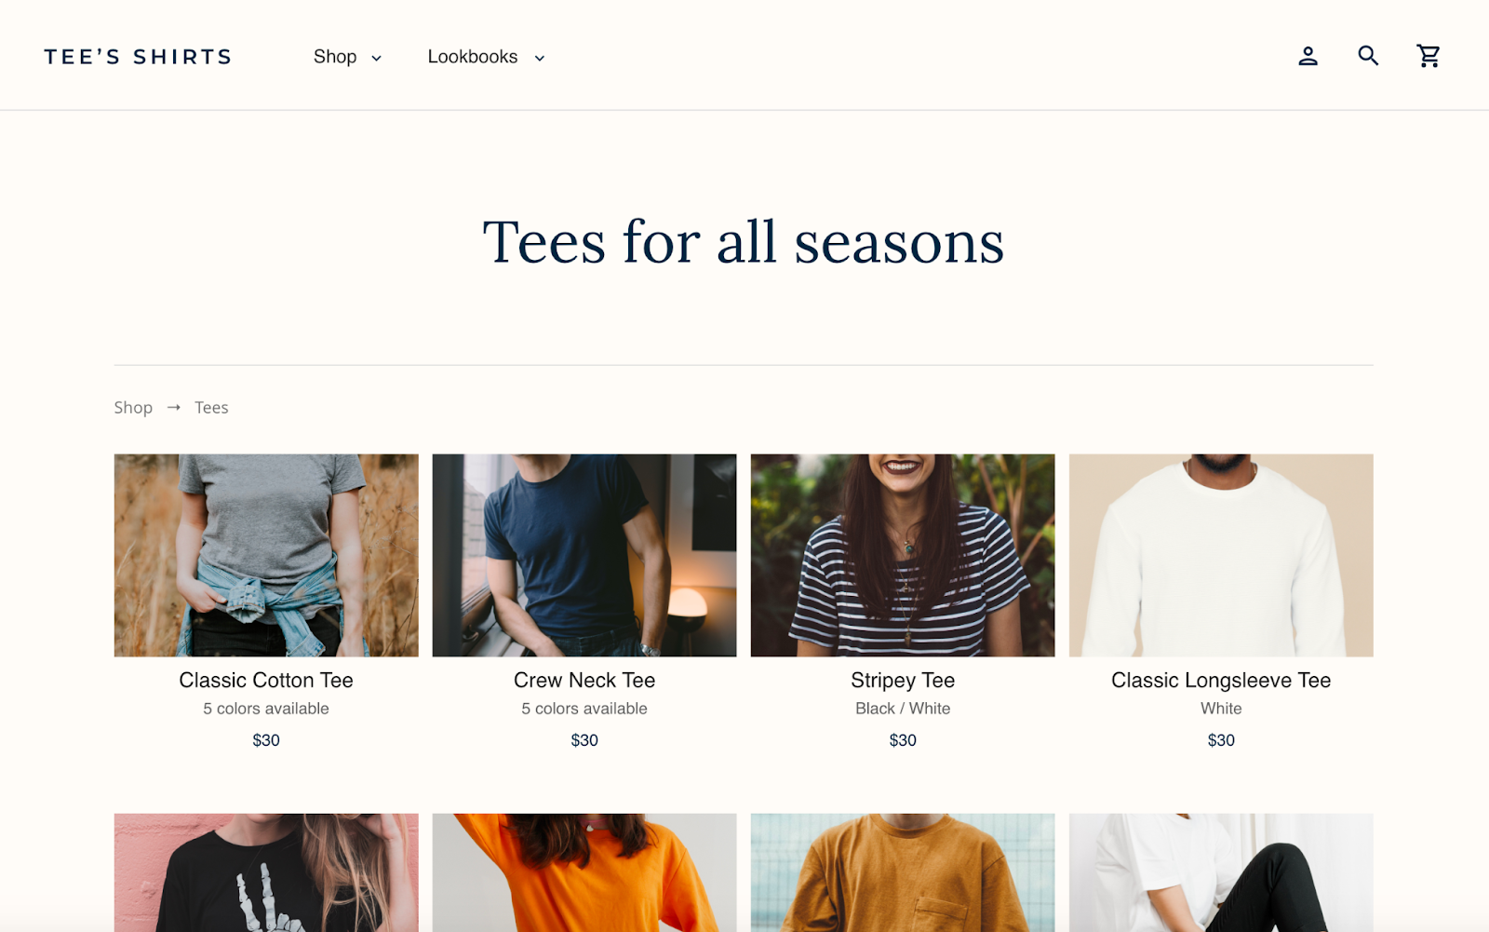
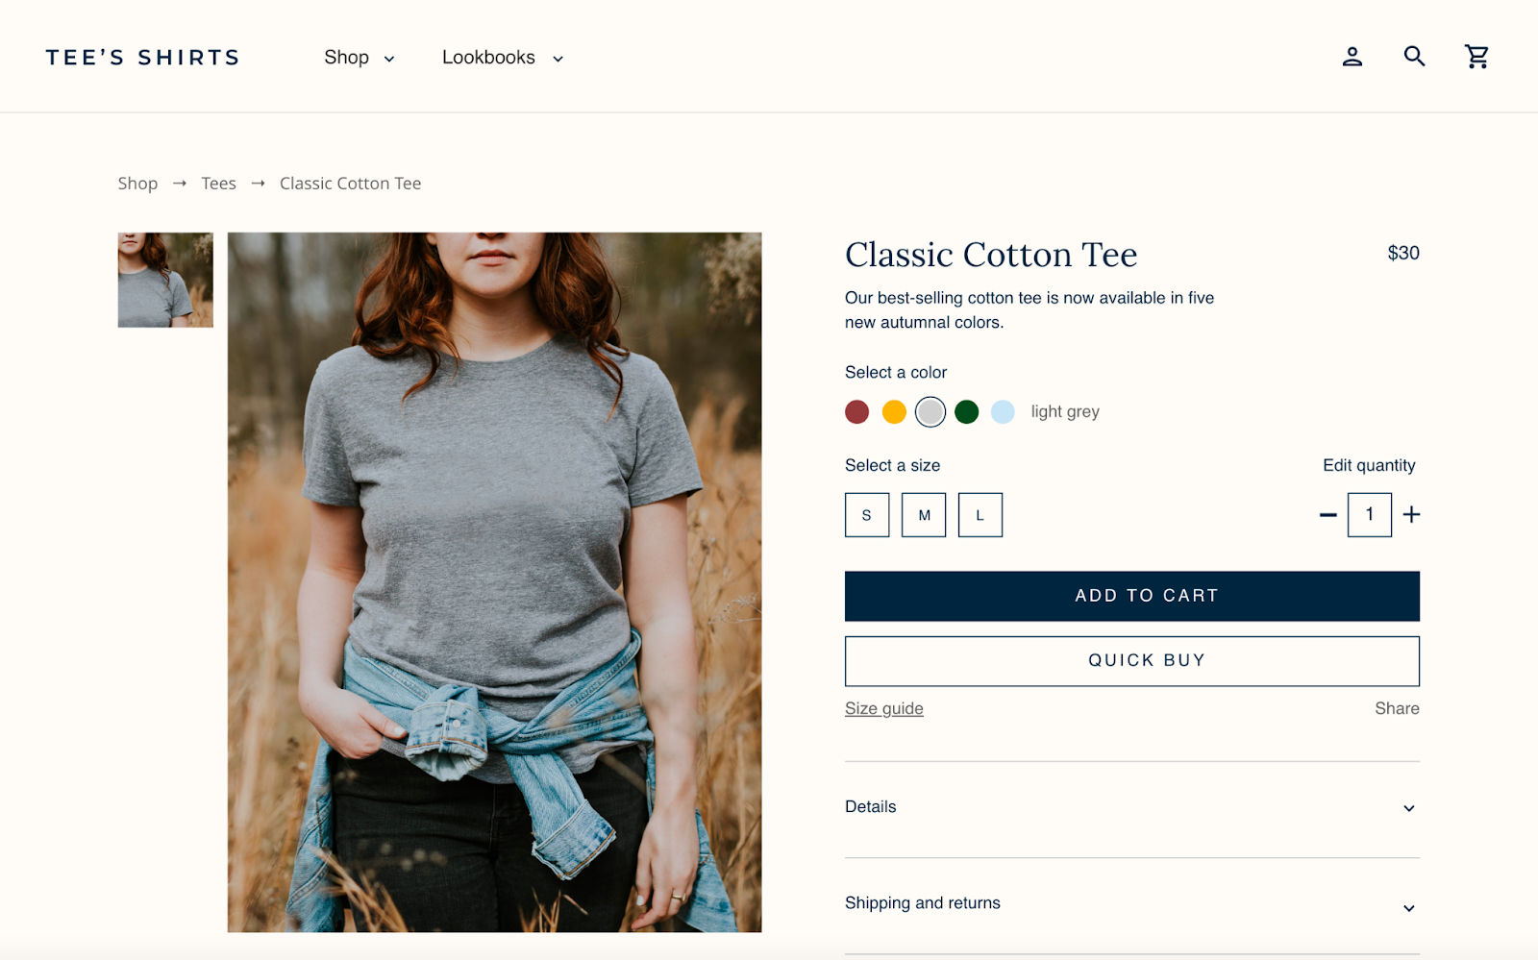
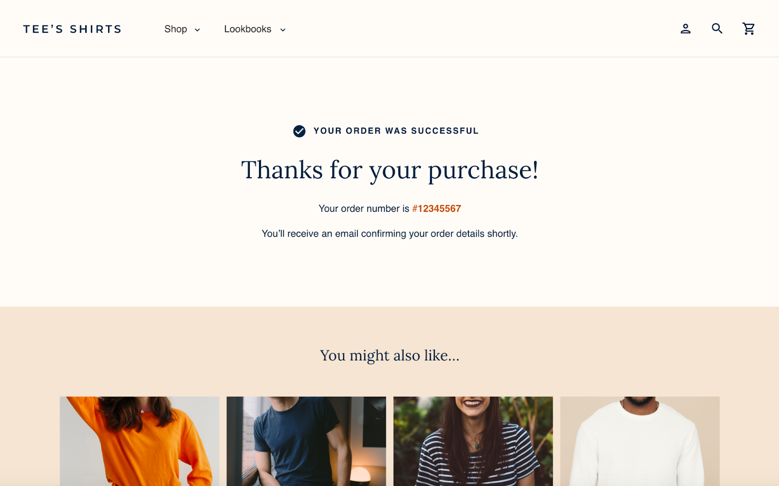
Mockups: Original screen size

Slide 23
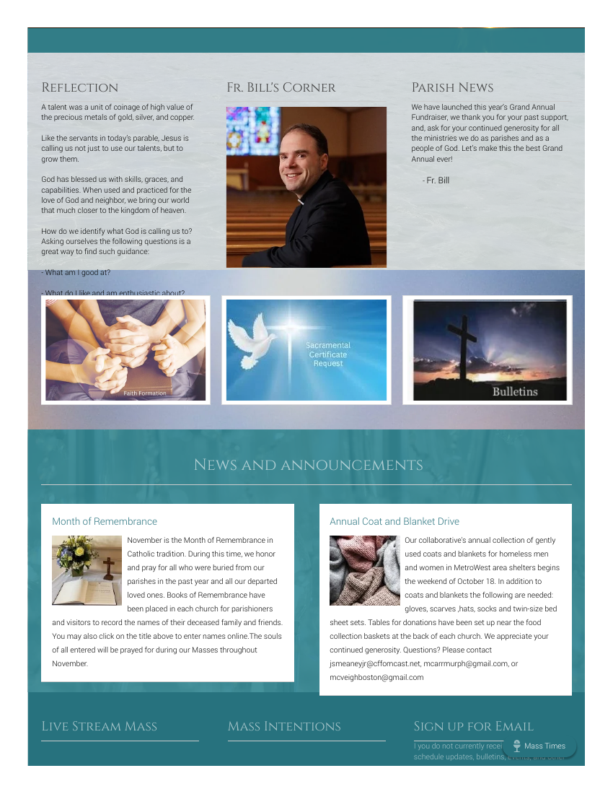
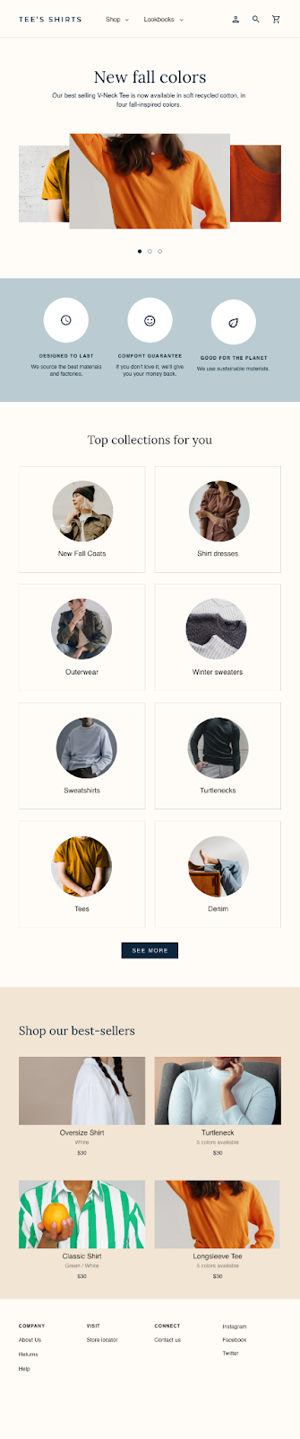
Mockups: Screen size variations
Building on the wireframes, I designed mockups for various screen sizes. Users access the site from different devices, so I optimized the browsing experience for mobile, tablet, and desktop.
Screenshots from the current parish website (mpb-stp.org), which has changed since this 2011 redesign.

Slide 24
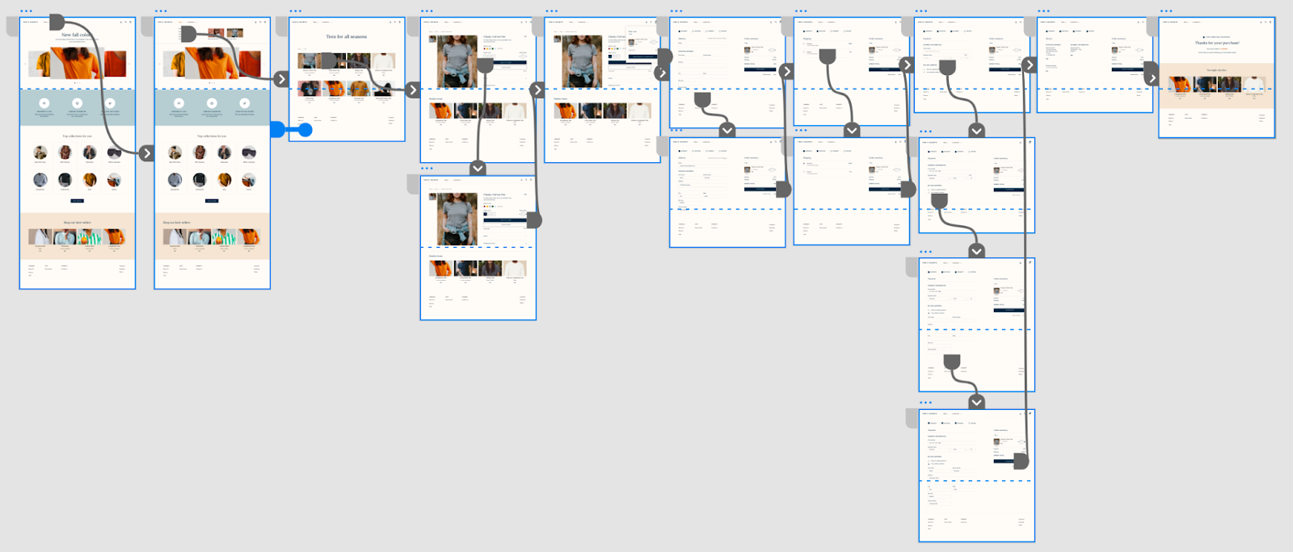
High-fidelity
prototype
The high-fidelity prototype followed the low-fidelity prototype's user flow and included changes from the usability study and team feedback.
View the high-fidelity prototype.

Slide 25
Accessibility considerations
1
2
3
Font Size and Contrast: Ensure sufficient font size and high contrast between text and background. Eleanor, like many older adults, may have vision changes that make small or low-contrast text hard to read. Allowing users to adjust font size also helps.
Keyboard Navigation: The website should be fully navigable using a keyboard alone. Some users may struggle with a mouse or trackpad, so keyboard accessibility is essential. This means clear visual focus indicators on interactive elements.
Screen Reader Compatibility: The website's content and structure should be compatible with screen readers. Screen readers are assistive technologies used by people with visual impairments. This involves using semantic HTML, providing alternative text for images, and ensuring proper heading structure.

Slide 26
Going forward
Takeaways
Next steps

Slide 27
Takeaways
Impact:
Improved user experience, increased engagement, enhanced church image.
What I learned:
User-centered design, usability testing, iterative design, and accessibility are essential.

Slide 28
Next steps
1
2
Conduct follow-up usability testing on the new website
Identify any additional areas of need and brainstorm new features

Slide 29

Let’s connect!
Thank you for reviewing my work on the church website redesign!
If you'd like to see more or get in touch, my contact information is below:
Email: millrjess@gmail.com
Website: millrjess.github.io
LinkedIn: linkedin.com/in/millrjess
© 2026 Jessica A. Miller

