Slide 1

New Chapter: GLP-1 Tracker™
Protect your strength while the medicine works.
A GLP-1 lifestyle tool with a personal AI coach. Everything in one place.
Jessica A. Miller, Founder

Slide 2
THE PROBLEM
The medicine works. The muscle is at risk.
≈25%
≈40%
of weight lost on tirzepatide was lean mass, not fat
SURMOUNT-1
of weight lost on semaglutide was lean mass, not fat
STEP-1
Losing muscle means losing strength and mobility.
The gap: a tool built around protecting strength, not just tracking weight.
New Chapter: GLP-1 Tracker™
2

Slide 3
THE MARKET
A large market, growing fast.
11%
15%
90%
of U.S. adults now take a GLP-1 for weight loss, up from 3% in 2024
have used one at some point
know GLP-1s can be used for weight loss
Millions are on the medicine. The open space is protecting their muscle.
Gallup National Health and Well-Being Index, June 2026 (5,065 U.S. adults).
New Chapter: GLP-1 Tracker™
3

Slide 4
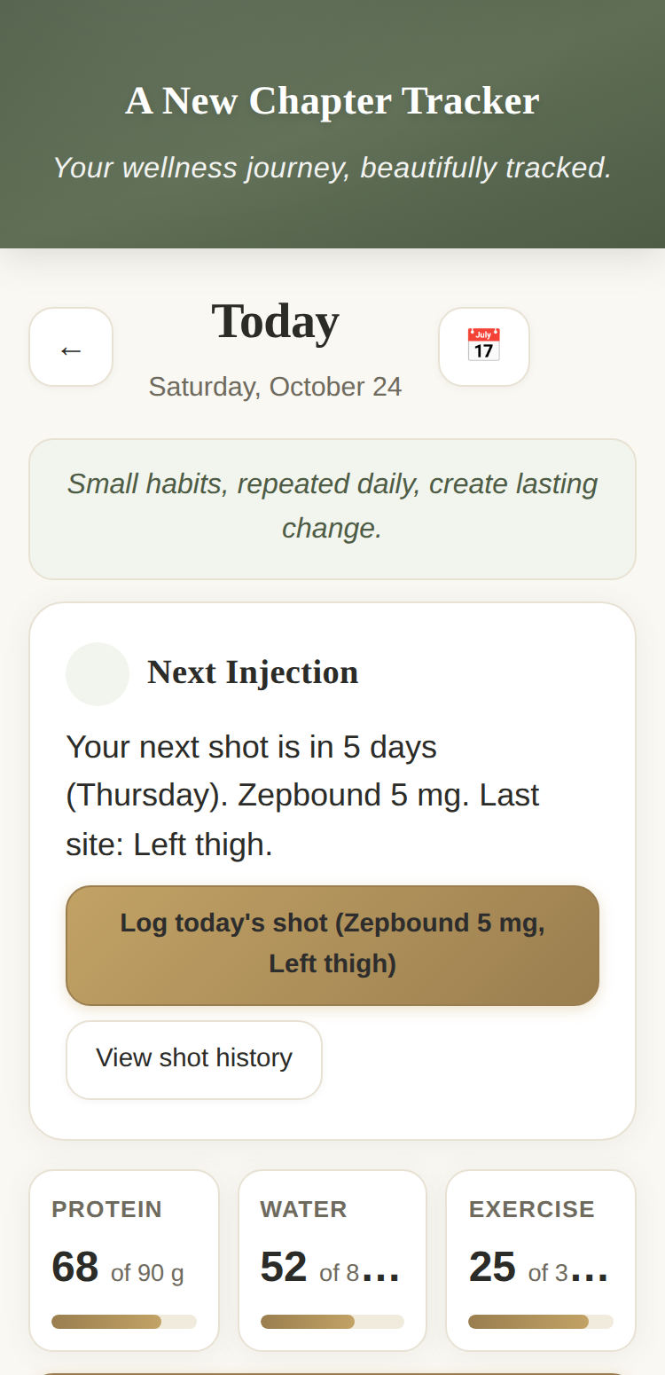
THE PRODUCT
One calm place for food, shots, weight, and the doctor.
Today: the lotus, what to do today, your week at a glance.
Shots: log a dose, set a reminder, open the doctor summary.
Weight: log with pace and goal date.
Kitchen: 171 recipes with photos.
Companion: a personal AI coach.
More: settings, help, backup, export.
The Today screen
New Chapter: GLP-1 Tracker™
4

Slide 5
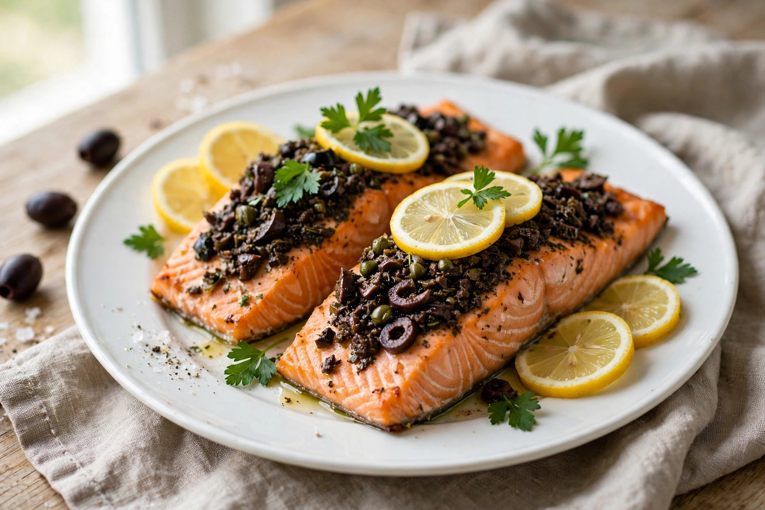
THE KITCHEN
171 recipes that protect muscle.
171
recipes
149 recipes, plus 22 new recipes across four new sections: 5 mocktails, 5 spice blends, 5 marinades, 7 salad dressings.
Every recipe: saturated fat 5g or less, low oxalate, no refined sugar, kidney-friendly.
Mediterranean, modeled on Greece, Sardinia, Sicily, the French Riviera, and Naples.
Baked Salmon with Olive Tapenade
New Chapter: GLP-1 Tracker™
5

Slide 6
THE COACH AND THE DOCTOR
A coach in your pocket. A record your doctor can use.
AI Wellness Companion
A personal AI coach. 40 messages a day.
It remembers you, only if you ask it to: name, goals, medication, dose, shot day.
It never gives medical advice.
Doctor visit summary
One summary at each refill: dose, weight, exercise, side effects.
Copy or download it. Send it through your medical portal.
“A direct line to your treatment team, not just a printout.”
New Chapter: GLP-1 Tracker™
6

Slide 7
THE BUSINESS
$3.99 a month. $29.99 a year.
Free for 30 days, then $3.99 a month or $29.99 a year. Cancel anytime before the trial ends and you will not be charged.
No permanent free version. A free demo to try: no sign-in, sample data only.
A year of MyFitnessPal Premium+ is $99.99 in the App Store. A year of New Chapter is $29.99.
Price is the conversion engine. The doctor summary is the retention wedge.
New Chapter: GLP-1 Tracker™
7

Slide 8
HOW IT WORKS
Four steps from demo to daily use.
1
2
3
4
Try the demo
Subscribe
Get your code
Connect the Companion
Free, no sign-in, sample data only.
$3.99 a month or $29.99 a year, through Stripe.
Issued after you pay. Lasts 1 hour.
Enter the code in Settings. Done.
New Chapter: GLP-1 Tracker™
8

Slide 9
PRIVACY
Your health information stays yours.
Tracking data stays on your device.
I cannot see your chats. No one at New Chapter can.
It leaves your phone only when you choose: to your doctor, or to the Companion for a reply.
No ads. We do not sell your health information.
Privacy is a feature, not a footnote.
New Chapter: GLP-1 Tracker™
9

Slide 10
THE FOUNDER
Built by someone who needed it.
Jessica A. Miller, Website Operations Consultant. 20 years building websites.
On Zepbound herself. She needed a way to stay organized during treatment, so she built the app she wanted.
One that understands her dietary needs, never makes her feel guilty about food, and keeps her health information on her phone.
Founder, designer, and operator. One person.
New Chapter: GLP-1 Tracker™
10

Slide 11
WHY THE LOTUS
The lotus.
“I chose the lotus because it grows in muddy water and rises clean. It opens a little each morning, and it blooms again. That is this journey. You start where you are. You log one day at a time. And you begin again, as many times as you need to.”
Jessica A. Miller, Founder
The lotus opens as you log, across 90 days. It is the app icon, the Today screen, and the brand.
New Chapter: GLP-1 Tracker™
11

Slide 12
DESIGN
Calm on purpose.
Clean, concise, straightforward. Short lines, generous whitespace, no clutter.
Today first. GLP-1 things first: shots, water, movement, weight, before food logging.
Accessible: WCAG 2.2 AA is the working standard. Keyboard-only use passes. VoiceOver works on iPhone.
No shaming. No guilt. No failure language. Reward the behavior, not the food.
New Chapter: GLP-1 Tracker™
12

Slide 13
EXECUTION
Shipped, not promised.
Web app v086 live: six tabs, 171 recipes, Companion, doctor summary.
Sales page live, with a walkthrough video. Free demo live, no sign-in.
22 versions shipped in three days: v065 to v086, November 11–13, 2026.
39 layout and engagement fixes in v080. Test suites at baseline: app 72 of 96, demo 60 of 86.
New Chapter: GLP-1 Tracker™
13

Slide 14
WHO IT IS FOR
Adults on GLP-1 medicine. All ages. All genders.
Built for adults prescribed a GLP-1. Not children or adolescents.
Works with Zepbound, Wegovy, Ozempic, Mounjaro, and other GLP-1 medications.
For weight management, diabetes, and the conditions that travel with them.
New Chapter: GLP-1 Tracker™
14

Slide 15
WHAT’S NEXT
Launch is dated, not wished for.
Google Play closed test: December 4–18, 2026.
Production application: December 18, 2026.
Live on Google Play: late December 2026 to early January 2027.
Meal planner: January 2027.
Send to Amazon and Instacart: January.
New Chapter: GLP-1 Tracker™
15

Slide 16
WHAT THIS PROVES
One person. Problem, product, market.
She identified a real problem, from her own treatment.
She built the product: design, code, content, and brand.
She shipped it: 22 versions in three days, verified live.
She is taking it to market: priced, listed, and dated.
New Chapter: GLP-1 Tracker™
16

Slide 17
SOURCES
Sources.
SURMOUNT-1 DXA substudy, Diabetes, Obesity and Metabolism, 2025. Of the body weight lost, about 75% was fat mass and 25% was lean mass. PMCID PMC11965027; PMID 39996356.
Karakasis et al., Metabolism, March 2025, PMID 39719170. About 25 percent of tirzepatide weight loss was lean mass.
STEP-1 (Wilding et al., New England Journal of Medicine, 2021), trial data reported in Tinsley and Nadolsky, 2025, PMCID PMC12536186. The STEP-1 DXA subset found about 40 percent of the weight lost was lean soft tissue.
Gallup National Health and Well-Being Index, June 2026. Survey of 5,065 U.S. adults, May 28 to June 5, 2026. 11% currently take a GLP-1 for weight loss, up from 3% in 2024.
MyFitnessPal Premium+ pricing: App Store, $99.99 per year.
New Chapter: GLP-1 Tracker™
17

Slide 18
Let’s talk.
Try the tracker, or reach out about the work.
LinkedIn: linkedin.com/in/millrjess
Tracker: millrjess.github.io/tracker/
Jessica A. Miller, Founder, New Chapter: GLP-1 Tracker™
© 2026 Jessica A. Miller

