Slide 1
U
X
D
E
S
I
G
N
C
A
S
E
S
T
U
D
Y
Two parishes.
One website.
Donations online.
Built around the people who use it.
Jessica A. Miller
· Website Operations Consultant
January – May 2011 · Archdiocese of Boston
Jessica A. Miller · Church Website Design
01

Slide 2
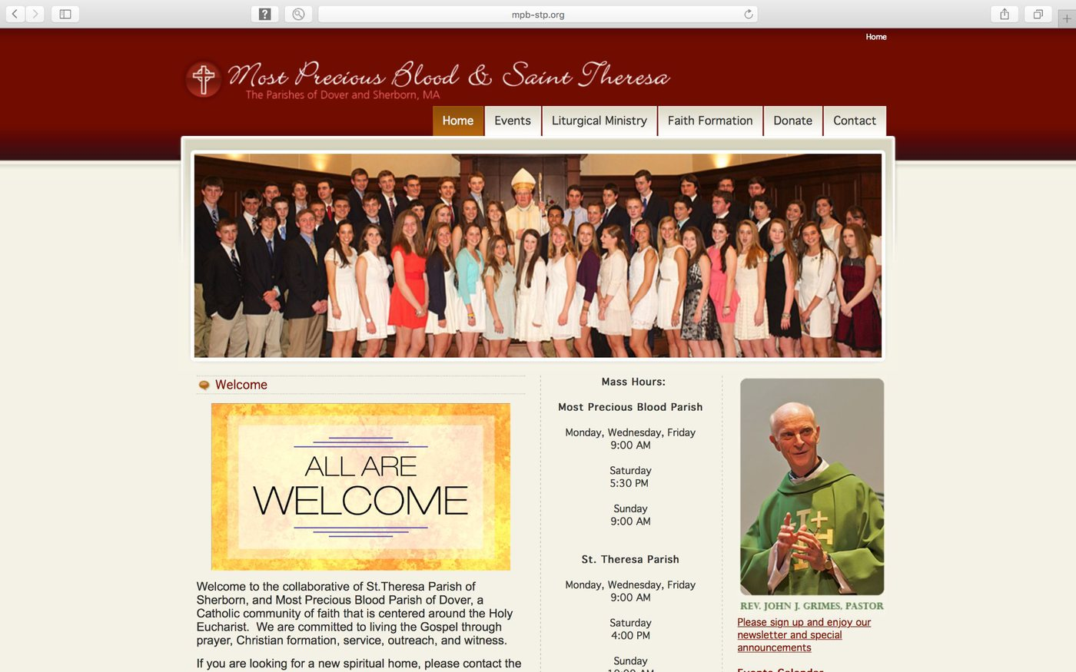
T
H
E
B
U
S
I
N
E
S
S
P
R
O
B
L
E
M
Two parishes, working together.
A website that didnʼt show it.
The Church of the Most Precious Blood
and Saint Theresa of Lisieux Parish work in
partnership, but visitors could not see it.
Visitors could not find service times.
Donations could not be made online. The
site looked dated on every device.
The parish homepage before the
For a parish, that is not a design problem.
redesign
It is lost donors.
Jessica A. Miller · Church Website Design
02

Slide 3
W
H
A
T
S
H
E
D
I
D
Research first. Design second.
Test everything.
01
02
03
04
Research
Design
Test
Iterate
Interviews and
A new sitemap,
A usability study:
Revisions from
empathy maps with
wireframes, and
five participants,
what testing found
the people who use
prototypes, low-
testing on their own
: simpler giving,
the site.
and high-fidelity.
devices.
clearer layout.
Built on Joomla, so the parishes update it themselves. Fully responsive,
meeting Archdiocese standards. Delivered January to May 2011, on schedule.
Jessica A. Miller · Church Website Design
03

Slide 4
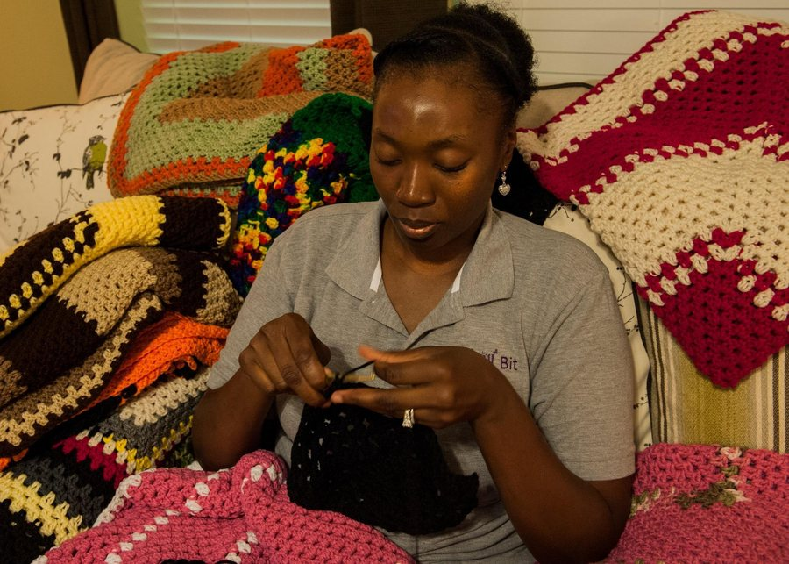
T
H
E
U
S
E
R
Eleanor, 62. She just wants
to find what she needs.
“I just want to find what I need
quickly.”
Eleanor Vance, 62
, retired North Andover
teacher, widow, active in her parish.
Her goal:
find parish information (services,
contacts, events) and donate online.
Her frustrations:
difficult navigation, outdated
content, poor mobile.
Persona based on user research for this case study
Jessica A. Miller · Church Website Design
04

Slide 5
W
H
A
T
S
H
E
F
O
U
N
D
Three problems.
Three business risks.
1
2
3
Navigation
Donations
Mobile
Confusing menus,
Giving leaves the
Layout breaks on
poor search, broken
site for a third-party
tablets and phones.
links.
page.
So what: visitors
So what: missed
So what: donors give
locked out.
connections.
up.
Jessica A. Miller · Church Website Design
05
Every one of these is a person the parish loses.

Slide 6
H
E
R
J
O
U
R
N
E
Y
Five steps to donate.
Four points of friction.
S
T
E
P
W
H
A
T
S
H
E
D
O
E
S
FEELING
W
H
A
T
C
H
A
N
G
E
S
1 · Search
Searches for the parish.
Hopeful
Easy to find.
2 · Homepage
Scans for times.
Frustrated
Times shown clearly.
3 · Service times
Clicks “Worship,” scrolls.
Annoyed
Times on homepage.
4 · Donate
Clicks “Donate,” redirected.
Overwhelmed
Giving on-site.
5 · Contact
Finds an email, no phone.
Resigned
Phone, email, form.
Keep her hopeful all the way to the donation.
Jessica A. Miller · Church Website Design
06

Slide 7
T
H
E
S
O
L
U
T
I
O
N
Structure first: one site,
easy to find everything.
Main navigation
Footer
H
o
m
e
Privacy Policy · Terms of Service
About Us
Contact Information
Our History · Our Staff · Our Beliefs
Address, phone number, email
Visit Us
Social Media Links
Service Times · Location · What to Expect
Connect
Design intent:
service times,
Events Calendar · News & Updates ·
Contact Us
contact, and giving, one tap from
Give Online
anywhere.
Donations · Other Ways to Give
Jessica A. Miller · Church Website Design
07

Slide 8
T
H
E
S
O
L
U
T
I
O
N
The new homepage: what matters,
first.
mpb-stp.org
Most Precious Blood
Home · Visit Us · Connect · Give Online
Two parishes, one community
Most Precious Blood & Saint Theresa of Lisieux, North Andover
Service Times
Events
Give Online
Sunday Mass times,
Upcoming parish
One tap to donate
shown first
events and news
Homepage wireframe: service times first, giving one tap away.
Jessica A. Miller · Church Website Design
08

Slide 9
T
H
E
S
O
L
U
T
I
O
N
Giving, simplified.
1
2
3
4
5
→
→
→
→
H
o
m
e
Visit Us
Events
Give Online
Confirm
Five steps from finding information to donating online.
B
E
F
O
R
E
A
F
T
E
R
✕
Redirected to a third-party site
✓
Integrated into the parish site
✕
Multi-step, unclear instructions
✓
Simplified steps, clear instructions
✕
Same information entered twice
✓
One checkbox reuses the information
Jessica A. Miller · Church Website Design
09

Slide 10
T
H
E
E
V
I
D
E
N
C
E
Tested with real users
before it shipped.
Five participants. Three problems found, all three fixed.
1
Navigation
: couldnʼt find service times.
Fixed:
clearer navigation.
2
Donations
: confusing process.
Fixed:
shorter, integrated giving.
3
Mobile
: layout issues on small screens.
Fixed:
layouts for every size.
Unmoderated, remote, United States · Five participants · 20–30 minutes each.
Jessica A. Miller · Church Website Design
10

Slide 11
A
C
C
E
S
S
I
B
I
L
I
T
Y
Built for the audience
that actually uses it.
An older congregation is not an edge case. It is the audience.
A
B
C
Larger type
Keyboard access
Screen reader
Large type, high
Fully navigable by
Semantic HTML, alt
contrast, adjustable
keyboard, with clear
text, proper
size.
focus.
headings.
Jessica A. Miller · Church Website Design
11

Slide 12
T
H
E
R
E
S
U
L
T
A website that shows the partnership
and takes donations.
✓
The partnership is visible on every page.
Two parishes, one community, stated at the top, not buried.
✓
Donations happen online, in a few clear steps.
Integrated into the parish site: no third-party redirect, no retyping.
✓
It works on every device.
Built on Joomla, so the parishes update it themselves.
Jessica A. Miller · Church Website Design
12

Slide 13
W
H
A
T
T
H
I
S
P
R
O
V
E
S
She manages stakeholders.
She ships.
1
Multiple stakeholders, one site.
Two parishes and an Archdiocese.
2
External standards, no brief.
She created the structure herself.
3
Tested before delivery.
Findings changed the design.
4
On time.
January to May 2011, a complete redesign on schedule.
Jessica A. Miller · Church Website Design
13

Slide 14
L
E
T
ʼ
S
T
A
L
K
If your website is losing people
or losing donations, letʼs fix it.
The same approach applies to any organization: start with the people
who use the site, test with real users, and ship a redesign that works for
them.
W
E
B
S
I
T
E
millrjess.github.io
E
M
A
I
L
millrjess@gmail.com
L
I
N
K
E
D
I
N
linkedin.com/in/millrjess
Jessica A. Miller · Church Website Design
© 2026 Jessica A. Miller
14

