Slide 1

A UX DESIGN CASE STUDY
Foodie Explorer
From recipe search to grocery order in one flow.
Jessica A. Miller
Website Operations Consultant

Slide 2
THE PROBLEM
Dinner should not take all evening.
Busy professionals want home-cooked meals. They do not have hours to plan, shop, and cook.
Their apps make it harder: hard to navigate, no personalization, uneven quality.
So time, food, and money get wasted, and takeout wins by default.
The gap: no single flow from finding a recipe to getting the groceries.
Jessica A. Miller · Foodie Explorer
2

Slide 3
THE WORK
Research first. Then design. Then test.
01
02
03
04
Research
Design
Test
Iterate
Surveys and usability tests with busy professionals.
Wireframes, then a working prototype in Figma.
Two rounds of usability studies with real users.
Redesigned on what users showed me.
Lead UX Designer and Researcher · 3–6 months
Jessica A. Miller · Foodie Explorer
3

Slide 4

THE USER
Meet David.
David Miller, 42, freelance photographer, Portland, Oregon.
Married, two children, ages 8 and 10.
“Life’s too short for boring meals and grocery store lines. I need a solution that’s as creative as my photography.”
Save time · Enjoy family time · Explore new foods · Support local businesses
Persona based on user research for this case study.
Jessica A. Miller · Foodie Explorer
4

Slide 5
THE INSIGHT
Four frictions. Four ways to lose a customer.
01
02
03
04
Time
Quality
Navigation
Personalization
Every extra minute pushes users to takeout.
One bad delivery breaks trust.
Can’t find it, can’t buy it.
Generic suggestions waste time.
Research showed convenience was not enough. Users also wanted meal planning, visual guidance, and local businesses.
Jessica A. Miller · Foodie Explorer
5

Slide 6
THE JOURNEY
Five moments that decide whether a customer stays.
1
2
3
4
5
›
›
›
›
Learn
Compare
Buy
Receive
Stay
Sees it, hears about it.
Researches, reads reviews.
Orders, pays, confirms.
Tracks it, checks quality.
Rates it, shares it, reorders.
Each stage is a place to lose a customer, or keep one.
Jessica A. Miller · Foodie Explorer
6

Slide 7
THE SOLUTION
One flow: find it, list it, order it.
1
→
2
→
3
Find a recipe
Build the list
Order
Search by ingredients, diet, cuisine, or time.
Ingredients become a shopping list with one tap.
One-page checkout. Delivery.
No retyping. No second app.
Jessica A. Miller · Foodie Explorer
7

Slide 8
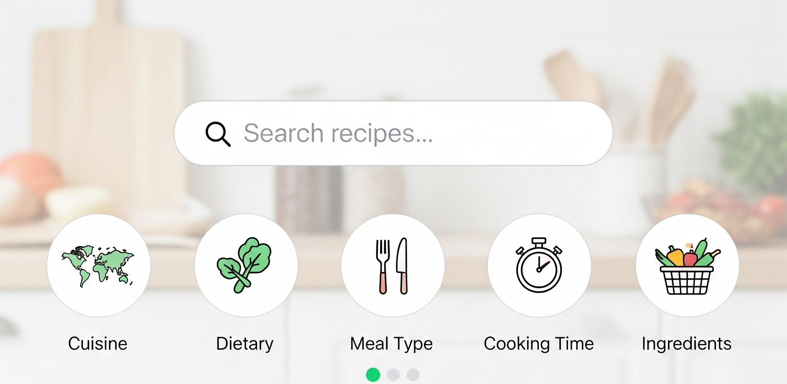
THE PRODUCT
Search the way people actually cook.
By the ingredients you already have.
By diet, cuisine, or cooking time.
Weeknight meals in 30 minutes or less.
Filtered recipe search.
Jessica A. Miller · Foodie Explorer
8

Slide 9
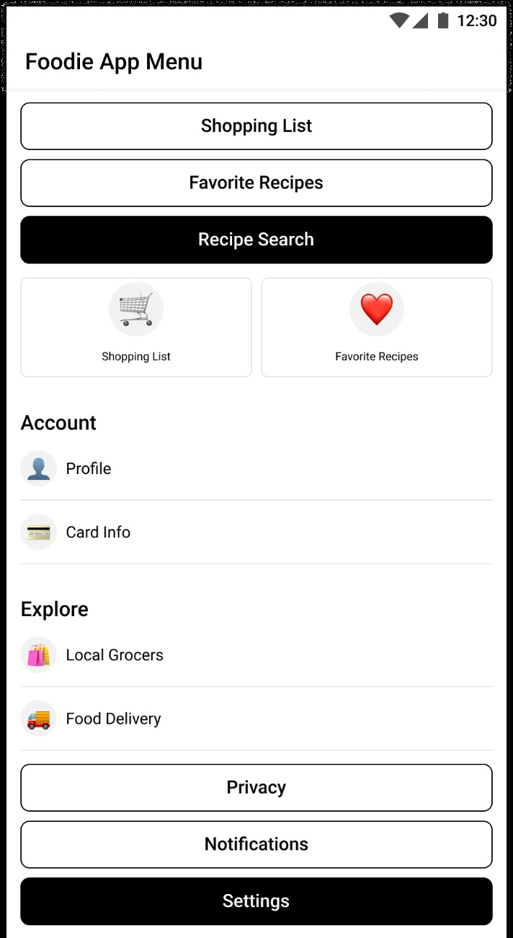
THE PRODUCT
One tap from recipe to grocery list.
Shopping list, favorite recipes, and recipe search in one menu.
Ingredients become a list automatically.
Checkout fits on one page.
The redesigned menu.
Jessica A. Miller · Foodie Explorer
9

Slide 10
THE EVIDENCE
Tested with real users. Twice.
1
2
3
Intuitive search
Visual guides
Streamlined navigation
Users found the search bar and filters easy to use. Recipe discovery became simpler.
Step-by-step visuals raised confidence, especially for new cooks.
A minimalist design made navigation quick.
Round 1 sharpened accessibility and personalization. Round 2 made checkout faster.
Jessica A. Miller · Foodie Explorer
10

Slide 11
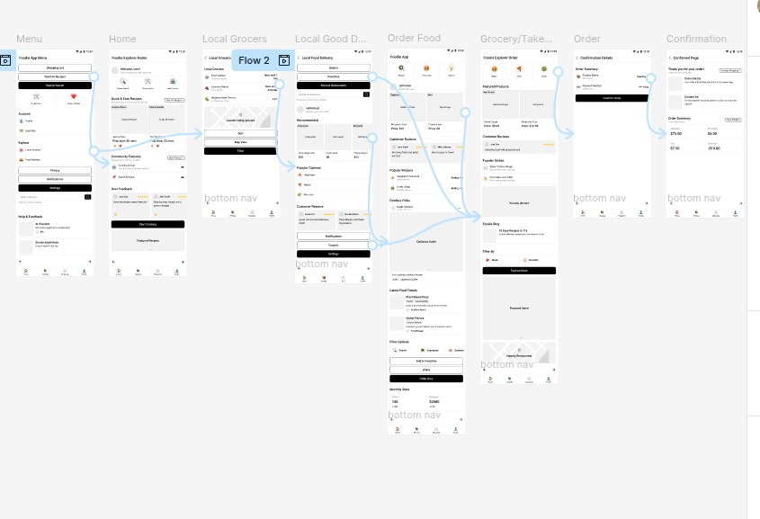
THE EVIDENCE
What changed after testing.
BEFORE
Simple layout, basic navigation.
No personalization.
No accessibility enhancements.
AFTER
Better search filters. Larger buttons.
Recommendations based on past orders
and dietary preferences.
The flows, connected in Figma: Home → search → grocery list → order → confirmation.
Jessica A. Miller · Foodie Explorer
11

Slide 12
ACCESSIBILITY
More people can use it. Fewer need help.
1
2
3
High-contrast mode
Voice search
Large tap targets
Readable fonts and strong contrast. Text stays clear for users with low vision.
Search by voice. Screen readers read every screen. No mouse needed.
Clear navigation and big, well-spaced buttons. Fewer misclicks.
Accessibility is reach. It is also fewer support calls and fewer lost customers.
Jessica A. Miller · Foodie Explorer
12

Slide 13
THE RESULT
A calmer, faster path from recipe to groceries.
“The app is so intuitive and saves me so much time. Now I can quickly find recipes and order groceries without stress!”
Usability study participant
The redesign streamlined recipe discovery and grocery ordering, so users plan and cook with less effort.
Jessica A. Miller · Foodie Explorer
13

Slide 14
HOW I WORK
The way I would work with you.
1
2
3
Start with your users
Test with real people
Build accessible from the start
Research before design. Surveys and usability tests, not guesses.
Two rounds of testing, then redesign on what they show me.
High contrast, voice search, and screen readers, not bolted on later.
Jessica A. Miller · Foodie Explorer
14

Slide 15
WHY ME
What this project proves.
1
2
3
Strategic thinking
Research rigor
A tested redesign
I found the business problem behind the UX problem: time lost is a customer lost.
Surveys, usability studies, two test rounds. Decisions backed by evidence.
I shipped a working prototype, tested it with real users, and improved it on their feedback.
Jessica A. Miller · Foodie Explorer
15

Slide 16
LET’S TALK
Let’s talk about your website.
Book a free 15-minute discovery call.
millrjess@gmail.com
linkedin.com/in/millrjess
millrjess.github.io
Jessica A. Miller · Website Operations Consultant
© 2026 Jessica A. Miller

