Slide 1
Modelling stars: some background for the exercise
Richard J. Stancliffe
(University of Hull, UK)

Slide 2
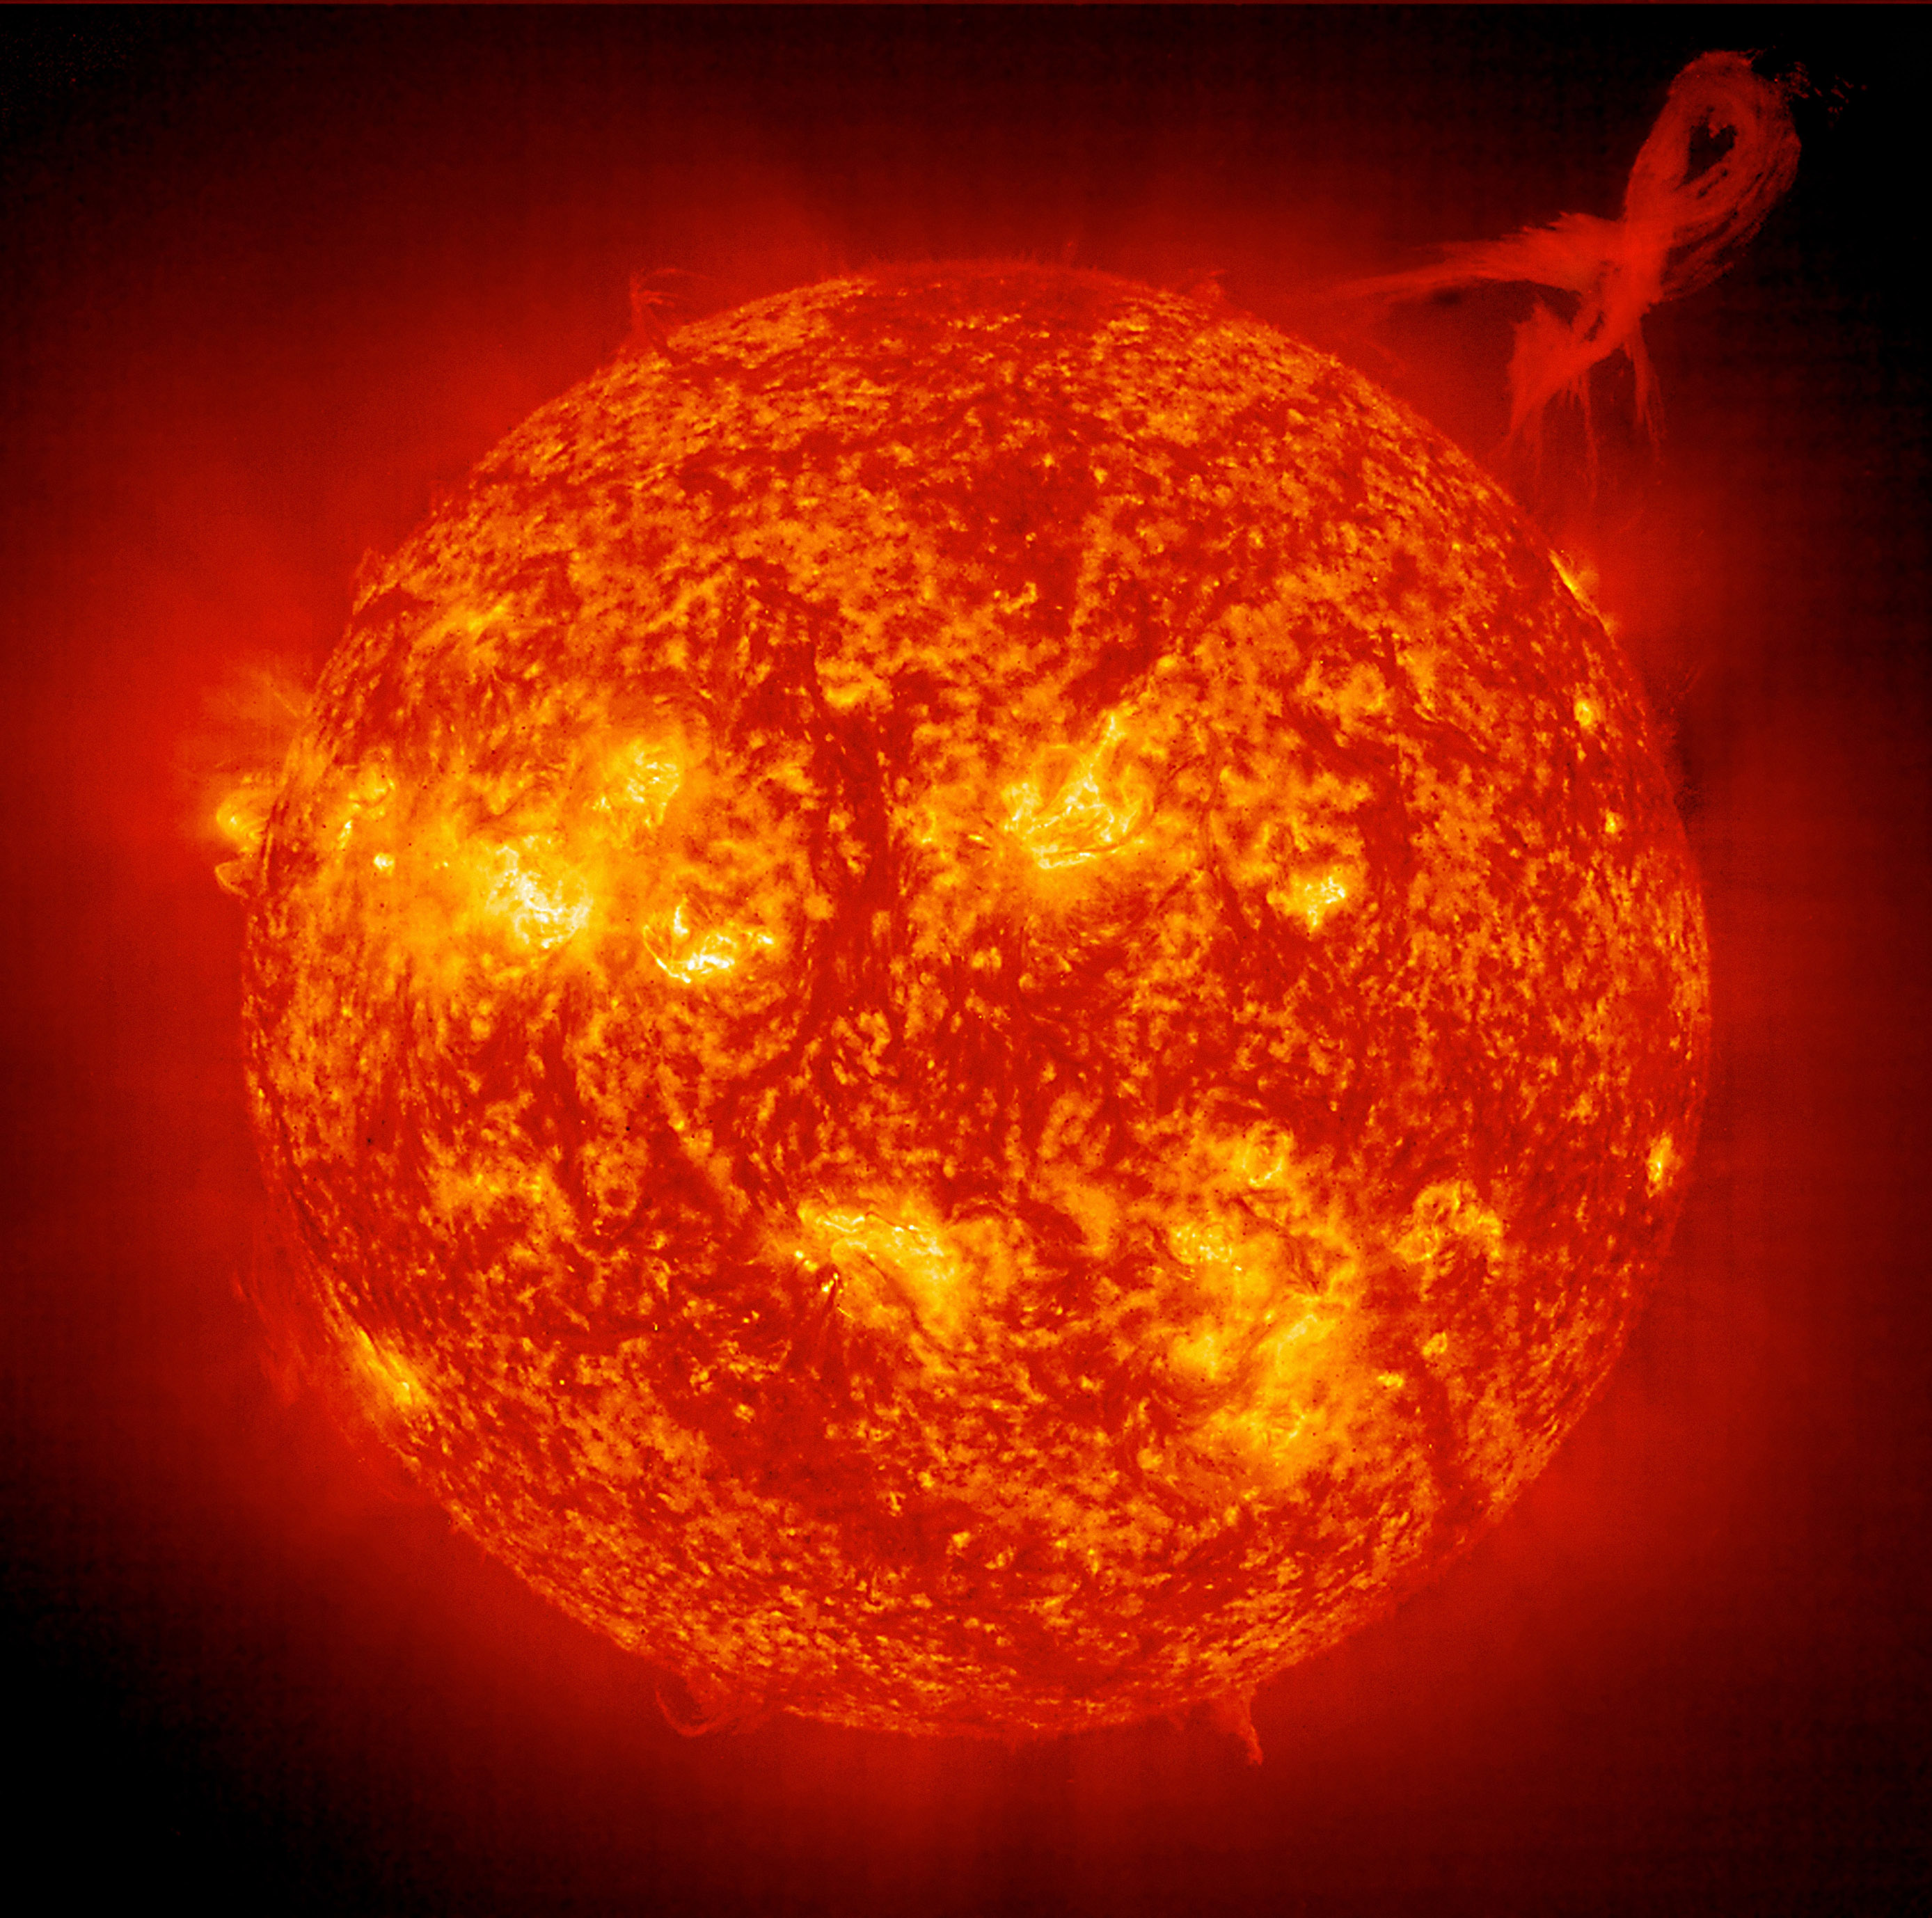
Modelling Stars
How do I go from this…
…into something I can model?
I have to simplify a few things!
Image: NASA

Slide 3
Assume everything is spherically symmetric
Everything becomes a 1D problem
Split the star up into boxes – called meshpoints
Each box has its own properties, mass, density, temperature, composition
We use mass as the important co-ordinate
The total mass enclosed between that mesh point and the centre
Centre
Surface

Slide 4
Composition
Each box contains a certain amount of each isotope
We describe the abundance in terms of the mass fraction
Usually given the symbol X, with a subscript for each isotope, i
You came across this in the pre-school assignment
The abundance is the fraction of the mass in this box that is in isotope i

Slide 5
Stellar Structure equations

Slide 6
Chemical evolution equations
X_{i}
+ mixing

Slide 7
How do we solve all this?
Just like your forward Euler method
If you know your structure at one time, t, we can calculate what it is like at t+dt
We call each time point in the model a cycle
The step sizes vary depending on what is happening
Large when the star is changing slowly

Slide 8
What do you end up with?
A sequence of cycles
Defined by a cycle number and time/age
Each cycle has its own structure
Composition/radius/temperature as a function of mass
This makes up an evolutionary sequence
You are now going to investigate some actual research data
NuGrid collaboration evolutionary sequences (Pignatari et al., 2016)

