Slide 1


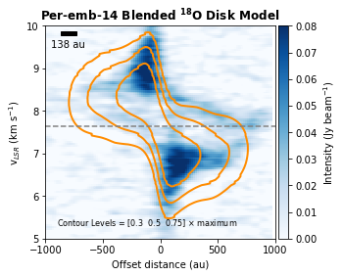
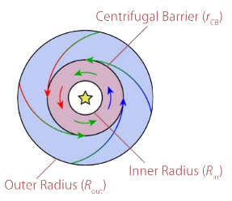
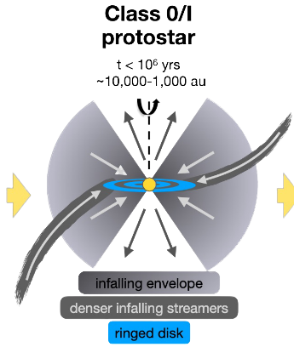
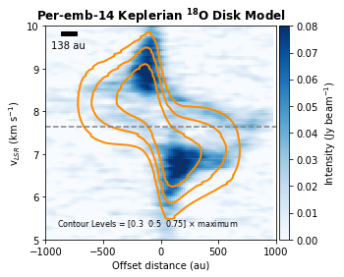
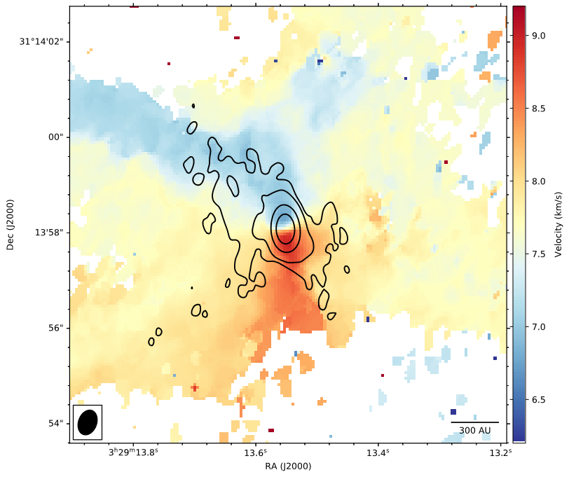
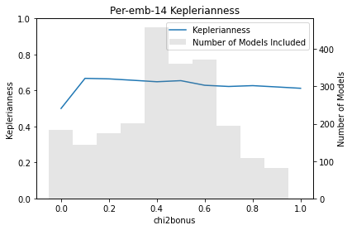
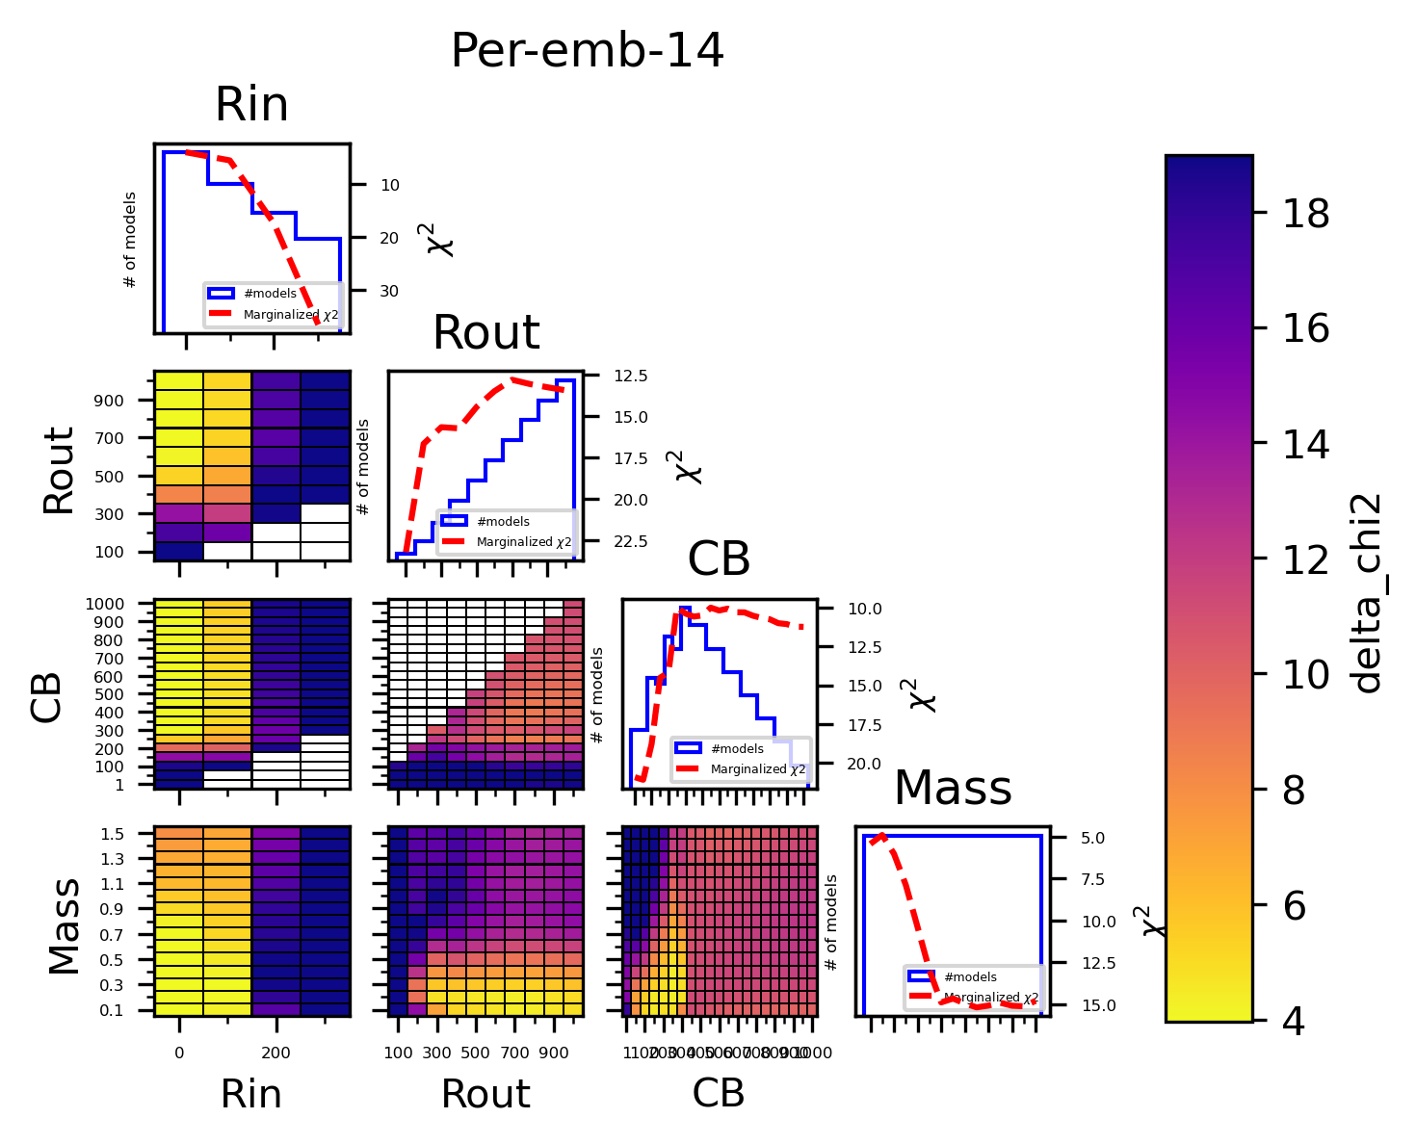



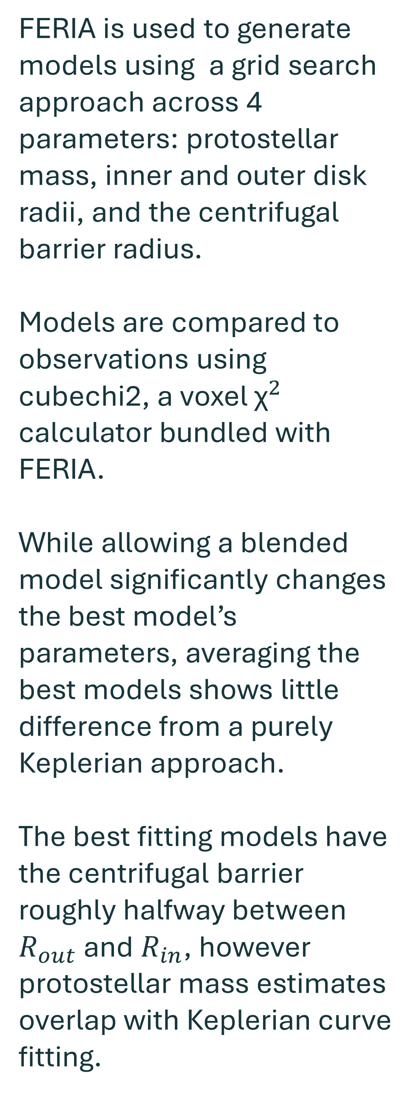

Studying Infall Towards 10 Class 0/I Protostars Using ALMA and FERIA
Andrew Milne¹, Dominique Segura-Cox¹
¹University of Rochester
Blended:
M 1.5
CB 350
Rout 1000
Rin 300
Keplerian:
M 0.1
CB 400
Rout 400
Rin 300
chi2bonus 1:
M 0.72 +/- 0.43
Rout 766.5 +/- 196.5
Rin 48.6 +/- 50
CB 482.8 +/- 218.1
Cayden values:
M 0.67
Rout 660
Rin 120
Class 0/I Protostars
Infalling Envelope Contribution
Fitting Keplerian disks to protostars can be a simple way of modeling, however contributions from an infalling envelope are often neglected.
Perfectly Keplerian models and perfectly IRE models can differ by up to a factor of 2 in protostellar mass estimates, potentially causing overestimation of protostellar masses.
This effect would be most pronounced in Class 0/I protostars where envelope infall is prevalent.
FERIA is used to generate models using a grid search approach across 4 parameters: protostellar mass, inner and outer disk radii, and the centrifugal barrier radius.
Models are compared to observations using cubechi2, a voxel ${\text{χ}}^{2}$ calculator bundled with FERIA.
While allowing a blended model significantly changes the best model’s parameters, averaging the best models shows little difference from a purely Keplerian approach.
The best fitting models have the centrifugal barrier roughly halfway between $R_{out}$ and $R_{in}$, however protostellar mass estimates overlap with Keplerian curve fitting.
Oya et al. 2022
Pineda et al. 2022
ALMA Data
Project 2017.1.01078.S
0.538” x 0.383” (∼161 au x 115
au at a distance of 300 pc) resolution.
Keplerianness = $1−\frac{(R_{out}−CB)}{({R_{out}−R}_{in})}$
Model Parameter Optimization and Results
Our grid search method allows for the collection of models which are ‘good enough’, providing a group to do statistics on. Model parameters can be reported with uncertainties.
In general, disk radii are overestimated compared to traditional values. We believe our parameters are tracing the envelope rather than the gas disk.
We do not see significant deviation from a traditional Keplerian mass fitting approach at this resolution. We therefore claim the IRE component is not significant enough to affect mass measurements.
A full manuscript for 10 protostellar sources is being written for publication.
References
Oya et al. (2022) PASP, 134, 1039. Pineda et al (2022) Nature Astronomy, 4, 1158

Slide 2
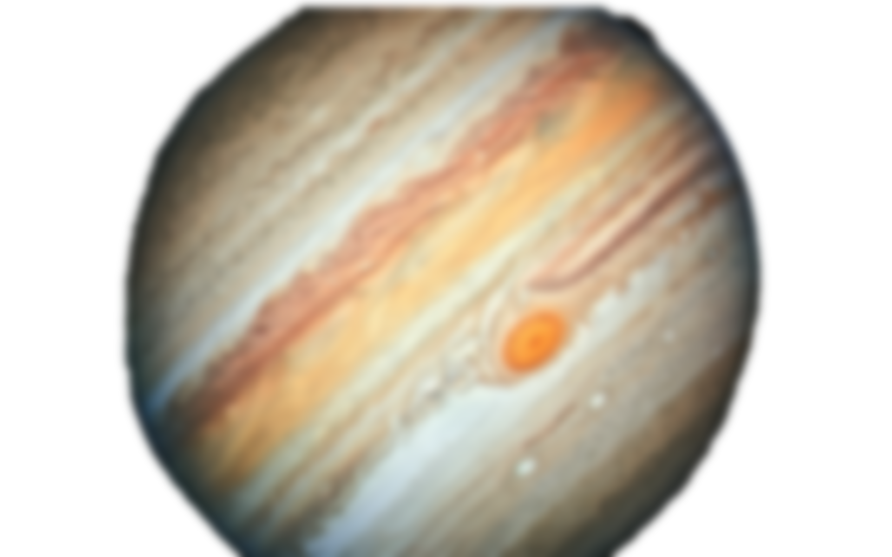


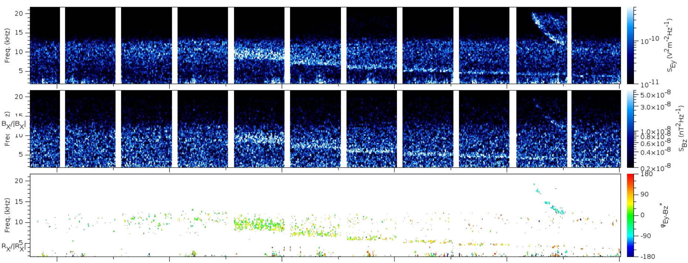
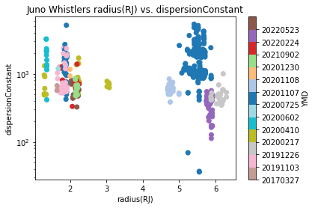
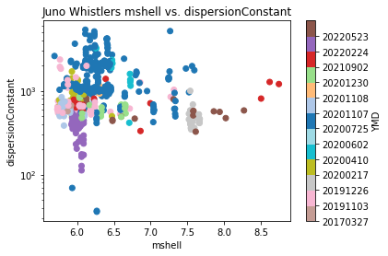
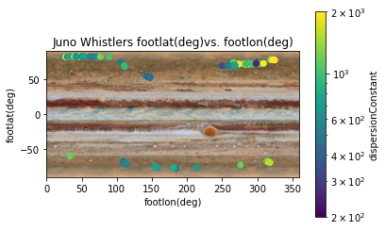
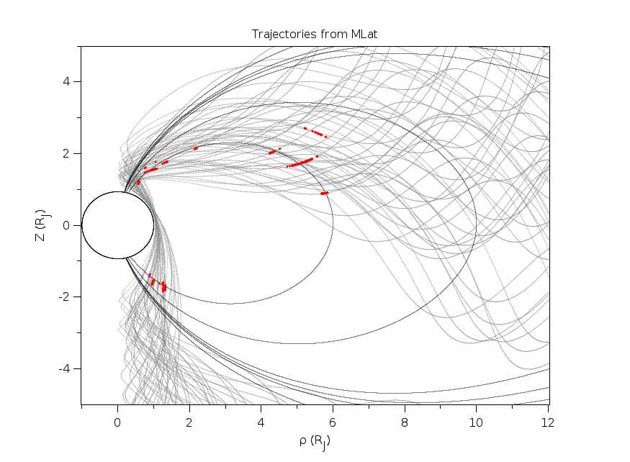
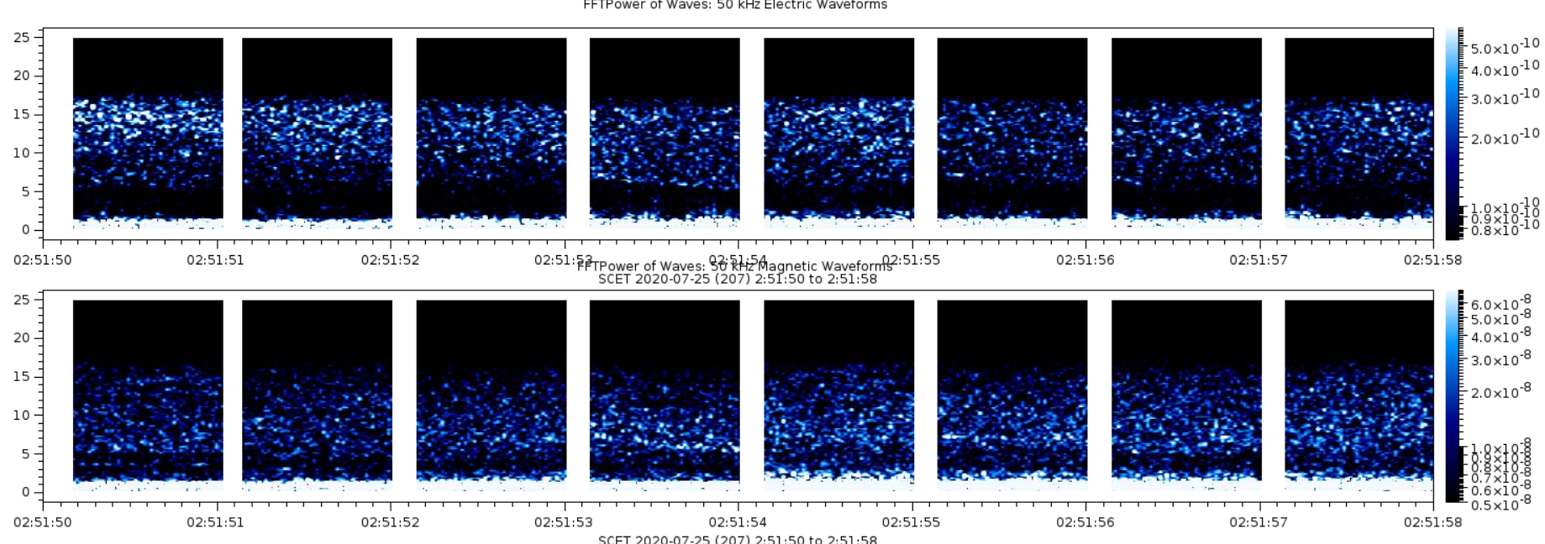
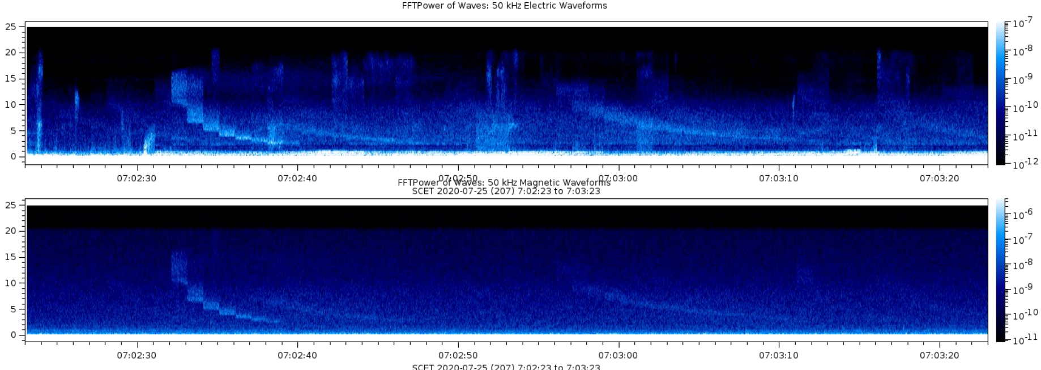

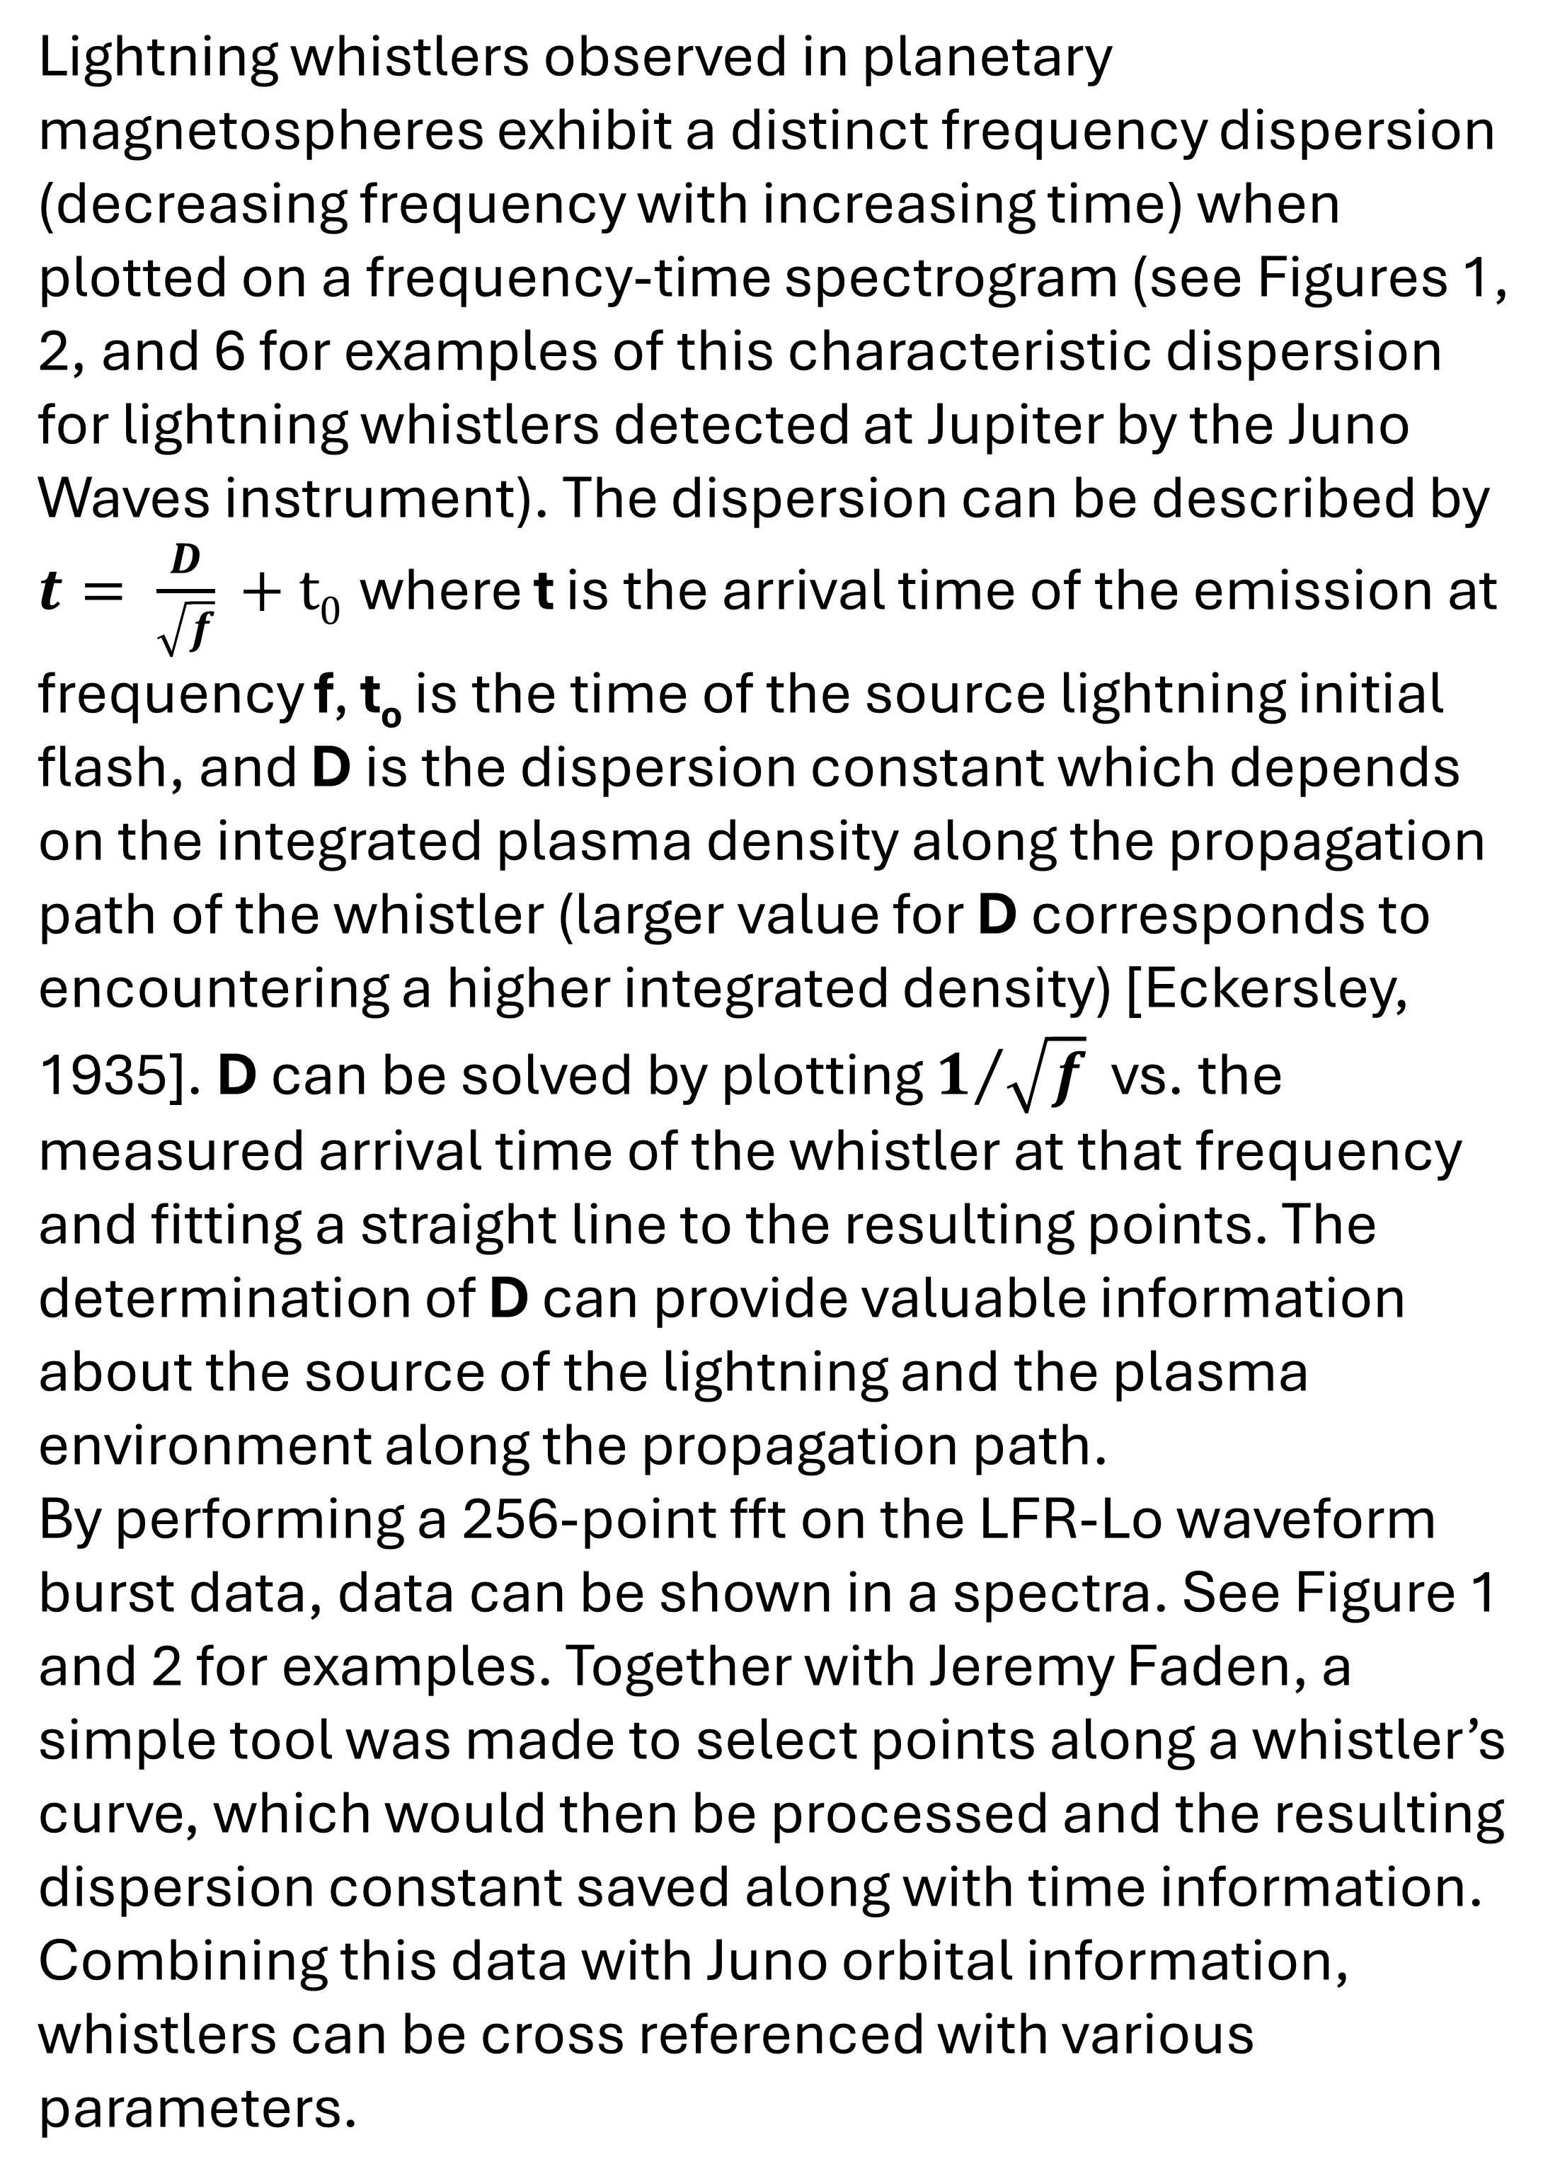
A Survey of Jovian Long Dispersion Lightning Whistlers Observed by Juno Waves
Andrew Milne¹, George Hospodarsky¹, Jeremy Faden¹
¹Department of Physics and Astronomy, College of Liberal Arts and Sciences, The University of Iowa, Iowa City IA
Introduction
Figures
NASA’s Juno arrived in orbit around Jupiter in July 2016. Juno carries the Waves instrument, an experiment designed to measure plasma and radio waves in the environment around Jupiter. Of note is the strong magnetic field around Jupiter and the plasma torus formed by volcanic ions from Io, creating a unique environment for waves to propagate.
Lightning flashes on Jupiter emit a broad spectrum of light, including low frequency radio waves. These lightning radio waves can escape into space and propagate along the planets magnetic field lines with the high frequencies traveling faster than the low frequencies, thereby dispersing the wave into a whistling tone that decreases in frequency with increasing time. The detection and characteristics of these ‘whistlers’ can be used to estimate the location of the source lightning on Jupiter and if they have traveled through the dense plasma associated with the Io torus
1
L
M
3
4
Figure 7: The trajectory of Juno in the Jupiter magnetic Rho vs. Z coordinate system determined using the JRM33 and CS2020 models. Measured long dispersion whistlers are marked in red. The red A and B shows the approximate location of Juno when the whistlers shown in Figures 1 and 2, and Figure 6 respectively were detected. Lines of constant mshell at 6 and 10 R_{J} above the magnetic equator are plotted to estimate field lines that map to the Io torus.
L
M
5
Figures 3, 4, 5: Plots showing whistler dispersion vs Juno’s distance from Jupiter, magnetic field line, and a plot showing where the whistlers originated on Jupiter.
7
Figure 1: A long dispersion whistler from 02:35:15 to 02:25:22, as well as a medium dispersion whistler from 02:35:20 to 02:35:21. This is a rare case of a simultaneous medium and long dispersion whistler, which serves to visually show the difference. Direction finding identifies the whistlers having different phases, showing the medium dispersion whistler traveling up from Jupiter and the long dispersion whistler traveling through the Io torus.
C
A
B
M = 6
M = 10
Methods
2
6
Lightning whistlers observed in planetary magnetospheres exhibit a distinct frequency dispersion (decreasing frequency with increasing time) when plotted on a frequency-time spectrogram (see Figures 1, 2, and 6 for examples of this characteristic dispersion for lightning whistlers detected at Jupiter by the Juno Waves instrument). The dispersion can be described by $t= \frac{D}{\sqrt{f}}\text{ + }\text{t}\text{0}$where t is the arrival time of the emission at frequency f, t_{o} is the time of the source lightning initial flash, and D is the dispersion constant which depends on the integrated plasma density along the propagation path of the whistler (larger value for D corresponds to encountering a higher integrated density) [Eckersley, 1935]. D can be solved by plotting $1/{\sqrt{f}}$ vs. the measured arrival time of the whistler at that frequency and fitting a straight line to the resulting points. The determination of D can provide valuable information about the source of the lightning and the plasma environment along the propagation path.
By performing a 256-point fft on the LFR-Lo waveform burst data, data can be shown in a spectra. See Figure 1 and 2 for examples. Together with Jeremy Faden, a simple tool was made to select points along a whistler’s curve, which would then be processed and the resulting dispersion constant saved along with time information. Combining this data with Juno orbital information, whistlers can be cross referenced with various parameters.
M
M
Figure 2: A Medium Dispersion whistler shown between 02:51:53 and 02:51:54.
While difficult to see, signal is strong enough to obtain direction finding, proving it is a medium dispersion whistler
Figure 6: A cluster of multiple long dispersion whistlers, shown both in the electric field(top) and magnetic field(bottom) frequencies. Note that these whistlers have dispersion constants ranging from 545 to 1915 within a short timespan
Summary
Future Work
Acknowledgements
Analyzing roughly 1000 whistlers, we identify 345 whistlers with a dispersion constant greater than 10, consisting of medium (D<100) and long (D>100) dispersion whistlers across many orbits. We detect whistlers both near the Io Torus and near Jupiter at mshells that connect through the Torus. See Figure 4 and 7
We see large variation in dispersion constant across small time scales, potentially showing small scale density structure. See Figure 6
We identify 2 examples of medium dispersion whistlers, identified by travel direction and relatively lower dispersion constant. See Figure 1 and 2
While detections of long dispersion whistlers happen within mshell 5-9, a statistical study is needed to identify how likely it is Juno sees whistlers at a given mshell per orbit. This statistical study can also be carried out for other parameters, such as the relative location of Io to Juno, or seasonal effects.
Figure 5 shows a deviation in the northern whistlers, which may be consistent with the Great Blue Spot, a magnetic anomaly of Jupiter.
A full paper is being written covering this work, expected 2025 publication date.
The research at the University of Iowa is supported by NASA through Contract 699041X734 with the Southwest Research Institute. A. M. acknowledges the use of the Space Physics Data Repository at the University of Iowa supported by the Roy J. Carver Charitable Trust.
Personal Website

Slide 3
