Slide 1
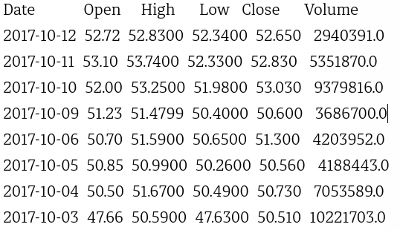
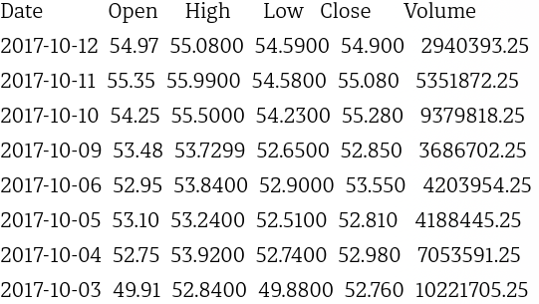
Historical prices of stocks
Discriminator Network
Real / Generated
Generator Network
X~N(0, 1)

