Slide 1
Spring-boot:run
Maryam Anwar

Slide 2
Setting up a spring-boot project
Back end - IntelliJ
Set up a project with a H2 database, JDBC and JPA starters
Import all dependencies
Build the classes that communicate with the database
Set up a database connection

Slide 3
Setting up a spring-boot project
Front end - Webstorm
Use npm to create a template project
Edit the template project
Use bootstrapVue CSS
Use a router to create a base page (i.e. header and footer) and make the router access different pages to be displayed on one page. – Generates a one page app.

Slide 4
Setting up a spring-boot project
Joining the two together
Import axios which is a library to help create POST, GET and UPDATE requests.
Use postman to generate requests and allow the database to be tested to look at the structure of the packets being sent.
Generate URL’s to access Local host

Slide 5
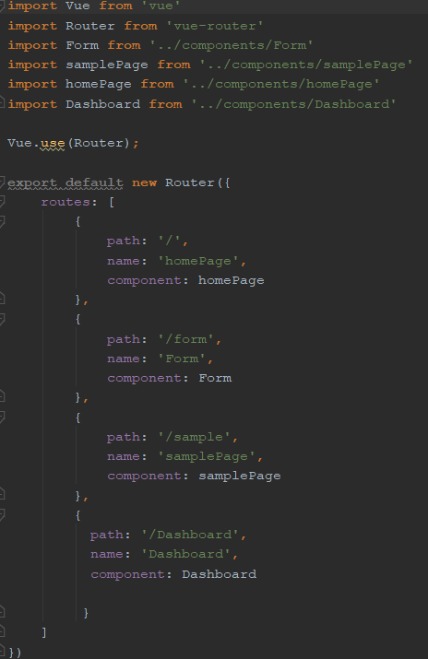
Router setup

Slide 6
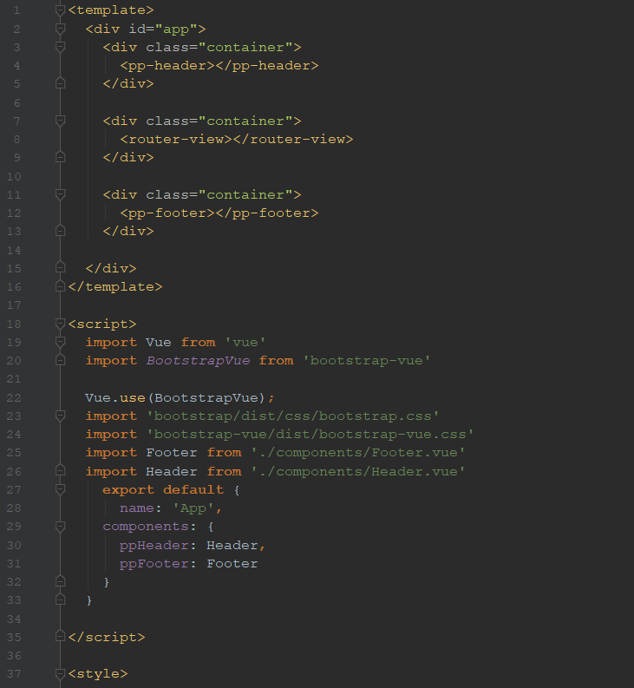
imports

Slide 7
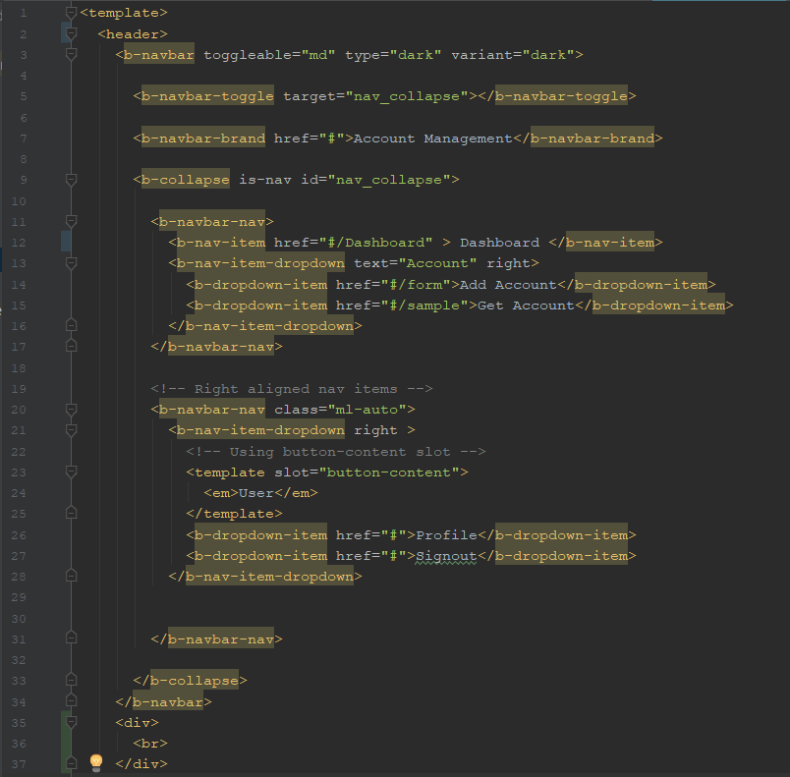
Setting up a header

Slide 8
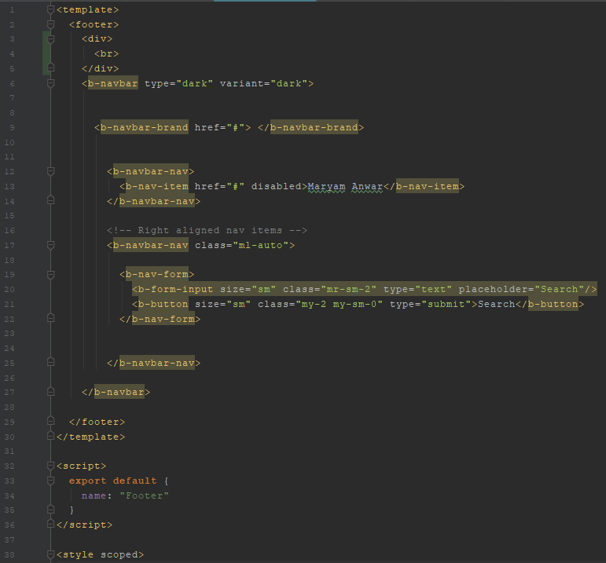
Setting up a footer

Slide 9
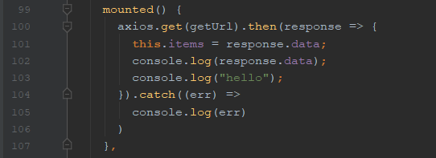
axios

Slide 10
