Slide 1
ENERGY CONSERVATION USING LOCATION ANALYSIS
TEAM : THE DATA VADERS
MANJARI CHINNIYAN SUBRAMANI
SAYALI NAKASHE
CHINMAY ITAGI
MILONI SHAH

Slide 2

INTRODUCTION
What Kiana does:
Augment physical security capabilities
Improve business profitability by magnifying foot traffic awareness
Optimize resource utilization through human capital planning, queue wait time identification and visitor behavior analytics
Our innovation: Regulation of temperature by analyzing visitor behavior and using number of occupants.

Slide 3

PROJECT DEFINITION
In this project we plan to use the spatio- temporal data that is the location and timestamp of the visitors to predict the densely populated areas of a commercial space and recommend the energy required for heating/cooling that area

Slide 4

PROJECT OBJECTIVE
Developing a solution to regulate usage of electricity in large spaces using real-time analysis of foot-traffic and visitor patterns.
The project will be beneficial in minimizing resource utilization in the long run.

Slide 5

BUSINESS USE CASE
Can be used by Kiana Analytics and their clients to implement energy conservation in large spaces like malls, corporate spaces, universities.
Can be used for different energy sources like lights.

Slide 6



PROJECT PLAN
ACQUIRED DATA
FORMULATING
FROM KIANA
TEMPERATURE
RECOMMENDATION
ANALYTICS
REGULATION
OF TEMPERATURE
TECHNIQUE
DATA SIMULATION
MODEL SELECTION
AND
– XGBOOST
REPORT
PREPROCESSING
REGRESSOR
FORMULATION
(ZONES)
MODEL BUILDING FOR OCCUPANT PREDICTION
COMPARISON OF
PROJECT CLOSE- OUT
MEAN SQUARED ERRORS

Slide 7

MILESTONES
DEFINE
02/24/2019
MEASURE
03/03/2019
ANALYSE
04/17 /2019
IMPROVE
04/21/2019
CONTROL
04/24/2019

Slide 8
MILESTONES
DEFINE | Identified project objective and goal ie energy conservation using WiFi analytics, developed Project Charter
MEASURE | Collection and simulation of data and high-level process maps
ANALYZE | Studied root causes and essential parameters required for model building, did so using Fishbone diagram and 5 Why’s problem solving, Pareto Chart
IMPROVE | Using XGBoost improved the model accuracy, made changes to zonal data.
CONTROL | Develop a control and monitoring plan, standardize the temperature regulation units.

Slide 9

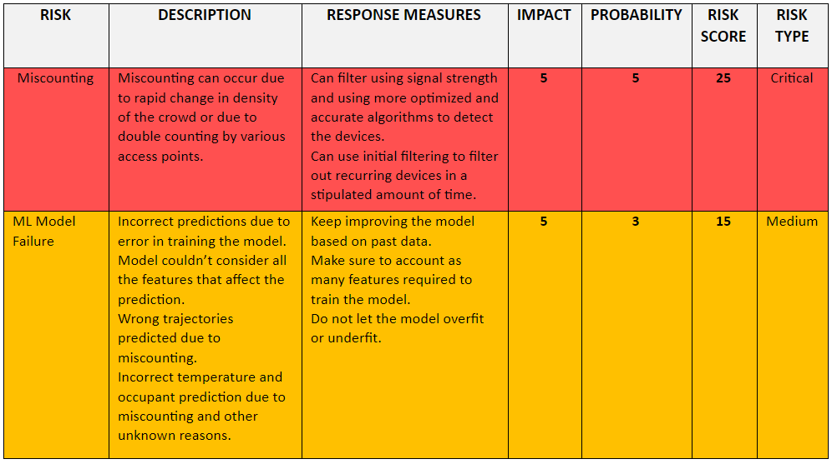
TECHNICAL FEASIBILITY STUDY

Slide 10

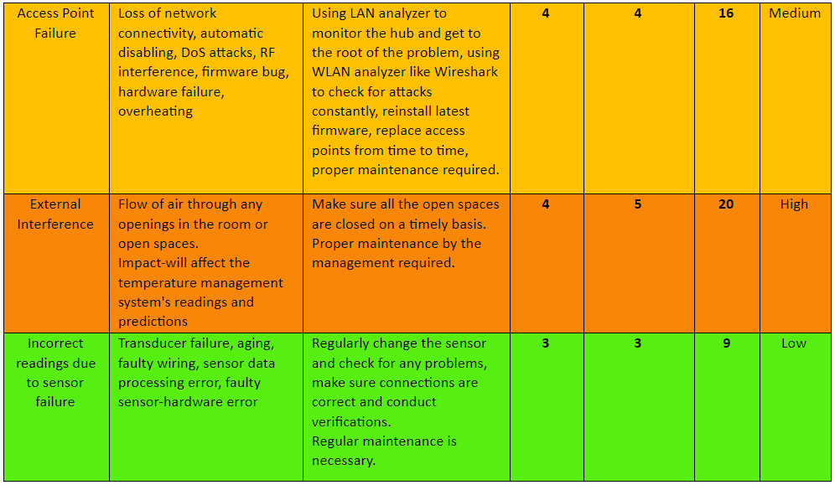
TECHNICAL FEASIBILITY STUDY

Slide 11
EXTERNAL DATA SOURCES - FOR IMPROVING SOLUTION
Data about the HVAC Systems will help predict the required energy in BTU’s more accurately.
Given the exact size of each zone, prediction for the particular area will be more accurate.
Information about the humidity, CO2 levels of the space

Slide 12

PERFORMANCE CRITERIA
Accuracy of the overall model(>70%)
BASELINE MEASUREMENTS
Comparison with ground truth value from validation data

Slide 13
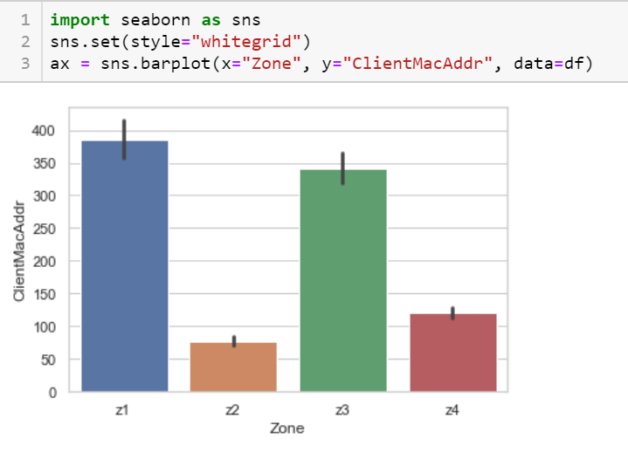
DATA EXPLORATION

Slide 14
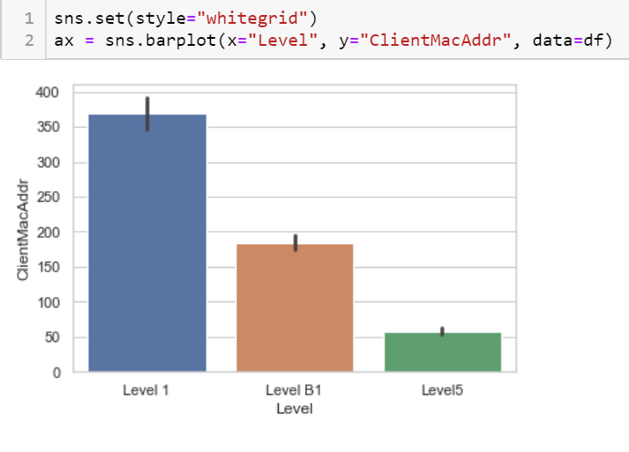
DATA EXPLORATION

Slide 15

TEST SCENARIO AND ACCEPTANCE CRITERIA
Energy consumption should be minimum when less number of people in room
2. Accuracy for occupant prediction which is determined by using the Mean Squared Error

Slide 16
SAMPLING OF DATA
MODEL | SAMPLING METHOD AND SAMPLE SIZE
OCCUPANT PREDICTION | Selected random 10 million records for training. (Stratified Sampling)

Slide 17

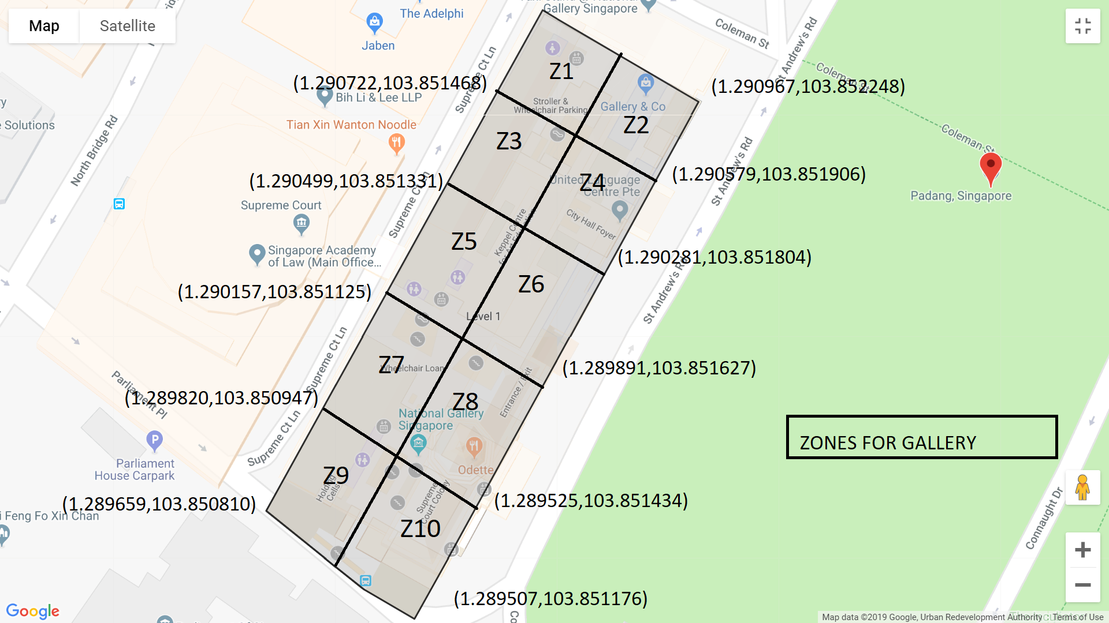
FEATURE ENGINEERING

Slide 18
FEATURE ENGINEERING
Further, to carry out prediction we are grouping the MacClientAddr by Zones, Levels and Localtime which is in intervals of 4 hours ie from 8-12, 12-16, 16-20 and 20-24.
Code Snippet :
x1 = temp.groupby(['Zone’, 'Level’, pd.Grouper(key='localtime', freq='240min')]).agg({'ClientMacAddr': 'count'}).reset_index()

Slide 19
FEATURE ENGINEERING
One-hot encoding the columns to generate feature columns.
For :
Zones
Levels
Day
Hours
Done using Pandas Library
final["Level"]=pd.Categorical(final["Level"])
df_dummies1 = pd.get_dummies(final["Level"],prefix='category')

Slide 20
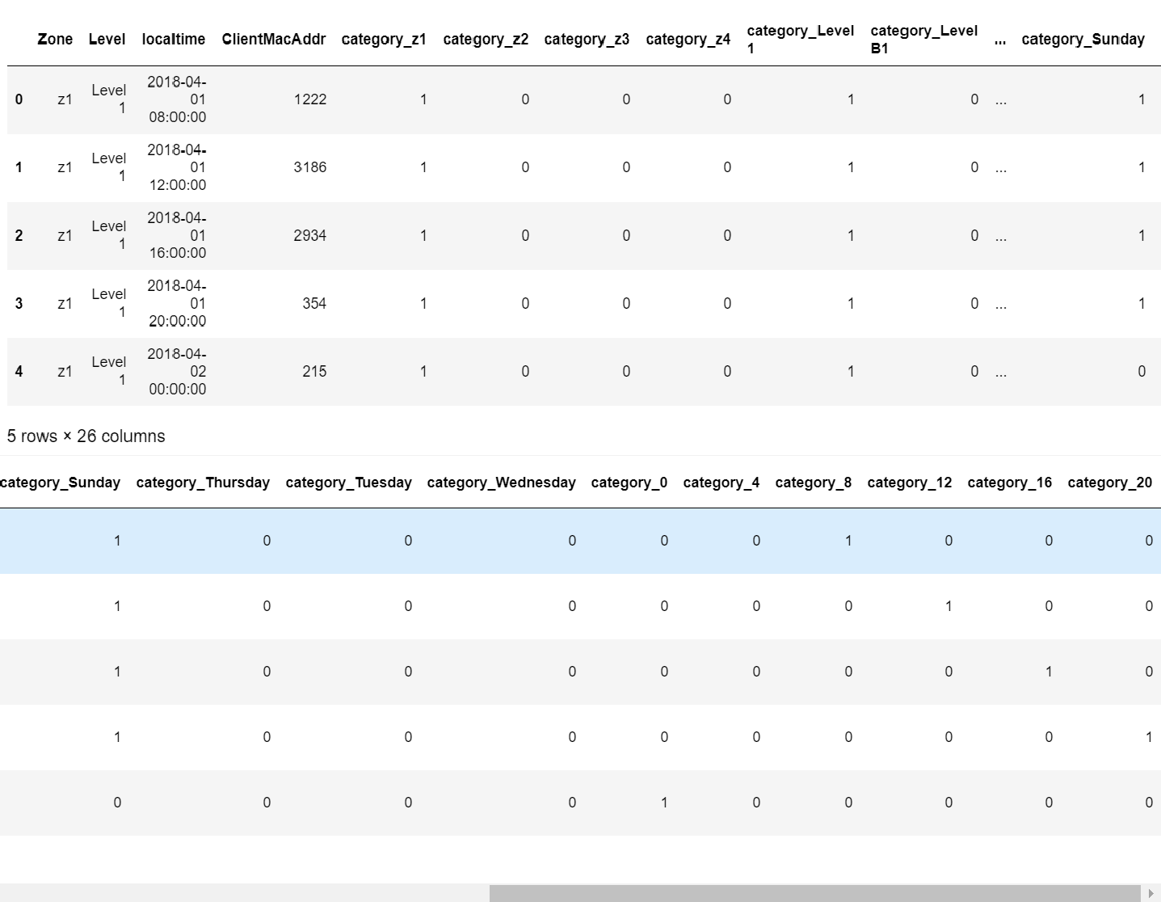
FINAL DATA

Slide 21

COMPARISON OF MODELS
3 models were trained on a sample dataset of 6500 rows namely Multiple regression, Lasso and Xgboost regressor.
Mean Squared Error :
Multiple Regression – 0.013
Lasso – 0.018 (Using alpha = 0.01)
Xgboost Regressor – 0.0091
Thus, we see that mean squared error is least for Xgboost.

Slide 22
XGBOOST REGRESSOR
Using xgboost from sklearn library, we created the XGboost regressor using the following parameters:
parameters = {'nthread’:[4]
'objective':['reg:linear'],
'learning_rate': [0.01, 0.03, 0.05, 0.07, 0.1], #so called `eta` value 'max_depth': [2, 4, 6, 8],
'min_child_weight': [2, 3, 4, 5, 6],
'silent': [1],
'subsample': [0.3, 0.7],
'colsample_bytree': [0.3, 0.7],
'n_estimators': [20, 30, 50, 100, 150, 200, 500]}

Slide 23
XGBOOST REGRESSOR
Thereafter, using GridSearchCV we get the best parameters by cross-validation.
Fit the model using the best parameters on the training data
Then, compute the Mean Squared Error
After CV, obtained these as the best parameters :
xgb1 = xgb.XGBRegressor(colsample_bytree=0.7, learning_rate=0.05, max_depth=4, min_child_weight=3, n_estimators=150, nthread=4, objective='reg:linear', silent= 1, subsample=0.7)

Slide 24

TEMPERATURE COMPUTATION
For 2000 sq ft of room, we require 34000 BTUs energy to keep it at an ambient temperature (considering there are at least 2 people in the room)
One zone in our partitioning is around 16062 sq ft
So approximately we require 8 times 2000 sq ft of energy i.e.
Total BTU’s required = 34000 * 8
= 272000 BTU’s

Slide 25
TEMPERATURE COMPUTATION
For each additional person in the area, we have to add
600 BTU’s
So, to find energy required to keep the room at an ambient temperature is given by
BTU’s = 272000 + [ 600 * (number of occupants –2)]

Slide 26

DELIVERABLES
An analytical model that predicts the number of occupants in every zone using Xgboost Regressor.
A report stating the procedure for temperature regulation and the method used for recommending the temperature.
Jupyter notebooks consisting of the codes for analysis and model building.
Tkinter application taking in Data, Time and Level with an output of required energy in BTU’s

Slide 27

FUTURE SCOPE
Work on the problem of double-counting
Feed the model with the daily predictions to add to the training data and improve predictions.
Improve accuracy of temperature prediction by considering other environmental factors.
Improve usability of application.

Slide 28

KEY LEARNINGS
Great opportunity to work with spatio-temporal data.
Handling large amount of data and usage of cloud.
Successfully implemented and understood the processes of DMAIC methodology.
Learnt professional project implementation skills, project integration and the art of documentation.

Slide 29

REFERENCES
1)https://www.researchgate.net/publication/311610515_Distributed_machine_learning_based_smart-grid_energy_management_with_occupant_cognition
2)https://www.researchgate.net/publication/328162012_A_Practical_Multi-Sensor_Cooling_Demand_Estimation_Approach_Based_on_Visual_Indoor_and_Outdoor_Information_Sensing
3) https://dl.acm.org/citation.cfm?id=2343582
4)https://www.researchgate.net/publication/262409328_Sentinel_occupancy_based_HVAC_actuation_using_existing_WiFi_infrastructure_within_commercial_buildings

Slide 30

TEAM ASSIGNMENT
TEAM MEMBER | RESPONSIBILITY
MANJARI SUBRAMANI | Data Simulation, Model development for occupant prediction using XGboost and PPT creation
SAYALI NAKASHE | Data Preparation and Data Simulation (Zone creation) and Linear Regression
CHINMAY ITAGI | Energy consumption research, Tkinter Application and model development using Linear Regression
MILONI SHAH | Data Simulation and Model development for occupant prediction(XGboost) and PPT creation

Slide 31
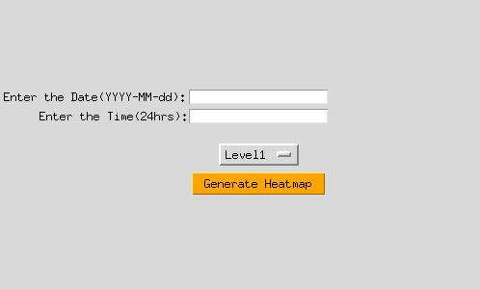
SCREENSHOTS

Slide 32
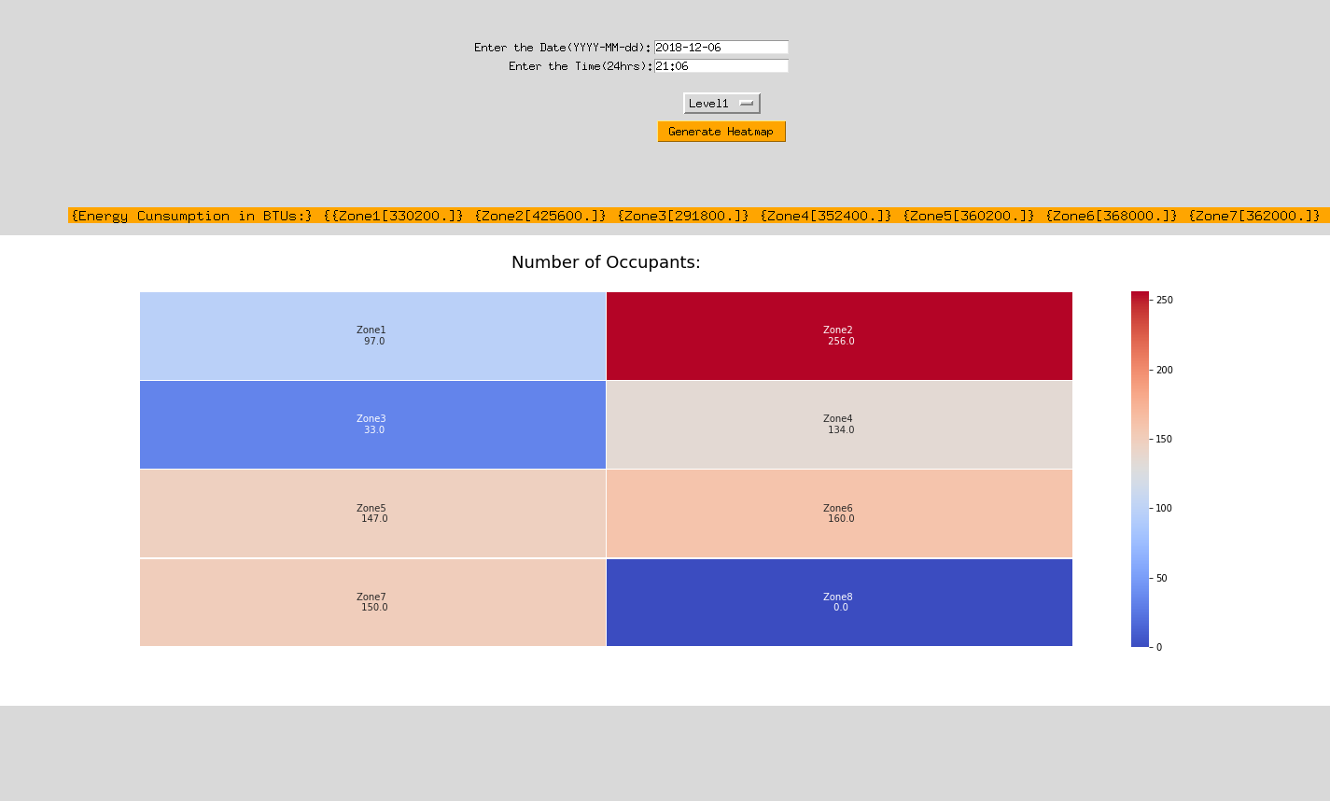
SCREENSHOTS

Slide 33
THANK YOU!

