Slide 1

PRODYNA
PAC MILOS NIKOLIC
CONFERENCE APP

Slide 2
PRODYNA BELGRADE
WHO WE ARE
PRODYNA is an innovative IT consultancy specialized on the topic of digital business. We consult companies through the processes of digital business transformation, and develop the custom software applications and systems required by your company to remain competitive in the age of the customer. The name PRODYNA stands for PROfessional and DYNAmic. Although most people think and act in the time unit “project”, the path to long term success is much longer. PRODYNA considers it extremely important to guarantee continuity to its customers. Since our capital is the knowledge and experience of our consultants, PRODYNA makes great investments in the further education, certification, and long term retention of its employees.

Slide 3
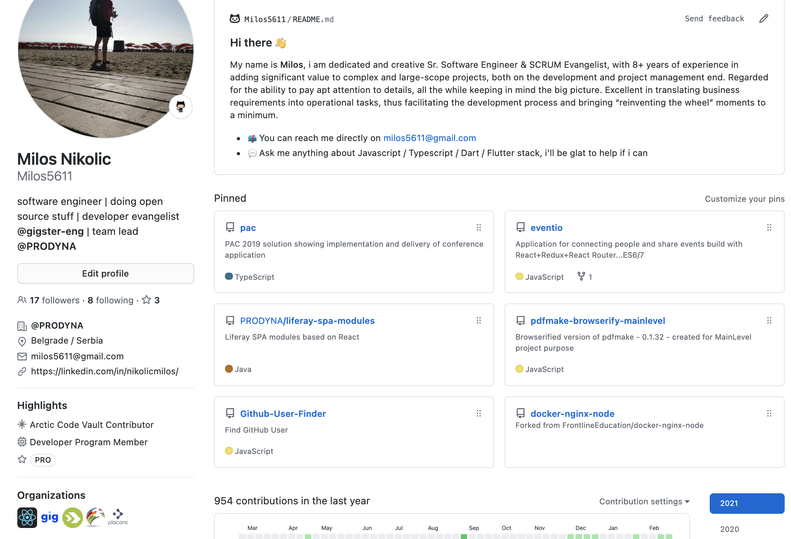
MILOS NIKOLIC
WHO I AM

Slide 4
CONFERENCE APP
WHAT WE ARE BUILDING
WE NEED… …DO GET RID OF BUNCH OF PAPERS …CLIENT APPLICATION THAT IS EASY TO USE …TO BE ABLE TO MAINTAIN APP EASILY …STABILITY IN CASE OF HEAVY USER TRAFFIC …AVAILABILITY TO ALL SUPPORTED MEDIUM …USER FRIENDLY

Slide 5
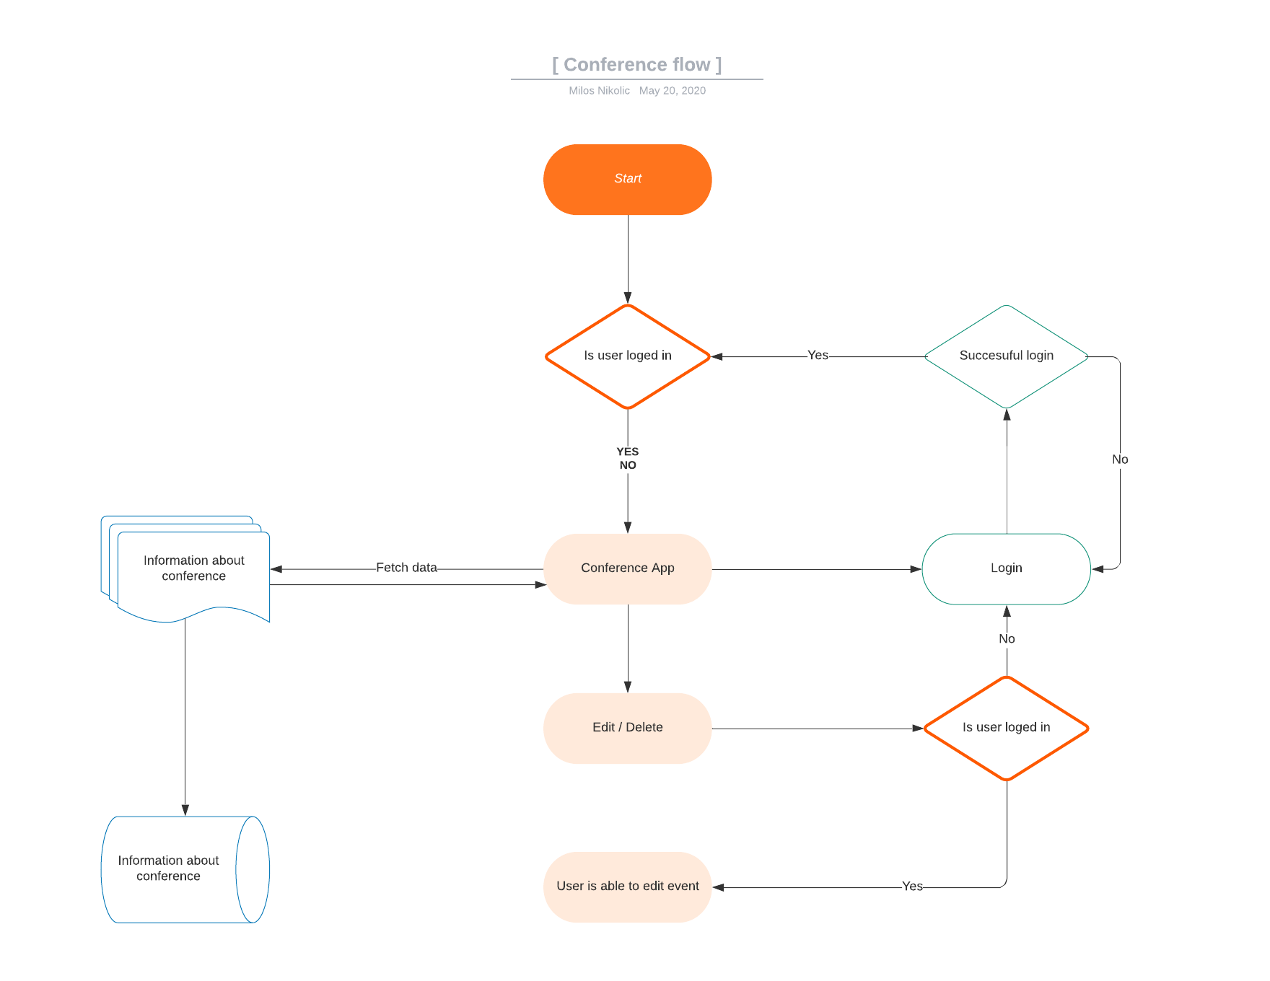
APPLICATION FLOW
WHAT IT SHOULD DO

Slide 6











WHAT TOOL WE ARE GOING TO USE
WHAT WE ARE BUILDING
Typescript Node JS LoopBack PostgresSQL Docker Svelte Okta Dataddog

Slide 7
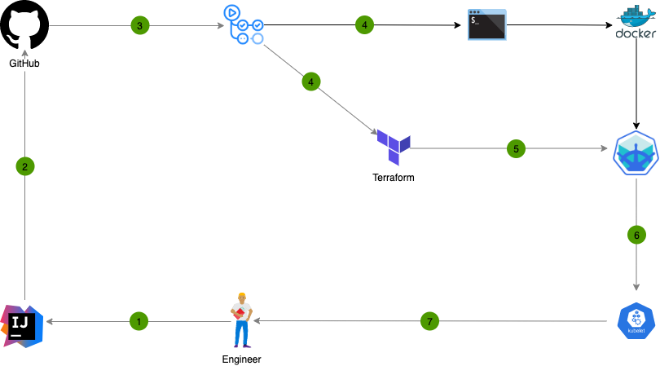
WHAT TOOL WE ARE GOING TO USE
HOW WE ARE BUILDING

Slide 8
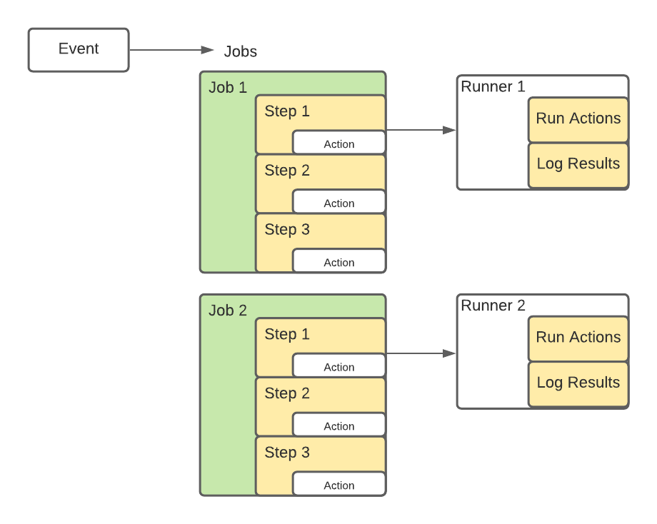
WHAT TOOL WE ARE GOING TO USE
HOW WE ARE BUILDING

Slide 9
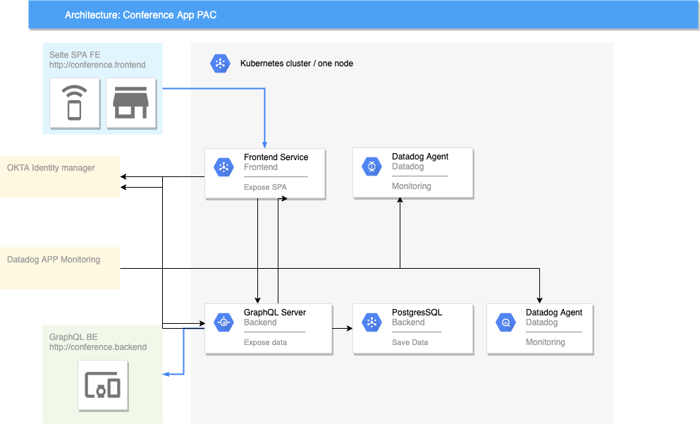
WHAT TOOL WE ARE GOING TO USE

Slide 10
PRODYNA
Questions ??? MILOS NIKOLIC
CONFERENCE APP

