Slide 1
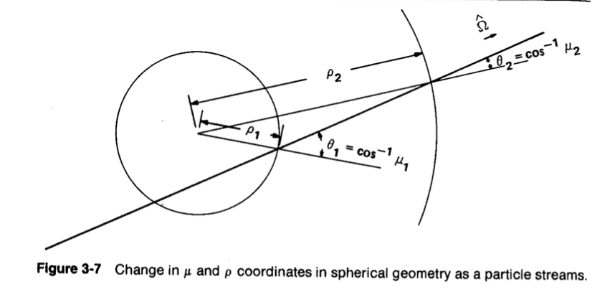
Multi-region solution of the neutron transport equation in 1-D spherical coordinates
Milos Atz
NE255 Final Project

Slide 2
Like in slab geometry, the transport equation is solved by discretizing in space and angle.
Unlike slab geometry, the reference angle changes as particles stream. Therefore, the solution must include a differencing scheme in angle.

Slide 3
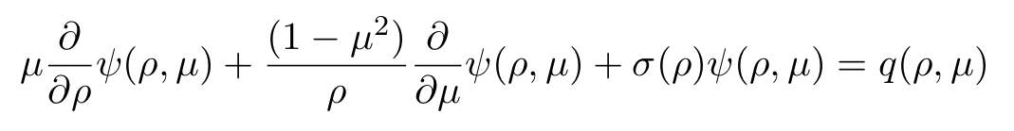
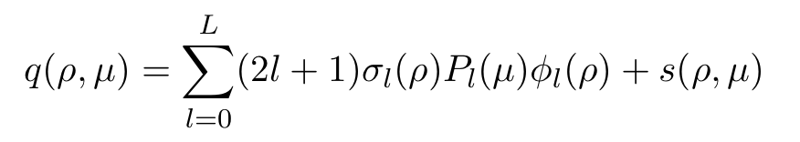
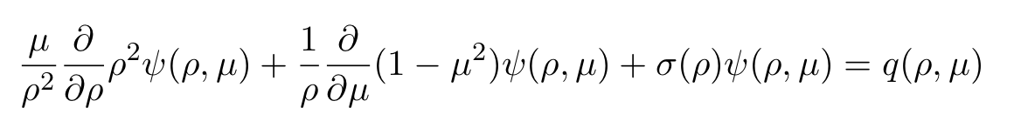
Transport equation in 1-D spherical coordinates
streaming
Absorption
Emission Density
(source)
Emission density
P_{N} scattering
expansion
external source
Conservation form

Slide 4

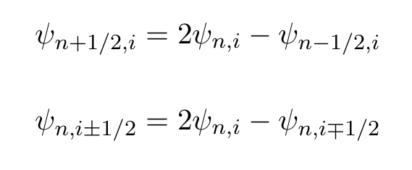
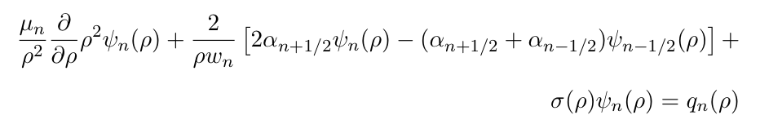
Conservation form (algebra)
Introducing DD in angle with angular differencing coefficients,
The angular differencing coefficients are defined recursively
Diamond differencing in angle

Slide 5
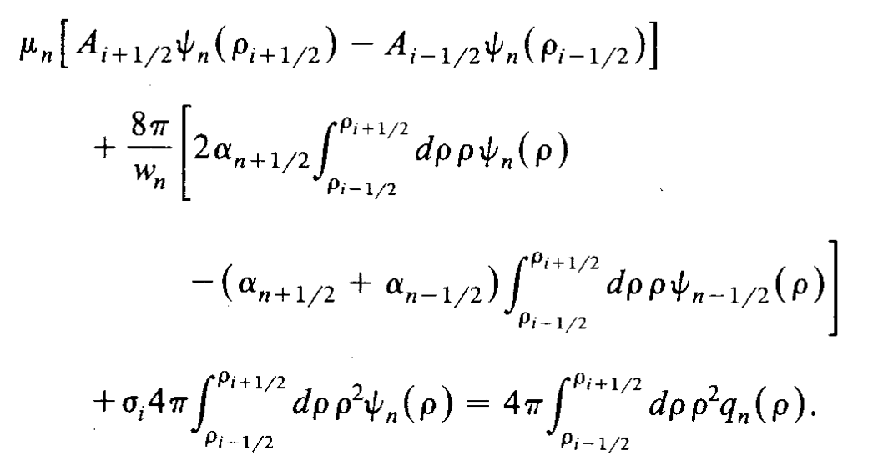
Conservation form of the TE, discretized in angle
Integrate over V_{i} ; define A_{i-1/2} and A_{i+1/2}

Slide 6
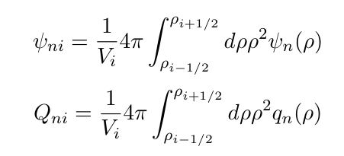
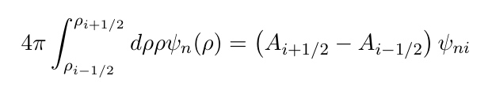

Slide 7
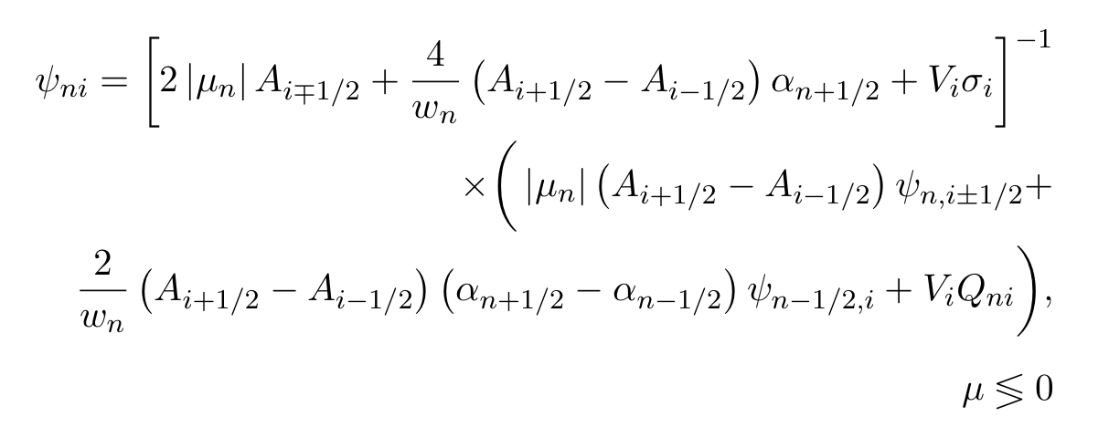

Slide 8
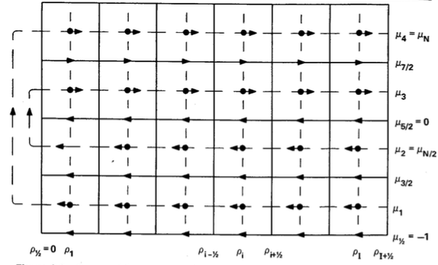
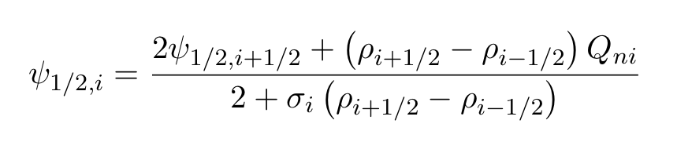

Slide 9
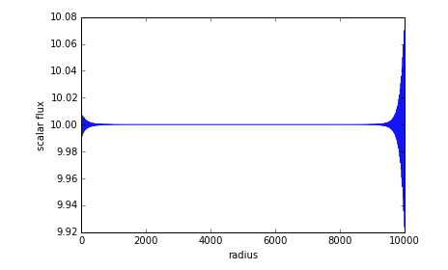
Results and test problems:
1. Near infinite medium, uniform isotropic source, no scattering
2. Bare sphere, point source at origin
3. Bare sphere, uniform isotropic source
4. Sphere + reflector, uniform isotropic source.
Expect constant in space and angle; S/Σ_{t}
S = 40.0
Σ_{t} = 4.0
Quadrature degree
N = 4
P_{N} expansion order
L = 4

Slide 10
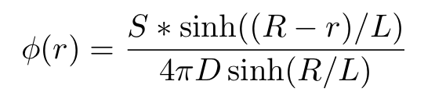
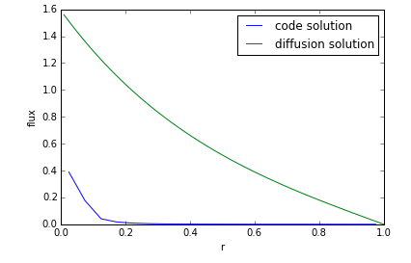
Results and test problems:
1. Near infinite medium, uniform isotropic source, no scattering
2. Bare sphere, point source at origin
3. Bare sphere, uniform isotropic source
4. Sphere + reflector, uniform isotropic source.
Expect exponential decay with r
Σ_{t} = 4.0
Σ_{s} = 2.0
S = 10.0
Quadrature degree
N = 2
P_{N} expansion order
L = 4

Slide 11

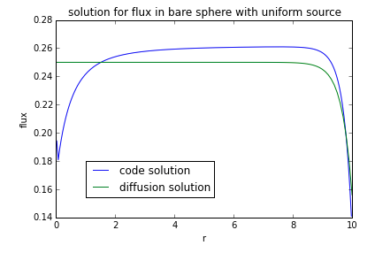
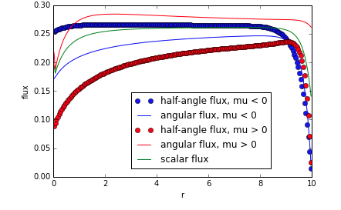
Results and test problems:
1. Near infinite medium, uniform isotropic source, no scattering
2. Bare sphere, point source at origin
3. Bare sphere, uniform isotropic source
4. Sphere + reflector, uniform isotropic source.
Σ_{t} = 5.0
Σ_{s} = 2.5
S = 0.5
Quadrature degree
N = 2
P_{N} expansion order
L = 4

Slide 12
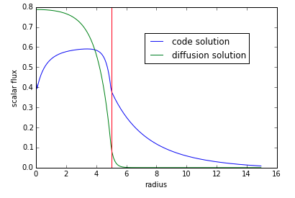
Results and test problems:
1. Near infinite medium, uniform isotropic source, no scattering
2. Bare sphere, point source at origin
3. Bare sphere, uniform isotropic source
4. Sphere + reflector, uniform isotropic source.
Core: Reflector:
Σ_{t} = 2.0 Σ_{t} = 5.0
Σ_{s} = 1.0 Σ_{s} = 2.0
S = 0.8 S = 0.0
Quadrature degree
N = 2
P_{N} expansion order
L = 4

Slide 13
References
1. E.E. Lewis and W.F. Miller. Computational Methods of Neutron Transport 1984: John Wiley & Sons.
2. E.E. Lewis. Fundamentals of Nuclear Reactor Physics 2008: Academic Press.

Slide 14
BACKUP SLIDES

Slide 15
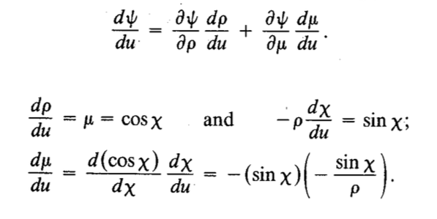
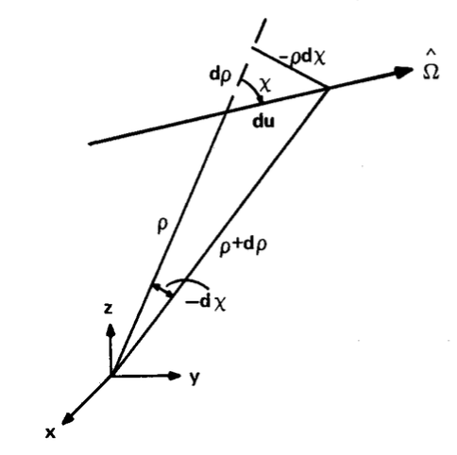
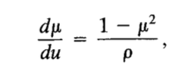
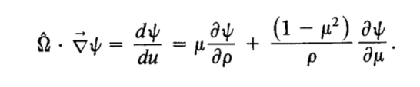
Streaming in 1-D spherical coordinates
Lewis and Miller pg 28-31

Slide 16


Streaming in 1-D spherical coordinates
Treatment of streaming in the conservation form

Slide 17




It is desirable to use well-known quadrature sets; however, straightforward diamond-difference in angle produces impossible constraints.
Consider a near-infinite system with no scattering and uniform, isotropic source:
The solution is constant in space and angle; this requires:
No regular quadrature set meets this constraint.

