Slide 1
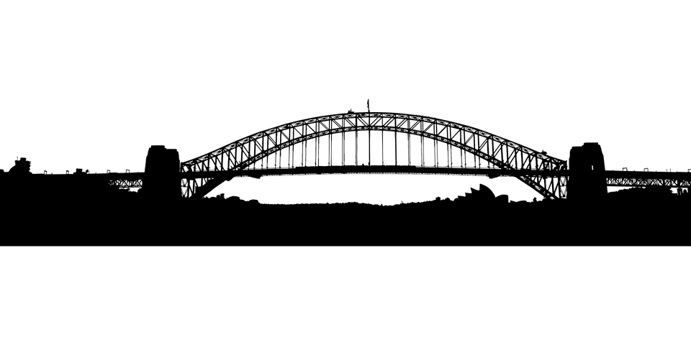
LIBERTY BRIDGE
Etherium to gno.land Bridge

Slide 2
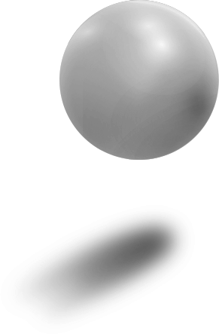
Blockchain Bridge
What are Blockchain Bridges?
They are platforms that facilitate the transfer of assets and data from one blockchain ecosystem to another.
Why Use Bridges?
Facilitate the transfer of assets and data between separate blockchains.
Enable cross-chain interactions and smart contract execution.
How Bridges Work:
Lock and Mint: Assets are locked in a smart contract on the source blockchain, and an equivalent asset is minted or issued on the destination blockchain.
Burn and Release: Assets on the destination blockchain are burned or destroyed when a corresponding amount is released on the source blockchain.

Slide 3

Blockchain Bridge
Types of Bridges:
Centralized Bridges: Operated by a central authority or entity.
Decentralized Bridges: Operated by smart contracts and decentralized protocols.
Challenges and Risks:
Security vulnerabilities, such as potential exploits in the bridging protocol.
Complexity in managing cross-chain transactions and maintaining compatibility.
Examples of Blockchain Bridges:
Wrapped Bitcoin (WBTC): Bitcoin assets represented on the Ethereum blockchain.
Polygon Bridge: Connects Ethereum and Polygon networks.

Slide 4
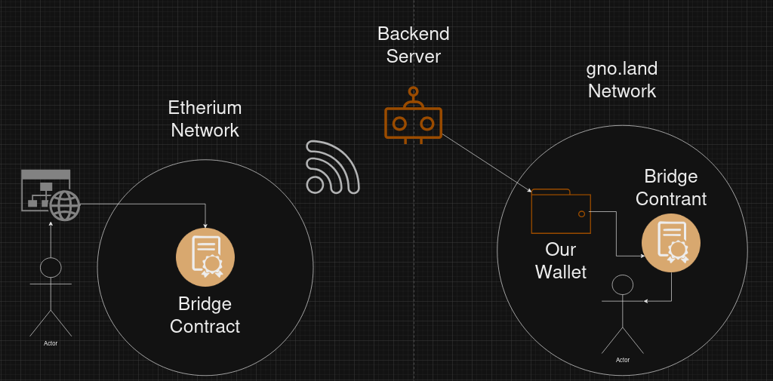
Architecture

Slide 5
FRONTEND
We used:
TypeScript, HTML & CSS
React
Wagmi
ethers.js
RainbowKit
User Experience:
User selects what way he want to send funds, he enters the address and amount
Server calls MetaMask API for transaction approval (RainbowKit)
Send transaction details to smart contract address stored in code

Slide 6
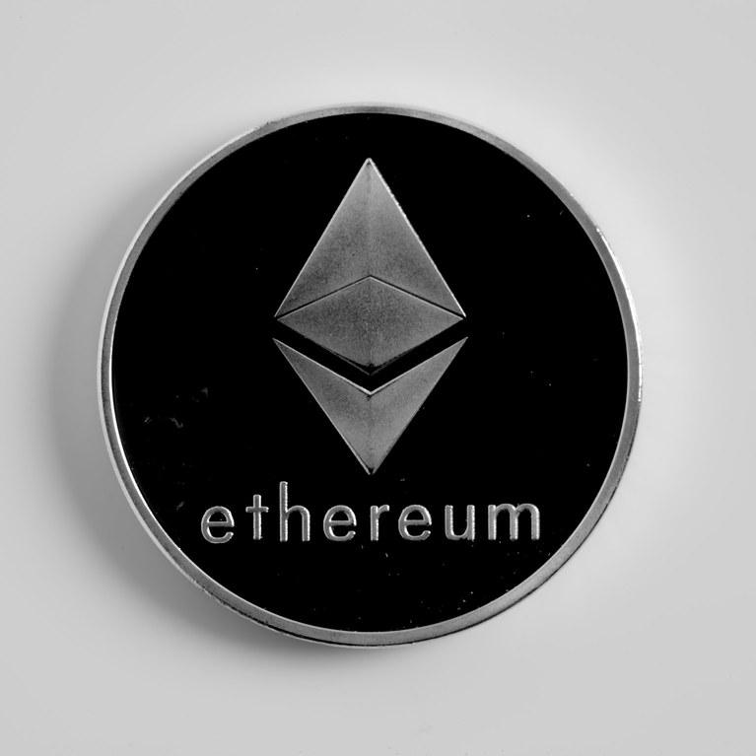
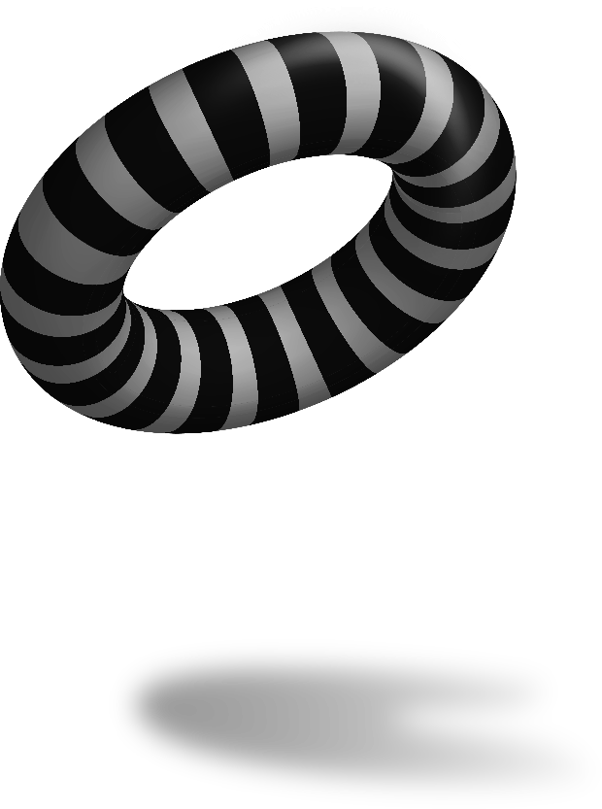
Ethereum
Solidity
Contract Bridge
Lock & Unlock
HashMaps
MyToken Contract

Slide 7
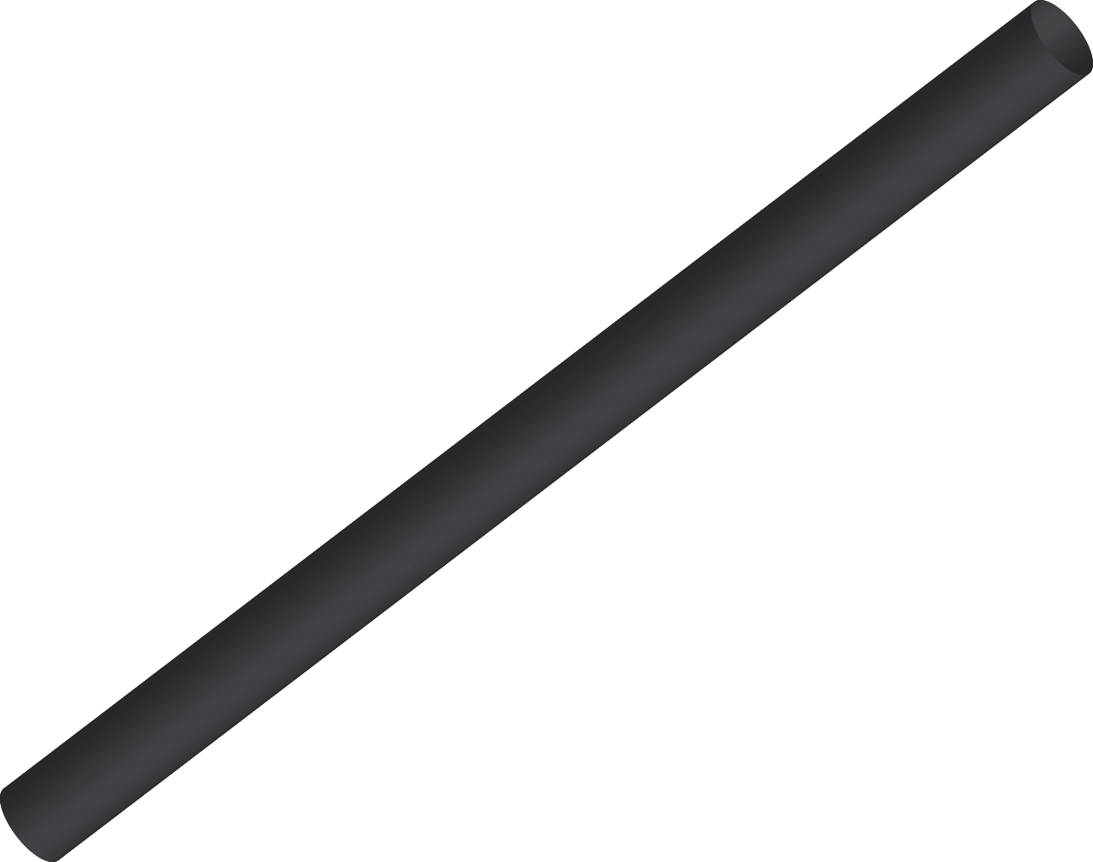
BACKEND
Deploy Script
Listener Script
Sepolia & TestNet4 (RPC)
Typescript
Gno-js Library
Wallet
Provider

Slide 8

gno.land
Gno
GETH Token (GRC20)
Bridge Realm
Minting
Burning
HashMaps

Slide 9
LIVE DEMO

Slide 10
Biggest Challenge
Compatibility
Redefining
Problem
Solution
gno.land Banker uses uint64 while Etherium uses uint256
We can redefine gno.land Banker so it can work with larger integers

Slide 11
FUTURE FEATURES
GNOT -> WGNOT
Fee
Custom Banker
EGRC20
01
02
Making Two-Way Bridging Possible
Implementing Fees To Make Business Sustainable
03
04
Increasing The Max Amount Of Tokens
Creating A Custom Token For Compatibility

Slide 12
THANK YOU!
Dragan Milosevic | Nemanja Matic | Amar Mujezinovic
https://github.com/Milosevic02/LibertyBridge

