Slide 1





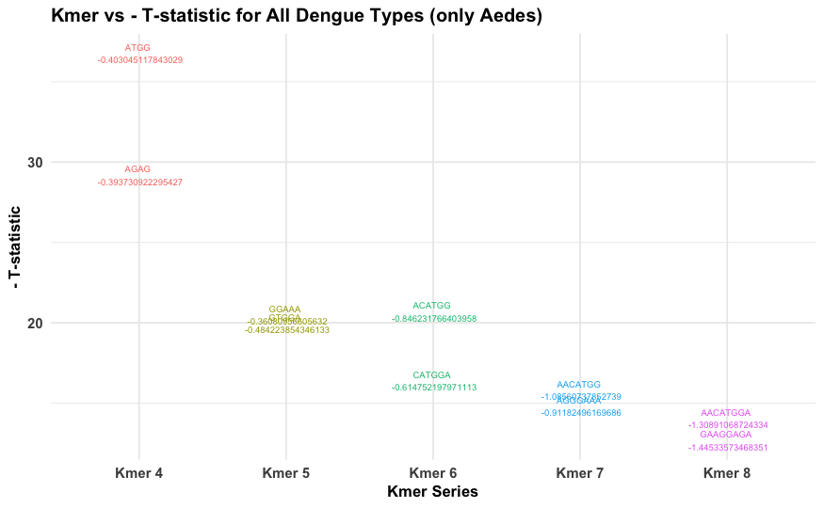
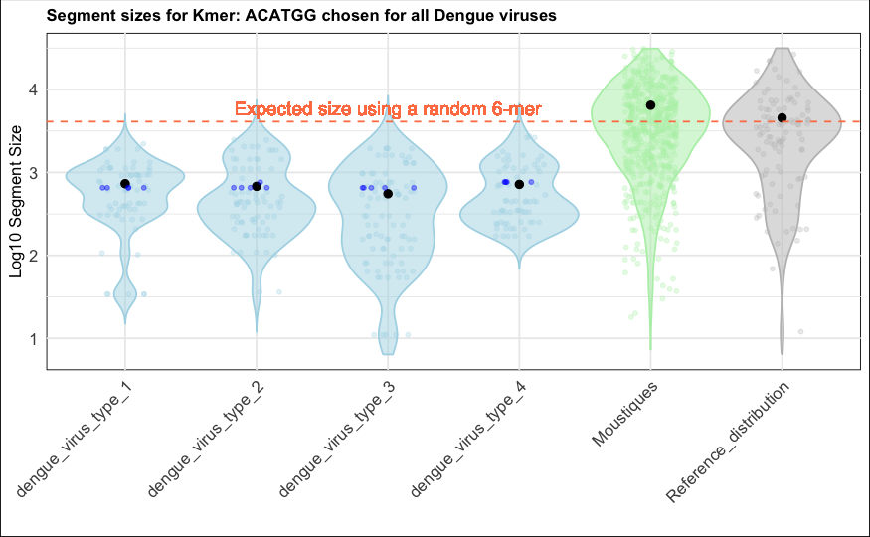
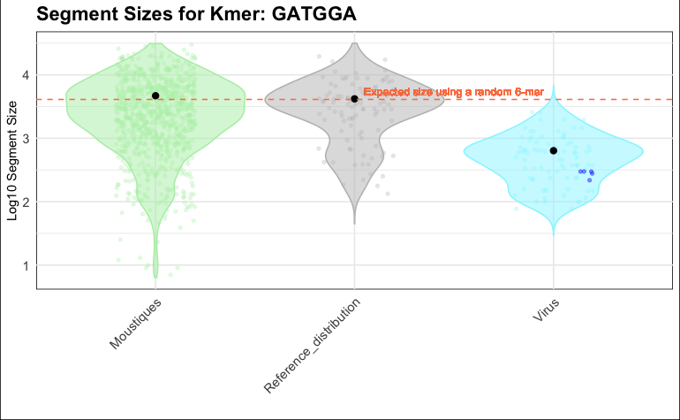
RNA analysis - Kmer Strategy
Comparison of Viral Targeted, Viral Pool, and Viral Agnostic Approaches
Virus RNA
10 000 pb
Segment length (200 – 2000 pb)
Mosquito RNA
600 000 000 – 1 200 000 000 pb
Host RNA
3 200 000 000 pb
Pool specific « Kmer »
amplicon sequencing
Monospecific « Kmer » amplicon sequencing

