Slide 1
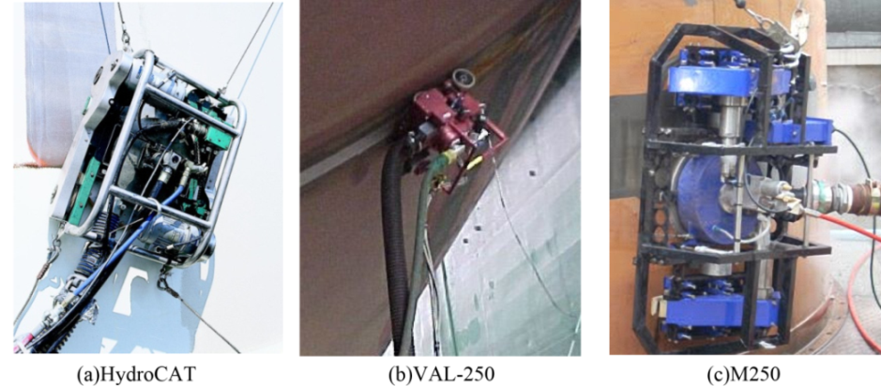
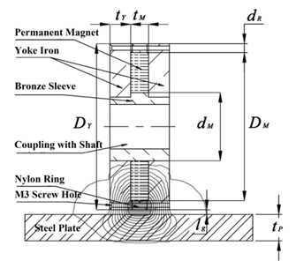
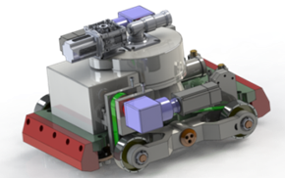
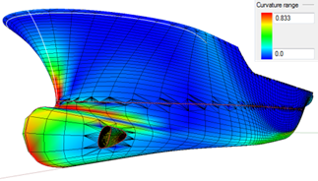
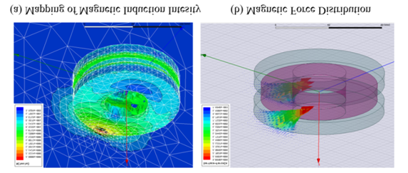
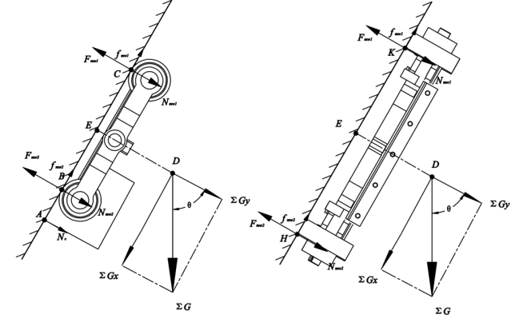
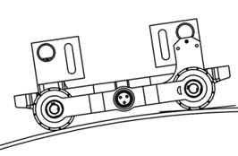
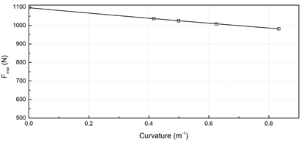
Design and Optimization of Magnetic Wheel for Wall Climbing Robot
ZhengYi Xu, Ke Zhang*, XiaoPeng Zhu, and Hao Shi
Shanghai Key Laboratory of Materials Laser Processing and Modification School of Materials Science and Engineering, Shanghai Jiao Tong University, Dong chuan Road, NO.800,Shang hai, 200240, China
zhangke@sjtu.edu.cn
Abstract: To satisfy the requirements on payload and surface adaptability of wall climbing robot working on ship hull, a kind of magnetic wheel with optimized adhesive ability is designed. A numerical computation model for accurately computing the 3D magnetic field is developed by using finite element method. Force requirements under various surface conditions are studied and dimensions of the wheel are optimized. Prototype results show that the wheel achieved desirable adhesive ability with decent weight, which can provide adhering force over 1100N on ship hull per wheel, and satisfies engineering requirements under all considered conditions in the design of robot.
Fig. 1. Surface Cleaning Robots Already in Application
Fig. 2. Magnetic Wheel Design in Section View
(a) Grit Blasting Robot Design (b) Ship Hull Curvature
Fig. 3. Robot Concept and Working Surface Fig. 4. Results of FE Simulation
Static Model on Longitude Direction (b) Static Model on Latitude Direction
Fig. 5. Static Analysis of Both Crawling DirectionFig
(a)Schema of Surface Curvature (b) Magnetic Force Variance with Curvature
Fig. 6. Magnetic Force Variance with Curvature Changes

