Slide 1
Variational Reasoning for Question Answering with Knowledge Graph
Maosen Zhang

Slide 2
Authors
Yuyu Zhang, Georgia Institute of Technology
Hanjun Dai, Georgia Institute of Technology
Zornitsa Kozareva, Amazon Web Services
Alexander J. Smola, Amazon Web Services
Le Song, Georgia Institute of Technology

Slide 3

End-to-end NN on KBQA
Treat the KG as a flattened big table of itemized knowledge records
Hard to exploit the structure information in the graph, weak on logic reasoning
Multi-hop questions:
“Who have co-authored papers with ...?”

Slide 4
Topic entities
Most existing works assume that the topic entity in question can be located by simple string matching
Problems: typos, ambiguity…
Training data for QA system is provided as question-answer pairs
Topic entities not annotated

Slide 5
Variational Reasoning Network
Simultaneously handle uncertain topic entity and multi-hop reasoning
Propagation-like deep learning architecture over the knowledge graph to perform logic inference in the probabilistic model
REINFORCE algorithm with variance reduction technique to make the system end-to-end trainable
Notes:
隐变量模型

Slide 6
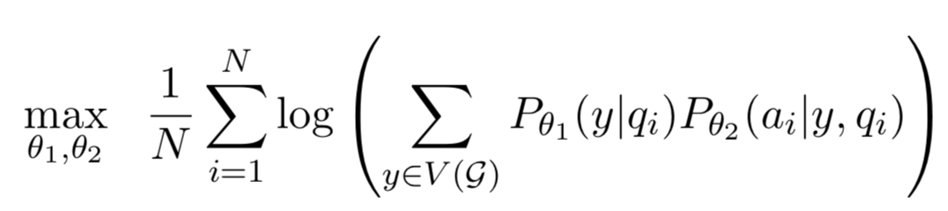

Problem Definition
KG: $G=\left(V\left(G\right), E\left(G\right)\right)$
Questions: $D={\left\{\left(q_{i}, a_{i}\right)\right\}}_{i=1}^{N}$
$P_{θ_{1}}\left(y | q_{i}\right)$
$P_{θ_{2}}(a_{i}|y,q_{i})$
Notes:
联合优化两个部分的概率模型

Slide 7
Module for topic entity recognition
Full context of the question can be helpful
Resolve the unique entity by checking the surrounding words in the question
In KG: multiple entities with the same name, but connected with different relations/entities
helps to resolve the unique entity
Notes:
利用整个问题文本的信息；同时也利用KG的结构信息

Slide 8
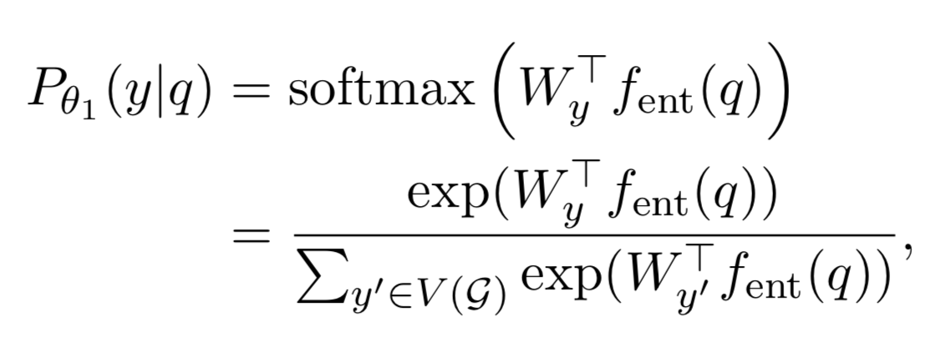

Module for topic entity recognition
Question representation (for entity): $f_{ent}$
BOW/RNN/CNN
Notes:
Encoder+dense+softmax

Slide 9
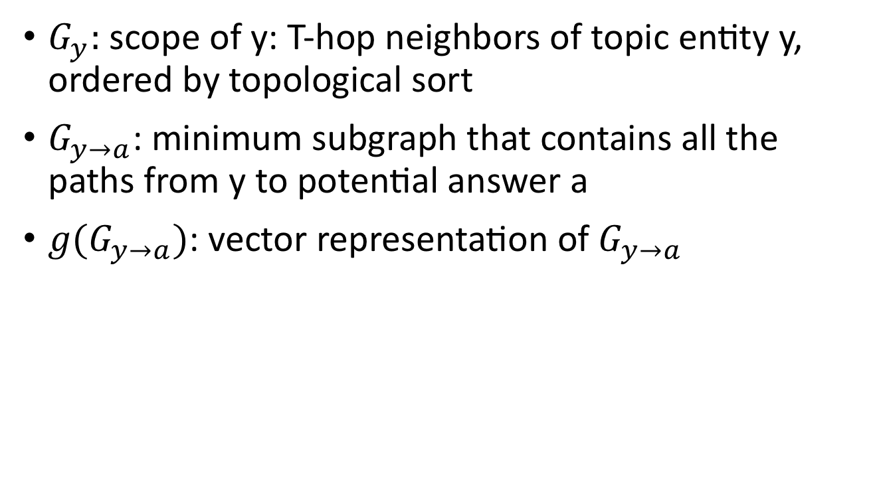
Module for logic reasoning over KG
$G_{y}:$ scope of y: T-hop neighbors of topic entity y, ordered by topological sort
$G_{y→a}$: minimum subgraph that contains all the paths from y to potential answer a
$g(G_{y→a})$: vector representation of $G_{y→a}$
Notes:
拓扑排序？T阶邻域？

Slide 10
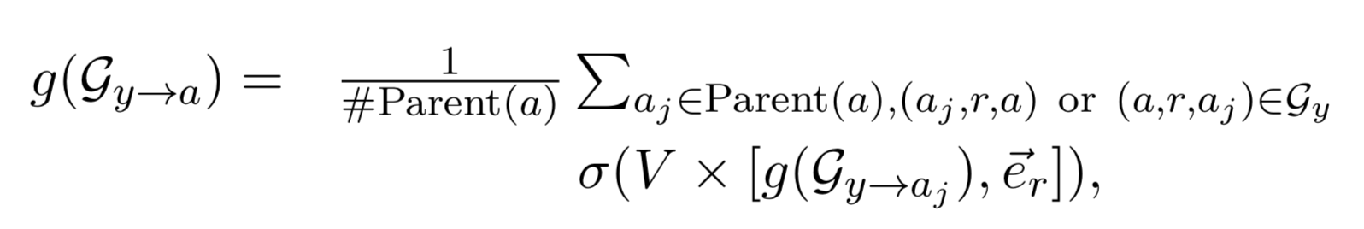

Module for logic reasoning over KG
$g(G_{y→a})$: vector representation of $G_{y→a}$
Recursively:
Notes:
递归计算embedding

Slide 11
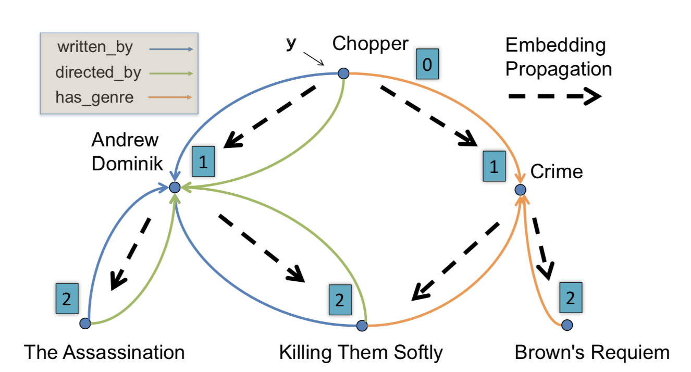

Module for logic reasoning over KG
$g(G_{y→a})$: vector representation of $G_{y→a}$
Notes:
递归计算

Slide 12
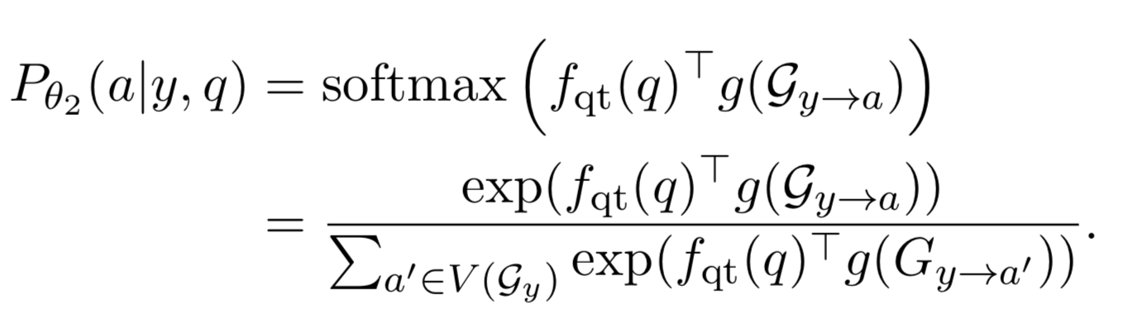

Module for logic reasoning over KG
Question representation: $f_{qt}$
captures the question type and implies the type of logic reasoning we need to perform
Notes:
Encoder输出问题embedding，和子图embedding求相似度，softmax

Slide 13
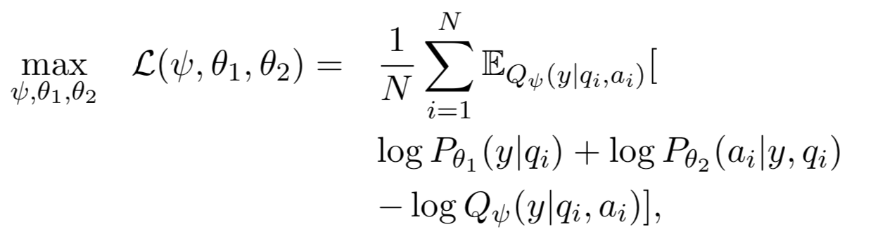
End-to-end Learning
Variational inference
Jenson’s inequality -> lower bound
Notes:
EM算法变种？
EM 计算不了后验概率
最大化目标函数的下界（由jenson不等式得到的）
变分推断是近似计算后验概率的一种算法

Slide 14

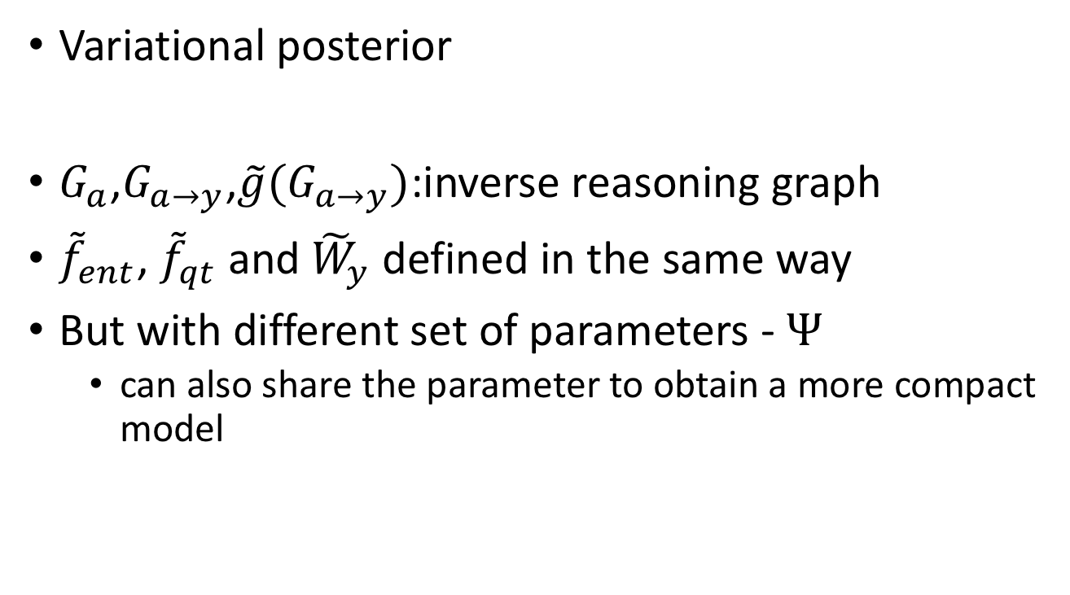
End-to-end Learning
Variational posterior
$G_{a}$,$G_{a→y}$,$\tilde{g}(G_{a→y})$:inverse reasoning graph
${\tilde{f}}_{ent}$, ${\tilde{f}}_{qt}$ and ${\tilde{W}}_{y}$ defined in the same way
But with different set of parameters - $Ψ$
can also share the parameter to obtain a more compact model
Notes:
Phi是后验参数

Slide 15
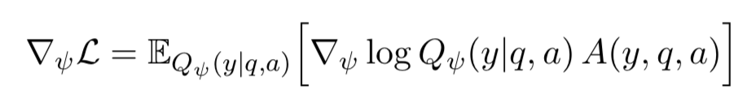

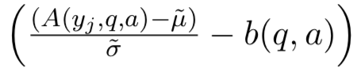

End-to-end Learning
Latent variable y in the variational objective takes discrete values, not differentiable with respect to $Ψ$
REINFORCE algorithm with variance reduction
Notes:
还是用梯度下降去优化
这里为了方便表示，假设N=1
到底是减还是加
B minize the quare loss

Slide 16
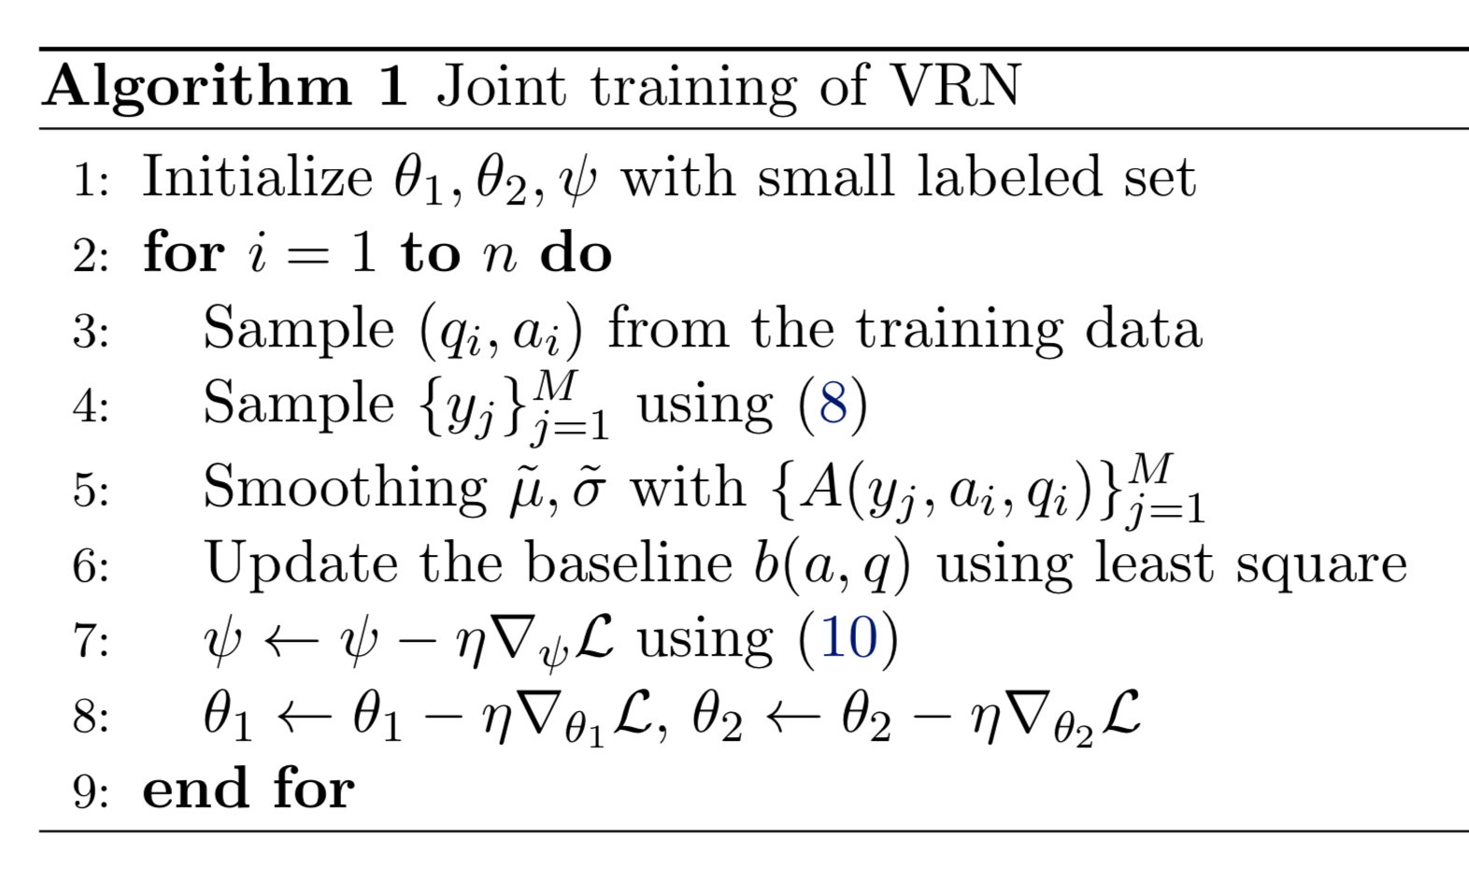
End-to-end Learning
1

Slide 17
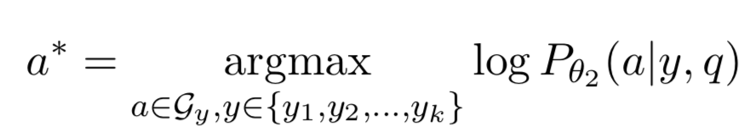
Inference
Topic entity unknown: select top-k candidates
Notes:
实际上实验中取k=1

Slide 18
Dataset - MetaQA
A comprehensive extension of WikiMovies
Vanilla: add 21 types of 2-hop questions
NTM: translate to French and then translate back with neural translation models
Have different wordings, keep the same meaning
Audio: generate with text-to-speech system

Slide 19
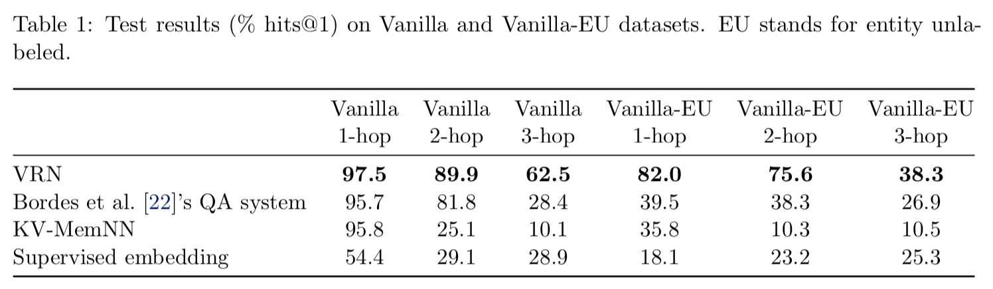
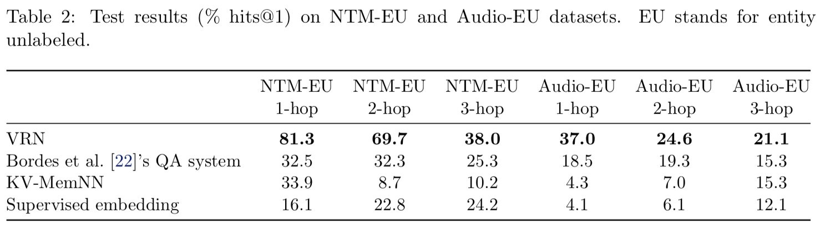
Experiments

Slide 20
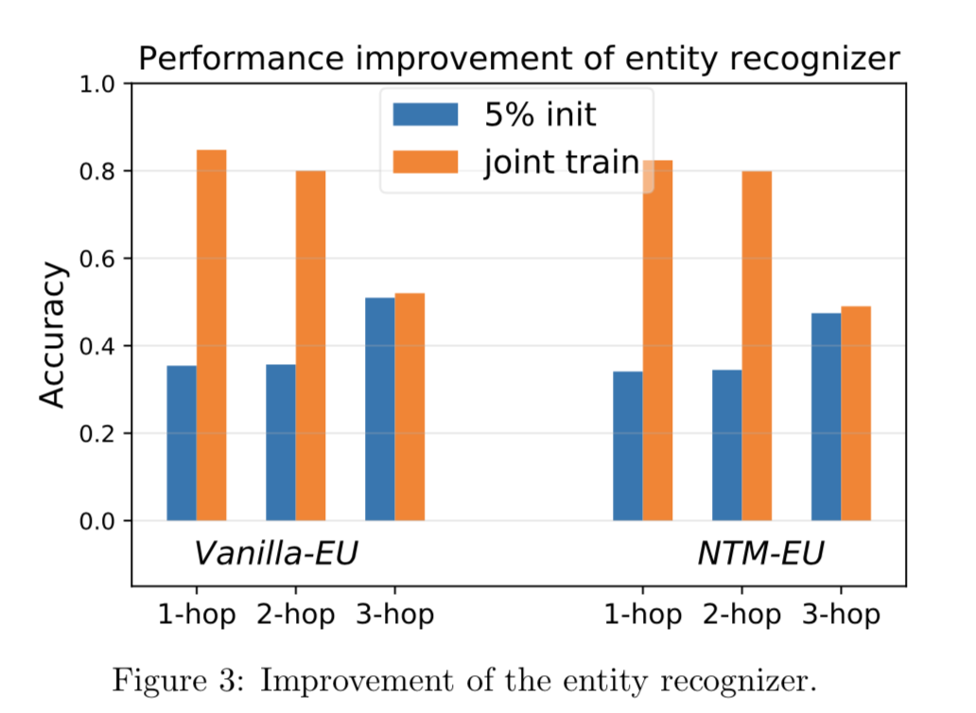
Experiments

Slide 21
Thanks!

