Slide 1
Learning beyond Datasets: Knowledge Graph Augmented Neural Networks for Natural Language Processing

Slide 2
Authors
Annervaz K M, Indian Institute of Science & Accenture Technology Labs
Somnath Basu Roy Chowdhury, IIT Kharagpur
Ambedkar Dukkipati, Indian Institute of Science

Slide 3
Motivation
Learning is still heavily on the specific training data
Propose to enhance learning models with world knowledge
In the form of Knowledge Graph (KG) fact triples
Develop a deep learning model that can extract relevant prior support facts from knowledge graphs
Depending on the task
Using attention mechanism

Slide 4
Example: Natural Language Inference
A: The couple is walking on the sea shore and
B: The man and woman are wide awake
Need common knowledge: “The man and woman and The couple means the same”
this information may not be specific to a particular inference

Slide 5
Example: Classify the News Snippet
“Donald Trump offered his condolences towards the hurricane victims and their families in Texas. ”
Need to know the facts <Donald Trump, president, United States> and <Texas, state, United States>.
Or we cannot classify it as a political news
Notes:
新闻片段

Slide 6
Overview
Extract relevant support facts on demand from a knowledge base
Incorporate it in the feature space along with features learned from the training data
Jointly model this look up mechanism along with the task specific training of the model
Generic enough so that it can be augmented to any task specific learning model to boost the performance

Slide 7
Knowledge Graph Representations
Structure-based embeddings
e.g. TransE ( h + r = t )
Semantically-enriched embeddings:
learns to represent entities/relations of the KG along with its semantic information.
NTN:
Initialize entity vectors with the average word embeddings followed by tensor-based operations.
DKRL:
Take into descriptive nature of text
Keep the simple structure of TransE model

Slide 8
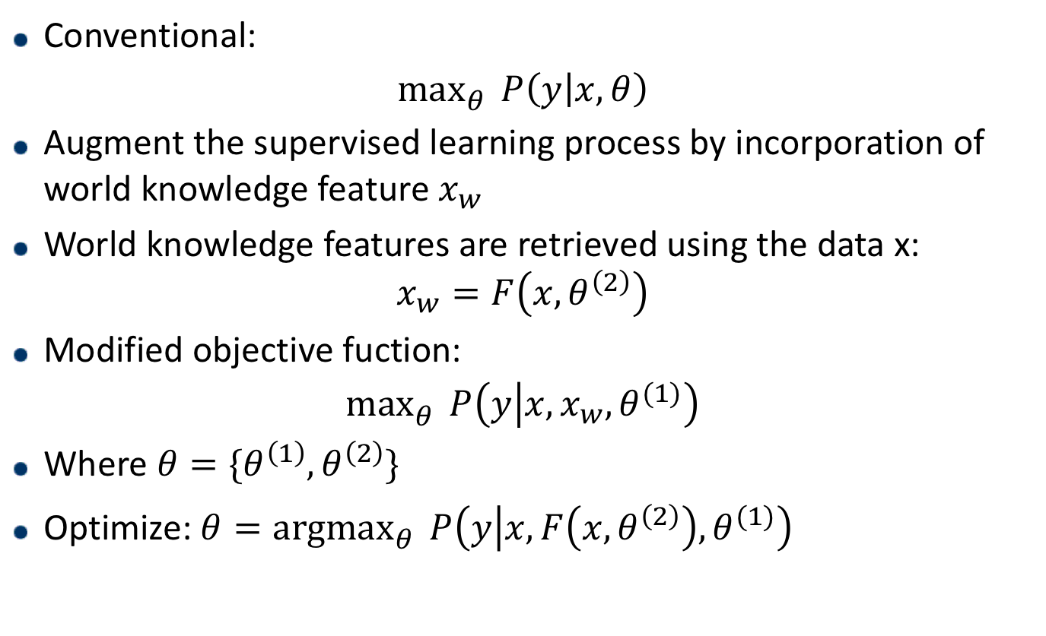
Conventional:
$$\max_{θ}^{}{P\left(y | x, θ\right)}$$
Augment the supervised learning process by incorporation of world knowledge feature $x_{w}$
World knowledge features are retrieved using the data x:
$$x_{w}=F\left(x, θ^{\left(2\right)}\right)$$
Modified objective fuction:
$$\max_{θ}^{}{P\left(y | x, x_{w}, θ^{(1)}\right)}$$
Where $θ=\{θ^{\left(1\right)}, θ^{\left(2\right)}\}$
Optimize: ${θ=argmax}_{θ}^{}{P\left(y | x,F\left(x, θ^{\left(2\right)}\right), θ^{(1)}\right)}$

Slide 9
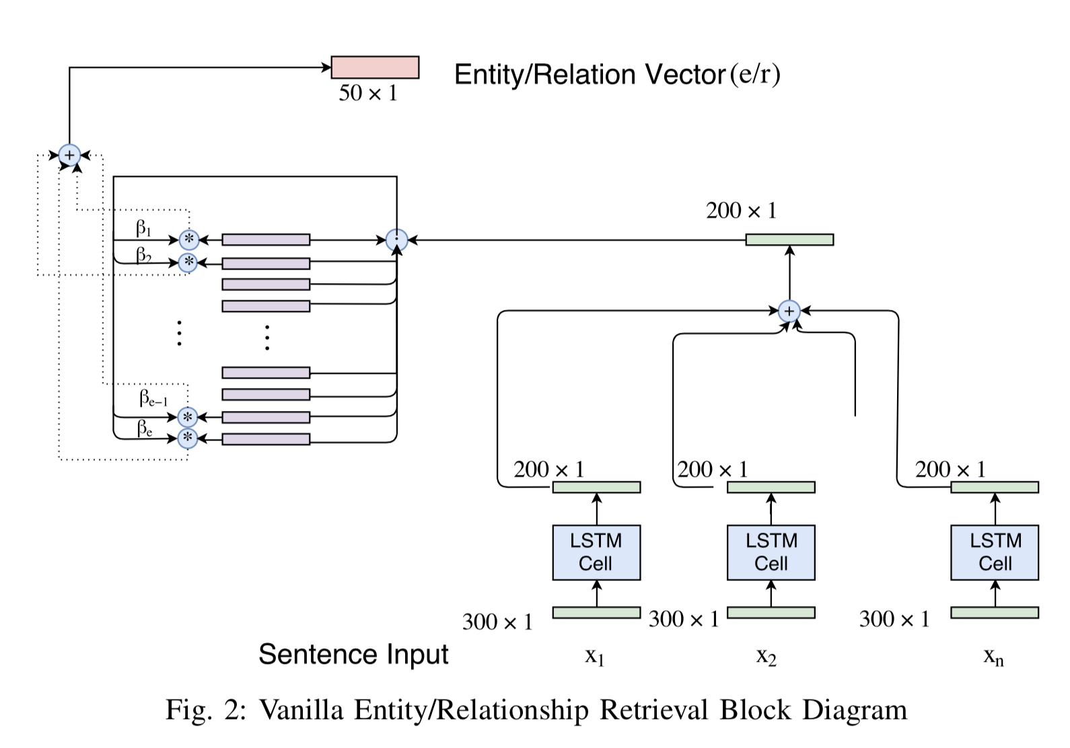
Vanilla Model
Notes:
平凡的，普通的

Slide 10
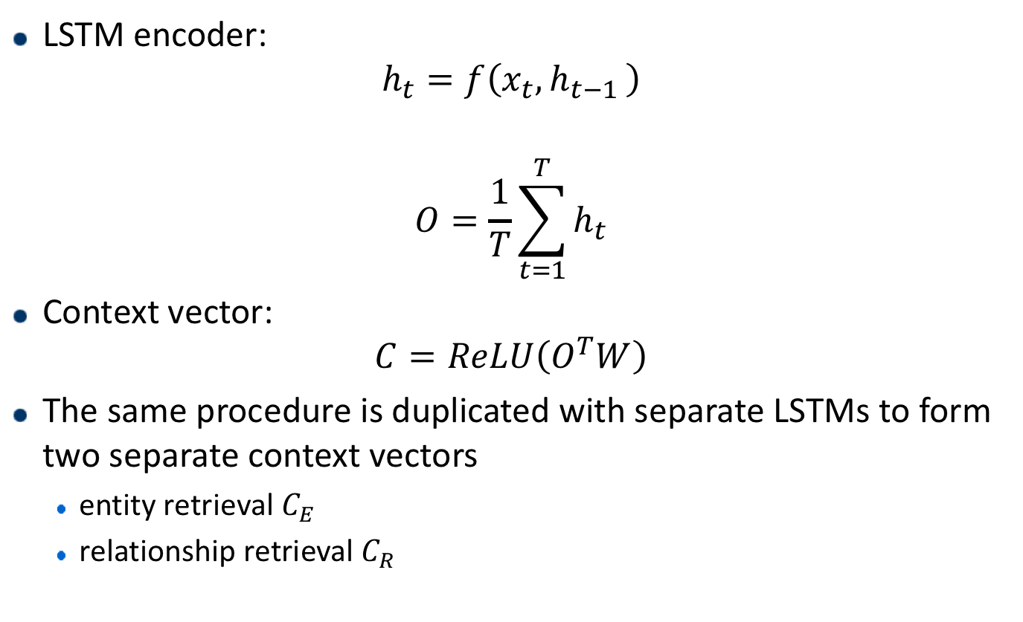
Vanilla Model - Encoder
LSTM encoder:
$$h_{t}=f\left(x_{t}, h_{t−1 }\right)$$
$$O=\frac{1}{T}\sum_{t=1}^{T}{h_{t}}$$
Context vector:
$$C=ReLU\left(O^{T}W\right)$$
The same procedure is duplicated with separate LSTMs to form two separate context vectors
entity retrieval $C_{E}$
relationship retrieval $C_{R}$
Notes:
W 权重参数

Slide 11
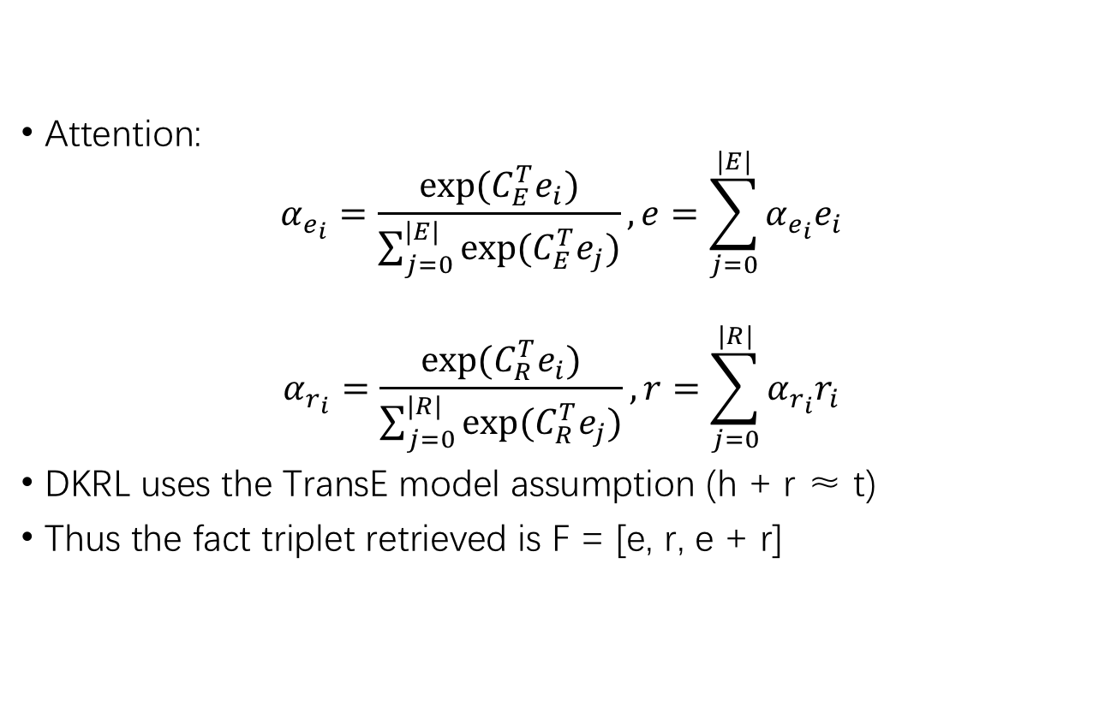
Vanilla Model - Retriever
Attention:
$$α_{e_{i}}=\frac{exp⁡(C_{E}^{T}e_{i})}{\sum_{j=0}^{|E|}{exp⁡(C_{E}^{T}e_{j})}}, e=\sum_{j=0}^{|E|}{α_{e_{i}}e_{i}}$$
$$α_{r_{i}}=\frac{exp⁡(C_{R}^{T}e_{i})}{\sum_{j=0}^{|R|}{exp⁡(C_{R}^{T}e_{j})}},r=\sum_{j=0}^{|R|}{α_{r_{i}}r_{i}}$$
DKRL uses the TransE model assumption (h + r ≈ t)
Thus the fact triplet retrieved is F = [e, r, e + r]
Notes:
e,r,e+r连接得到F

Slide 12
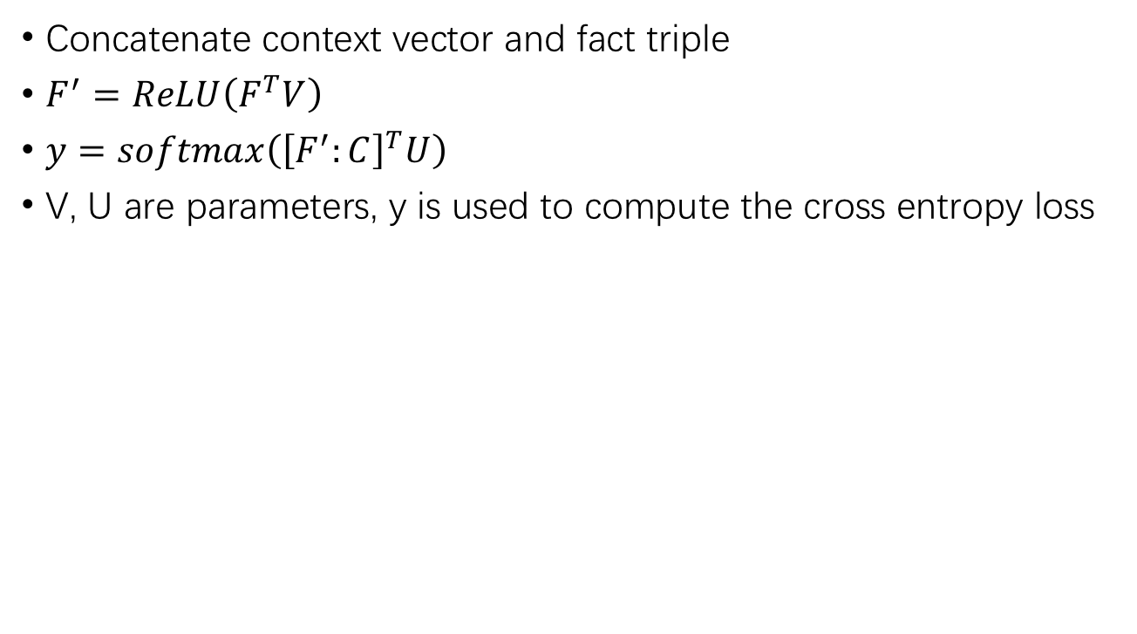
Vanilla Model
Concatenate context vector and fact triple
$F^{′}=ReLU\left(F^{T}V\right)$
$y=softmax\left({\left[F^{′}:C\right]}^{T}U\right)$
V, U are parameters, y is used to compute the cross entropy loss

Slide 13
Vanilla Model - Problems
Vanilla model attends over the entire entity/relation space
Gradient for each attention value gets saturated easily as observed
While training the classification and retrieval module together, the model tends to ignore the KG part and gradient propagates only through the classification module
Most pertinent information for the task at hand comes from the training samples, only background aiding information comes from KG
After few epochs of training, the KG retrieved fact always converged to a fixed vector

Slide 14
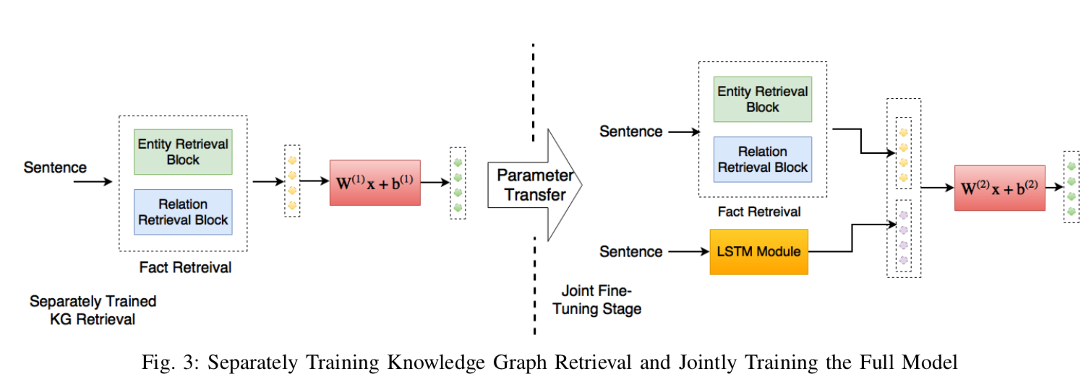
Pre-training KG Retrieval

Slide 15
Pre-training KG Retrieval
Pre-trained KG model is used to retrieve the facts
Joint training:
Concatenate with the classification module
Allow error to be propagate through the pre-trained model
The separate KG part alone shows significant performance
59% for News20 and 66% for SNLI
KG doesn’t return noise and has essential information for the task

Slide 16
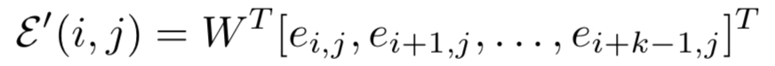
Convolution-based Cluster Representation
Reduce the attention space
Learning the representation of similar entity/relation vectors
Use k-means clustering to form l clusters
With equal number of entity/relation vectors in each cluster
Each clusters were then encoded using convolutional filters
1D convolution
Window size k
pooling layer
Notes:
using 2-D filters the model failed to converge at all
latent representation of two different indices in the vector ei, should not be tampered using convolution

Slide 17
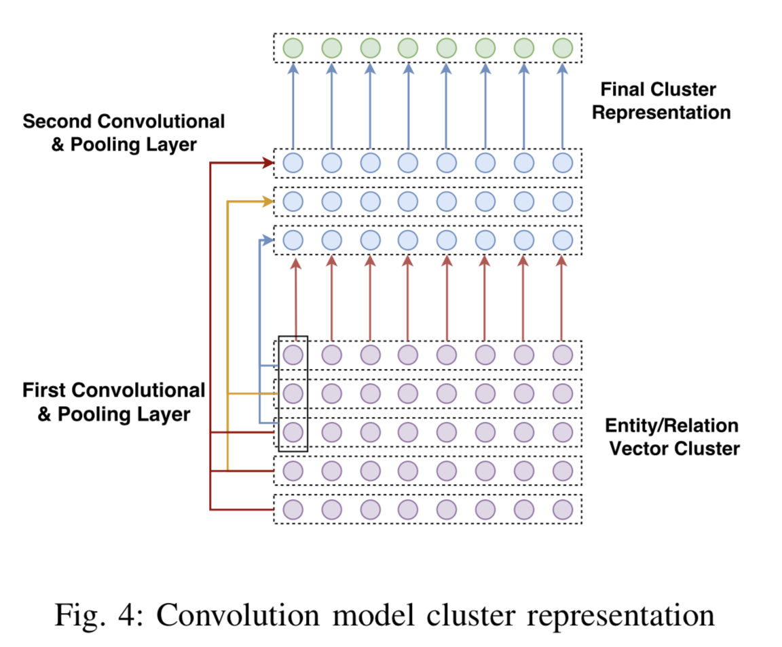
Convolution-based Cluster Representation

Slide 18
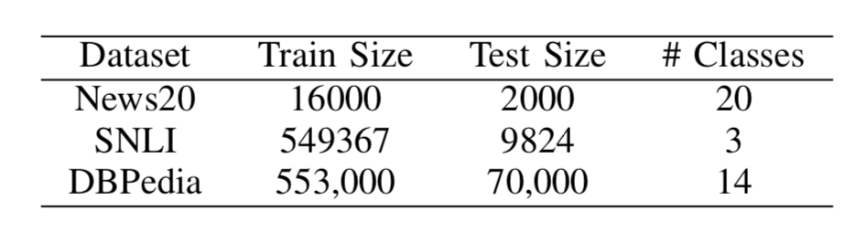
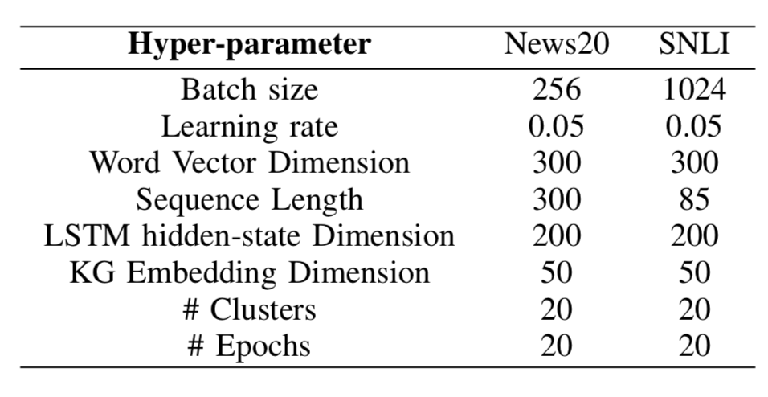
Experiments

Slide 19
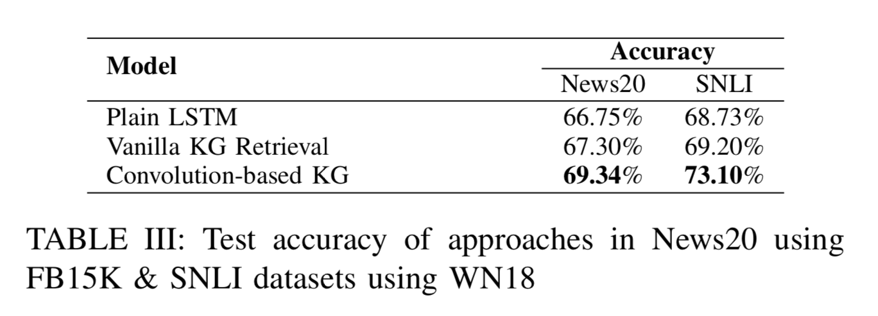
Experiments

Slide 20
Summary
Applicable for other domain task
Future work:
Attention structure: flat – hierarchical attention
Soft attention – hard attention
Convolution based – similarity based

Slide 21
Thanks!

