Slide 1
Business Canvas
Noah Templet, Jared Moise, Michael Sheppard, Brian Simpson

Slide 2
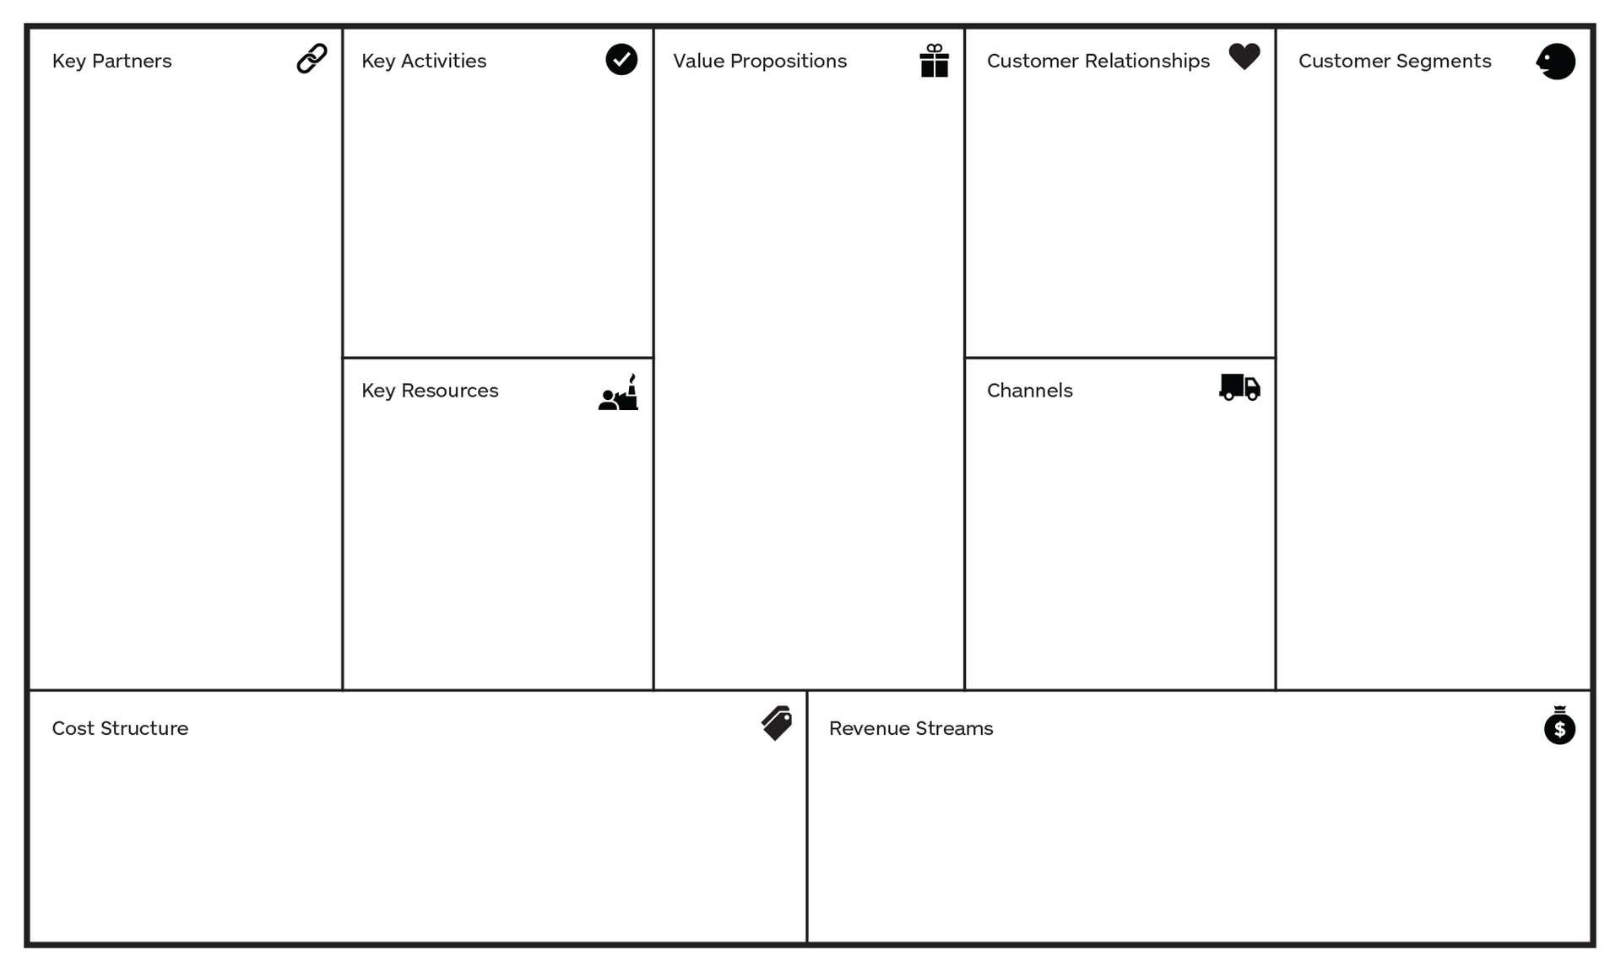
Businesses with specials that provide the information needed for app.
As a part of the agile process, the users of the service will be a key partner in developing further features.
Build large number of active daily users.
Clean, easy to use system
- Kill customer pain through eliminating the need to look in multiple places for information.
- Customer gain through lowering costs (taking advantage of specials)
- Kill business pain of having to post information in multiple places
- Business gain through free centralized advertising.
With consumers and businesses we would like to have a close, working relationship to ensure quality of our product and to include their opinion as part of the agile process
Customers and businesses that offer specials
We will deliver our message not only on our website, but also by personally contacting potential or requested business. We also reach out to consumers via socail media and in person to gain users.
- Human resources in the sense of programmers.
- Information resources in the sense of specials from businesses
~$100:
~$65 - SSL Certification
~$5 - Domain Registration
~$30 - Storage and Hosting
Corporation management tool with yearly subscription fee to manage multiple locations. Eventually, in-app advertisements along with the ability to buy a pro version to prevent ads.

