Slide 1
a SUSE company
Kubernetes Master Class
A Seamless Approach to Rancher & Kubernetes Upgrades
February 9, 2021
Notes:
Welcome to our first Kubernetes Master Class as a part of SUSE!

Slide 2



HOST
SPEAKER
Q&A
Connie Lin
Global Events Manager
SUSE
Matthew Mattox
Principal Support Engineer
SUSE
Luca Ramage
Support Engineer
SUSE

Slide 3
Rancher Master Class Series
45 minutes – 75 minutes
Questions are always welcome!
Use the questions tab to submit your questions
We do our best to respond to all questions during the Q&A at the end, so mark your question as private if needed

Slide 4
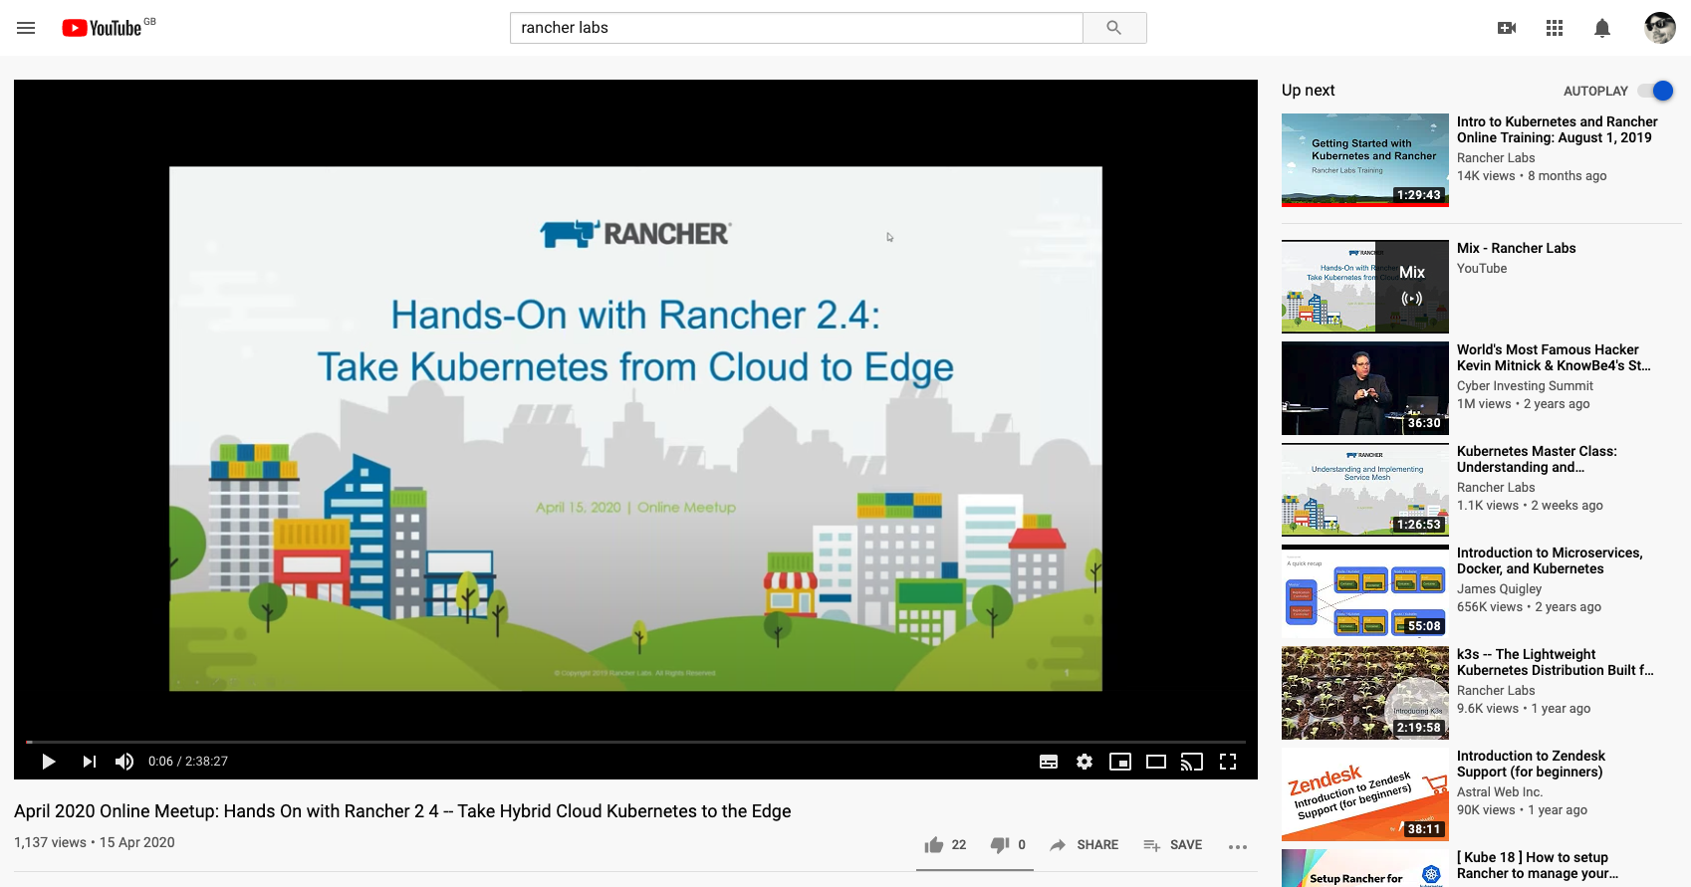
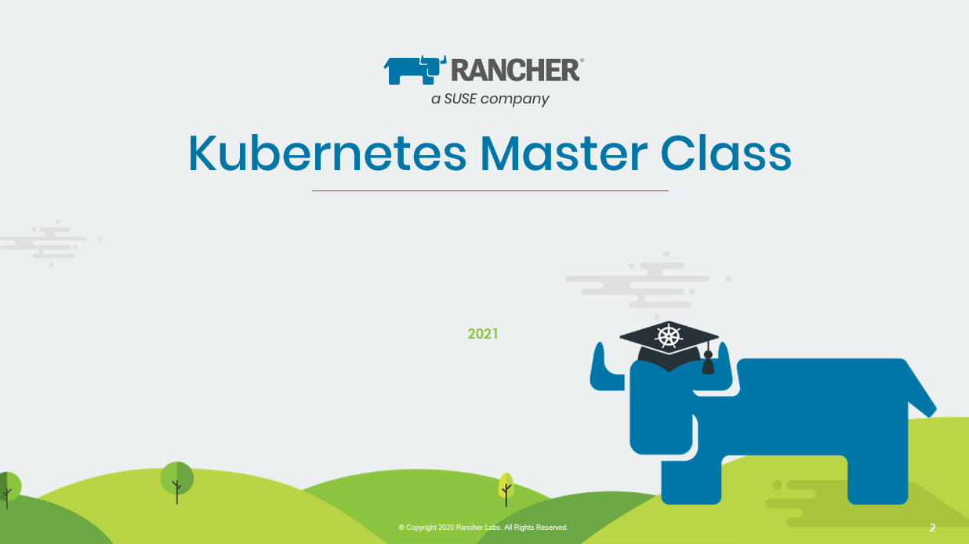
This session is being recorded!
http://youtube.com/c/rancher

Slide 5
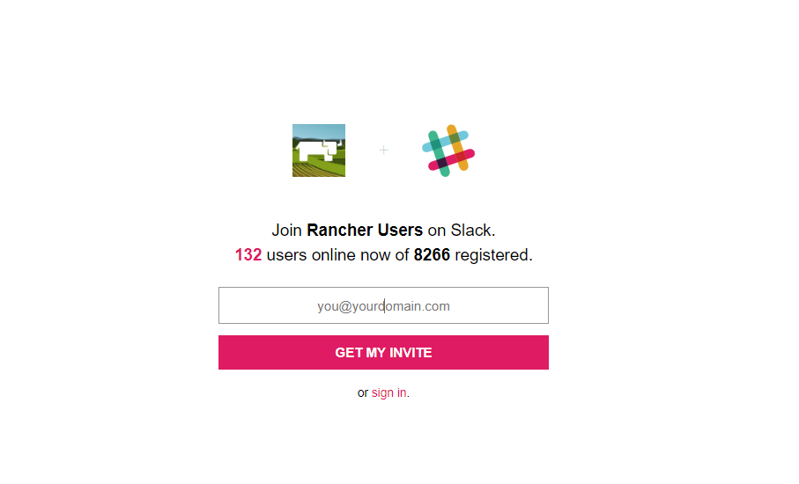
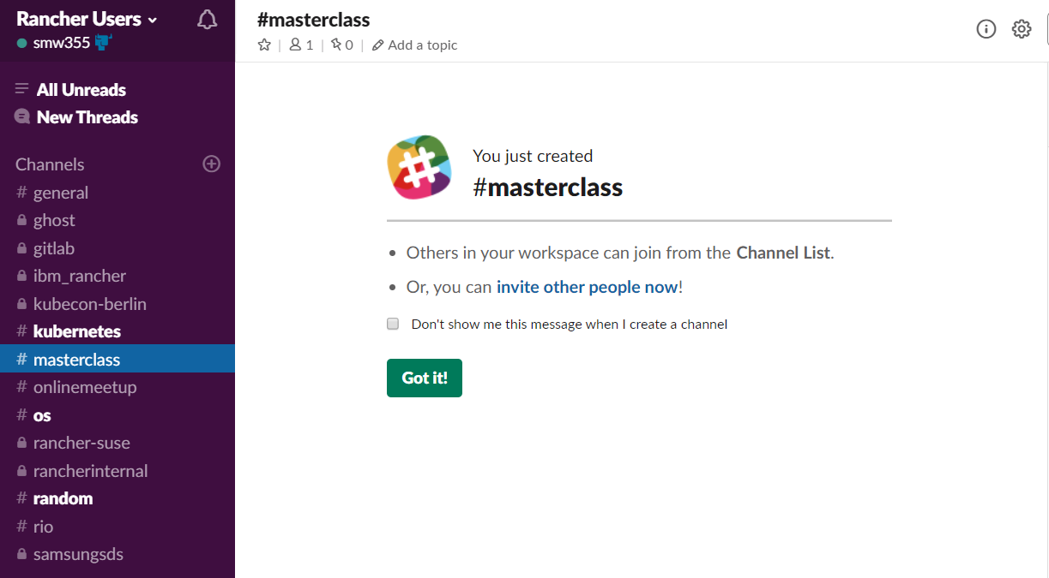
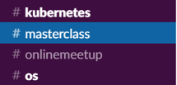
Join the conversation on Slack
http://slack.rancher.io
#masterclass

Slide 6
a SUSE company
Kubernetes Master Class
A Seamless Approach to Rancher & Kubernetes Upgrades
February 9, 2021
Notes:
Welcome to our first Kubernetes Master Class as a part of SUSE!

Slide 7




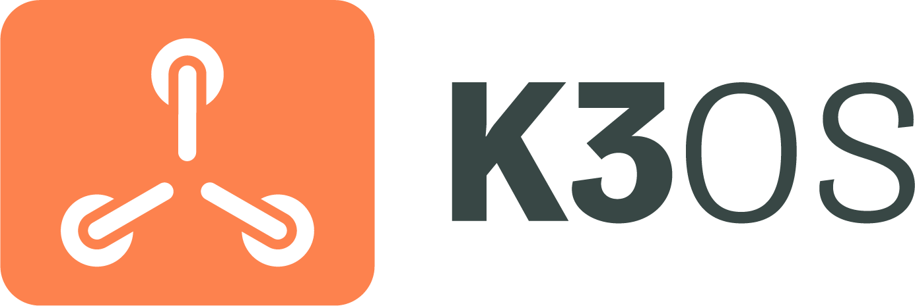



Products & Projects
PRODUCTS
Flagship product - world’s most popular Kubernetes Management platform.
A CNCF-certified Kubernetes distribution that runs entirely within Docker containers.
A CNCF-certified, Lightweight Kubernetes distribution. Easy to install, half the memory, all in a binary less than 100MB.
Makes it faster and easier for DevOps to build, test, deploy, scale and version stateless applications in any K8s cluster.
Purpose-built to simplify Kubernetes operations in low-resource computing environments.
Fleet addresses the challenges of managing thousands to millions of clusters at the network edge.
OPEN SOURCE PROJECTS
Open source project for microservices-based distributed block storage.
Built to connect overlay networks of different Kubernetes clusters.

Slide 8
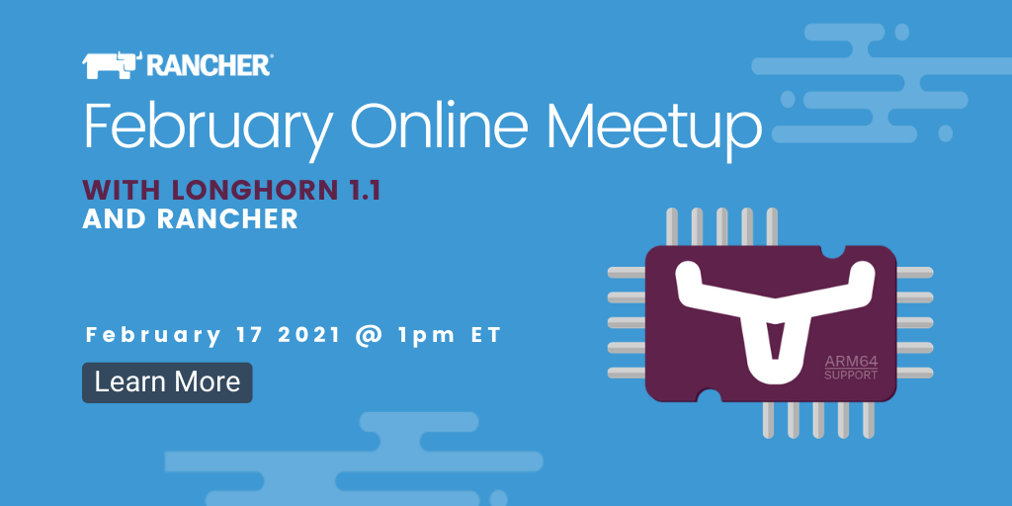
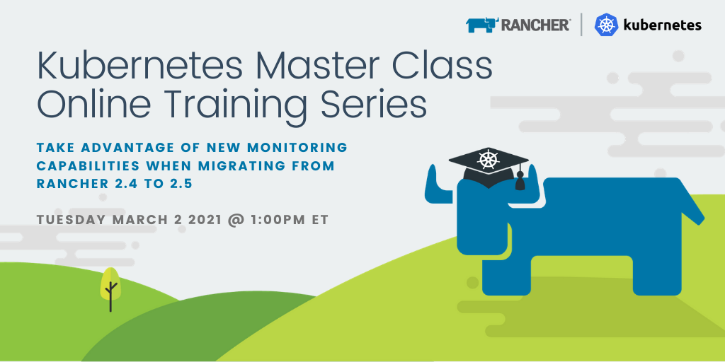
Upcoming Events
Find all upcoming classes & events at rancher.com/events
February Online Meetup
Wednesday Feb 17 @ 1pm ET (7pm CET)
Kubernetes-native Storage Has Arrived with Longhorn 1.1 and Rancher
Kubernetes Master Class
Tuesday Mar 2 @ 1pm ET (7pm CET)
Take Advantage of New Monitoring Capabilities When Migrating from Rancher 2.4 to 2.5

Slide 9
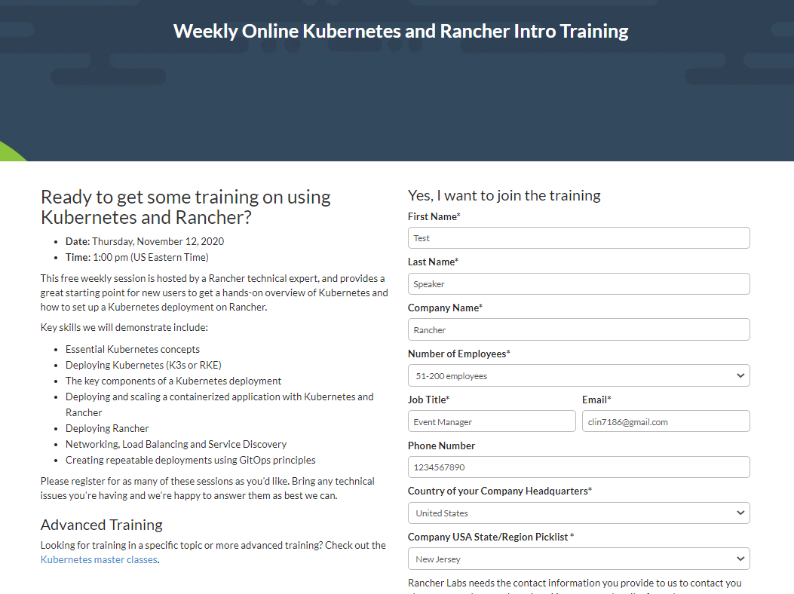
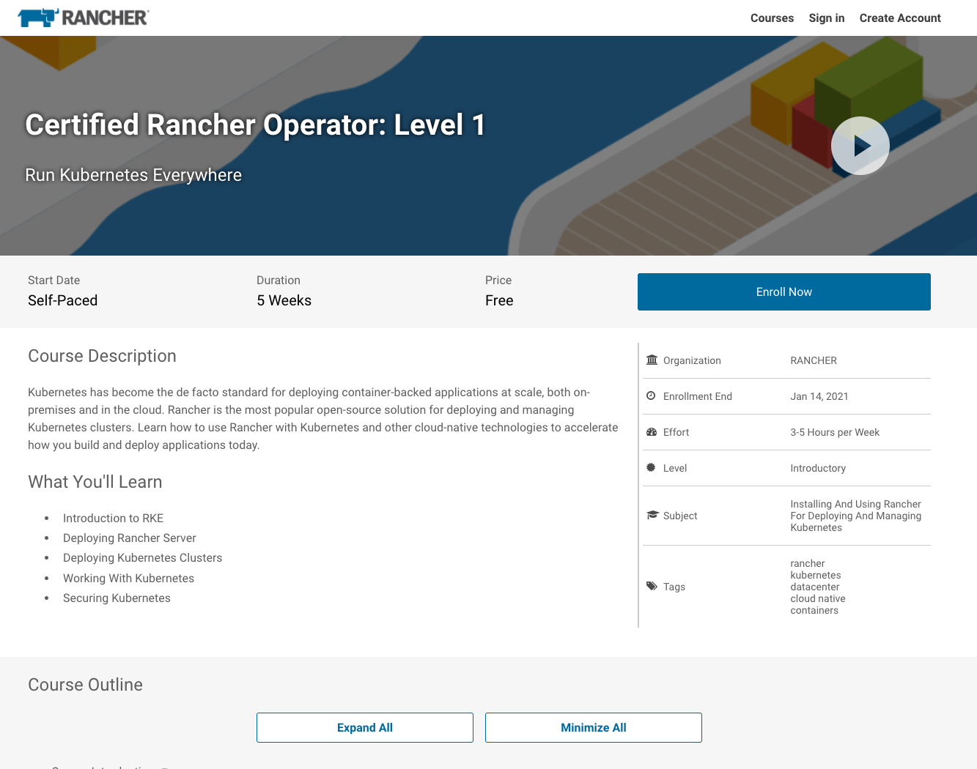
Additional Resources
Intro Training
Get Certified!
https://rancher.com/training
academy.rancher.com

Slide 10
Overview
Terms
High-Level rules
Picking a version
Creating your change control
Rancher Upgrade
Kubernetes/RKE Upgrade
Command issues / Demo
All scripts, commands, labs, and documentation is located at https://github.com/mattmattox/Kubernetes-Master-Class-Upgrades

Slide 11
Terms
Rancher Server is a set of pods that run the main orchestration engine and UI for Rancher.
RKE (Rancher Kubernetes Engine) is the tool Rancher uses to create and manage Kubernetes clusters
Local/upstream cluster This is the cluster where the Rancher server is installed, this is usually an RKE built cluster)
Downstream cluster(s) are Kubernetes cluster that Rancher is managing

Slide 12
High-Level rules
The following are the high-level rules for planning a Rancher/Kubernetes/Docker upgrade.
Do not rush an upgrade.
Do not stack upgrades (We recommended at least 24hours between upgrades)
Make sure you have a good backup
The recommended order of upgrades is Rancher, Kubernetes, and then Docker.
All upgrades should be tested in a lab or non-prod environment before being deployed to Production.
Review all release notes link
Review the support matrix link
It is not required, but we recommended pausing any CI/CD pipelines using the Rancher API during an upgrade.

Slide 13
Picking a version
Please see the following recommendations when planning version upgrades.
- Rancher: perform one minor version jump at a time
For example: when upgrading from v2.1.x -> v2.3.x. We encourage upgrading v2.1.x -> v2.2.x -> v2.3.x but this is not required.
- Kubernetes: perform no more than 2 minor versions at a time, ideally avoid skipping minor versions entirely as this can increase the chances of an issue due to accumulated changes
For example: when upgrading from v1.13.x -> v1.19.x we encourage upgrading v1.13.x -> v1.15.x -> v1.17.x -> v1.19.x
- RKE: perform one major RKE versions jump at a time
For example: when upgrading from v0.1.x -> v1.1.0 instead do v0.1.x -> v0.2.x -> v.0.3.x -> v1.0.x -> v1.1.x

Slide 14
Creating your change control
Scheduled change window
Rancher upgrade - 30Mins for install with 30mins for rollback
Kubernetes upgrade - 60Mins for install which may be longer for larger clusters with 60Mins for troubleshooting/rollback
Effect / Impact during the change window
Rancher upgrade - Only management of Rancher and downstream clusters are impacted, Applications shouldn't know that anything is being done. But any CI/CD pipelines should be paused
Kubernetes upgrade of the local cluster - The Rancher UI should disconnect and reconnect after a few mins due to the ingress-controllers being restarted.
Kubernetes upgrade of downstream clusters - Applications might see a short network blip as ingress-controllers and networking is restarted. See link for more details
Maintenance window
Rancher upgrade - A maintenance window is not required, but CI/CD pipelines should be paused.
Kubernetes upgrade of the local cluster - A maintenance window is not needed, but CI/CD pipelines should be paused.
Kubernetes upgrade of downstream clusters - This should be done during a maintenance window or a quiet time

Slide 15
Rancher Upgrade – Prep work
Check if the Rancher UI is accessible
Check if all clusters in UI are in Active state
Check if all pods in kube-system and cattle-system namespaces are running in both the local and downstream clusters.
kubectl get pods -n kube-system
kubectl get pods -n cattle-system
Verify etcd has scheduled snapshots configured, and these are working.
RKE: if Rancher is deployed on a Kubernetes cluster built with RKE, verify etcd snapshots are enabled and working, on etcd nodes you can confirm with the following:
ls -l /opt/rke/etcd-snapshots
docker logs etcd-rolling-snapshots
k3s: if Rancher is deployed on a k3s Kubernetes cluster, ensure scheduled backups are configured and working. Please see the k3s documentation pages for further information on this.
Create a one-time datastore snapshot, please see the following documentation for RKE and k3s, and the single node Docker install options for more information
RKE: check for expired/expiring Kubernetes certs
for i in $(ls /etc/kubernetes/ssl/*.pem|grep -v key); do echo -n $i" "; openssl x509 -startdate -enddate -noout -in $i | grep 'notAfter='; done

Slide 16
Rancher Upgrade – Change
Update helm repo cache
helm repo update
helm fetch rancher-stable/rancher
Verify you’re connected to the correct cluster
kubectl get nodes -o wide
Take an etcd snapshot
rke etcd snapshot-save --config cluster.yaml --name pre-rancher-upgrade-`date '+%Y%m%d%H%M%S'`
Grab the current helm values using helm get values rancher -n cattle-system
Use the values to build your upgrade command (NOTE: The only thing you should change is the version flag)
helm upgrade --install rancher rancher-stable/rancher \
--namespace cattle-system \
--set hostname=rancher.example.com \
--set ingress.tls.source=secret \
--set auditLog.level=2 \
--set antiAffinity=required \
--version 2.5.5
Wait for the upgrade to finish
kubectl -n cattle-system rollout status deploy/rancher
Official Rancher upgrade documentation

Slide 17
Rancher Upgrade – Verify
Check if the Rancher UI is accessible
Check if all clusters in UI are in an Active state
Check if all pods in kube-system and cattle-system namespaces are running in both the local and downstream clusters.
kubectl get pods -n kube-system
kubectl get pods -n cattle-system
Verify new Rancher version (Bottom Left corner)
Verify all Rancher, cattle-cluster-agent, and cattle-node-agent is running on the new version on the local cluster
kubectl get pods -n cattle-system -o wide
Verify all downstream cluster are Active
Verify all Rancher, cattle-cluster-agent, and cattle-node-agent runs on the new version on all downstream clusters.
kubectl get pods -n cattle-system -o wide
Take a post-upgrade etcd snapshot
rke etcd snapshot-save --config cluster.yaml --name post-rancher-upgrade-`date '+%Y%m%d%H%M%S'`

Slide 18
Rancher Upgrade – Backout
You can not downgrade Rancher; you must do an etcd restore Documentation
rke etcd snapshot-restore --name pre-rancher-upgrade-..... --config ./cluster.yaml

Slide 19
RKE Upgrade – Prep work
Verify the correct cluster.yaml and cluster.rkestate file
Verify SSH access to all nodes in the cluster
Verify all nodes are Ready
kubectl get nodes -o wide
Verify all pods are Healthy
kubectl get pods --all-namespaces -o wide | grep -v 'Running\|Completed’
We're looking for Pods crashing or stuck.
Verify Kubernetes version is available in RKE
rke config --list-version --all –print
You might need to upgrade to a newer RKE version if the recommend k8s version isn't available.

Slide 20
RKE Upgrade – Change
Take an etcd snapshot
rke etcd snapshot-save --config cluster.yaml --name pre-k8s-upgrade-`date '+%Y%m%d%H%M%S'`
Change "kubernetes_version" in the cluster.yaml
kubernetes_version: "1.19.7-rancher1-1"
If you have an air-gapped setup, please see documentation

Slide 21
RKE Upgrade - Verify
Verify all nodes are Ready and at the new version
kubectl get nodes -o wide
Verify all pods are Healthy
kubectl get pods --all-namespaces -o wide | grep -v 'Running\|Completed’
All pods should be healthy; we're looking for Pods crashing or stuck.

Slide 22
RKE Upgrade – Backout
You can not downgrade Rancher; you must do an etcd restore
rke etcd snapshot-restore --name pre-k8s-upgrade-..... --config ./cluster.yaml
Documentation

Slide 23
Common issues – Missing cluster.yaml and cluster.rkestate
DEMO
https://github.com/mattmattox/Kubernetes-Master-Class-Upgrades#missing-clusteryaml-and-clusterrkestate

Slide 24
Common issues – Upgrading from an old Helm version
DEMO
https://github.com/mattmattox/Kubernetes-Master-Class-Upgrades#upgrading-from-a-old-helm-version

Slide 25
Common issues – Upgrading with a broken node
DEMO
https://github.com/mattmattox/Kubernetes-Master-Class-Upgrades#upgrading-with-a-broken-node

Slide 26
Q & A
https://github.com/mattmattox/Kubernetes-Master-Class-Upgrades

Slide 27
Thank You

