Slide 1
Automatic Provisioning
Zach Vickery
Devops Engineer, CradlePoint
https://github.com/zvickery/bsu-cloud-computing

Slide 2
About me
Brief bio
Life of a DevOps engineer
How to become a DevOps engineer (or not)
CradlePoint enviroment
Lots of servers – traditionally hosted, managed hosted, and cloud
Lifetimes vary – years, months, hours
SaaS and M2M at scale
Full stack automation is a challenge
Change, change, change!

Slide 3
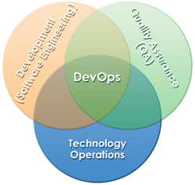
What is DevOps?
http://en.wikipedia.org/wiki/DevOps

Slide 4
A Cloud Server.. Now What?
A new server has been created and is online – what happens next?
The old/manual way
Someone logs in and sets it up
Creates users and groups
Installs packages
Tweaks config files
This is easy and is viable for prototyping or hobby projects
Not scalable!

Slide 5
Paradigm Shift
Dedicated server mentality
Provisioned manually by people
Long-lived, have names, and are managed by IT staff (separate from development team)
Tweaked and tuned over time
Cloud server mentality
Provisioned by code written by developers (either the core team or DevOps types)
Short lived, disposable, with names like i-7e9ec175

Slide 6
Automatic Provisioning
Creating single servers
API/SDK or CLI
Configuring servers
Chef, Ansible, Puppet
Creating entire stacks of servers, with virtual networking, security policies, etc.
AWS CloudFormation, OpenStack Heat

Slide 7
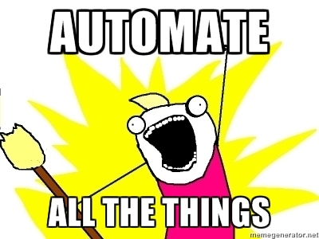
Ideology
If you have to use ssh to do anything on the host, your automation has failed

Slide 8
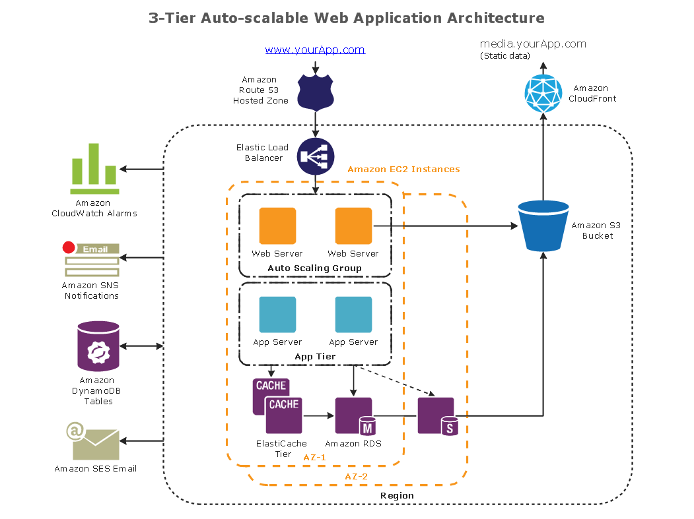

Slide 9
Running stuff at launch
http://docs.aws.amazon.com/AWSEC2/latest/UserGuide/user-data.html
EC2 (and other cloud providers) provide ways to launch commands upon boot
bash scripts and cloud-init are typical
Great way to perform automatic instance configuration
Installing/invoking chef at launch
Example – boto and awscli

Slide 10
Configuration Management with Chef
An open source CM framework developed by Opscode
Uses Ruby DSL for automation
“Chef turns infrastructure into code”
The chef client is a program that runs on a node
It can get code (“cookbooks”) from a chef server or from a HTTP endpoint

Slide 11
Chef Operating Model
Chef is agent based
Chef agents on servers run on some interval to perform “chef runs” which perform synchronizing tasks
Great for ensuring a system stays in a specified state
Less great for resource cost and time to converge across a stack

Slide 12
Chef Concepts
Recipes represent the smallest level of automation task
Cookbooks are related collections of recipes and are the primary code unit in chef
Attributes are configuration items within a cookbook (e.g. IP address, URL)
Nodes represent servers themselves

Slide 13
Chef Concepts
Roles represent a node’s personality (what it does) and typically have a “run list” of cookbooks/recipes associated (how it does it)
Environments represent a collection of roles that can be configured as one (e.g. production, test, etc.)
Organizations are top-level concepts for everything including users
Attributes can be set at the cookbook, node, role, and environment levels
https://docs.getchef.com/essentials_cookbook_attribute_files.html#attribute-precedence

Slide 14
Chef Lightweight Resource Providers
LWRPs are the backbone of Chef recipes
Built-ins cover most standard actions: files, directories, users, packages, etc.
You can write your own of course
Reference: http://docs.getchef.com/chef/resources.html

Slide 15
What about tests?
If it’s code, it should be testable
Chef cookbooks can be tested in many ways
Chefspec
Unit test style testing of cookbooks. It simulates chef runs to provide test coverage.
TestKitchen/Vagrant/Serverspec
Uses vagrant to setup a local VM to actually run your cookbook and to test the configuration of a deployed system. TestKitchen provides automation and Serverspec provides assertion framework.
Foodcritic
Static analysis tool

Slide 16
Developing with Chef
chefdk is recommended
https://downloads.getchef.com/chef-dk/
Installs a bunch of stuff
ruby, chef client, knife, foodcritic, test kitchen, rspec, …
Once installed, you’re ready to author and test cookbooks

Slide 17
Chef Cookbook Walkthrough
Recipes
Attributes
Files
Templates
Tests (rspec and serverspec)

Slide 18
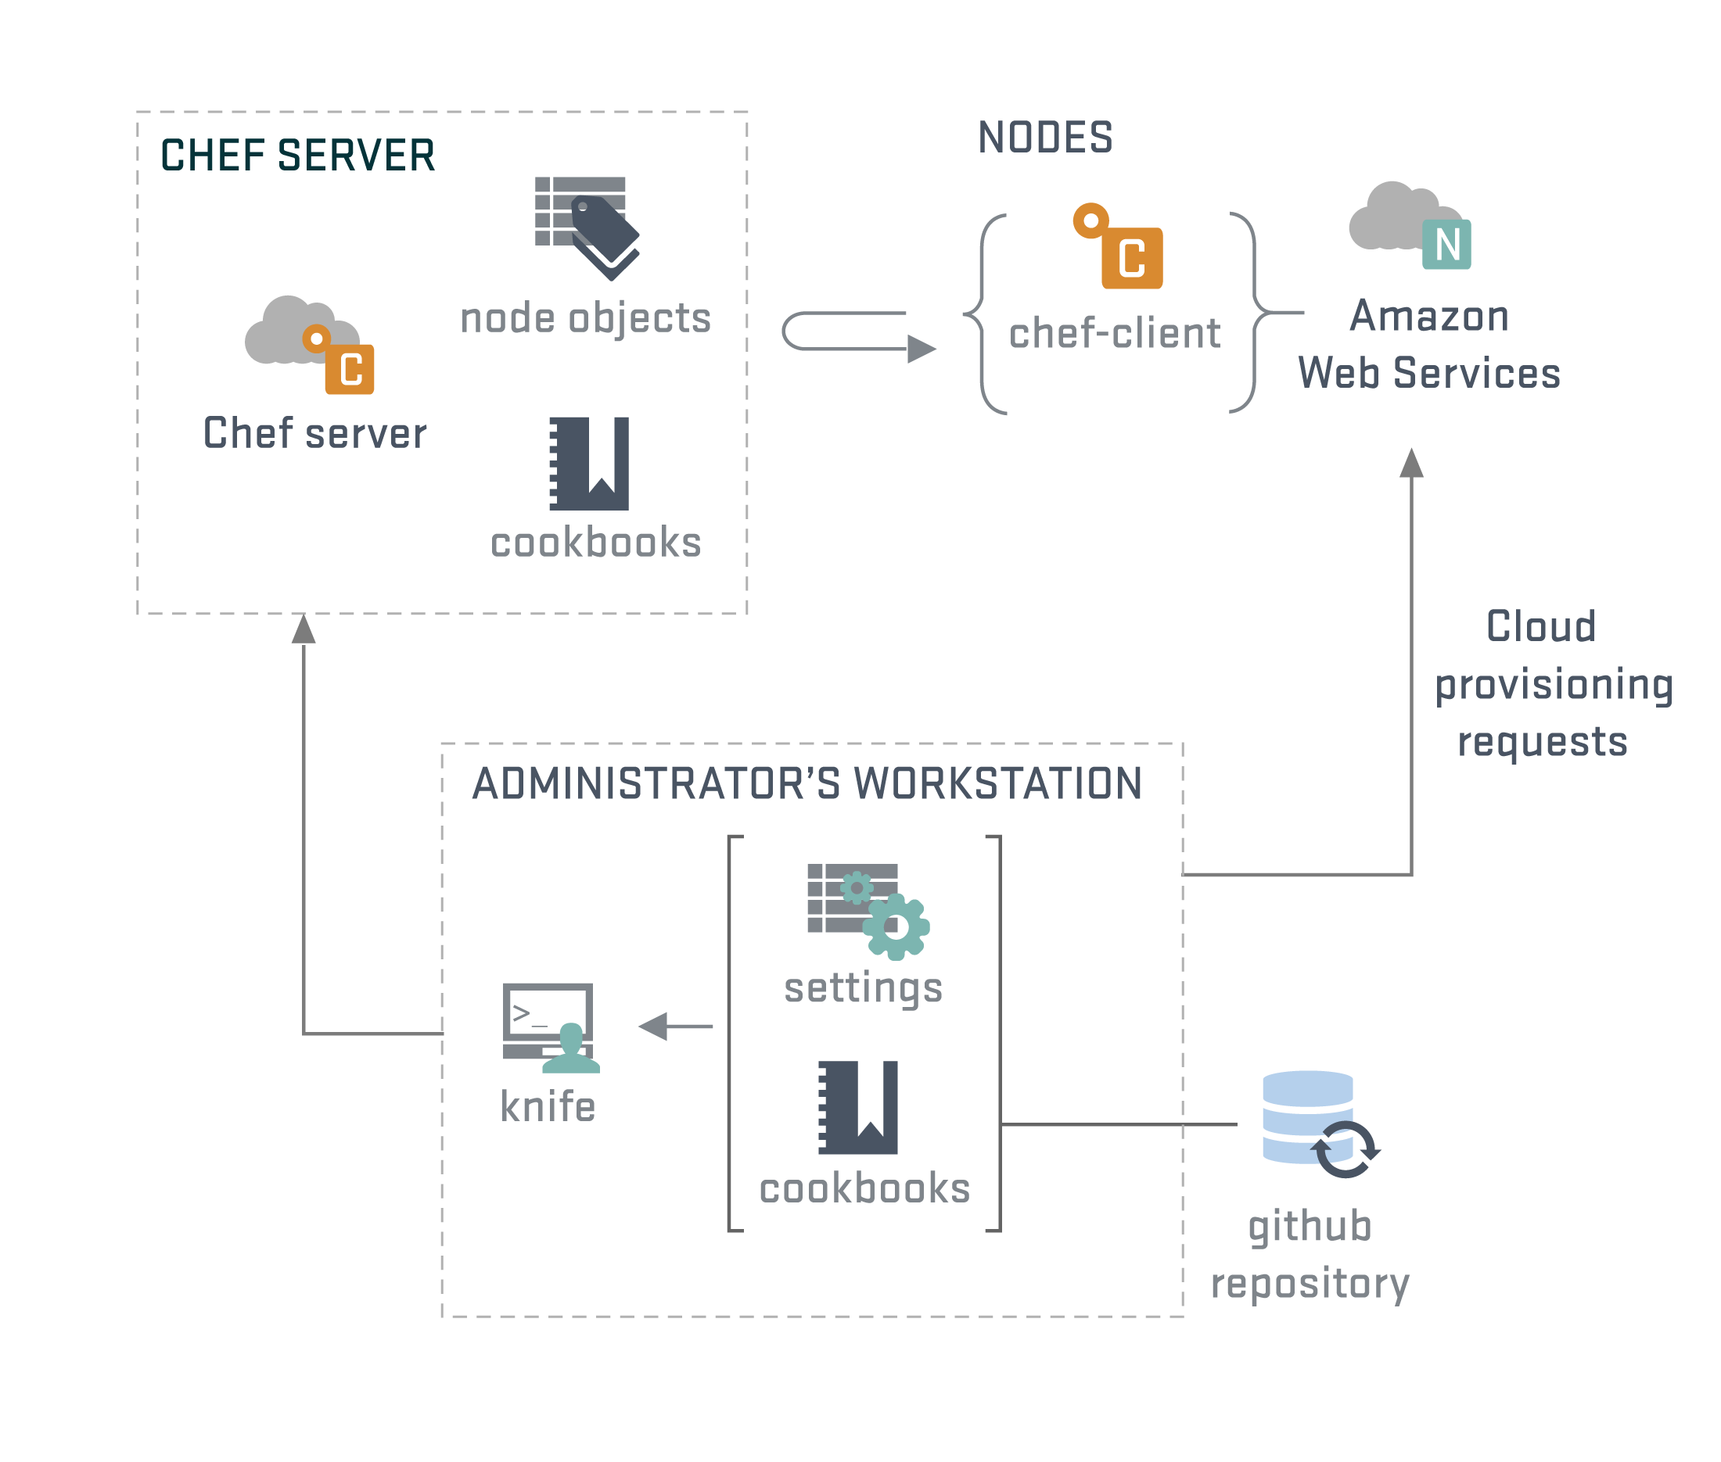
Chef Architecture

Slide 19
Chef Operating Model
Chef-zero
An emulator used for unit testing and the like
Chef-solo
Used to simply download cookbooks onto a node and execute them
Chef server
A client/server model where clients receive cookbooks and other configuration from a central server
On boot, a cloud server associates with the chef server to get configured
Client can run regularly to allow near continuous management

Slide 20
Chef Server
Chef server build a central repository of cookbooks and configuration for a large set of nodes
https://docs.getchef.com/chef_overview_server.html
Can also be hosted in the cloud (OpsCode)

Slide 21
Chef Server Demo
Managing via the UI
Managing via knife and json files
Opscode (hosted Chef) UI

Slide 22
Continuous Integration
Chef cookbooks can easily be part of a continuous integration cycle
Upon checkin, tests are run ensuring a baseline of quality in the repo
Harder to do with more basic automation techniques (e.g. bash scripts)

Slide 23
Creating a cookbook
knife cookbook create my_cookbook
Quick rundown of what’s created

Slide 24
Other chef features
Data bags
Basically just a JSON file which can be referenced by recipes
Store global data items of a static nature
Can be encrypted to manage passwords, certificates, API keys, etc.

Slide 25
That’s a lot of work..
It is!
Benefits
Easy to reproduce an application configuration
Disposable test servers/stacks
Application updates can consist entirely of code with no manual steps
Facilitates continuous deployment and business agility

Slide 26
Counterpoint: Ansible
Open source framework supported by Ansible, Inc.
Uses YAML for configuration files
Ansible performs configuration management via ssh only
Has a “radically simple” push model:
Deployment server pushes changes to infrastructure
Deployment server must be configured to know about stacks
No special software needed on deployed servers

Slide 27
Playbooks
Playbooks are the rough equivalent of recipes in chef
http://docs.ansible.com/playbooks_intro.html
Automation tasks consist of running playbooks on hosts that are defined in an inventory
Inventory must be statically maintained!

Slide 28
Inventory
Since there is no central server to keep track of who’s registered, you get to do it
An inventory is basically a file describing servers by IP and putting them in groups
Playbooks are run on slices of your inventory
http://docs.ansible.com/intro_inventory.html

Slide 29
YAML
Yet Another Markup Language
http://docs.ansible.com/YAMLSyntax.html

Slide 30
Testing Ansible
http://docs.ansible.com/test_strategies.html
“Ansible believes you should not need another framework to validate basic things of your infrastructure is true. This is the case because Ansible is an order-based system that will fail immediately on unhandled errors for a host, and prevent further configuration of that host.”
Serverspec could be used to validate Ansible automation

Slide 31
Ansible Modules
Ansible has built in modules for integrating various services
http://docs.ansible.com/modules_by_category.html
Sort of like Chef LWRPs but even includes things like cloud provider integrations

Slide 32
Ansible Demo
Build a cloud server
Provision it
Take an image of it

Slide 33
Stack Building
OK, I can create servers and configure them
How about an application stack with the following?
Two load balanced web servers
Load balancer
Database as a service
Private networking
Bastion host for admin ssh access

Slide 34
AWS CloudFormation
You could do all of that manually…
AWS CloudFormation
AWS’ tool for building sets of infrastructure declaratively and transactionally
Uses json to specify what will be created
Can use user data/cloud-init to kick off provisioning of instances
Demo

Slide 35
OpenStack Heat
OpenStack equivalent of CloudFormation
Syntax is either CloudFormation compatible or YAML
https://github.com/openstack/heat-templates/blob/master/hot/servers_in_existing_neutron_net.yaml

Slide 36
One Button Stack Deploy
Press a button and..
A CloudFormation template is instantiated to create stack resources
The compute nodes on the stack use user data to install chef and invoke chef-client to register with chef server
Chef server and client work together to configure nodes based upon role
Once the chef runs complete (and converge if needed), a new stack is online!
Tear-down even simpler

Slide 37
Application Updates
In place update on existing stack:
Fire off a chef recipe that runs everywhere which pulls code from somewhere (cloud storage?), installs it, and restarts services
Roll application servers
Use scaling group to add new servers; the new ones will load new code with chef. Then gradually retire the old ones. Data tier must handle this.
Roll entire stack
Bring up a new stack with new code and cut over DNS. Need to consider data migration.

Slide 38
Other Operational Tasks
Managing users/groups
Chef can do a good job of this
LDAP/AD/SSO if you’re fancy
Security updates
Run updates with knife ssh
knife ssh example
Run a recipe (needs more forethought)
Reboot or throw away instances?

Slide 39
Machine Images
How much to do with a machine image vs automation?
There is a continuum
Machine image: static and repeatable but much heavier to update. Extra cost too.
Automation: Repeatability can be a problem, can take longer to spin up in an autoscaling group

Slide 40
Service Discovery
A complement to these automation tools is a service discovery mechanism
Apache Zookeeper is an example
ZooKeeper is a centralized service for maintaining configuration information, naming, providing distributed synchronization, and providing group services.
http://zookeeper.apache.org/

Slide 41
Service Discovery
Service discovery mechanisms allow stack convergence to happen much quicker than with configuration management tools like chef
Async notification builtin
Can also support distributed mutual exclusion and other scenarios

Slide 42
Container Computing
Shipping code and runtime environment together
The same image that runs on a workstation is run in production
Docker is the primary implementation
https://www.docker.com/
https://cloud.google.com/compute/docs/containers
http://aws.amazon.com/blogs/aws/container-computing/

Slide 43
Summary
Automation is hard work
A field unto itself at any scale and distinct from typical software development
It changes all the time, like the code it hosts and the infrastructure it relies upon
So much more to think about
Monitoring, notification, logging, backup, DR, HA, provisioning, scaling, etc.
It is required to fully take advantage of the benefits of cloud computing

Slide 44
Questions?
Lots of online resources
http://docs.getchef.com/
http://jtimberman.housepub.org/blog/2011/09/03/guide-to-writing-chef-cookbooks/
http://docs.ansible.com/
http://aws.amazon.com/documentation/
https://boto.readthedocs.org/en/latest/
http://serverspec.org/
http://techblog.netflix.com/

