Slide 1


BLOCKCHAIN EXPLAINED:
LET’S #BUIDL TOGETHER
What is a blockchain? Brief History, Intro to Bitcoin
What is Ethereum?
“The world computer”
Deji Jimoh
What is a smart contract?
Your first decentralized web app

Slide 2
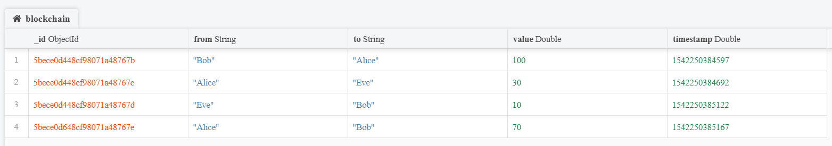
Blockchain: A distributed ledger
Blockchain ledger, a database of transaction records.
OUTPUTS
Eve pays Bob 10
Bob: 10
INPUTS
Eve: 30
Transaction: 3
Fee: 1
Eve: 19
Notes:
These records can take any form, from monetary payments, to the transfer of real estate from one individual to another. There are a few properties though that make blockchain truly special and unlike any other database that has come before it. Traditional databases are centralized, while blockchain is a decentralized network where no single entity owns the database. Instead it is spread across thousands of machines, a network open to participation by anyone with an internet connection. Another beautiful property is that the ability to make a new transaction is secured by unbreakable encryption and any individual in the world can create their own special key to do so. The consensus mechanism embedded in blockchain protocols ensures that no one individual, institution or government has the power to dictate which transactions are valid. Instead, the network participants each use their computing power to “vote” and come to an agreement on the network’s valid transaction state.

Slide 3
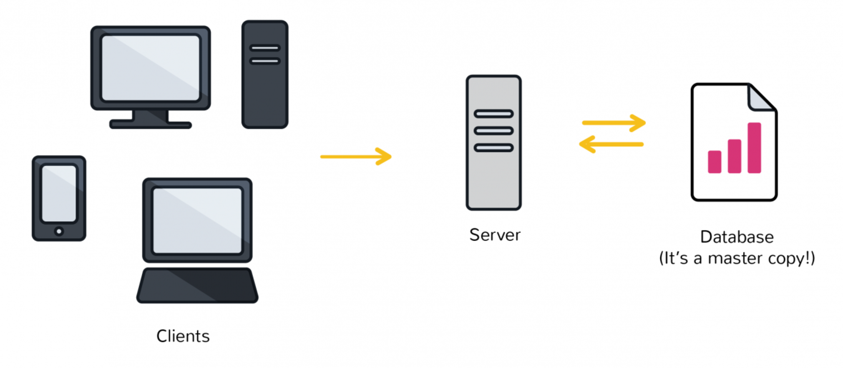

Traditional Databases: Centralized
All data is updated and maintained by a central authority
Notes:
These records can take any form, from monetary payments, to the transfer of real estate from one individual to another. There are a few properties though that make blockchain truly special and unlike any other database that has come before it. Traditional databases are centralized, while blockchain is a decentralized network where no single entity owns the database. Instead it is spread across thousands of machines, a network open to participation by anyone with an internet connection. Another beautiful property is that the ability to make a new transaction is secured by unbreakable encryption and any individual in the world can create their own special key to do so. The consensus mechanism embedded in blockchain protocols ensures that no one individual, institution or government has the power to dictate which transactions are valid. Instead, the network participants each use their computing power to “vote” and come to an agreement on the network’s valid transaction state.

Slide 4
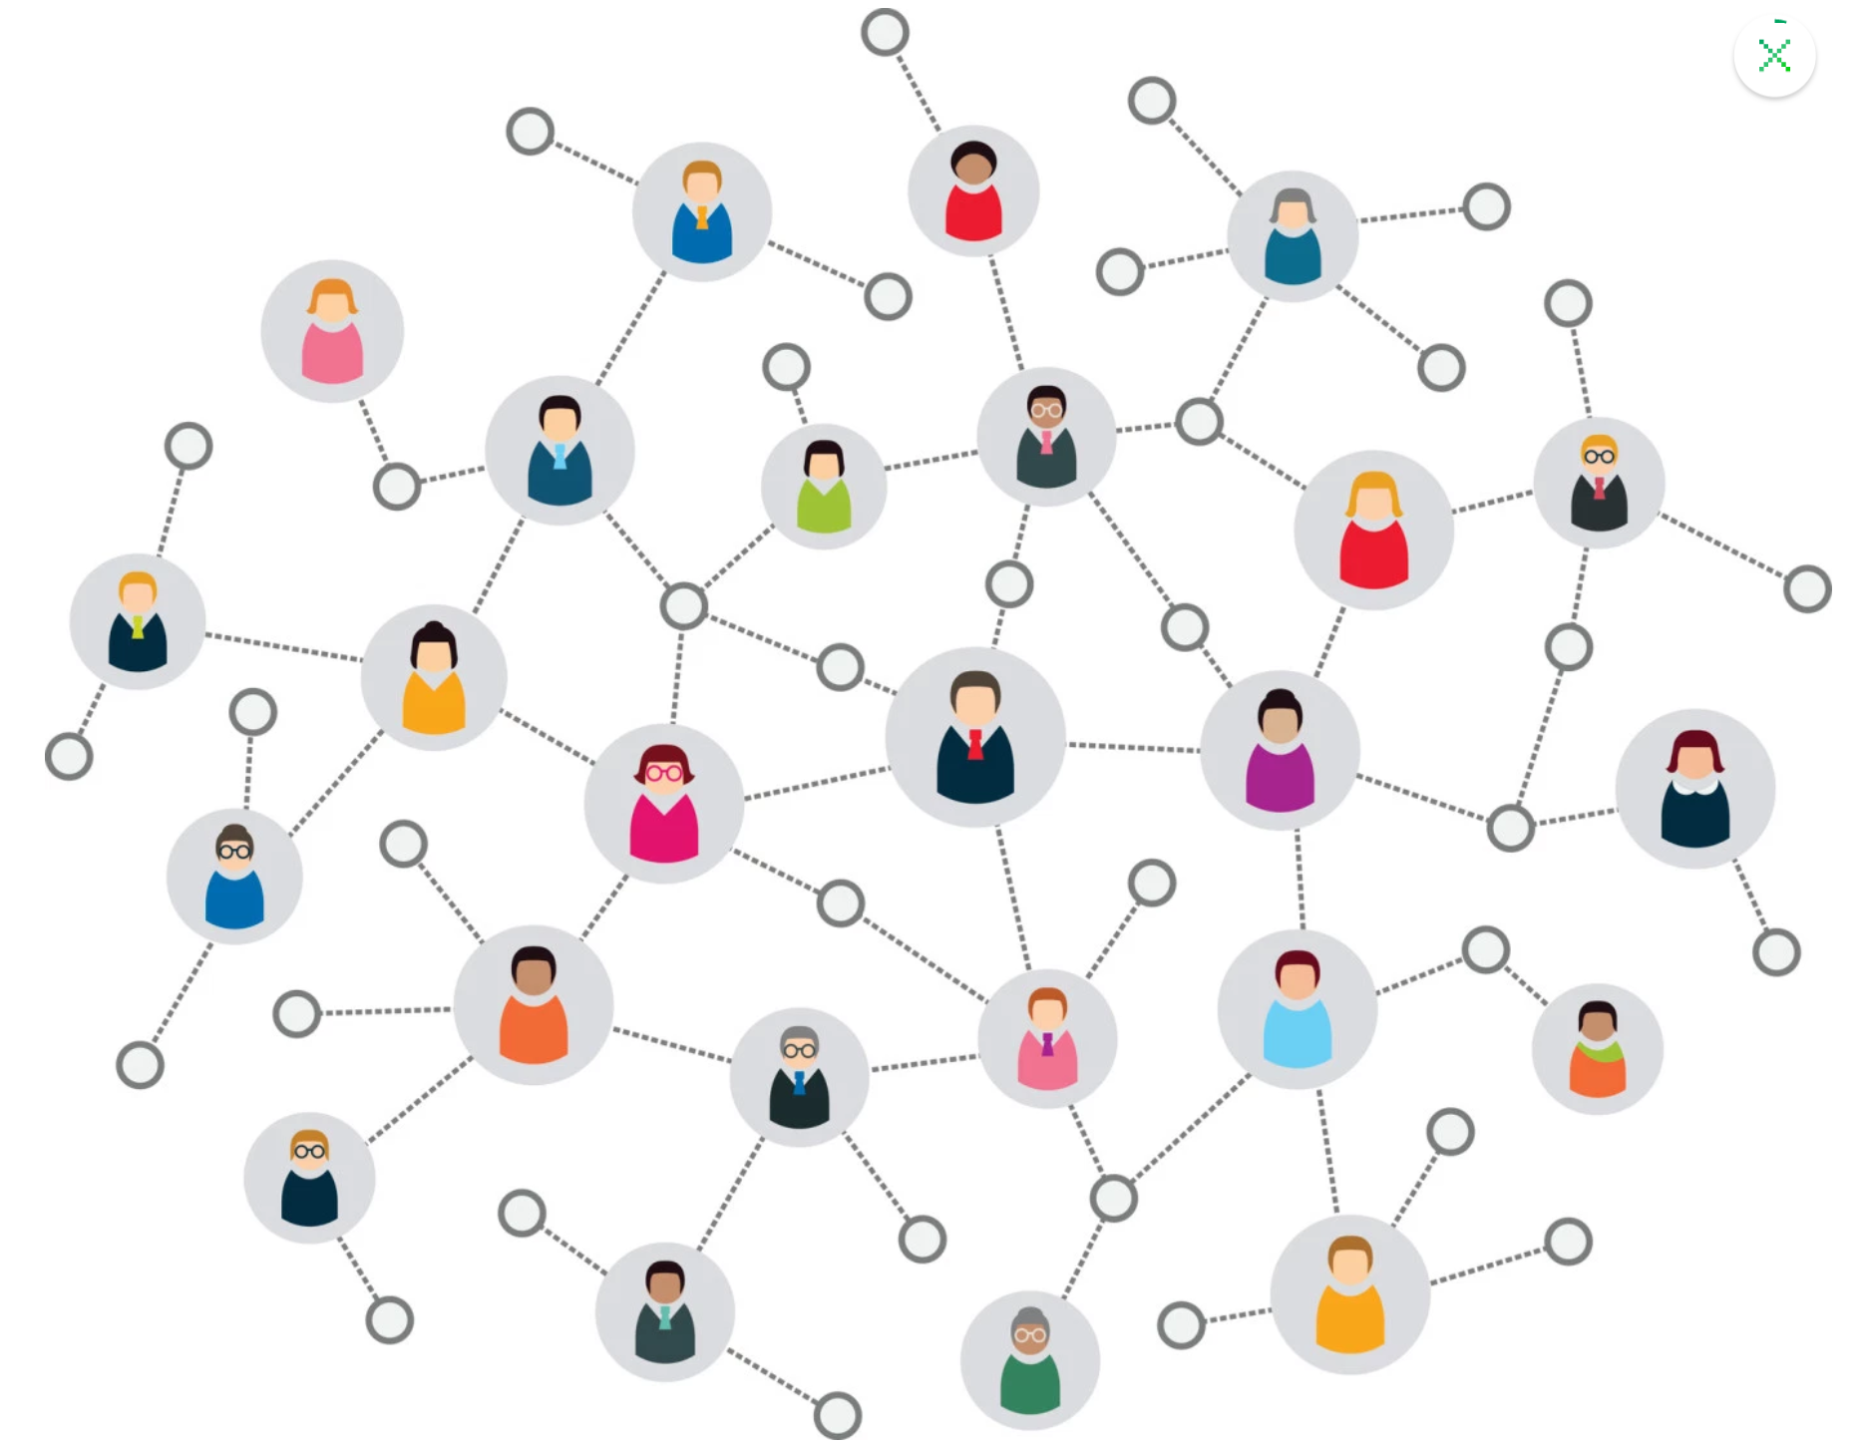
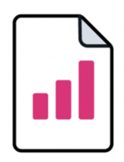
Blockchain: Decentralized
No single entity owns the database as it’s replicated across 1,000 of independent machines
Notes:
Gossip Protocol
Decentralized Validation

Slide 5
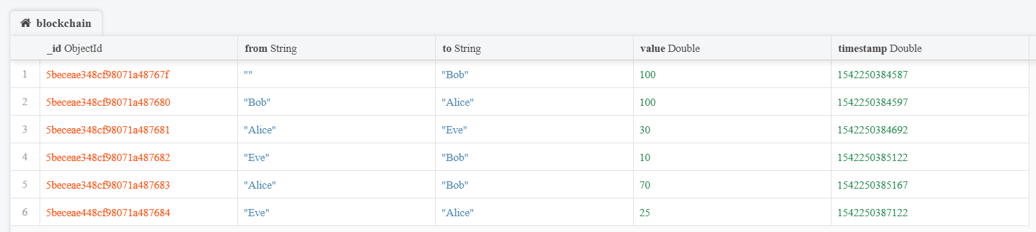
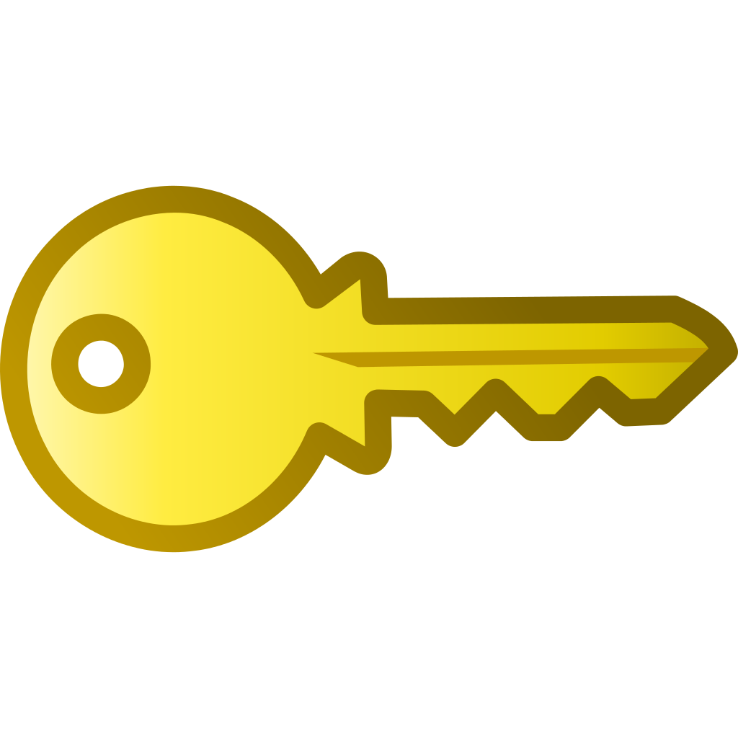
Distributed Validation
Address: 1LrN44QGR56EKjQh9ZKNWJumBTwu2CcDBa
Private Key: KycgkriYU4VaXiXJJP1N8fmtS6DQHMcWmrvR6YjRagewHtozeGci
Alice can initiate transactions because she has the key for her address
Eve’s transaction will be rejected by the network since she only has 20 left
Notes:
Key Validation
Value Validation

Slide 6
Blockchain Consensus
Proof of Work (aka mining): Security and Decentralization
Incentivization scheme to economically secure the blockchain.
Real energy costs required to brute force solve cryptographic puzzle
Consumes more energy than entire country of Ireland
Deters denial of service (DDOS) attacks, spam, and malicious use of computing power
Ensures immutability
Notes:
The consensus mechanism that governs blockchain networks and validates transactions, also ensures immutability, meaning you can trust that any data written to the blockchain has not been tampered with and can never be altered. That’s a pretty powerful property! It enables blockchains to also be used as a definite historical record for activities such as tracking. For example, the movement of agricultural products tracked on blockchain can be traced back to their source almost instantly in the event of a salmonella outbreak. Technology giants like IBM are already working with major food suppliers like Walmart, Dole, and Nestle to integrate blockchain into the global food supply chain to make this a reality.

Slide 7
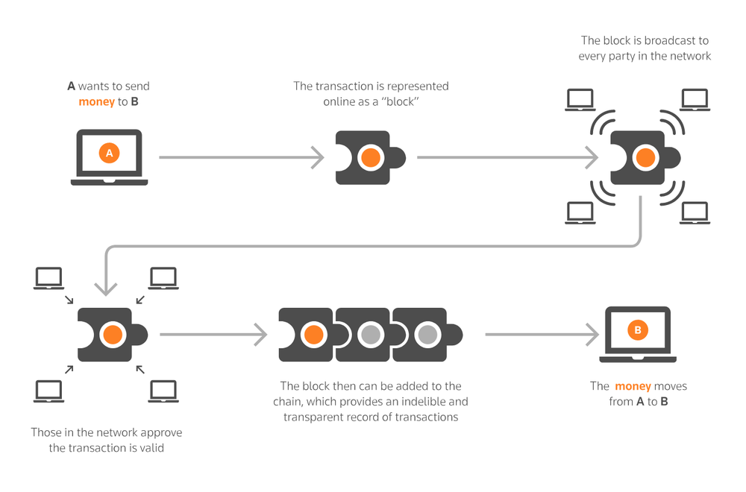
Blockchain Components
Peer-to-peer (P2P) network connecting users, propagating transactions and blocks of verified transactions
Messages, in the form of transactions, representing state transitions
A set of consensus rules, governing what constitutes a transaction and what makes for a valid state transition
A chain of cryptographically secured blocks that acts as a journal of all the verified and accepted state transitions

Slide 8
Blockchain Birth: January 3, 2009
Blockchain first emerged in the 2008 Bitcoin Whitepaper (“A Peer-to-Peer Electronic Cash System”) penned under the name Satoshi Nakamoto (true identity still unknown)
This first blockchain, the Bitcoin network, officially came into existence on January 3, 2009
Bitcoin is a decentralized digital currency without a central bank or single administrator, that can be sent from user-to-user on the peer-to-peer network without the need for intermediaries.

Slide 9
Ethereum Blockchain
Created by Vitalik Buterin, went live in July 2015
A decentralized open source platform based on blockchain technology that enables developers to build and deploy decentralized applications.
A Turing-complete scripting language providing trustless smart contracts. Smart contracts function as “cryptographic ‘boxes’ that contain value and only unlock it if certain conditions are met”
Over 1,500 dapps currently built on Ethereum
16,000+ live nodes, 240MM transactions: https://media.consensys.net/blockchain-by-the-numbers-33-stats-on-ethereum-and-consensys-738cb1637cb3
Notes:
Ethereum allows you to create multiple types of value

Slide 10
Your First Decentralized Web App
What is a decentralized web app?
An application that runs on a P2P network of computers. Unlike centralized applications, there is no single authority or set of servers responsible for running application logic.
Censorship resistant
Fault Tolerant
Open source and transparent

Slide 11
Our DApp Toolbox
Truffle – “Sweet tools for smart contracts”
npm install –g truffle
https://truffleframework.com/ganache
Metamask – Browser extension for interacting with Ethereum apps
https://metamask.io/
Web3 – Ethereum JavaScript API
npm install web3
Angular – Front-end JavaScript framework
npm install –g @angular/cli
Notes:
cd vob
truffle init
ng new web

Slide 12
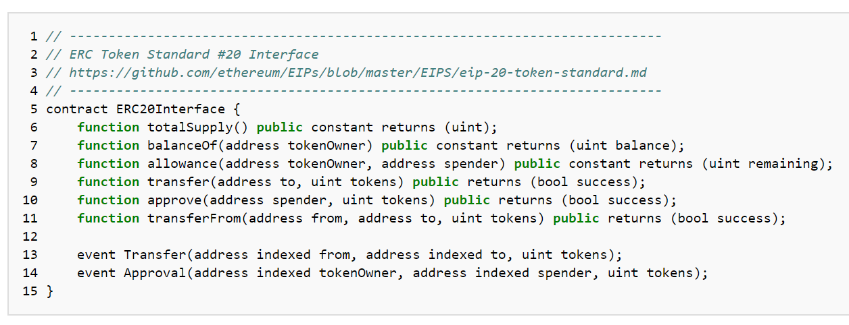
Create a New Smart Contract
truffle init
ERC20 Token Standard - https://theethereum.wiki/w/index.php/ERC20_Token_Standard
OpenZepplin – open source library of secure smart contracts
npm install –E openzepplin-solidity
Notes:
mkdir blockchain
cd blockchain
truffle init
ERC20 - common interface defining basing rules of ownership and coin transfer

Slide 13
Test Contract
Write tests to ensure contract does EXACTLY what it is supposed to and ONLY what it is supposed to
Compile Contract
truffle compile
Solidity compiler will generate an Application Binary Interface (ABI)
Launch Development Console
truffle develop => migrate –-reset => test
OR use Ganache (https://truffleframework.com/ganache)
truffle migrate –-reset
truffle test
Run Tests
truffle test
Notes:
cd vob
truffle init
ng new web

Slide 14
Deploy Contract
Infura – Your Access to the Ethereum Network
https://infura.io/
Setup Truffle Deployment Config
npm install --save-dev truffle-hdwallet-provider
truffle migrate --reset --network ropsten
Notes:
cd vob
truffle init
ng new web

Slide 15
Create and Launch Web App
Angular CLI – create new web project
ng new web
Launch web app
ng serve
Notes:
cd vob
truffle init
ng new web

Slide 16
https://github.com/djimoh5/dapp
Mastering Bitcoin: Programming the Open Blockchain
Mastering Ethereum: Building Smart Contracts and DApps
Digital Gold: Bitcoin and the Inside Story of the Misfits and Millionaires Trying to Reinvent Money
Notes:
This would conclude our presentation. We are happy to set up a one-on-one meetings with you where we can answer any specific questions, share the financials and term sheet.

