Slide 1
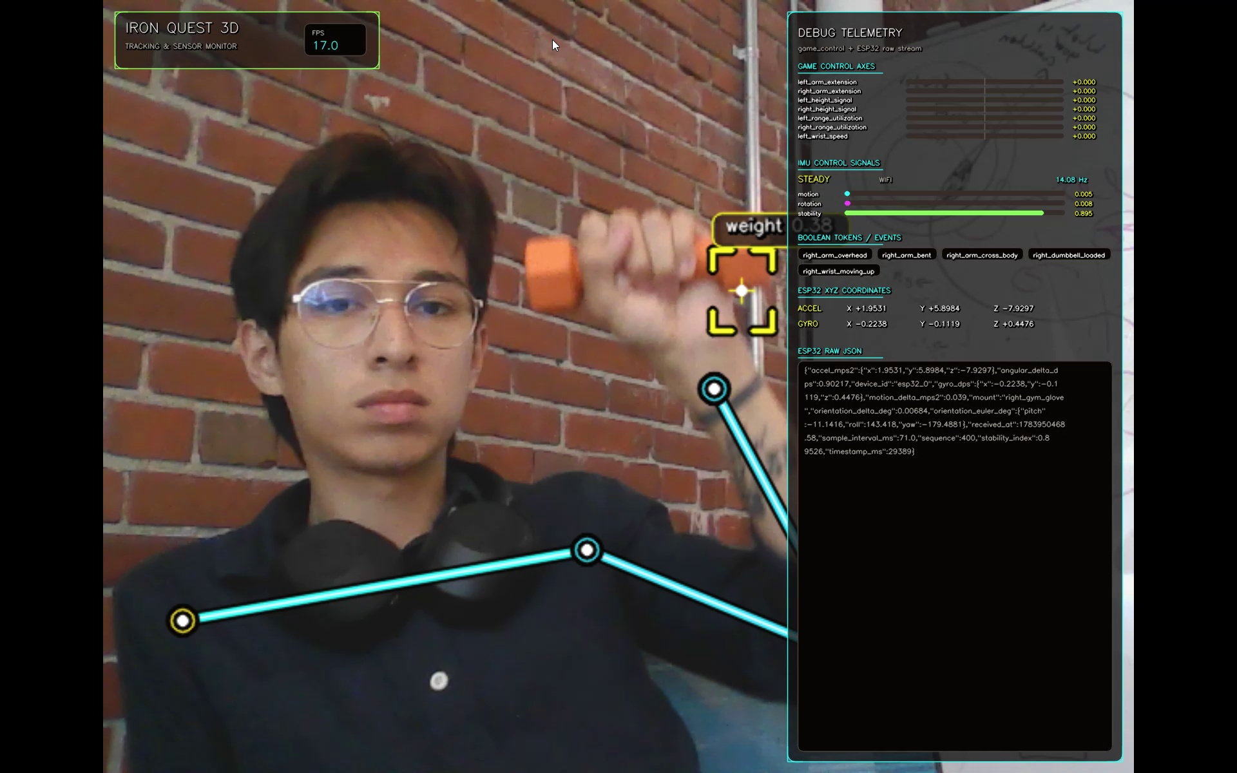
PERSUASIVE COMPUTING LAB / DALHOUSIE UNIVERSITY
FitQuest
FITQUEST PROTOTYPE
Sensor-fusion engine for physical interaction
PROBLEM STATEMENT
METHODOLOGY / TECH STACK
- Interactive systems do not model physical movement reliably across heterogeneous sensors.
- Vision-only and isolated wearable approaches lack synchronized, standardized signals.
- This limits analysis of posture, load, symmetry and exertion.
- Camera + YOLO: body-pose estimation and dumbbell detection.
- ESP32 + IMU: motion, orientation and stability telemetry.
- Garmin Venu 3: heart-rate and physiological context.
- Fusion pipeline synchronizes, calibrates and exports normalized JSON/JSONL features.
Live monitor: pose, object context, IMU telemetry and heart-rate data in one view.
EXPECTED OUTCOMES & IMPACT
- Reusable signals for arm extension, range, symmetry, stability and exertion.
- Consistent frame-level data for HCI evaluation and future interactive applications.
- Middleware foundation for adaptive, assistive and rehabilitation-oriented systems.
- Validate sensor fusion before the final game layer.
PERSONAL INFO
Name: Milton Torres
Program: MITACS Globalink Research Intern
Origin: Mexico
Supervisors: Dr. Rita Orji; Dr. Fidelia Orji; Dr. Grace Ataguba
Research-ready movement signals
for adaptive interaction.
PERSUASIVE COMPUTING LAB | DALHOUSIE UNIVERSITY
FITQUEST / 2026
Notes:
Hi, I am Milton Torres, a MITACS Globalink Research Intern from Mexico, supervised by Dr. Rita Orji, Dr. Fidelia Orji and Dr. Grace Ataguba. FitQuest addresses the challenge of representing physical movement reliably across heterogeneous sensors. The methodology combines camera-based YOLO pose and dumbbell detection, ESP32 IMU telemetry, and Garmin heart-rate context. The expected outcome is a reusable set of normalized movement signals for HCI evaluation and future adaptive, assistive and rehabilitation-oriented applications.

