Slide 1
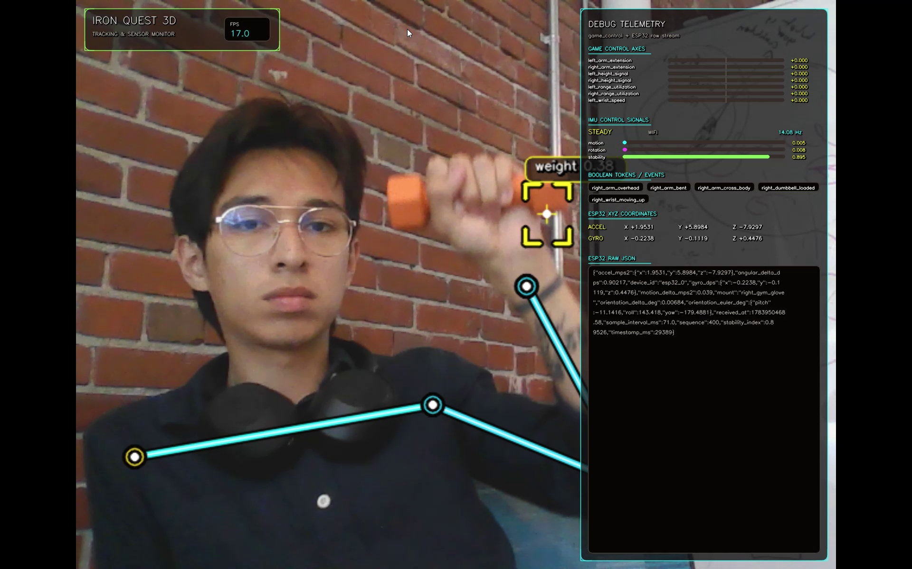
PERSUASIVE COMPUTING LAB / DALHOUSIE UNIVERSITY
MILTON ESTUARDO TORRES MERAZ
LIVE PROTOTYPE
Software Developer | Persuasive Computing Lab
Iron Quest 3D
Turns physical movement into research-ready signals.
A sensor-fusion engine that combines body movement, dumbbells, IMU telemetry and heart-rate context so future interactive applications can understand movement reliably.
One view, multiple signals
The monitor exposes what the system can already see: posture, object context, sensor status and normalized control axes.
HOW IT WORKS
CAMERA + YOLO
Pose + dumbbells
→
ESP32 + IMU
Motion + orientation
→
GARMIN VENU 3
Heart-rate context
Normalized JSON / JSONL signals: arm extension, range, symmetry, stability and exertion.
For research analysis now.
For adaptive interaction next.
CURRENT FOCUS
Prove reliable sensor fusion first; the game layer comes next.
ORCID 0009-0005-3217-9935 | Mexico to Halifax, Canada
MITACS PROJECT / 2026
Notes:
Hi, I am Milton Estuardo Torres Meraz, a software developer in the Persuasive Computing Lab at Dalhousie University. My project, Iron Quest 3D, is a sensor-fusion engine for physical interaction. It combines camera-based pose and dumbbell detection with ESP32 and IMU telemetry, plus Garmin heart-rate context, and converts them into normalized signals such as arm extension, stability and exertion. The current goal is to prove the middleware before building the final game layer.

