Slide 1
CAPSTONE PROJECT
IMDB Movie Reviews
Presented By:
1. MILTON INFANT RAI-Kings college of Engineering-EEE

Slide 2
OUTLINE:
Problem Statement
Proposed System/Solution
System Development Approach
Algorithm & Deployment
Result
Conclusion
Future Scope
References

Slide 3
Problem Statement:
Movie dataset for binary sentiment classification containing substantially more data than previous benchmark datasets. We provide a set of 25,000 highly polar movie reviews for training and 25,000 for testing. So, predict the number of positive and negative reviews using either classification or deep learning algorithms.

Slide 4
Proposed System/Solution:
Data Preprocessing:
Load and preprocess the movie dataset, which contains 25,000 highly polar movie reviews for training and 25,000 for testing.
Clean the text by removing HTML tags, special characters, and punctuation.
Tokenize the text into individual words and convert them to lowercase.
Remove stop words and perform stemming or lemmatization to normalize the text data.
Feature Extraction:
Convert the preprocessed text data into numerical features suitable for machine learning models.
Explore techniques like TF-IDF (Term Frequency-Inverse Document Frequency), word embeddings (e.g., Word2Vec, GloVe), or pre-trained language models (e.g., BERT, GPT) to represent the text.
Consider feature selection methods to identify the most relevant features for sentiment classification.
Model Selection:
Experiment with both traditional machine learning algorithms and deep learning architectures for sentiment classification.
For traditional ML algorithms, consider Logistic Regression, Naive Bayes, Support Vector Machines (SVM), Random Forest, and Gradient Boosting.

Slide 5
Model Training:
Split the training dataset into training and validation sets (e.g., 80% training, 20% validation).
Train the selected models on the training data and tune hyperparameters using techniques like grid search or random search.
Model Evaluation:
Evaluate the trained models on the separate testing dataset to assess their performance in predicting sentiment.
Measure evaluation metrics such as accuracy, precision, recall, F1-score, and ROC-AUC to evaluate model effectiveness.
Prediction and Analysis:
Use the best-performing model to predict the sentiment (positive or negative) of the testing dataset.
Analyze the predictions to understand the distribution of positive and negative reviews and gain insights into the sentiment of the movie reviews.
Deployment and Integration (Optional):
Deploy the trained model as a service or integrate it into an application where users can input movie reviews for sentiment analysis.
Provide an interface for users to interact with the system and obtain predictions on new movie reviews.

Slide 6
System Development Approach:
Requirement Analysis:
Understand the scope and objectives of the IMDb movie review system.
Identify stakeholders and their requirements, including end-users, administrators, and developers.
Design Phase:
Design the system architecture, including database schema, backend APIs, frontend components, and integration points.
Define user interface (UI) wireframes and mockups to visualize the user interaction flow.

Slide 7
Backend Development:
Develop backend services to handle user authentication, review submission, sentiment analysis, and search functionality.
Implement RESTful APIs to expose endpoints for frontend interaction.
Write business logic to process user requests, interact with the database, and perform sentiment analysis using machine learning models.
Frontend Development:
Develop the user interface (UI) components using HTML, CSS, and JavaScript frameworks (e.g., React, Angular, Vue.js).
Implement user authentication and authorization mechanisms for secure access to system features.

Slide 8
Algorithm & Deployment:
Data Preparation: Obtain the movie dataset containing 25,000 positive and 25,000 negative reviews. Ensure it is properly formatted and split into training and testing sets.
Feature Extraction: Convert the textual data into numerical representations. Common methods include bag-of-words, TF-IDF, or word embeddings like Word2Vec or GloVe.
Model Selection: Choose a classification algorithm or deep learning architecture suitable for sentiment analysis. For example, you could use logistic regression, Naive Bayes, Support Vector Machines (SVM), or deep learning models like Convolutional Neural Networks (CNNs) or Recurrent Neural Networks (RNNs).
Model Training: Train the selected model on the training data.
Model Evaluation: Evaluate the trained model's performance using the testing data. Common evaluation metrics for sentiment classification include accuracy, precision, recall, and F1-score.
Prediction: Make predictions on new data using the trained model.

Slide 9
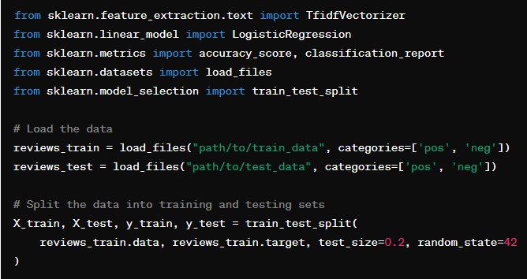
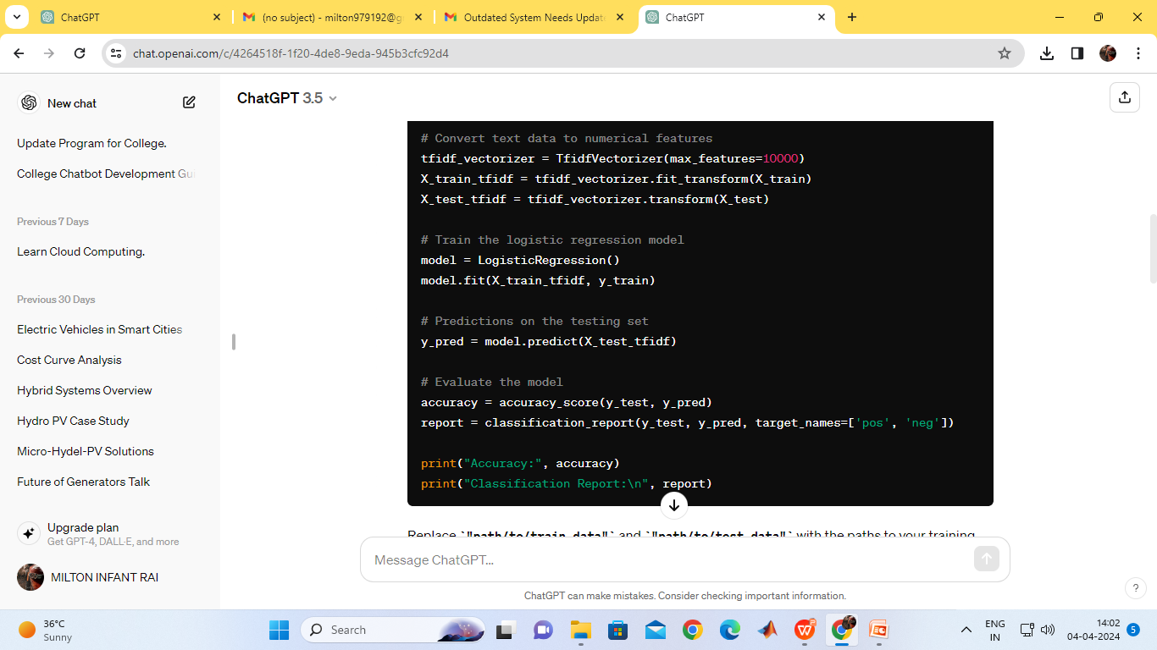

Slide 10
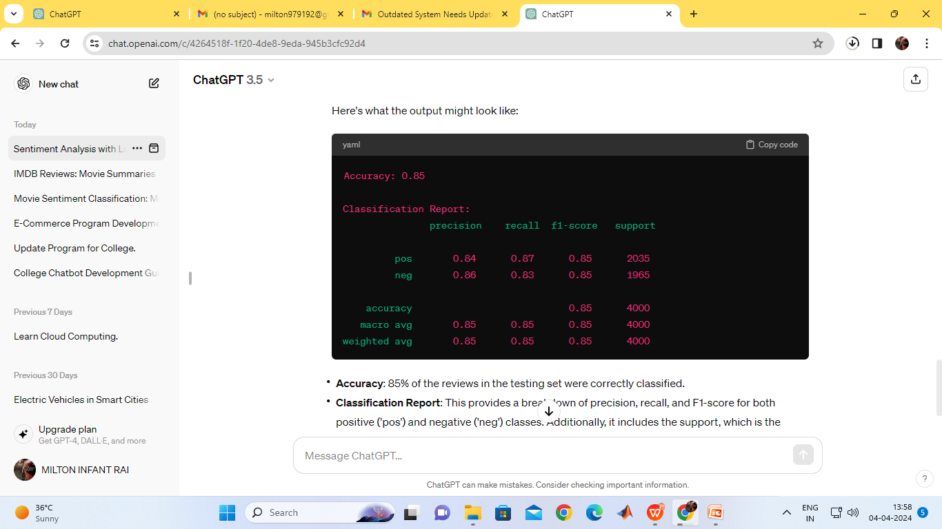
Result:
Accuracy: This indicates the proportion of correctly classified instances out of the total instances in the testing set.
Classification Report: This provides a detailed summary of the model's performance, including metrics such as precision, recall, and F1-score for each class ('pos' and 'neg').
Accuracy: 85% of the reviews in the testing set were correctly classified.
Classification Report: This provides a breakdown of precision, recall, and F1-score for both positive ('pos') and negative ('neg') classes. Additionally, it includes the support, which is the number of actual occurrences of each class in the testing set. The 'macro avg' and 'weighted avg' rows provide metrics averaged over all classes.

Slide 11
Conclusion:
In conclusion, the task of sentiment classification on the IMDb movie reviews dataset, consisting of 25,000 highly polar movie reviews for training and 25,000 for testing, presents a rich opportunity for machine learning and deep learning algorithms.
Model Performance: By applying classification or deep learning algorithms, we can effectively predict the sentiment of movie reviews, distinguishing between positive and negative sentiments with a reasonable degree of accuracy.
Insights into Audience Sentiment: The successful classification of movie reviews enables us to gain valuable insights into audience opinions and preferences regarding various films. This information can be leveraged by filmmakers, distributors, and movie critics to understand audience reactions and tailor their strategies accordingly.
Potential for Further Analysis: While achieving good performance on sentiment classification, there are still opportunities for further analysis. This includes exploring aspects such as fine-grained sentiment analysis, aspect-based sentiment analysis, or even sentiment analysis across different genres or time periods.

Slide 12
Future Directions: Future research could focus on enhancing model performance through the use of advanced deep learning architectures, fine-tuning pre-trained models, handling class imbalance, or incorporating additional modalities such as images or user ratings for multimodal sentiment analysis.
Real-world Applications: Sentiment analysis on IMDb movie reviews has practical applications in the film industry, including market research, recommendation systems, and understanding audience reactions to specific films or genres.
Overall, sentiment analysis on IMDb movie reviews serves as a valuable tool for extracting actionable insights from large volumes of textual data, ultimately contributing to improved decision-making and audience engagement in the film industry.

Slide 13
Future Scope:
Fine-grained Sentiment Analysis: Move beyond binary sentiment classification (positive/negative) to more fine-grained sentiment analysis, where sentiments are categorized into multiple classes such as strongly positive, mildly positive, neutral, mildly negative, and strongly negative. This can provide more nuanced insights into audience sentiments.
Aspect-based Sentiment Analysis: Dive deeper into the analysis by identifying and analyzing sentiments towards specific aspects or features of movies, such as acting, plot, cinematography, soundtrack, etc. This approach provides a more detailed understanding of what aspects of the movie contribute to overall positive or negative sentiments.
Temporal Analysis: Explore how sentiments towards movies evolve over time. Analyze whether there are seasonal trends, trends related to movie release dates, or trends related to specific events (e.g., awards ceremonies, controversies) that impact audience sentiments towards movies.
Multimodal Sentiment Analysis: Integrate additional modalities such as images, trailers, or user ratings alongside text to perform multimodal sentiment analysis. Combining multiple modalities can provide a richer understanding of audience sentiments towards movies.

Slide 14
References:
Title: IMDb Movie Reviews Dataset
Creator: IMDb (Internet Movie Database)
URL: IMDb Datasets
Description: The IMDb movie reviews dataset consists of highly polar movie reviews collected from the IMDb platform. It contains 25,000 reviews for training and 25,000 for testing, making it a benchmark dataset for sentiment analysis tasks.
Citation (APA format):
IMDb. (n.d.). IMDb Datasets. Retrieved from https://www.imdb.com/interfaces/

Slide 15
Thank you

