Slide 1
Efficient load balancing with modified ant colony algorithm
PRESENTED BY
Md. Golam Hakkani
Roll No: 150132
Session: 2014-15
Degree of Bachelor of Science in Computer Science and Engineering
UNDER THE SUPERVISION OF
Subir Saha
Assistant Professor
DEPARTMENT OF COMPUTER SCIENCE & ENGINEERING
PABNA UNIVERSITY OF SCIENCE & TECHNOLOGY

Slide 2
Thesis Outline
Introduction
Objectives
About Cloud Computing & Load Balancing
Motivation
Proposed System
Implementation
Result And discussion
Conclusion & Future Work

Slide 3
Introduction
Cloud computing is an entirely internet-based approach where all the applications and files are hosted on a cloud which consists of thousands of computers interlinked together in a complex manner. Cloud computing incorporates concepts of parallel and distributed computing to provide shared resources; hardware, software and information to computers or other devices on demand. These are emerging distributed systems which follows a “pay as you use” model. The customer need not buy the software or computation platforms. With internet facility, the customer can use the computation power or software resources by paying money only for the duration he/she has used the resource. Many cloud providers are available nowadays like amazon web services, google cloud, etc. Cloud provider provides many services to the user which is Reliable, Efficient and Low cost. Using virtualization technology, cloud data centers become more secure and flexible and provide better support for on-demand allocation

Slide 4
Objectives
The main objective of our proposed work is,
To distribute the workload among server to main the load.
To improve resource utilization, minimum completion time and improve Performance of system

Slide 5
What Is Cloud Computing?
Cloud computing is an entirely internet-based approach where all the applications and files are hosted on a cloud which consists of thousands of computers interlinked together in a complex manner. Cloud computing incorporates concepts of parallel and distributed computing to provide shared resources; hardware, software and information to computers or other devices on demand.
Example of Cloud Computing:
.google drive, drop box, one drive ,degoo,
Why Cloud Computing ?
Data security
Unlimited storage capacity
Services in pay per use
Low maintenance cost
Resource flexibility
Pay as you go

Slide 6
Application Of Cloud computing
Business
Entertainment
Data storage
Social networking
Education
Management

Slide 7
Types of cloud computing
There are three types of cloud computing
i) Iass-> Infrastructure as a service
ii) Sass-> Software as a services
iii-) pass-> Platform as a services

Slide 8
Load balancing
Load Balancing : Load balancing means distributed the upcoming request among the multiple server to maintain the load. It ensure that every computing resource is distributed efficiently and fairly. It provides high satisfaction to the user.
Goal Of Load Balancing:
For better performance
Manage resource efficiently
Utilize is the system resources as effectively as possible
For construction of fault tolerance system

Slide 9
Load balancing Algorithms
Static Load balancing Algorithm:
i)Round robin
ii) Waited round robin
iii) Threshold
Dynamic Load Balancing Algorithm:
Throtted
FCFS
Ant colony
Honey bee

Slide 10
Motivation
Many of the previous works mainly focus on how balance the load in cloud environment dynamically. Mostly the paper showed a wonderful performance in balancing the load using their developed algorithm inspired from the base algorithm “Ant Colony Load Balancing Algorithm”. We want to develop such a algorithm, for that case we take in concern the response time of virtual machines, datacenter processing time. We have shown our improvement result of our modified algorithm and also discussed how we can further improve our algorithm for better performance in future.

Slide 11
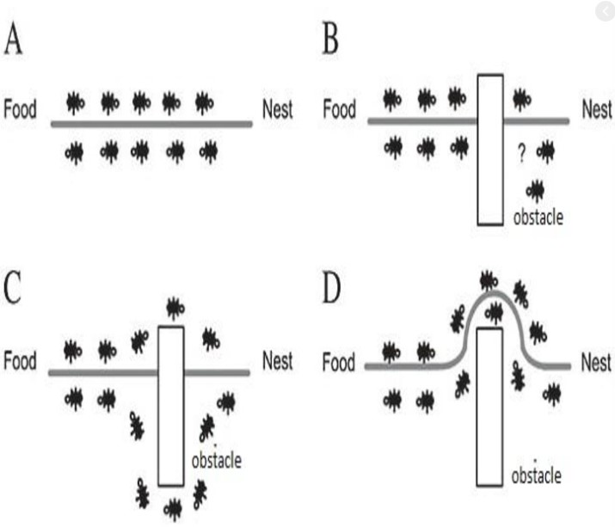
Proposed System
Behavior of ant colony

Slide 12
Flow diagram of Ant colony
Initialize ant colony parameters
Construct solution using probability distribution
Local updating of pheromone
All ants have visited through all cities
Compute the length of the optimal path and update on the amount of the pheromone on the optimal path
The termination condition is satisfied ?
Output value contains the maximum pheromones

Slide 13
Pseudo Code of ant colony algorithm
begin Initialize the pheromone while (stopping criterion not satisfied) do Position each ant in a starting VM while (stopping when every ant has build a solution) do for each ant do Chose VM for next task by pheromone trail intensity end for end while Update the pheromone end while end

Slide 14
Implementation
Software requirement of proposed algorithm:
Eclipse (version 3.5.1 and higher)
Java Development Kit (JDK) 1.6 or Higher
CloudSim Tool Kit
Commons-math library
Hardware Requirement in Proposed Algorithm
1 GB RAM
Intel Pentium Processor or higher

Slide 15
What is cloudsim toolkit?
It is a stretchy framework for modeling and simulation of any application’s performance in cloud environment on large scale. CloudSim is basically a library of cloud simulation scenarios.
Cloudsim properties:
Regions
Datacenter
Hosts
Cloudlet
Service Broker
VM allocation:
VM scheduler

Slide 16
Why cloudsimulation?
Flexibility
Reliability
Repeatabilty
High simulation speed
Accuracy
Cost benefits

Slide 17
Simulation process
Defining and configuration of User Bases.
Defining and configuring Data Centers.
Allocating of Virtual Machines in Data Centers.
Review and Adjustment of various other parameters such as Packet size, No of
packets, Bandwidth, and Load balancing policies.

Slide 18
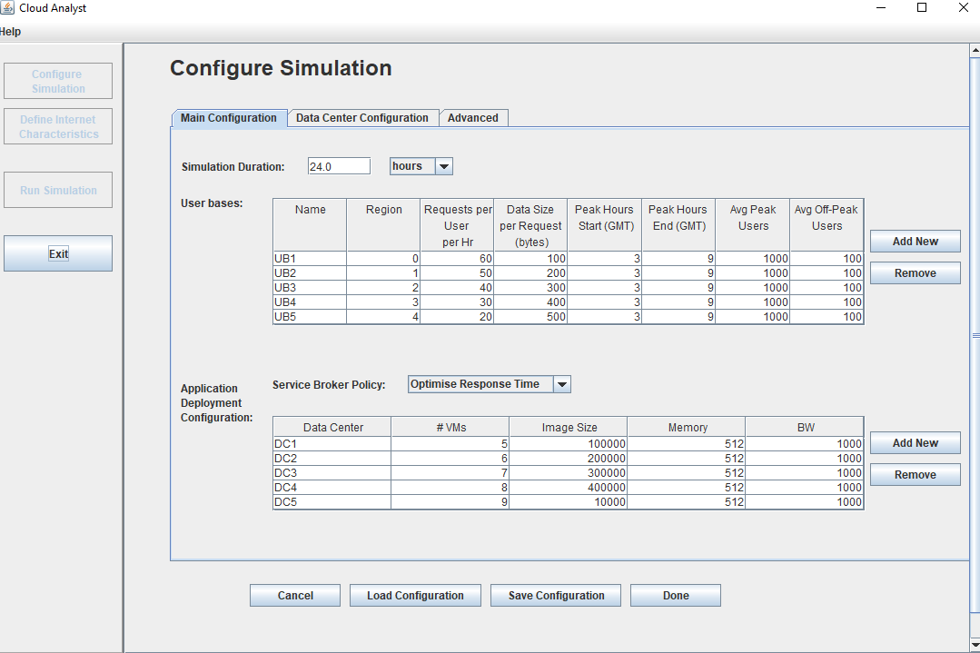
Simulation process for implementation of modified Ant colony Algorithm

Slide 19
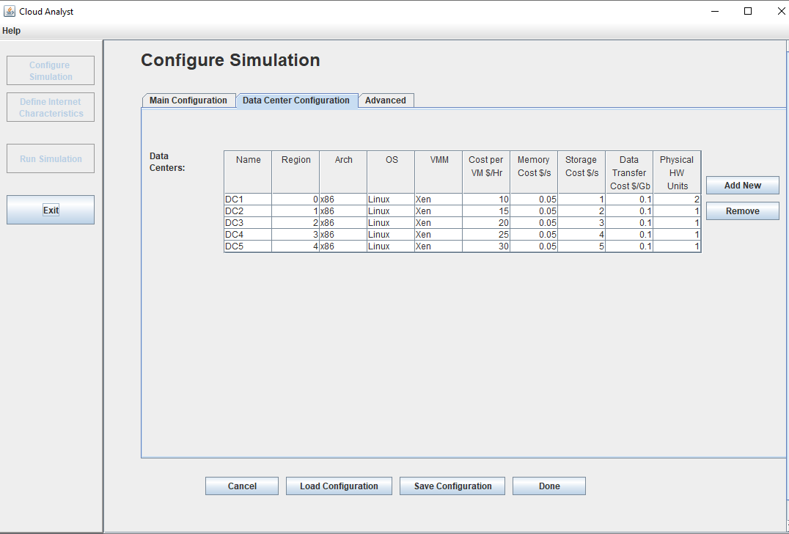
Data center Configuration in Cloud Analyst

Slide 20
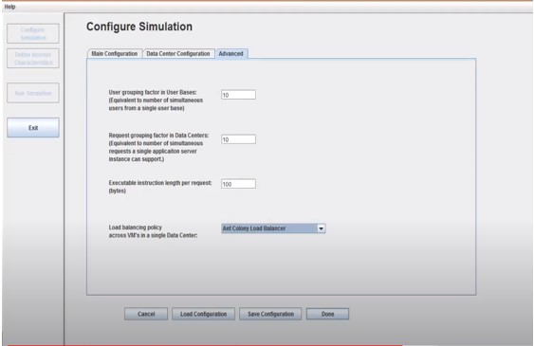
Running our own algorithm in Cloud Analyst

Slide 21
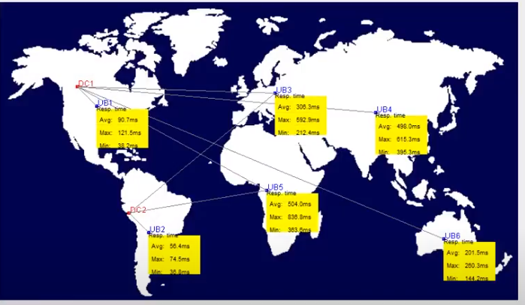
Physical output of the configuration in CloudAnalyst

Slide 22
Result and discussion
Result of Proposed Algorithm
At first we have include our modified algorithm in the cloud simulation tool and then run the simulation tool with the configuration and produce output. The result of the developed algorithm output is shown in following table
The cost value of processing the data on vm and datacenter are given bellow:-
Total Virtual Machine Cost ($): 1801.52
Total Data Transfer Cost ($): 37.39
Grand Total: ($) 1838.91
Time | Avg (ms) | Min (ms) | Max (ms)
Overall response time: | 52.43 | 38.53 | 70.21
Data Center processing time: | 2.65 | 0.01 | 15.14

Slide 23
Result of RoundRobin Algorithm
Time | Avg (ms) | Min (ms) | Max (ms)
Overall response time: | 70.11 | 37.56 | 220.54
Data Center processing time: | 20.36 | 0.00 | 62.32
The cost value of processing the data on 5 vms and datacenter are given bellow:- Total Virtual Machine Cost ($): 2640.28
Total Data Transfer Cost ($): 44.86
Grand Total: ($) 2685.13

Slide 24
Result of Throtolled Algorithm
Time | Avg (ms) | Min (ms) | Max (ms)
Overall response time: | 52.78 | 36.91 | 79.48
Data Center processing time: | 3 | 0.01 | 23.39
The cost value of processing the data on 5vm and datacenter are given bellow:-
Total Virtual Machine Cost ($): 8640.91
Total Data Transfer Cost ($):44.86 Grand Total: ($) 8685.76

Slide 25
THANK YOU

