Slide 1
Recipe Website Project Report
Matt Imel
Notes:
Title

Slide 2
Recipe Website Overview
Promotes a collaborative and constructive environment around creating and refining recipes.
Allow users to upload “Variants” to recipes. Variants can be tagged not only by cuisine or type, but by intent. Webpage, using CakePHP as a framework.
Notes:
Proposal

Slide 3
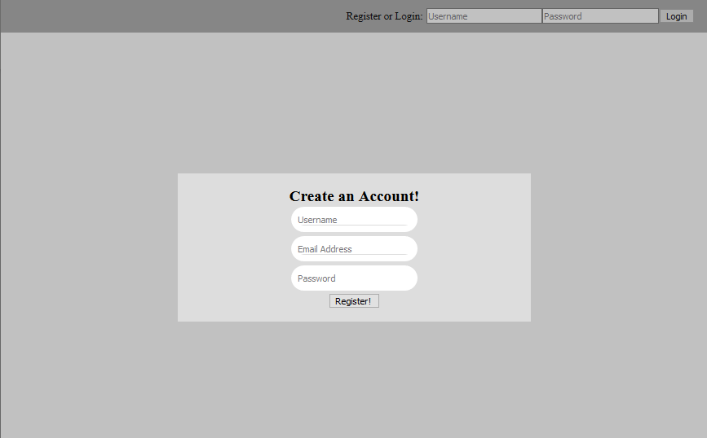
Login System (/)
Notes:
Proposal

Slide 4
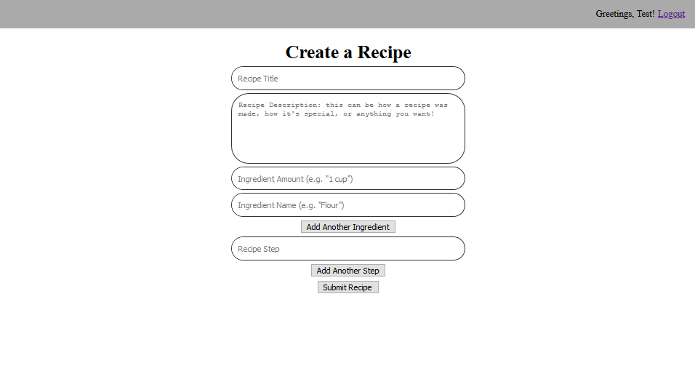
Create Recipe Form (/create)
Notes:
Proposal

Slide 5
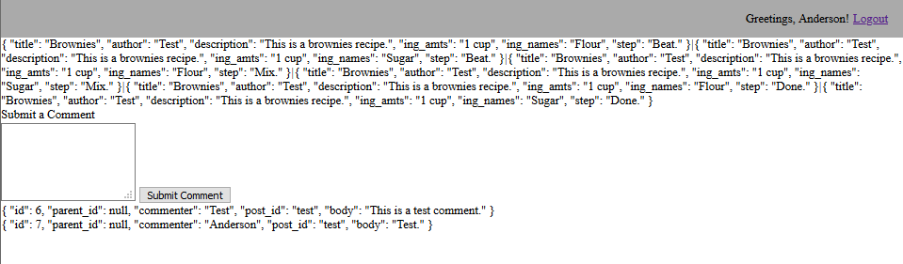
Recipe Page (/recipes/:slug)
Notes:
Proposal

Slide 6
Schedule
October ✔Create database ✔Complete User Creation/Login/Logout Functionality ✔Complete Recipe Creation Functionality 〜 Style User Login Tools 〜 Style Recipe Creation Page
November 〜 Complete Comment Functionality ✘ Complete Tagging Functionality ✘ Style Recipe Page
December ✘ Complete Recipe Search Functionality ✘ Responsivity Testing ✘ Speed Testing ✘ Penetration Testing
Notes:
Proposal

Slide 7
Questions?
Notes:
Proposal

