Slide 1
Recipe Website
Matt Imel
Notes:
Title

Slide 2
Recipe Website
Promotes a collaborative and constructive environment around creating and refining recipes.
Allow users to upload “Variants” to recipes. Variants can be tagged not only by cuisine or type, but by intent.
Possible reasons to build and search for Variants include:
Ethical (Vegan, Vegetarian…)
Health-Related (Low sugar…)
Dietary (Keto-friendly…)
Religious (Non-pork, Kosher…)
Allergenic (Lactose-free, Gluten-free…)
Monetary (“Wine, on my budget?”)
Cultural (“This isn’t a real Texas Chili!”)
Regional (“I can’t find X at my grocery store.”)
Notes:
Proposal

Slide 3
Goals
This website should be, above all:
Responsive
Intuitive
Fast
Notes:
Proposal

Slide 4
Sitemap
Sign Up
Main Page
About Page
Login
Recipe Browse
Recipe Search
Recipe Page
Notes:
Sitemap

Slide 5
User Actions
Users should be able to:
Create an account
Sign in/Sign out
Upload a recipe
Post a comment to a recipe (or to another comment)
Create a “Variant” to a recipe in their comment (can be made in response to a base recipe or another Variant)
Notes:
Use-case diagram

Slide 6
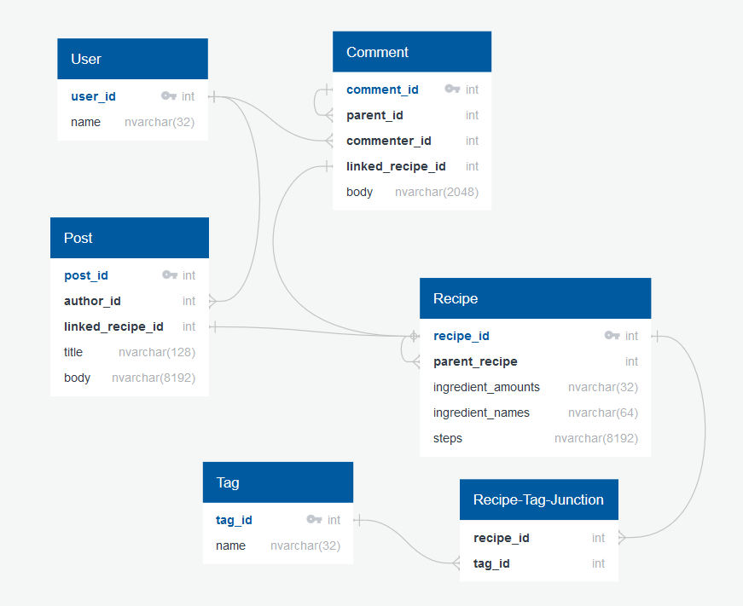
Database Diagram
Courtesy of QuickDBD
Notes:
Database Diagram

Slide 7




Libraries
Notes:
Libraries

Slide 8
Schedule
End of September: Finish planning, get acquainted with CakePHP.
End of October: Build user login/registration and recipe upload functionalities. Design front-end for desktop views with regards to mobile views. Create Database.
End of November: Build user commenting and variant upload functionalities. Finish front-end design.
End of December: UI/UX, Speed, Pen Testing
Stretch Goals: Reputation/Karma System, Ratings, Search, Reporting UI
Notes:
End of September: Finish planning, get acquainted with CakePHP.
End of October: Build user login/registration and recipe upload functionalities. Design front-end for desktop views while considering mobile views.
End of November: Build user commenting and variant upload functionalities. Finish front-end design.
End of December: UI/UX, Penetration Testing
Stretch Goals: Reputation/Karma System, Ratings, Search, Reporting UI

Slide 9
Questions?
Notes:
Questions?

